Slide 1
God’s Press Conference
Bill Perry

Slide 2
“Press Conference”
Modified from:
noun 1. a prearranged interview with media reporters, held to create publicity or, as granted by a spokesperson, to make an announcement or fulfill a request from the press. Frequently this includes a time for questions and answers.

Slide 3
Romans chapter 8 finishes with Paul raising 5
questions. The answers summarize all that
Paul has written from chapter 1 onward.
This is like God’s press conference.

Slide 4
It’s

Slide 5
Our First Question
Romans 8:31
What then shall we say to these things? If God is for us, who can be against us?

Slide 6
Consider
Romans 8:31
Question:
What then shall we say to these things? If God is for us, who can be against us?
What are the “these things” Paul is asking about?

Slide 7
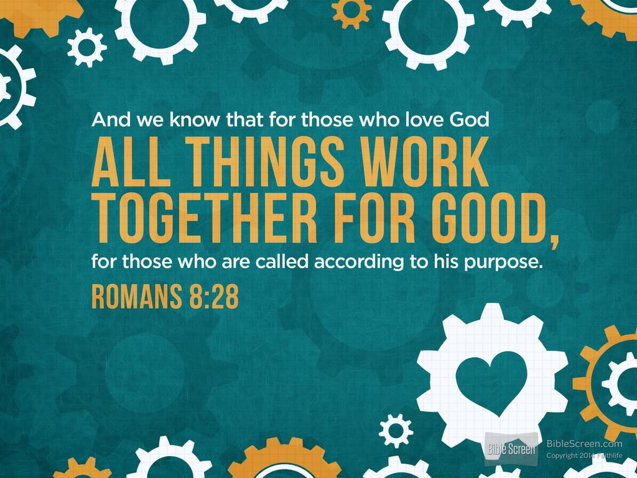
These Things
First, for Paul, “these things” are what he has
been writing about since 1:16. What came
before that was his introduction.
Second, let’s look at the last 3 verses before verse 31 to see what he just said.

Slide 8
Romans 8:28-30
And we know that all things work together for good to those who love God, to those who are the called according to his purpose. For whom he foreknew, he also predestined to be conformed to the image of his Son, that he might be the firstborn among many brethren. Moreover whom he predestined, these he also called; whom he called, these he also justified; and whom he justified, these he also glorified.

Slide 9
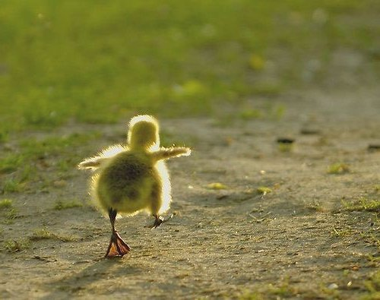
One step at a time
Let’s take these verses one at a time!

Slide 10
Consider
Romans 8:28
Insight
And we know that all things work together for good to those who love God, to those who are the called according to his purpose.
Paul tells us his audience: all genuine believers. God calls them and by his Spirit inside them they have love for God in their hearts.

Slide 11
Consider
Romans 8:28
Insight
And we know that all things work together for good to those who love God, to those who are the called according to his purpose.
“Work together” is a word that means God combines everything, every person, and every event to bring good out of it for you and me and all his people.

Slide 12
Consider
Romans 8:28
Insight
And we know that all things work together for good to those who love God, to those who are the called according to his purpose.
The omniscient, omnipotent and omnipresent God mixes, coordinates and constructs every single thing in our lives for our good! This is beyond human explanation!

Slide 13
Consider
Romans 8:28
Insight
And we know that all things work together for good to those who love God, to those who are the called according to his purpose.
This doesn’t mean that everything is good, but that God uses and makes all things work out for good...our good. This is not a promise but a fact we know!

Slide 14
Consider
Romans 8:29
Insight
For whom he foreknew, he also predestined to be conformed to the image of his Son, that he might be the firstborn among many brethren.
Romans 11:1-2 tell us who this is: ”Has God cast away his people? Certainly not! I am an Israelite... God has not cast away his people [Jews] whom he foreknew.”

Slide 15
Consider
Romans 8:29
Insight
For whom he foreknew, he also predestined to be conformed to the image of his Son, that he might be the firstborn among many brethren.
God planned before time began that all believers, Jews and Gentiles, would become like Jesus, remade in his image. God is restoring us daily until we’re done.

Slide 16
Consider
Romans 8:29
Insight
For whom he foreknew, he also predestined to be conformed to the image of his Son, that he might be the firstborn among many brethren.
God’s purpose is that Jesus is foremost (what “firstborn” means) of an innumerable amount of people who are just like him living in fellowship in heaven.

Slide 17
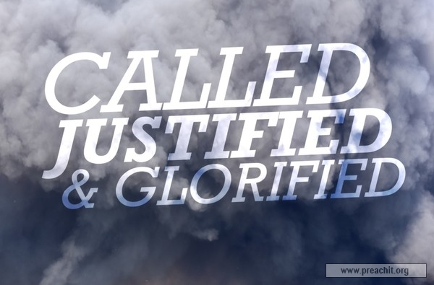
Consider
Romans 8:30
Insight
Moreover whom he predestined, these he also called; whom he called, these he also justified; and whom he justified, these he also glorified.
God does nothing partially. He does everything completely and with no mistakes. Aren’t you glad it’s God who saves us and not us saving ourselves?!

Slide 18
Consider
Romans 8:30
Insight
Moreover whom he predestined, these he also called; whom he called, these he also justified; and whom he justified, these he also glorified.
Predestining and calling happened before time in the past. Justifying happens in this life (when we got saved) in the present. Glorifying happens in the future. Salvation is so much bigger than we know!

Slide 19
Consider
Romans 8:29
Insight
For whom he foreknew, he also predestined to be conformed to the image of his Son, that he might be the firstborn among many brethren.
God’s salvation was for Jews first. When they rejected it God had the gospel shared to Gentiles (Acts 10-11) so they would continue sharing it to Israel (Romans 11).

Slide 20
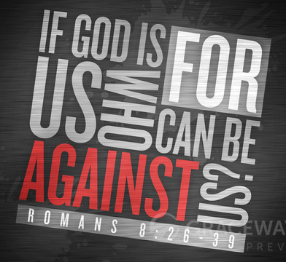
So Back To Our First Question
Romans 8:31
What then shall we
say to these things?
If God is for us, who
can be against us?

Slide 21
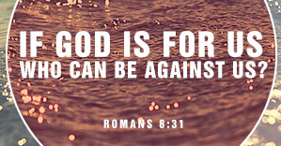
Consider
Romans 8:31
Insight
What then shall we say to these things? If God is for us, who can be against us?
What can we say to such things? We should be speechless except to praise our Heavenly Father for loving us so much! Paul did that in Romans 11:33-36.

Slide 22
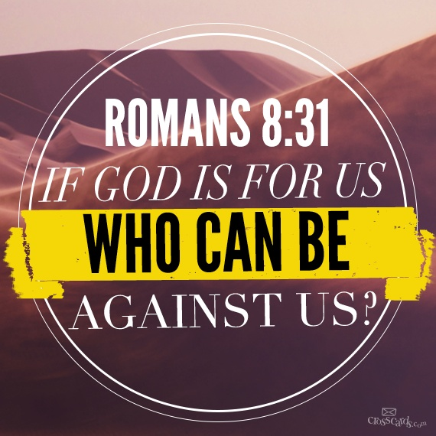
Consider
Romans 8:31
Insight
What then shall we say to these things? If God is for us, who can be against us?
The word “if” here means since because it’s true. Our God is for us! Since he is omnipotent, no enemy can ultimately succeed against us. He watches over us.

Slide 23
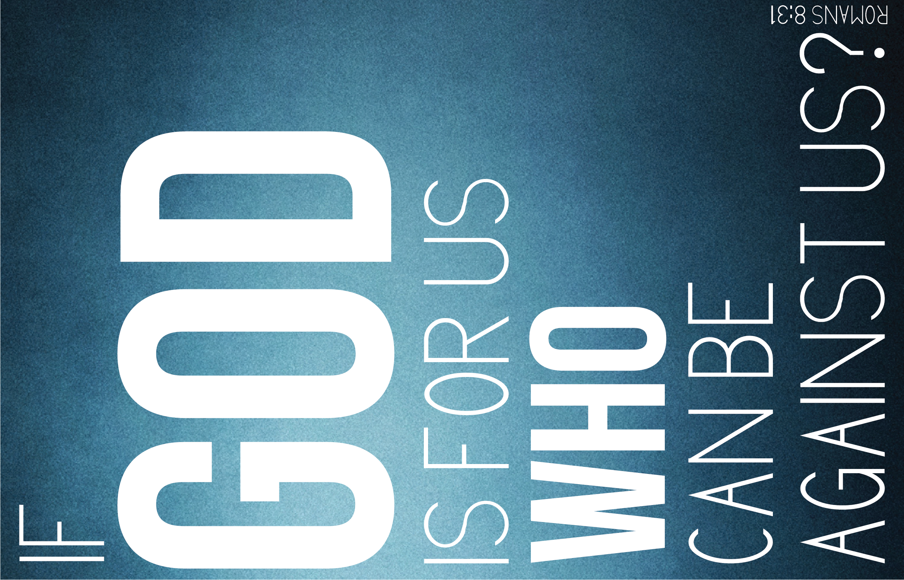
Consider
Romans 8:31
Insight
What then shall we say to these things? If God is for us, who can be against us?
Notice that Paul answers a question with a question. Jesus did that a lot. Doing so forces the questioner to answer back and turns the tables on them.

Slide 24
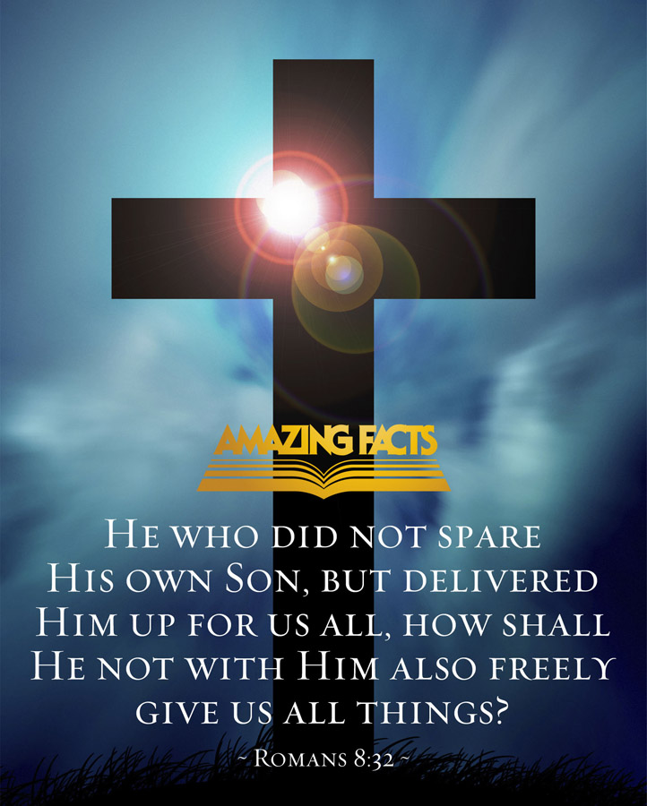
Our Second Question
Romans 8:32
He who did not spare his own Son, but delivered him up for us all, how shall he not with him also freely give us all things?

Slide 25
Consider
Romans 8:32
Insight
He who did not spare his own Son, but delivered him up for us all, how shall he not with him also freely give us all things?
Paul makes the obvious point that God gave up Jesus for us already. Who or what is more important to God than his own Son? He has withheld nothing from us!

Slide 26
Consider
Romans 8:32
Insight
He who did not spare his own Son, but delivered him up for us all, how shall he not with him also freely give us all things?
The point here is theoretical: if God gave Jesus, then he would freely give us all things. But since we have Jesus (the Creator) we already have all things (the created). See Eph 1:3.

Slide 27
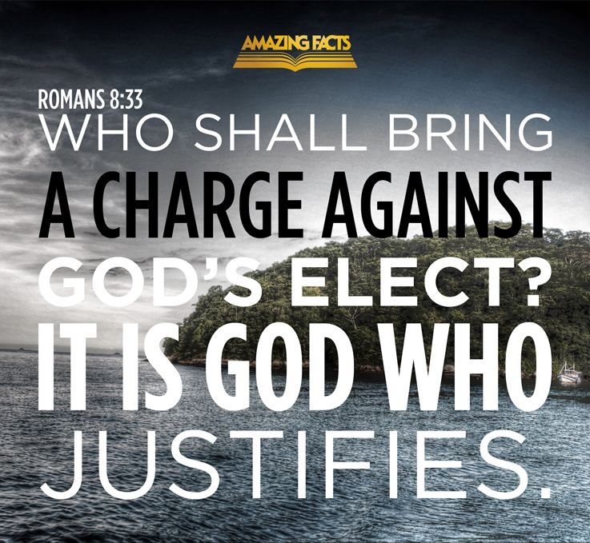
Our Third Question
Romans 8:33
Who shall bring a charge against God's elect? It is God who justifies.

Slide 28
Consider
Romans 8:33
Insight
Who shall bring a charge against God's elect? It is God who justifies.
This question is set in God’s judgment hall or divine courtroom. Who might be “out there” trying to accuse us of sins/crimes that could cause us to lose our salvation?

Slide 29
Consider
Romans 8:33
Insight
Who shall bring a charge against God's elect? It is God who justifies.
The only one that could theoretically charge us and convict us is God himself. And he has already justified us. If he condemned us after that, God would be untrustworthy!

Slide 30
Our Fourth Question
Romans 8:34
Who is he who condemns? It is Christ who died, and furthermore is also risen, who is even at the right hand of God, who also makes intercession for us.

Slide 31
Consider
Romans 8:34
Insight
Who is he who condemns? It is Christ who died, and furthermore is also risen, who is even at the right hand of God, who also makes intercession for us.
Paul’s question here asks who it is that has the authority to condemn us? We’ve already seen it’s not God. Maybe Christ would condemn us.

Slide 32
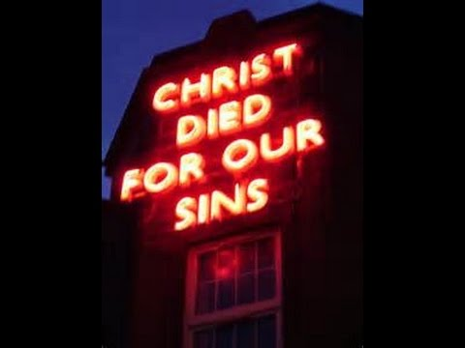
Consider
Romans 8:34
Insight
Who is he who condemns? It is Christ who died, and furthermore is also risen, who is even at the right hand of God, who also makes intercession for us.
Jesus will not (and never!) condemn us because he already has died for us. If he condemned us, why then did he die? Him condemning us goes against everything he has done for us.

Slide 33
Consider
Romans 8:34
Insight
Who is he who condemns? It is Christ who died, and furthermore is also risen, who is even at the right hand of God, who also makes intercession for us.
Not only has Jesus died for us, but also he has risen to the Father’s right hand and is praying for us right now! There is no reason for Jesus to condemn us.

Slide 34
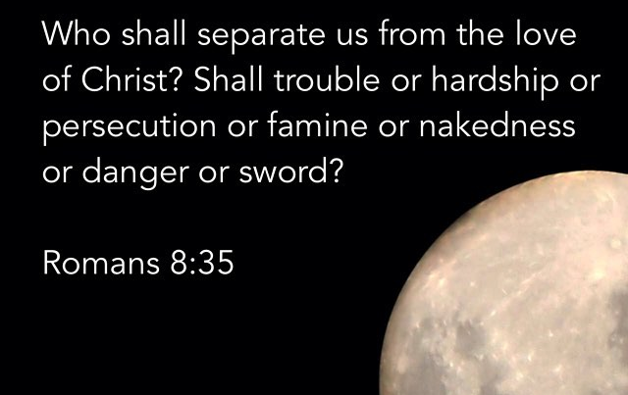
Our Fifth Question
Romans 8:35
Who shall separate us from the love of Christ? Shall tribulation, or distress, or persecution, or famine, or nakedness, or peril, or sword?

Slide 35
Our Fifth Question
Romans 8:35
Who shall separate us from the love of Christ? Shall tribulation, or distress, or persecution, or famine, or nakedness, or peril, or sword?
These are things Paul experienced in his life.

Slide 36
Paul will now give an extended
answer to his question and wrap
up God’s press conference.

Slide 37
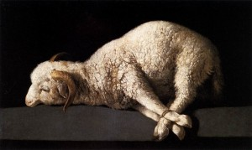
Paul’s Extended Answer
Romans 8:36
As it is written: "For your sake we are killed
all day long; we are accounted as sheep
for the slaughter."

Slide 38
Consider
Romans 8:36
Insight
As it is written: "For your sake we are killed all day long; we are accounted as sheep for the slaughter."
Paul quotes from Psalm 44:22, a lament (sad song) about God not delivering them from an enemy. He said he felt now like Israel did back then.

Slide 39
Paul’s Extended Answer
Romans 8:37
Yet in all these things we are more than conquerors through him who loved us.

Slide 40
Consider
Romans 8:37
Insight
Yet in all these things we are more than conquerors through him who loved us.
Many Christians want to focus only on this part of the verse because it says we do better (“more”) than just win. And that’s understandable. Who doesn’t like to win?!

Slide 41
Consider
Romans 8:37
Insight
Yet in all these things we are more than conquerors through him who loved us.
We win “through him who loved us.” In other words, he is permanent; hardships are temporary. We live because he has made us eternal. We will outlast hardships.

Slide 42
Question
How did Jesus defeat:
Sin (Romans 5:12-6:11)?
Death (2 Timothy 1:10)?
The Devil (Hebrews 2:14)?

Slide 43
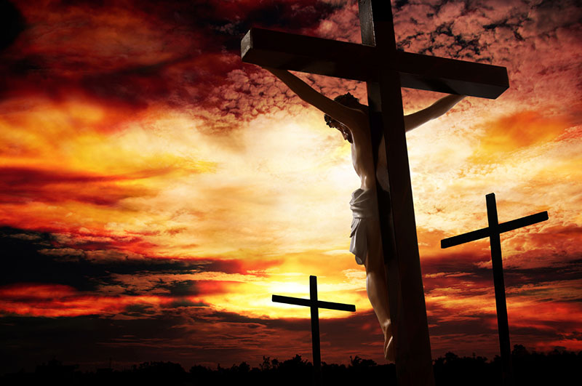
Answer
By dying!

Slide 44
Consider
Romans 8:37
Insight
Yet in all these things we are more than conquerors through him who loved us.
So we follow Jesus into “tribulation, or distress, or persecution, or famine, or nakedness, or peril, or sword” (verse 35) knowing we are eternal and they are not!

Slide 45
Consider
Romans 8:37
Insight
Yet in all these things we are more than conquerors through him who loved us.
Disciples know that one day we will lose everything that is temporary. But we gain the eternal that we can never lose. That is ultimate winning. We trade up!

Slide 46
Paul’s Extended Answer
Romans 8:38-39
For I am persuaded that neither death nor life, nor angels nor principalities nor powers, nor things present nor things to come, nor height nor depth, nor any other created thing, shall be able to separate us from the love of God which is in Christ Jesus our Lord.

Slide 47
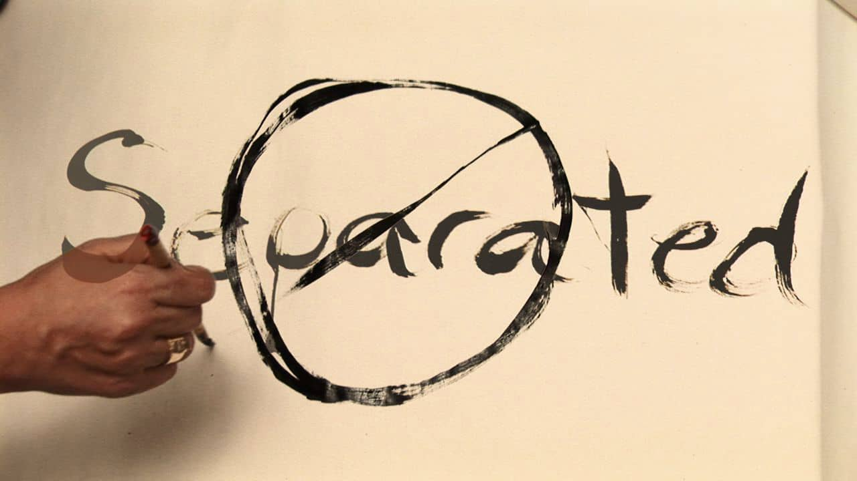
Consider
Romans 8:38-39
Insight
For I am persuaded that neither death nor life, nor angels nor principalities nor powers, nor things present nor things to come, nor height nor depth, nor any other created thing, shall be able to separate us from the love of God which is in Christ Jesus our Lord.
The word “separate” can have a good or bad meaning. It simply means to divide or depart. We don’t want to separate from good things and people but we do want to separate from bad things and people.

Slide 48
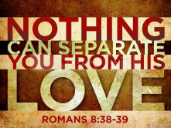
Consider
Romans 8:38-39
Insight
For I am persuaded that neither death nor life, nor angels nor principalities nor powers, nor things present nor things to come, nor height nor depth, nor any other created thing, shall be able to separate us from the love of God which is in Christ Jesus our Lord.
No created thing will separate us from God’s love in Jesus because he was the one who died on the cross for us. It is the highest example of and the best way to understand God’s love.

Slide 49
Consider
Romans 8:38-39
Insight
For I am persuaded that neither death nor life, nor angels nor principalities nor powers, nor things present nor things to come, nor height nor depth, nor any other created thing, shall be able to separate us from the love of God which is in Christ Jesus our Lord.
So love is what motivates disciples to obey when it’s hard and painful and even when it feels like everyone is against you.

Slide 50
Conclusion

Slide 51
Conclusion

Slide 52
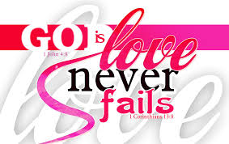
Conclusion

Slide 53
Conclusion

Slide 54
The press conference is over!
Thank you
for coming.

