Slide 1
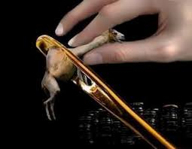
Discipleship 101: What a Rich Man and a Camel Can Teach Us
Mark 10:17-31
Bill Perry

Slide 2
What is a Parable?

Slide 3
What is a Parable?
An earthly story with
a heavenly meaning

Slide 4
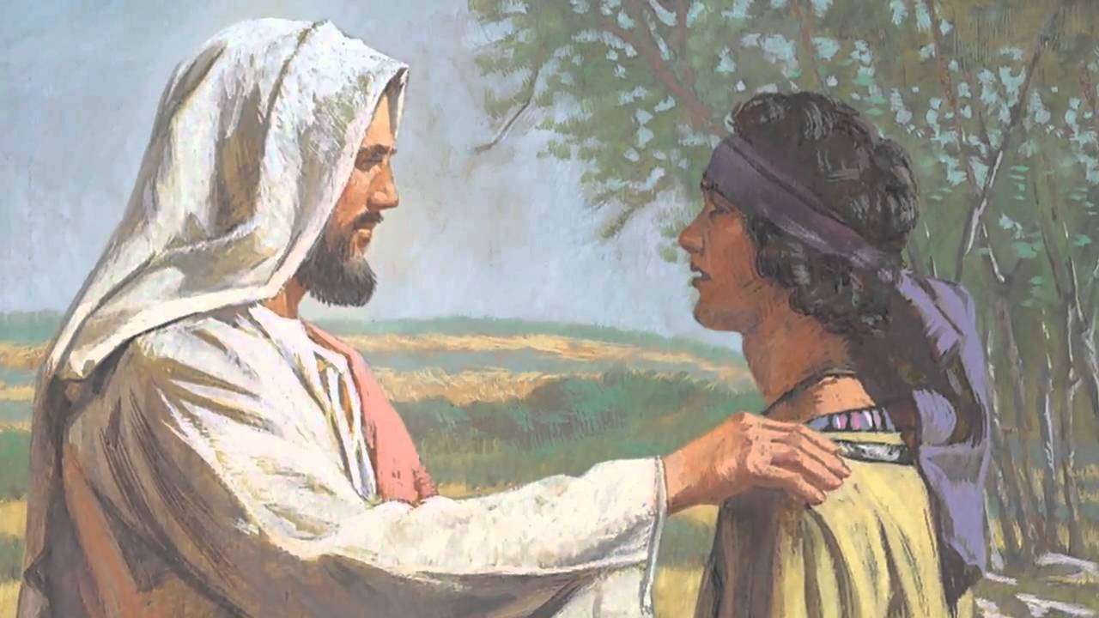
Mark 10:17
Now as [Jesus] was going out on the road, one came running, knelt before him, and asked him, “Good Teacher, what shall I do that I may inherit eternal life?”

Slide 5
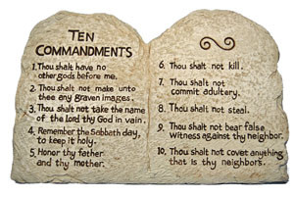
Mark 10:18-19
So Jesus said to him, “Why do you call Me good? No one is good but One, that is, God. You know the commandments: ‘Do not commit adultery,’ ‘Do not murder,’ ‘Do not steal,’ ‘Do not bear false witness,’ ‘Do not defraud,’ ‘Honor your father and your mother.’”

Slide 6
Mark 10:20
And he answered and said to him, “Teacher, all these things I have kept from my youth.”

Slide 7
Who is this guy?
1. He has “great possessions” (verse 22).
2. He is thinking about eternal life.
3. He asks a very good question.
4. He quotes God’s commandments.
5. He says he has kept God’s laws from childhood.
First impression: by today’s standards he sounds like he might be a Christian!

Slide 8
Observation:
The man claims to have obeyed these
commandments since a young boy (!) but still
lacks a knowledge/assurance of eternal life.
Have you ever met
someone like this before?

Slide 9
Mark 10:21
Then Jesus, looking at him, loved him, and said to him, “One thing you lack: Go your way, sell whatever you have and give to the poor, and you will have treasure in heaven; and come, take up the cross, and follow me.”

Slide 10
Compare
Mark 10:21
Comment
Then Jesus, looking at him, loved him, and said to him, “One thing you lack: Go your way, sell whatever you have and give to the poor, and you will have treasure in heaven; and come, take up the cross, and follow me.”
Notice that Jesus loved this man. He probably loved his ambition for eternal life and his willingness to ask about it. There may have been something about him that indicated to Mark that Jesus was compassionately concerned for his eternal well being.

Slide 11
Compare
Mark 10:21
Comment
Then Jesus, looking at him, loved him, and said to him, “One thing you lack: Go your way, sell whatever you have and give to the poor, and you will have treasure in heaven; and come, take up the cross, and follow me.”
With the man having confessed his need, Jesus adds more commands – “go, sell…, give to the poor…take up and follow” him, to gain treasure in heaven, appealing to the man’s desire for and his interest in wealth. What could be better than eternal treasure in heaven, right?

Slide 12
What is Jesus doing??
First, for Jesus to add his own commands to the 10 Commandments is nothing short of blasphemy…if he is not God in the flesh.

Slide 13
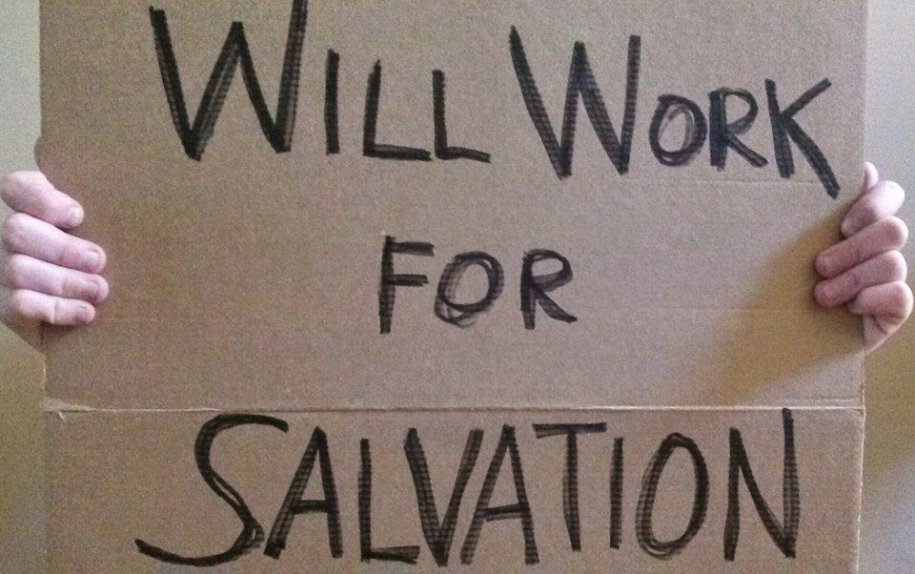
What is Jesus doing??
Second, why is Jesus telling this man to keep the Old Testament law and then adding more commands to it?

Slide 14
What is Jesus doing??
Do people gain eternal life by
working for it, by doing
good deeds?

Slide 15
What about you??
Would you share the gospel
this way? Why or why not?

Slide 16
Observations:
In Middle Eastern cultures, 3 values were of supreme importance:
(1)
(2)
(3)

Slide 17
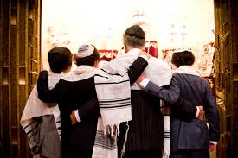
Observations:
In Middle Eastern cultures, 3 values were of supreme importance:
(1) Family
(2)
(3)

Slide 18
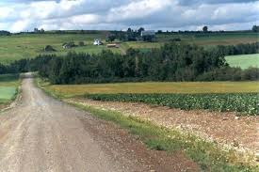
Observations:
In Middle Eastern cultures, 3 values were of supreme importance:
(1) Family
(2) Property
(3)

Slide 19
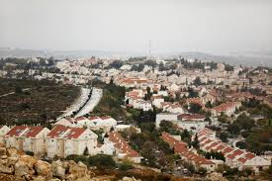
Observations:
In Middle Eastern cultures, 3 values were of supreme importance:
(1) Family
(2) Property
(3) Community

Slide 20
Observations:
In Middle Eastern cultures, 3 values were of supreme importance:
(1) Family
(2) Property
(3) Community
All three of these together gave
people a strong sense of identity.

Slide 21
Question
What is Jesus not doing by adding his
commands, “go…sell…give…and
come, follow me”?

Slide 22
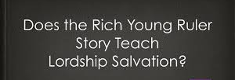
Answer
Jesus is not:
calling this man to a discipleship-based gospel or presenting Lordship salvation.

Slide 23
Answer
Jesus is not:
calling this man to a discipleship-based gospel or presenting Lordship salvation.
sharing the gospel with him using these statements.

Slide 24
Answer
Jesus is not:
calling this man to a discipleship-based gospel or presenting Lordship salvation.
sharing the gospel with him using these statements.
misleading this man.

Slide 25
What Jesus is doing:
Jesus is knocking down all the supports this
man’s family and culture provide for him. It
will take faith for this man to accept Jesus as
his new family leader and new support system.
Jesus will decide what property he’ll need
and will give it to him. His disciples will
become this man’s new community.

Slide 26
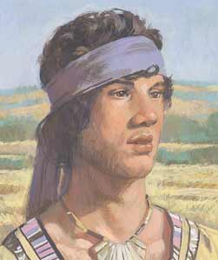
What does the young man decide to do?

Slide 27
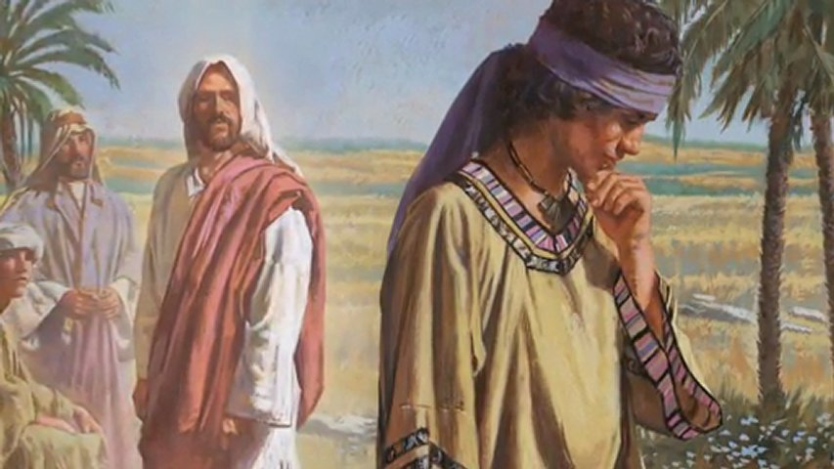
Mark 10:22
But he was sad at this word, and went away sorrowful, for he had great possessions.

Slide 28
Compare
Mark 10:22
Comment
But he was sad at this word, and went away sorrowful, for he had great possessions.
The rich man heard Jesus’ second list of commands and went away sorrowful because he had “great possessions” and had greater faith in his current supports – family, property, and community – than in Jesus.

Slide 29
Observations:
This rich man looked at pure life straight in
the eyes and turned Jesus down! Because
Jesus knew this man didn’t have the faith
to trust Jesus for his lack, he let him go.
This is why Jesus didn’t chase after
him or try to convince
him otherwise.

Slide 30
Question
What does this tell us about
our evangelism efforts today
if Jesus let this guy go?

Slide 31
Mark 10:23-25
“Then Jesus looked around and said to his disciples, “How hard it is for those who have riches to enter the kingdom of God!” And the disciples were astonished at his words. But Jesus answered again and said to them, “Children, how hard it is for those who trust in riches to enter the kingdom of God! It is easier for a camel to go through the eye of a needle than for a rich man to enter the kingdom of God.”

Slide 32
Compare
Mark 10:23-25
Comment
“Then Jesus looked around and said to his disciples, “How hard it is for those who have riches to enter the kingdom of God!” And the disciples were astonished at his words. But Jesus answered again and said to them, “Children, how hard it is for those who trust in riches to enter the kingdom of God! It is easier for a camel to go through the eye of a needle than for a rich man to enter the kingdom of God.”
Some people have proposed the idea that a small hole in the wall of Jerusalem was called the “eye of the needle.” This is pure fiction. A hole in the wall would be a security breach and would be sealed up immediately upon discovery.

Slide 33
From this
To this

Slide 34
Compare
Mark 10:23-25
Comment
“Then Jesus looked around and said to his disciples, “How hard it is for those who have riches to enter the kingdom of God!” And the disciples were astonished at his words. But Jesus answered again and said to them, “Children, how hard it is for those who trust in riches to enter the kingdom of God! It is easier for a camel to go through the eye of a needle than for a rich man to enter the kingdom of God.”
Matthew, Mark and Luke all use the same Greek word rhaphis, meaning sewing needle. Jesus spoke literally of a needle, not figuratively.

Slide 35
Compare
Mark 10:23-25
Comment
“Then Jesus looked around and said to his disciples, “How hard it is for those who have riches to enter the kingdom of God!” And the disciples were astonished at his words. But Jesus answered again and said to them, “Children, how hard it is for those who trust in riches to enter the kingdom of God! It is easier for a camel to go through the eye of a needle than for a rich man to enter the kingdom of God.”
Jesus gives commentary to his disciples of what just took place, saying how “hard it is for a rich man to enter the kingdom of heaven” and gives the camel and the eye of the needle parable. In fact, it is easier for the camel than the rich man!

Slide 36
Mark 10:26-27
And they were greatly astonished, saying among themselves, “Who then can be saved?” But Jesus looked at them and said, “With men it is impossible, but not with God; for with God all things are possible.”

Slide 37
Compare
Mark 10:26-27
Comment
And they were greatly astonished, saying among themselves, “Who then can be saved?” But Jesus looked at them and said, “With men it is impossible, but not with God; for with God all things are possible.”
The disciples’ question reflects typical Jewish thinking: if a rich man (supposedly blessed by God, which was evident by his riches) can’t be saved, then who can?
Actual name of a book!

Slide 38
Compare
Mark 10:26-27
Comment
And they were greatly astonished, saying among themselves, “Who then can be saved?” But Jesus looked at them and said, “With men it is impossible, but not with God; for with God all things are possible.”
Jesus’ answer speaks about people in general, not just wealthy people. That includes even poor people who don’t have wealth and money but still want it. So they are “wannabe wealthy people.” And it is impossible for them also to be saved with this kind of thinking.

Slide 39
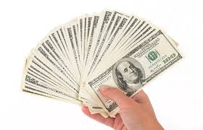
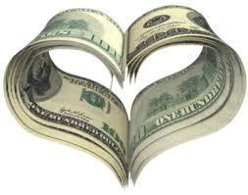
Let’s Be Honest!
How many people here think
they would be better off with
a little more money?

Slide 40
Let’s Be Honest!
How many people here think
they would be better off with
a little more money?
“For the love of money is a root of all evil…”
– 1 Timothy 6:10

Slide 41
John D. Rockefeller
(1839-1937)
When John D. Rockefeller, co-founder of Standard Oil Company, gave a rare interview, the reporter was shocked when Rockefeller said he didn’t have enough money. When the reporter asked how much more is enough, Rockefeller said, “Just a little bit more.”
https://starwinar.wordpress.com/daily-short-story/just-a-little-bit-more/

Slide 42
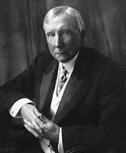
John D. Rockefeller
“It is wrong to assume
that men of immense
wealth are always
happy.”
http://www.brainyquote.com/quotes/authors/j/john_d_rockefeller.html

Slide 43
Observation
Trust in material riches is frequently
stronger than faith in spiritual matters,
especially faith in God and Jesus, and
keeps many wealthy and “wannabe
wealthy” people out of heaven.
Their “faith” is in only what they see!

Slide 44
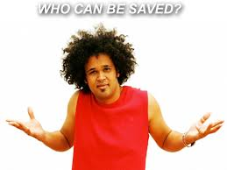
Compare
Mark 10:26-27
Comment
And they were greatly astonished, saying among themselves, "Who then can be saved?” But Jesus looked at them and said, "With men it is impossible, but not with God; for with God all things are possible."

Slide 45
Compare
Mark 10:26-27
Comment
And they were greatly astonished, saying among themselves, "Who then can be saved?” But Jesus looked at them and said, "With men it is impossible, but not with God; for with God all things are possible."
The disciples are astonished at the impossible situation the parable describes and ask a great question. Jesus’ reply shows that only God can truly impact what happens in the human heart.

Slide 46
Observation
Since only God can truly work inside
the human heart and we cannot, we must
trust him to work where we cannot work!

Slide 47
Mark 10:28
Then Peter began to say to him,
“See, we have left all and followed you.”
Matthew 19:27 adds Peter saying,
“Therefore what shall we have?”

Slide 48
Compare
Mark 10:28
Comment
Then Peter began to say to him, “See, we have left all and followed you. Therefore what shall we have?”
Peter asks what will they have (in other words, “What’s in it for me or us?”), remembering clearly what Jesus told the rich man: “You’ll have treasure in heaven.”

Slide 49
Mark 10:29-30
So Jesus answered and said, “Assuredly, I say to you, there is no one who has left house or brothers or sisters or father or mother or wife or children or lands, for my sake and the gospel’s, who shall not receive a hundredfold now in this time--houses and brothers and sisters and mothers and children and lands, with persecutions--and in the age to come, eternal life.”

Slide 50
Compare
Mark 10:29-30
Comment
So Jesus answered and said, “Assuredly, I say to you, there is no one who has left house or brothers or sisters or father or mother or wife or children or lands, for my sake and the gospel’s, who shall not receive a hundredfold now in this time--houses and brothers and sisters and mothers and children and lands, with persecutions--and in the age to come, eternal life.”
Notice: Jesus doesn’t rebuke him for such an apparently self-centered question! On the contrary, Jesus affirms such thinking by rewarding his disciples 100 times what they left, including family, property and community.

Slide 51
Mark 10:31
“But many who are first will be last,
and the last first.”

Slide 52
Compare
Mark 10:31
Comment
“But many who are first will be last, and the last first.”
This means that those who put material things “first” will be “last” in the spiritual realm, and those who are thought to be the “last” on earth (i.e., poor believers who don’t have many material blessings of the rich) will be “first” in the spiritual realm.

Slide 53
Compare
Mark 10:31
Comment
“But many who are first will be last, and the last first.”
Jesus used this saying many times. At the very least it shows just how much human and worldly thinking is contrary to God’s thinking and therefore is upside down.
Amen!

Slide 54
Summary Points
The Jews thought God blessed wealthy people. As proof, even the disciples were shocked to see Jesus let the wealthy man leave and say how hard it is for the wealthy to understand God’s thinking.

Slide 55
Summary Points
What is a priority to man is last for God.
What is a priority for God is last for man.
Man thinks it’s possible to save himself.
God knows that’s impossible!
Only God can do what the impossible!

Slide 56
Discipleship 101
What is needed today, especially in Christians living in the United States in this time, is a healthy beginning or renewal in biblical and godly thinking. It all starts with our thinking. We must be transformed “by the renewing of our minds” (Romans 12:2). We’ll get more insights about biblical thinking next time.

