Slide 1
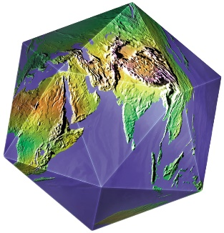
Welcome To Perspectives on the World Christian Movement
Lesson 7, Part 2:
International Student/Scholar Ministry (ISM)

Slide 2
What We Have Seen (Part A)

Slide 3
What We Have Seen (Part A)
We are in the Third Wave of global mission outreach.

Slide 4
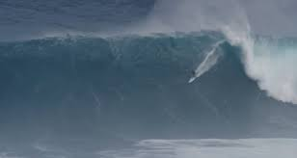
What We Have Seen (Part A)
We are in the Third Wave of global mission outreach.
Based on how close we are to finishing the task, the Third Wave could inevitably be the last wave.

Slide 5
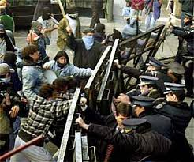
What We Have Seen (Part A)
We are in the Third Wave of global mission outreach.
Based on how close we are to finishing the task, the Third Wave should inevitably be the last wave.
God continues to use wars, social and political disruptions, etc., for his glory.

Slide 6
History of ISM Organizations
Start
year
Year ISM
began
Wesley Foundation 1913
BSU/BCM 1921
Navigators 1933
IV (InterVarsity) 1941 (1958)
1st half of the 20th Century

Slide 7
History of ISM Organizations
Start
year
Year ISM
began
Wesley Foundation 1913
BSU/BCM 1921
Navigators 1933
IV (InterVarsity) 1941 (1958)
Cru (Campus Crusade) 1951 (1968-69)
XA (Chi Alpha) 1953
ISI (Int’l Students, Inc.) 1953 (1953)
RUM/RUF (Reformed) 1973
1st half of the 20th Century
2nd half of the 20th Century

Slide 8
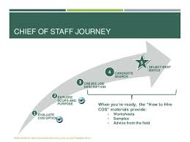
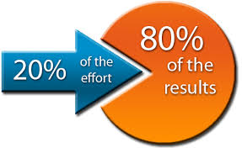
2002
I became Chief of Staff of InterFACE
Ministries. I saw nationwide ministry
numbers I’d never seen before. The
numbers were underwhelming. Later I realized
we in ISM were doing the same thing local
churches did: utilized 20% of the group to do
80% of the ministry! It’s called the “80-20 rule.”

Slide 9
2002-2005
I continued doing research to see how
we could improve our success ratio
without having to work harder or
longer, but smarter, more strategic and totally
biblical. How could we fulfill 2 Timothy 2:2 –
“And the things you have heard from me
among many witnesses, commit these to faithful
men who will be able to teach others also”?
It’s called biblical

Slide 10
A New ISM Model
Based on original research, our new model would:
Focus on volunteer peers (students), not paid staff
Automatically be cost effective
Begin training Christian high school juniors and seniors before they arrive at college
Have hard copy and online training materials
Have national online student and mentor networks
Be reformatted for every generation

Slide 11
A New ISM Model
Based on original research, our new model would:
Focus on volunteer peers (students), not paid staff
Automatically be cost effective
Begin training Christian high school juniors and seniors before they arrive at college
Have hard copy and online training materials
Have national online student and mentor networks
Be reformatted for every generation

Slide 12
2007!
I keynoted the ACMI National Conference at St. Olaf’s College in Northfield, MN. There I demonstrated numerically that the 2 current models of doing international student/scholar ministry (ISM), the staff-centered and volunteer-centered models, would only touch a very tiny fraction of the int’ls in the US.
Association of Christians Ministering to Internationals

Slide 13
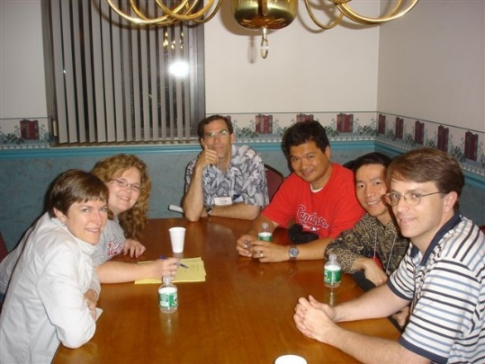
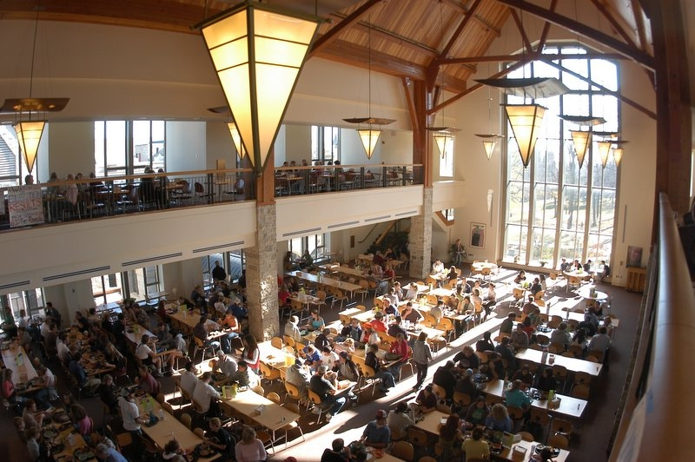
2007!
Then I introduced original research that showed that there is an equal or greater number of American Christian students at colleges nationwide as there are int’l students that graduate with their faith intact. In other words, reaching an int’l student with the gospel would be a 1-to-1 process by peer volunteers who have the greatest access to int’l students.
St. Olaf cafeteria

Slide 14
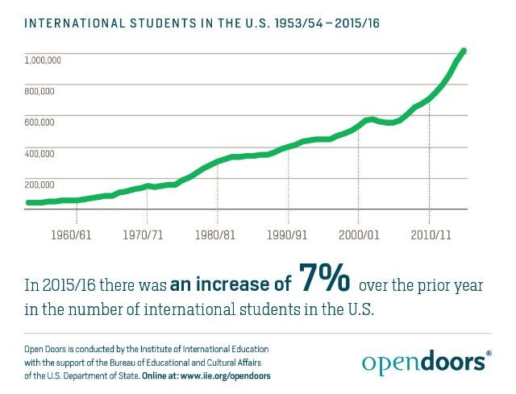
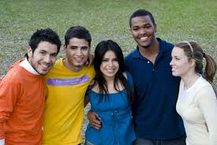
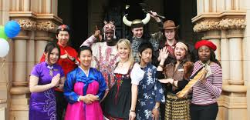
8 Years Later in 2015
The number of international students and scholars in the US topped 1 million for the first time!

Slide 15
Quotable
“I think God desires every one of those million international students to hear a credible presentation of the gospel. With our sister organizations, we may be affecting 30,000 to 40,000 in a meaningful way. That leaves the vast majority untouched.” (That’s 96%-97%)
– IVCF ISM Director Marc Papai, “Campus Ministries Race to Keep Up with Record Number of International Students,” Sarah Eekhoff Zylstra, February 2, 2017

Slide 16
Is the Context Considered?
Another ISM regularly touts this statistic: “For the third year in a row, for every hour of every single day, students have told us they accepted Christ through this ministry.” That number is 8,760. Praise the Lord! Amen!

Slide 17
Is the Context Considered?
Another ISM regularly touts this statistic: “For the third year in a row, for every hour of every single day, students have told us they accepted Christ through this ministry.” That number is 8,760. Praise the Lord! Amen!
But let’s consider the context: Of the 1.1 million int’l students in the US, that is 0.008% of the group they are reaching. Could we be more strategic, biblical and do it with less expense?

Slide 18
There will never be enough paid staff and off-campus volunteers to reach every int’l student on campus. The largest volunteer base is on the campus right now! All we need to do is vision cast, recruit and train American students to befriend 1 international student in 4 years of college.

Slide 19
Consider
With only 1 exception, all the Christian high school and college students I have talked to about this tell me they can easily make a friend with 1 international student in 4 years at the university. In many cases, they ask me what else can they do!

Slide 20
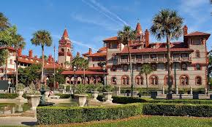
The best missions trip they never took!
For
Christian students, college should be…

Slide 21
What’s Even Better:
Training college bound students to reach
international students and scholars before
they arrive on campus, while they are still
juniors and seniors in high school still under
the oversight of parents and in church youth
groups and Christian
or home schools.

Slide 22
Remember the Period of Transition?
Second Era
Third Era
1934
1980
Period of Transition
How Did Ralph Winter characterize it?

Slide 23
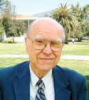
Remember the Period of Transition?
Second Era
Third Era
1934
1980
Period of Transition
“…[S]ignificant tension existed due to the divergent missiologies (understandings of mission) appropriate in older fields of mission work and what was appropriate to new beginnings…”

Slide 24
ISM Organization Timeline
Second Era
Third Era
1913 Wesley
1973
RUF
1934
1980
Period of Transition

Slide 25
ISM Organization Timeline
Second Era
Third Era
1913 Wesley
1973
RUF
2007
1934
1980
Period of Transition
My talk at ACMI

Slide 26
So What Was The Result?
After 4 years of speaking nationally at large regional and national home school conventions vision casting and challenging students, parents, educators, youth group leaders, etc., on college as a global missions field, we saw no long lasting response. After draining our savings account, we had to stop.

Slide 27
But there is

Slide 28
Good News Point #1
“In January [2017], Chi Alpha rolled out an initiative that acknowledges
both the work God is doing among international students and the responsibility of Christian students
to intentionally engage them.”
-- Sarah Eekhoff Zylstra, “Campus Ministries Race to Keep up with Record Number of International Students” (2/2/17), https://www.thegospelcoalition.org/article/campus-ministries-race-to-keep-up-with-record-number-international-students

Slide 29
Good News Point #2
“Almost all of InterVarsity’s 1,000 chapters now contain at least one international student.”
-- Marc Papai, Director of InterVarsity ISM, quote by Sarah Eekhoff Zylstra in “Campus Ministries Race to Keep up with Record Number of International Students” (2/2/17), https://www.thegospelcoalition.org/article/campus-ministries-race-to-keep-up- with-record-number-international-students

Slide 30
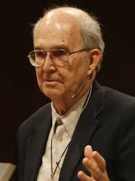
Kenneth E. Bailey
1930-2016
Concerning 1 Corinthians 9:22-23 –
“Paul does not argue that he ‘must
become all things to all people’ so
that the gospel can receive a hearing
and be accepted. For him, God, through the gospel, was already at work across cultural lines, and he wanted to become its partner. The gospel train was moving and he could jump on or be left behind. This wonderful language describes a gospel out of control that has its own energy and is on the move. No one can chain it down (2 Timothy 2:9). The same sense of wonder and excitement is felt by people all over the world as they observe the continuing rapid expansion of the gospel in Asia, Africa and South America. We, like Paul, have two choices: Join that movement or be left behind by it.” (Emphasis his.)
(2011) -- Page 261

Slide 31
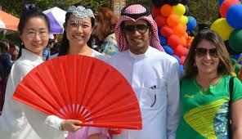
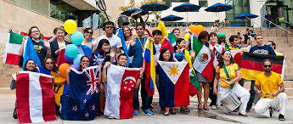
Consider
Approximately 98% of all
international students in the
US are from Asia, Africa
and South America.

Slide 32
What About You?
Anyone today can start a generational movement to send missionaries to college to reach the world right now by influencing, vision casting and preparing young people at home, in the “hood,” in Sunday school, church, youth group, Bible studies…

Slide 34
Today!

Slide 35
If you would like a free copy of
this powerpoint, please go to KingdomServants.com/powerpoints/
and download it for free.

