Slide 1
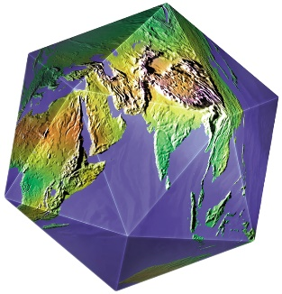
Welcome To Perspectives on the World Christian Movement
Lesson 7, Part 1
Bill Perry,
Chief of Staff, Director of Training Materials
InterFACE Ministries

Slide 2
P
erson(s)
U
R
esults / Reached Areas
P
rayer / Student Movement
O
pposition
S
ending Base
E
ra / Dates

Slide 3
Two Quotes
“We study history not to find out what happened, but to find out who we are.”

Slide 4
Two Quotes
“People who are not making history will become tools in the hands of those who will.”

Slide 5
Key Word?
Finishing!

Slide 6
Let’s take a little stroll through history since the Reformation.

Slide 7
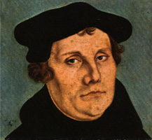
Reformation: Martin Luther
1517 AD
(1483-1546)

Slide 8
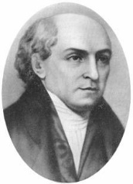
Luther
Carey
275 years
1517
1792

Slide 9
William Carey: “The Father of Modern Missions”
“Lo, I am with you always, even unto the end of the world.”
Matt. 28:20b
“Go ye therefore, and teach all nations, baptizing them in the name of the Father, and of the Son, and of the Holy Ghost: teaching them to observe all things whatsoever I have commanded you.”
Matt. 28:19-20a
(1761-1834)

Slide 10
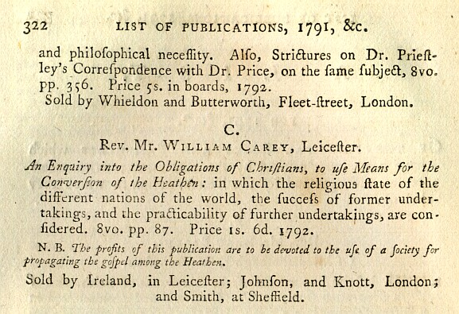

Slide 11
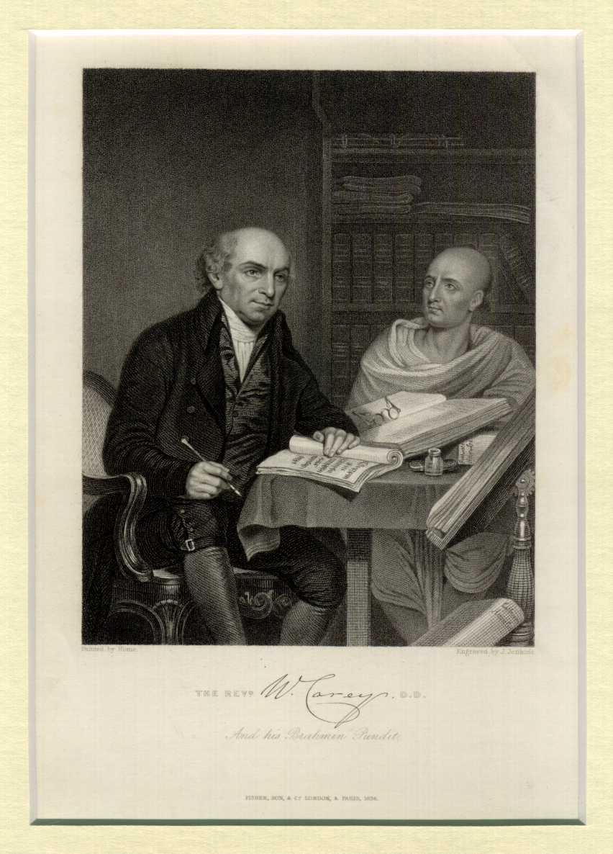
“Enlarge the place of thy tent, and let them stretch forth the curtains of thine habitations: spare not, lengthen thy cords, and strengthen thy stakes; for thou shalt break forth on the right hand and on the left; and thy seed shall inherit the Gentiles, and make the desolate cities to be inhabited.”
Isaiah 54:2-3

Slide 12
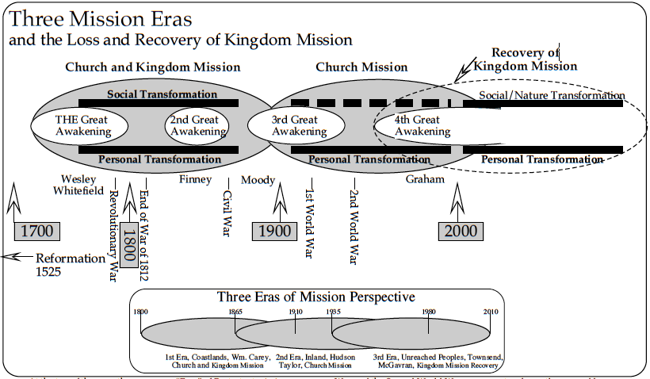
Dr. Ralph Winter

Slide 13
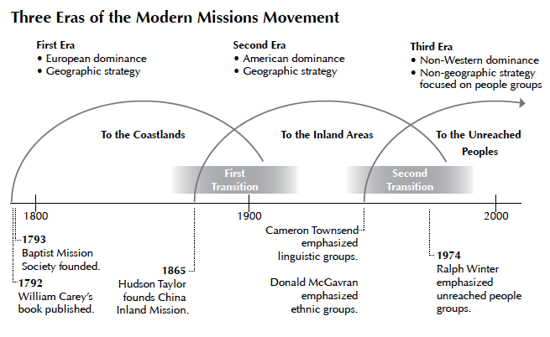
Yvonne Wood Huneycutt

Slide 14
Dr. Ralph Winter
“The First Era, 1800-1910, followed the much delayed conversion of Protestant Christianity to missions. In that conversion, Protestantism went from being merely a profoundly religious and semi-political movement to a sudden awareness of global mission, both Church and Kingdom Mission. In a sense the conversion took roughly 300 years, from 1500 to 1800. However, in the last few years before the year 1800 Protestant mission awareness accelerated very rapidly on the surfboard of the Evangelical Awakening.”

Slide 15
The American Backstory
“Soon after 1800, two momentous events took place…the British, partly due to their preoccupation with Napolean at Waterloo, abruptly gave up their War of 1812 against the new American republic, signing the treaty of Ghent in 1815. That, plus the incredible Louisiana Purchase, threw open the whole North American continent for occupation…and as a result, one of history’s greatest migrations… That massive development provided the kind of social upheaval that often supports religious awakenings and mission thinking, and…fostered the most extensive positive transformation any country has ever experienced in history.”
-- Dr. Ralph Winter, The Three Mission Eras and the Loss and Recovery of Kingdom Mission, 1800-2000

Slide 16
Three Eras of Modern Missions
First Era
“To The Coastlands”
Edinburgh Missions Conference
1792
Notable elements
1910
Mainly European Sending Base
Haystack Prayer Meeting
ABCFM

Slide 17
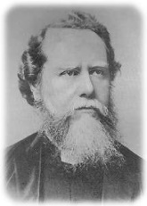
Three Eras of Modern Missions
First Era
Second Era
Edinburgh Missions Conference
1865
1910

Slide 18
Three Eras of Modern Missions
First Era
Second Era
Edinburgh Missions Conference
1865
1910
Period of Transition

Slide 19
Period of Transition from the First and Second Eras
“The next, Second Era, had already begun years earlier in 1865. In the 45-year overlapping period (1865-1910) significant tension existed due to the divergent missiologies (understandings of mission) appropriate in older fields of mission work and what was appropriate to new beginnings where there were no churches. In this transition there was also the beginning of the the polarization between Church Mission along and Church Mission plus Kingdom mission…”
-- Dr. Ralph Winter, The Three Mission Eras and the Loss and Recovery of Kingdom Mission, 1800-2000

Slide 20
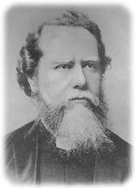
Three Eras of Modern Missions
Second Era
“To The Inlands”
Edinburgh Missions Conference II
1865
Notable elements
1980
Mainly American Sending Base
Hudson Taylor founds China Inland Mission
ABCFM

Slide 21
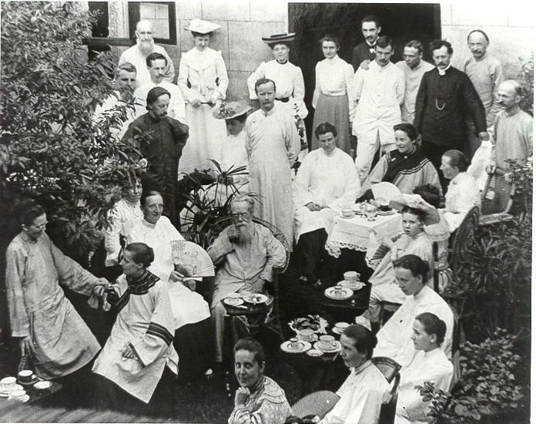
Hudson Taylor: Missionary to China
1832-1905

Slide 22
Four Stages of Missions Activity
Stage One:
Pioneering Stage
Missionary
Church

Slide 23
Four Stages of Missions Activity
Stage Two:
Parenting Stage
Missionary
Church

Slide 24
Four Stages of Missions Activity
Stage Three:
Partnership Stage
Missionary
Church

Slide 25
Four Stages of Missions Activity
Stage Three:
Partnership Stage
Missionary
Church

Slide 26
Four Stages of Missions Activity
Stage Four:
Participation Stage
Missionary
Church

Slide 27
Three Eras of Modern Missions
First Era
Second Era
First Period of Transition
Edinburgh Missions Conference
1865
1910
Pioneer - Parent - Partnership - Participation
Pioneer - - - - -

Slide 28
The “E” Scale
E-0:
No cultural barriers, revival
E-1:
Perhaps the Church itself
E-2
Church / Cross-cultural barrier
E-3
Church / 2+ Cross-cultural barriers

Slide 29
Three Eras of Modern Missions
First Era
Second Era
“The Inlands”
Edinburgh Missions Conference
1865
1910
Notable elements
Mainly North American Sending Base
Prayer: Student and Women’s Mission Societies
Student Volunteer Movement

Slide 30
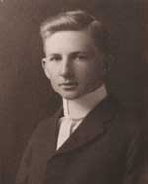
Three Eras of Modern Missions
Second Era
Third Era
Edinburgh Missions Conference II
1934
1980
Notable people
Cameron Townsend
Donald McGavran

Slide 31
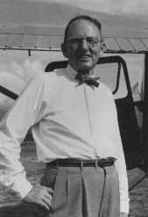
Cameron Townsend
“There is no greater missionary than the Bible in the native tongue. It never needs a furlough and it is never considered foreign.”
(1896-1982)

Slide 32
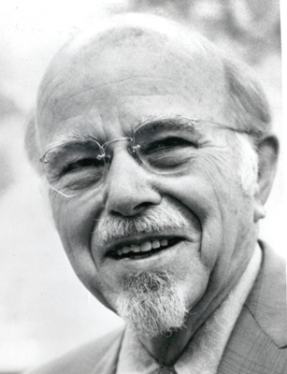
Donald McGavran
“The individual does not think of himself as a self-sufficient unit, but a part of the group.* His business affairs, his children’s marriages, his personal problems, or the difficulties he has with his wife are properly settled by group thinking. Peoples become Christian as their group-mind is brought into the lifegiving relationship to Jesus as Lord.”
-- from Bridges of God
(1897-1990)
*Cultural, ethnic and tribal group

Slide 33
Three Eras of Modern Missions
Second Era
Third Era
“Unreached People Groups”
Edinburgh Missions Conference II
1934
1980
Notable elements
Non-western and Specialized Sending Base
Campus Crusade for Christ, InterVarsity, etc.
Concerts of Prayer, College Campuses

Slide 34
Three Eras of Modern Missions
Second Era
Third Era
“Unreached People Groups”
Second Period of Transition
Edinburgh Missions Conference II
1934
1980
Pioneer - Parent - Partnership - Participation
Pioneer - - - - -

Slide 35
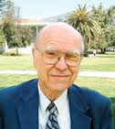
Three Eras of Modern Missions
Second Era
Third Era
“Unreached People Groups”
Second Period of Transition
Edinburgh Missions Conference II
1934
1974
1980
Pioneer - Parent - Partnership - Participation
Dr. Ralph Winter
(1924-2009)
Pioneer - - - - -

Slide 36
Dr. Ralph Winter
“At the Lausanne Congress on World Evangelism in 1974, Winter popularized the concept of unreached people groups. He made it clear that in order to finish the Great Commission, special efforts were required to make the gospel understandable and available within every ethno-linguistic group. To accomplish this, a culturally-appropriate church movement must be planted within every people group. Winter’s Lausanne address rocked the world of missions. Six years later, the Winter-promoted Edinburgh 1980 conference made the phrase “a church for every people” common among mission movements all over the world, but particularly among the emerging mission structures in the non-Western world.”
-- Yvonne Wood Honeycutt, “New Pioneers Leading the Way
in the Final Era”

Slide 37
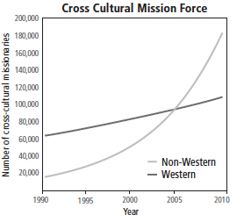
Sources of the Global Missionary Force

Slide 38
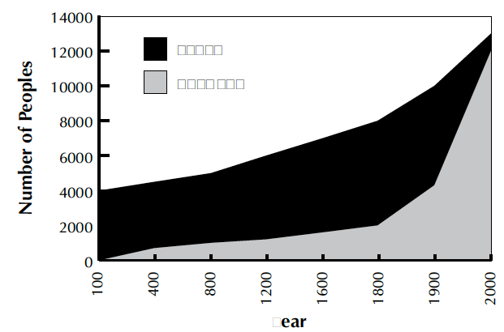
Two Millennia of Evangelizing Peoples
People not hearing the gospel
People hearing the gospel
Year

Slide 39
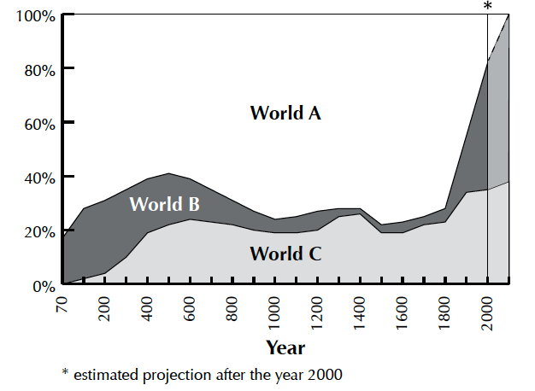
The Spread of Christianity
World C = all of Christendom (Catholics, Orthodox and Protestants
~38%

Slide 40
The Spread of Christianity
World B = non-Christians who have heard the gospel or live in a context that they will hear it in their lifetimes.
World C = all of Christendom (Catholics, Orthodox and Protestants
~80%

Slide 41
The Spread of Christianity
World A = all non-Christians who will not hear the gospel unless new efforts to reach them.
World B = non-Christians who have heard the gospel or live in a context that they will hear it in their lifetimes.
World C = all of Christendom (Catholics, Orthodox and Protestants
~20%

Slide 42
The Spread of Christianity
2017: How much is left to do?

Slide 43
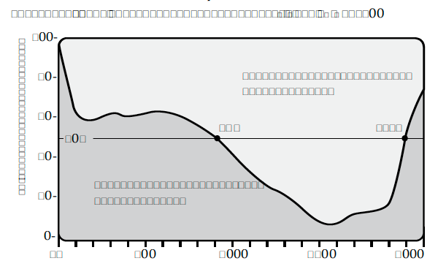
World Christianity in 2010
100%
Global
North
80%
60%
50%
1990AD
900AD
40%
Global
South
20%
1900AD
|
|
Years
0 500 1000 1500 2000

Slide 44
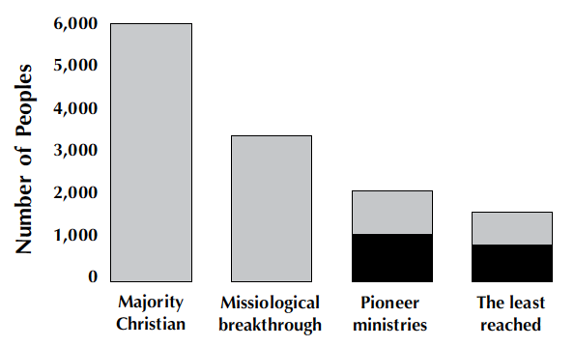
Discipling the World’s People
Protestant, Catholic, Orthodox and other groups claiming to be Christian.

Slide 45
Discipling the World’s People
Protestant, Catholic, Orthodox and other groups claiming to be Christian.
Christian-ity has become a viable part of the native culture.

Slide 46
Discipling the World’s People
The indigenous church is either non-existent, culturally marginalized or too small to impact the current generation without outside help.
Protestant, Catholic, Orthodox and other groups claiming to be Christian.
Christian-ity has become a viable part of the native culture.

Slide 47
Discipling the World’s People
The indigenous church is either non-existent, culturally marginalized or too small to impact the current generation without outside help.
The dark sections represent a population of over 10,000 and less than 5% Christ-ian or 2% Evangelical
Protestant, Catholic, Orthodox and other groups claiming to be Christian.
Christian-ity has become a viable part of the native culture.

Slide 48
The key word is “Finishing!” The finish line is closer than it has ever been before! We finish here with the first session. In our next session we will examine a global application that applies to anyone that lives near a college.

Slide 49
If you would like a free copy of
this powerpoint, please go to KingdomServants.com/powerpoints/
and download it for free.

