Slide 1
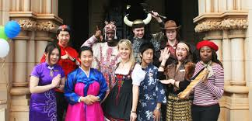
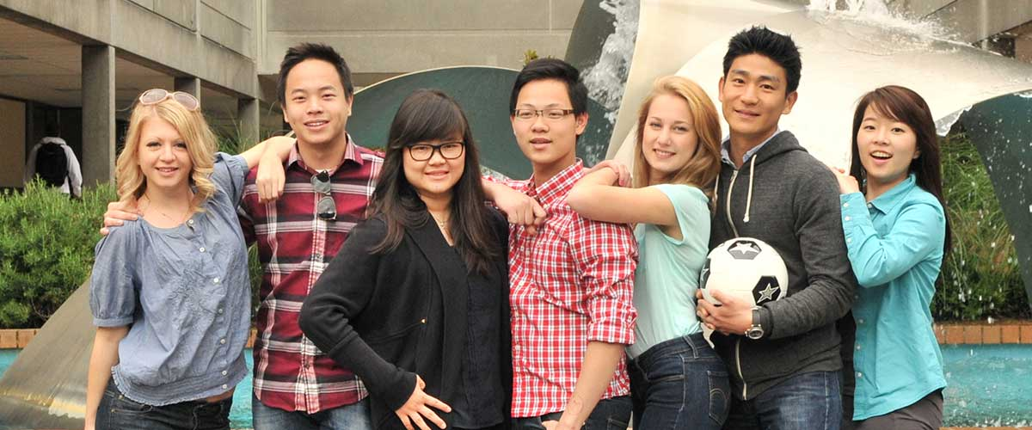
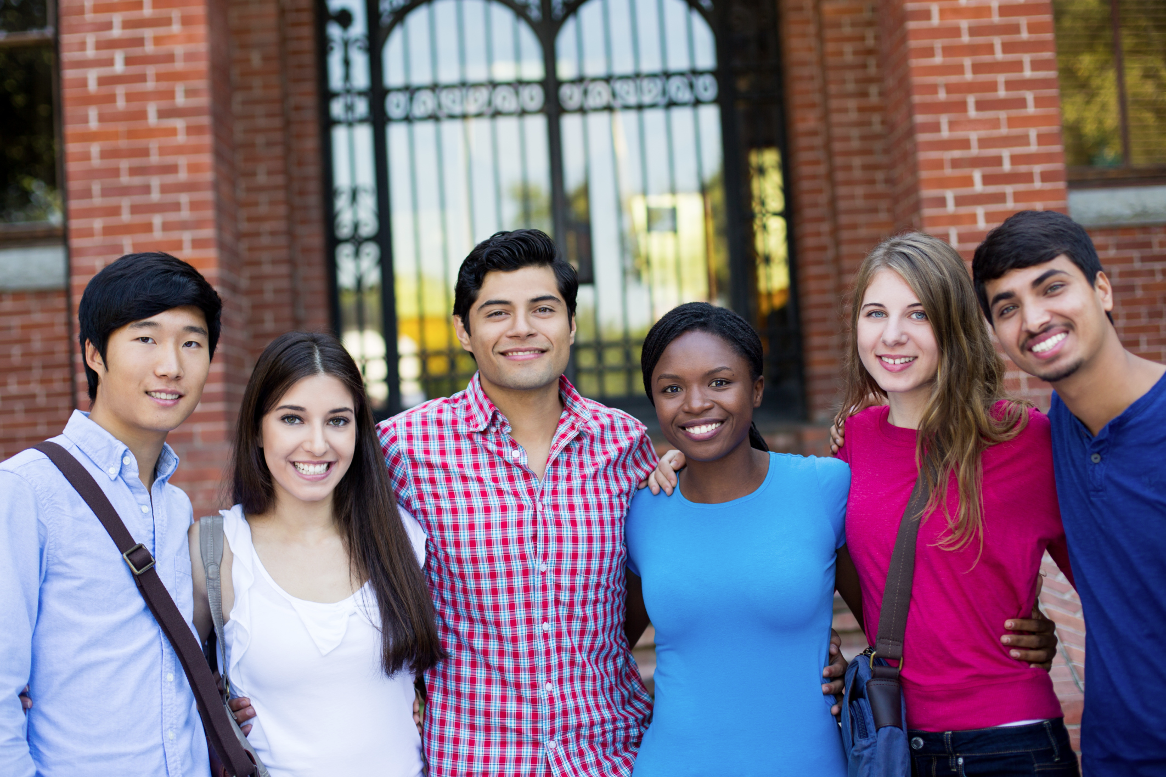
The best way to reach out to international students on campus
Bill Perry

Slide 2
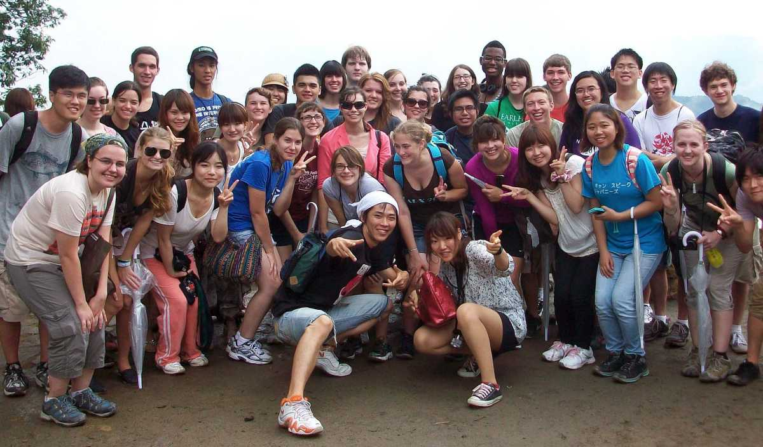
A Crash Course on ISM history

Slide 3
A Crash Course on ISM history
The first recorded international students attended British schools in the 1200-1300’s.
.

Slide 4
A Crash Course on ISM history
The first recorded international students attended British schools in the 1200-1300’s.
The first international student in the US was probably Henry Obookiah from the Sandwich Islands who became a Christian in the early 1800’s.

Slide 5
A Crash Course on ISM history
The first recorded international students attended British schools in the 1200-1300’s.
The first international student in the US was probably Henry Obookiah from the Sandwich Islands who became a Christian in the early 1800’s.
The modern phase of international students educated in the US began shortly after WW1.

Slide 6
A Crash Course on ISM history
The first recorded international students attended British schools in the 1200-1300’s.
The first international student in the US was probably Henry Obookiah from the Sandwich Islands who became a Christian in the early 1800’s.
The modern phase of international students educated in the US began shortly after WW1.
The number of international student topped 1 million for the first time in 2015.

Slide 7
The Best Way Because It…
Has a Biblical outcome as its goal
Utilizes biblical methods
Incorporates a national strategy
Works with all the players on and off campus
Marshals the largest number of volunteers
Is cost effective
Is sustainable
Uses proven, effective resources

Slide 8
1) Biblical outcome as its goal
What is the goal of history
from God’s point of view?

Slide 9
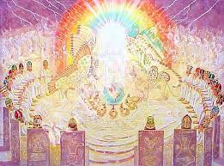
The Goal of History
Revelation 5:9-12
And they sang a new song, saying: “You are worthy to take the scroll, and to open its seals; for you were slain, and have redeemed us to God by your blood out of every tribe and tongue and people and nation, and have made us kings and priests to our God; and we shall reign on the earth.” Then I looked, and I heard the voice of many angels around the throne, the living creatures, and the elders; and the number of them was ten thousand times ten thousand, and thousands of thousands, saying with a loud voice: “Worthy is the Lamb who was slain to receive power and riches and wisdom, and strength and honor and glory and blessing!”

Slide 10
The Goal of History
Revelation 5:9-12
And they sang a new song, saying: “You are worthy to take the scroll, and to open its seals; for you were slain, and have redeemed us to God by your blood out of every tribe and tongue and people and nation, and have made us kings and priests to our God; and we shall reign on the earth.” Then I looked, and I heard the voice of many angels around the throne, the living creatures, and the elders; and the number of them was ten thousand times ten thousand, and thousands of thousands, saying with a loud voice: “Worthy is the Lamb who was slain to receive power and riches and wisdom, and strength and honor and glory and blessing!”

Slide 11
History meets the future!
“out of every tribe and tongue
and people and nation”
Doesn’t that sound like today’s college
campus full of international students?!

Slide 12
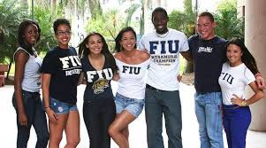
2) Biblical Methods
Method
Reference
Being witnesses
Acts 1:8

Slide 13
2) Biblical Methods
Method
Reference
Being witnesses
Speaking the truth in love
Acts 1:8
Ephesians 4:15

Slide 14
2) Biblical Methods
Method
Reference
Being witnesses
Speaking the truth in love
Working with others
Acts 1:8
Ephesians 4:15
2 Corinthians 8:1

Slide 15
2) Biblical Methods
Method
Reference
Being witnesses
Speaking the truth in love
Working with others
Reproduces as quickly as possible
Acts 1:8
Ephesians 4:15
2 Corinthians 8:1
2 Timothy 2:2

Slide 16
2) Biblical Methods
Method
Reference
Being witnesses
Speaking the truth in love
Working with others
Reproduces as quickly as possible
Know how to answer
Acts 1:8
Ephesians 4:15
2 Corinthians 8:1
2 Timothy 2:2
Colossians 4:6

Slide 17
2) Biblical Methods
Method
Reference
Being witnesses
Speaking the truth in love
Working with others
Reproduces as quickly as possible
Know how to answer
Being hospitable
Acts 1:8
Ephesians 4:15
2 Corinthians 8:1
2 Timothy 2:2
Colossians 4:6
Romans 12:13

Slide 18
The Engel’s Scale

Slide 19
The Engel’s Scale
The goal of evangelism is to get the outsiders moving up the scale.

Slide 20
The Engel’s Scale
This is what Paul did at Mars Hill!
The goal of evangelism is to get the outsiders moving up the scale.

Slide 21
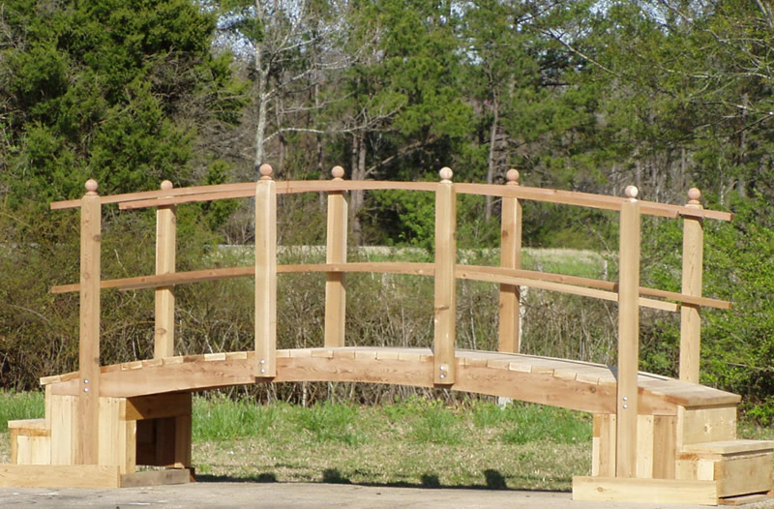
Reaching our Muslim, Atheist and Pantheist Friends
“The Friendship Bridge”
This bridge represents the friendships we have with outsiders. To reach others, we must be good at being friendly and keeping up with friends. That means face-to- face, not just on Facebook!

Slide 22
Reaching our Muslim, Atheist and Pantheist Friends
“The Friendship Bridge”
A lot of friendship is about learning to really listen to our friends. We need to learn this skill better. Asking questions that clarify is very important, like, “What do you mean by that?” and “How did that make you feel?”

Slide 23
Reaching our Muslim, Atheist and Pantheist Friends
“The Friendship Bridge”
When our friends answer those kinds of questions they will sense your interest in them. That helps make you a trusted friend that cares. And usually they will open up more to you. Keep listening!

Slide 24
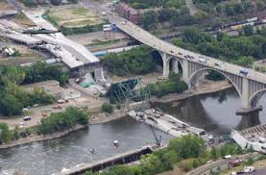
Reaching our Muslim, Atheist and Pantheist Friends
“The Friendship Bridge”
Listening is how to build a strong bridge that will support the truth when you share it! You don’t want to collapse the bridge, which means the friendship is over.

Slide 25
Reaching our Muslim, Atheist and Pantheist Friends
“The Friendship Bridge”
As you learn more about them, you can find out where they are on the Engel’s scale. This is when you can begin to raise the topic of your faith. Sharing little by little is the best way to introduce biblical TRUTH.
T
R
U
T
H

Slide 26
3) National Strategy
This means we accept responsibility for our part of “the whole pie” (1,000,000+ int’ls).

Slide 27
3) National Strategy
This means we accept responsibility for our part of “the whole pie” (1,000,000+ int’ls).
Since our strategy is national, it can work and be replicated anywhere on virtually any campus.

Slide 28
4) Works with all the players on and off campus
Off campus
On campus
Churches (American and ethnic)
Individual believers
Bible study groups
Christian-owned companies
Christian day schools
Christian foundations

Slide 29
4) Works with all the players on and off campus
Off campus
On campus
Churches (American and ethnic)
Individual believers
Bible study groups
Christian-owned companies
Christian day schools
Christian foundations
Campus based ministries
Chaplains
Christian professors and officials
Christian international students
American (or now “domestic”) students

Slide 30
At the
In 2006 I spearheaded an international ministry partnership by invitation that included churches, on-campus ministries, chaplains and Christian-owned or sympathetic businesses. We called ourselves:

Slide 31
At the
In 2006 I spearheaded an international ministry partnership by invitation that included churches, on-campus ministries, chaplains and Christian-owned or sympathetic businesses. We called ourselves:
Internationals at Miami
Mi@mi

Slide 32
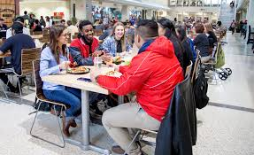
At the
As a result of this partnership we set records in 2007 and 2008 for the largest number of UM’s international students attending a welcome dinner in the history of the school ! All-in partnership is what is needed to see God bless our efforts with synergistic results.

Slide 33
All players in partnership
Synergy is a New Testament concept and comes from the Greek word sunergos (sun = with; ergos = energy) meaning workers or working together.

Slide 34
All players in partnership
Synergy is a New Testament concept and comes from the Greek word sunergos (sun = with; ergos = energy) meaning workers or working together.
1 Cor 3:9, “fellow workers”
2 Cor 6:1, “workers together”
Phil 4:3, “fellow workers”
Romans 8:28, “work together”

Slide 35
All players in partnership
Synergy is a New Testament concept and comes from the Greek word sunergos (sun = with; ergos = energy) meaning workers or working together.
1 Cor 3:9, “fellow workers”
2 Cor 6:1, “workers together”
Phil 4:3, “fellow workers”
Romans 8:28, “work together”
Synergy means a greater result is achieved when all the parts are working together than the result of all the parts working separately.

Slide 36
5) Largest number of volunteers
Who are they??

Slide 37
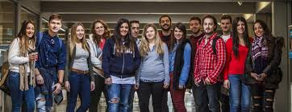
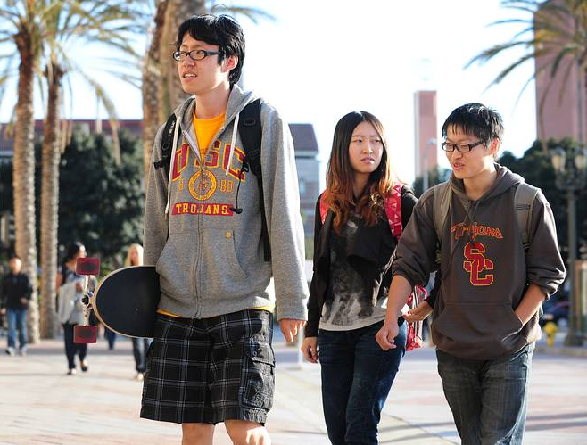
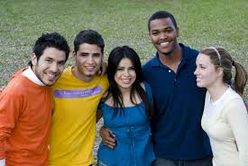
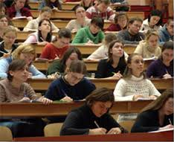
5) Largest number of volunteers
Christian students
on campus

Slide 38
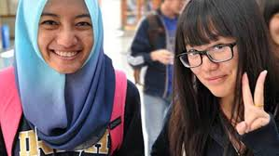
5) Largest number of volunteers
Christian students
on campus
In 2007 I broke original research that found the number of Christian students on college campuses in North America graduating with their faith intact is equal to or greater than the number of international students (over 1,000,000). This is far greater than the combination of Christian faculty and administration personnel and ISM staff, volunteers and host families/friendship partners combined!

Slide 39
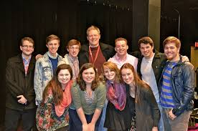
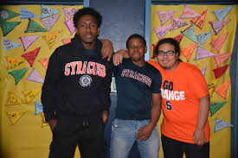
5) Largest number of volunteers
Christian students
on campus
Thus an American peer-centered outreach strategy that organically multiplies itself is the smartest, best and fastest growing model for ISM so that international students may hear the gospel and trust
Christ for salvation.

Slide 40
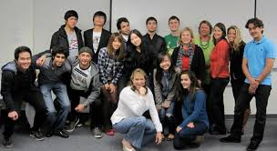
6) Cost effective
Because these American volunteers already live inside the campus “circle” of the dorm, classroom, library and student center along with international students, they require no pay and don’t need extra money to be a friend and hang out.

Slide 41
6) Cost effective
Because these American volunteers already live inside the campus “circle” of the dorm, classroom, library and student center along with international students, they require no pay and don’t need extra money to be a friend and hang out.
What they will need is training before they arrive at college (i.e., in high school) to help them see college as the best missions trip they never took!

Slide 42
7) Sustainable
An American peer-centered approach is not nearly as dependent on campus ministry staff and/or chaplains to succeed. An organic outreach is fluid and grows where people develop good relationships. Christians should be cognizant of how important their friendship contacts are and build them intentionally. Most friendships need little staff oversight. Thus this model is more sustainable in both practical and financial ways.

Slide 43
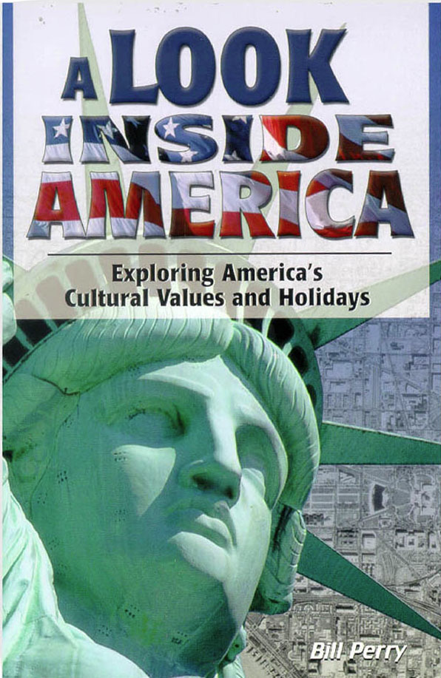
8) Uses proven, useful resources
These resources have
stood the test of time
and demonstrated they
work across the cultural
and worldview hurdles
quite successfully with
tens of thousands in
circulation around the globe.

Slide 44
Consider
Less than 10% of all international students in the US ever see the inside of any American home, let alone a Christian American home (<100,000).

Slide 45
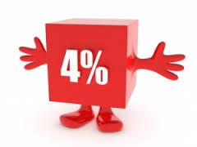
Consider
Less than 10% of all international students in the US ever see the inside of any American home, let alone a Christian American home (<100,000).
Less than 4% of all international students in the US hear the gospel (<40,000).

Slide 46
Consider
Less than 10% of all international students in the US ever see the inside of any American home, let alone a Christian American home (<100,000).
Less than 4% of all international students in the US hear the gospel (<40,000).
Yet upwards of 50% of all international students in the US return home and assume positions of leadership, influence & authority.

Slide 47
Conclusion
Dr. Ralph Winter (1924-2009) founded the US Center for World Missions (now Frontier Ventures and Venture Center and said:

Slide 48
Conclusion
Dr. Ralph Winter (1924-2009) founded the US Center for World Missions (now Frontier Ventures and Venture Center and said:
“International student ministry in the US is the most challenging mission field in the whole world.”

Slide 49
Conclusion
Dr. Ralph Winter (1924-2009) founded the US Center for World Missions (now Frontier Ventures and Venture Center and said:
“International student ministry in the US is the most challenging mission field in the whole world.”
“International student ministry in the US is the most potentially fruitful mission field in the whole world.”

Slide 50
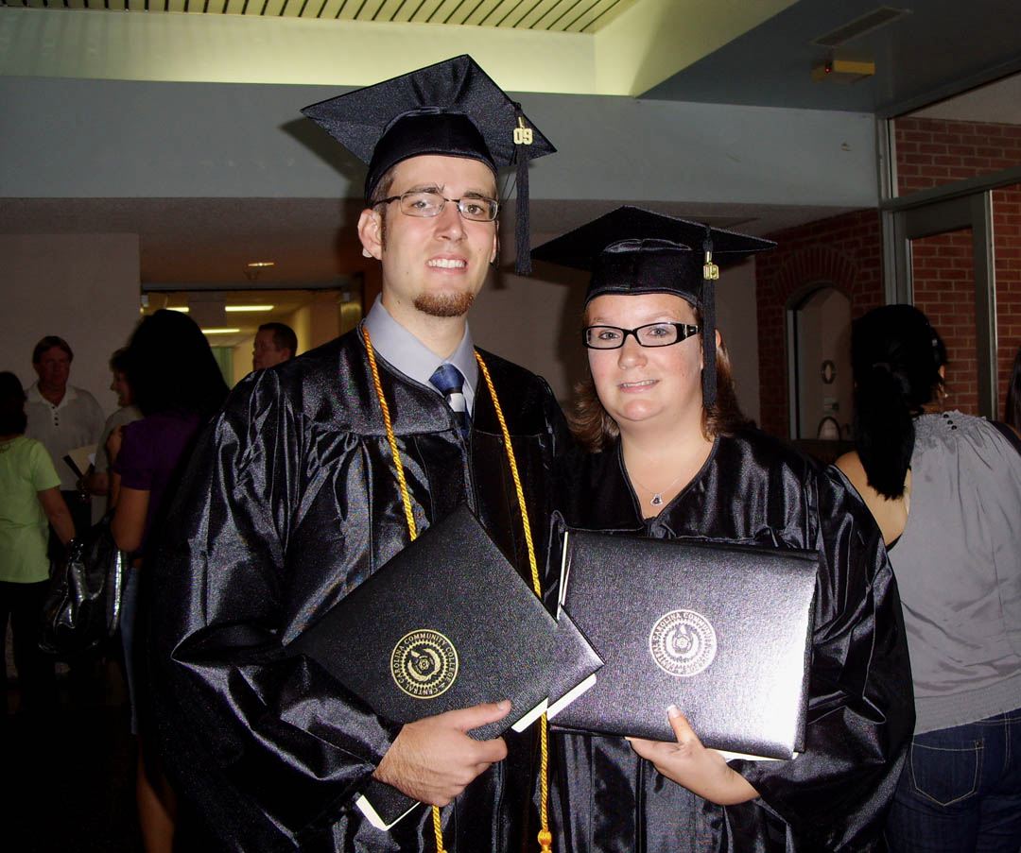
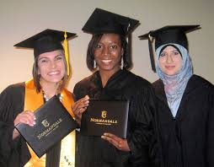
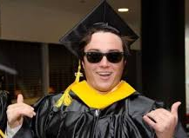
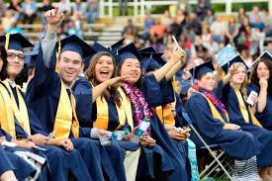
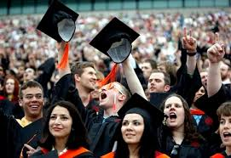
Think about it
When you graduate,
how many internationals
will rendezvous with
you in heaven?

Slide 51
Last but not least
If you would like a free copy of this presentation, please email bill@billperry.tv
For free useful Kingdom resources, please visit www.KingdomServants.com

