Slide 1
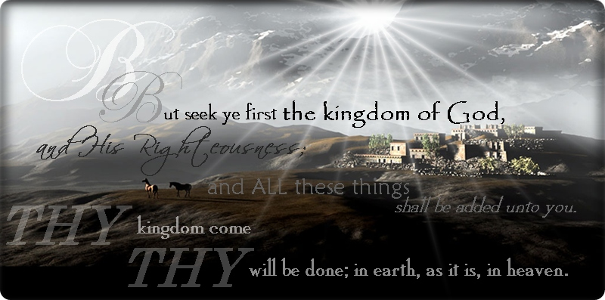
The Kingdom of God Opposition Round 2
Bill Perry

Slide 2
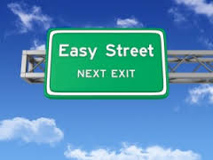
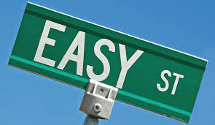
Have you
ever lived on
Easy Street ?

Slide 3
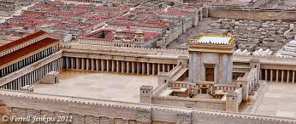
Acts 5:12-13 (Review)
Solomon’s Porch
And through the hands
of the apostles many
signs and wonders were done among the people.
And they were all with one accord in Solomon’s
Porch. Yet none of the rest dared join them, but
the people esteemed them highly.

Slide 4
Acts 5:14-15 (Review)
And believers were increasingly added to the Lord, multitudes of both men and women so that they brought the sick out into the streets and laid them on beds and couches, that at least the shadow of Peter passing by might fall on some of them.

Slide 5
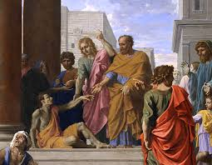
Acts 5:16 (Review)
Also a multitude gathered
from the surrounding cities
to Jerusalem, bringing sick people and those
who were tormented by unclean spirits, and
they were all healed.

Slide 6
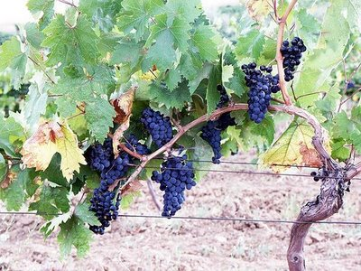
John 15:2
“…Every branch that
bears fruit [the Father]
prunes, that it may bear
more fruit.”

Slide 7
John 15:2
“…Every branch that
bears fruit [the Father]
prunes, that it may bear
more fruit.”
Jesus told this to his disciples the night he was betrayed to prepare them
for the times when they would face major challenges and difficulties
because pruning fruitful branches yields more fruit as the outcome.

Slide 8
Acts 5:17-18 (The narrative resumes)
Then the high priest rose up, and all those
who were with him (which is the sect of the
Sadducees), and they were filled with
jealousy, and laid their hands on the
apostles and put them in the common prison.

Slide 9
Then the high priest rose
up, and all those who were
with him (which is the sect
of the Sadducees), and they
were filled with jealousy,
and laid their hands on the
apostles and put them in
the common prison.
This time it was ALL of the
apostles, not just Peter and
John earlier.
Acts 5:17-18
Comment

Slide 10
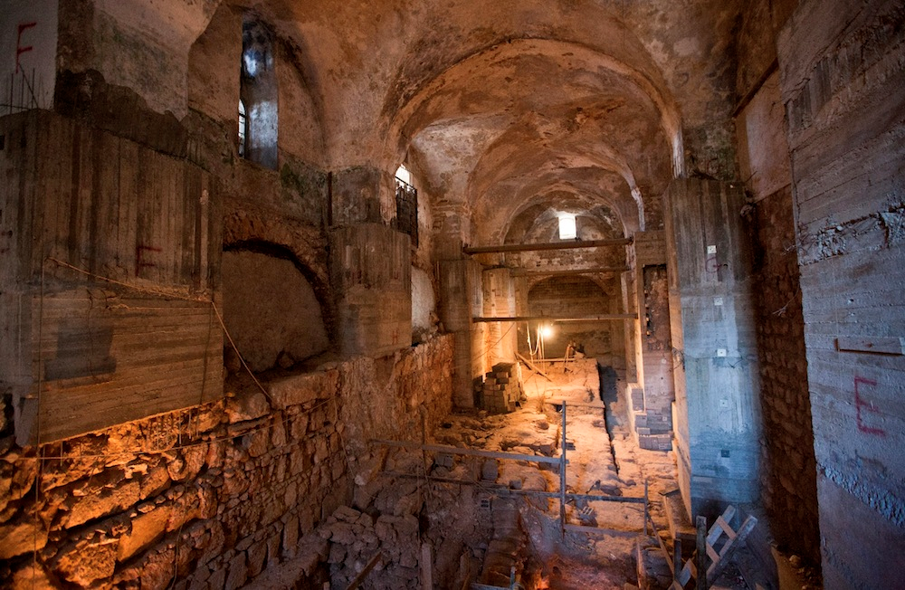
Then the high priest rose
up, and all those who were
with him (which is the sect
of the Sadducees), and they
were filled with jealousy,
and laid their hands on the
apostles and put them in
the common prison.
The common prison may
have looked something like
this:
Acts 5:17-18
Comment

Slide 11
Acts 5:19-20
But at night an angel of the Lord opened the
prison doors and brought them out, and said,
“Go, stand in the temple and speak to the
people all the words of this life.”

Slide 12
Acts 5:19-20
But at night an angel of
the Lord opened the
prison doors and
brought them out, and
said, “Go, stand in the
temple and speak to
the people all the
words of this life.”
This is not “the Angel
(Messenger) of the Lord”
in the Old Testament, which
was probably a form of the
pre-incarnate Christ.
Acts 5:19-20
Comment

Slide 13
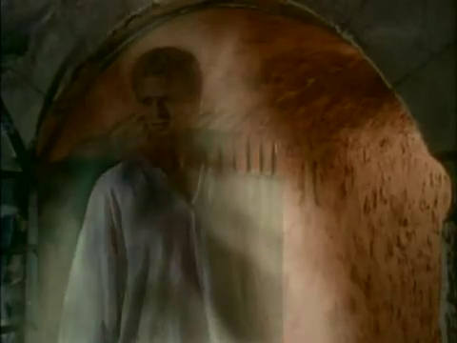
Acts 5:19-20
But at night an angel of
the Lord opened the
prison doors and
brought them out, and
said, “Go, stand in the
temple and speak to
the people all the
words of this life.”
The angel may have looked
something like this:
Acts 5:19-20
Comment

Slide 14
“Would you return to the Temple like the angel said? Why or why not?”

Slide 15
Acts 5:21
Here’s what they did.
And when they heard that, they entered the
temple early in the morning and taught. But
the high priest and those with him came and
called the council together, with all the elders of
the children of Israel, and sent to the prison to
have them brought.

Slide 16
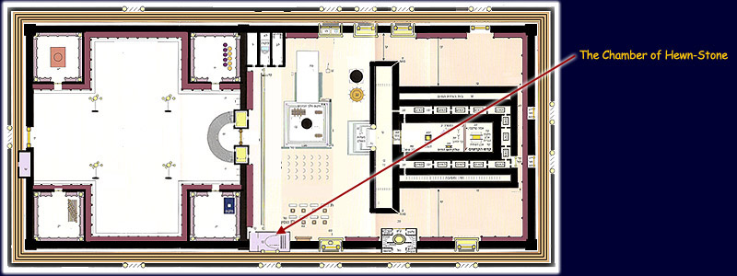
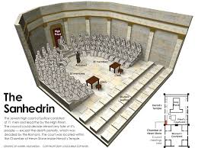
“Places, everyone”
The Sanhedrin met primarily in The Chamber of Hewn Stone near the altar in the Temple complex.

Slide 17
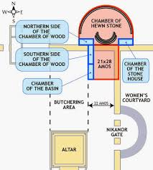
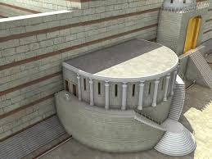
“Places, everyone”
The Sanhedrin met primarily in The Chamber of Hewn Stone near the altar in the Temple complex.

Slide 18
“Places, everyone”
The Sanhedrin met primarily in The Chamber of Hewn Stone near the altar in the Temple complex.
The Sanhedrin expected the apostles to still be detained in the local jail in the city.

Slide 19
“Places, everyone”
The Sanhedrin met primarily in The Chamber of Hewn Stone near the altar in the Temple complex.
The Sanhedrin expected the apostles to still be detained in the local jail in the city.
The apostles were actually back at Solomon’s Porch on the perimeter of the Temple complex.

Slide 20
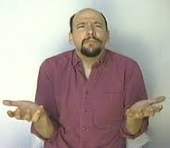
Acts 5:22-23
But when the officers came and did not find
them in the prison, they returned and reported,
saying, “Indeed we found the prison shut
securely, and the guards standing outside
before the doors; but when we opened
them, we found no one inside!”

Slide 21
Acts 5:24
-25
Now when the high priest, the captain of the temple, and the chief priests heard these things, they wondered what the outcome would be. So one came and told them, saying, "Look, the men whom you put in prison are standing in the temple and teaching the people!"

Slide 22
First, there was an empty tomb.
Now, there is an empty jail cell!
(Are we seeing a pattern here?)

Slide 23
If you were a member of the Sanhedrin…
What would you do?

Slide 24
Acts 5:26
Then the captain went with
the officers and brought them
without violence, for they feared the people, lest they should be stoned.

Slide 25
Question
What is suggested by “without violence,
for they feared the people, lest they
should be stoned”?

Slide 26
Question
If you were an apostle, would you
go with them? Yes or no?

Slide 27
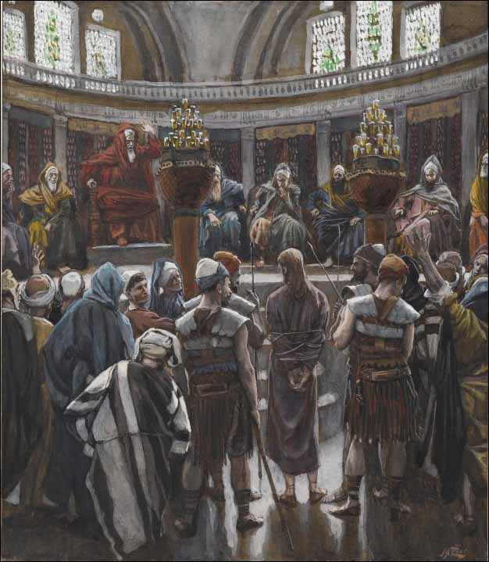
Acts 5:27
Here’s what they did.
And when they had brought them, they set them before the council. And the high priest asked them…

Slide 28
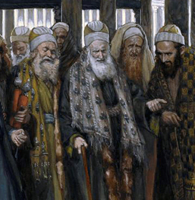
Acts 5:28
“Did we not strictly
command you not
to teach in this name? And look, you have
filled Jerusalem with your doctrine, and
intend to bring this man’s blood on us!”

Slide 29
Acts 5:28
The Charges
The Commentary
Acts 4:17, 21 – “Let us severely threaten them, that from now on they speak to no man in this name.”
Acts 4:16 – Jerusalem’s streets are full of people.
Matt.27:25 – “His blood be on us and on our children!”
“Did we not strictly command you not to teach in this name?”
“You have filled Jerusalem with your doctrine.”
“You intend to bring this man’s blood on us!”

Slide 30
Observation
They couldn’t bring themselves to say the name of “Jesus”:
“…not to teach in this name”
“…intend to bring this man’s blood on us!”

Slide 31
Acts 5:29-32
But Peter and the other apostles answered and said: “We ought to obey God rather than men. The God of our fathers raised up Jesus whom you murdered by hanging on a tree. Him God has exalted to his right hand to be Prince and Savior, to give repentance to Israel and forgiveness of sins. And we are his witnesses to these things, and so also is the Holy Spirit whom God has given to those who obey him.”

Slide 32
“Obey”
The Greek word is used only 4 times in the New Testament. Peter uses it twice here.
It means “to obey a ruler or a superior.”
Israel’s history had examples of their people obeying God and not a human authority:

Slide 33
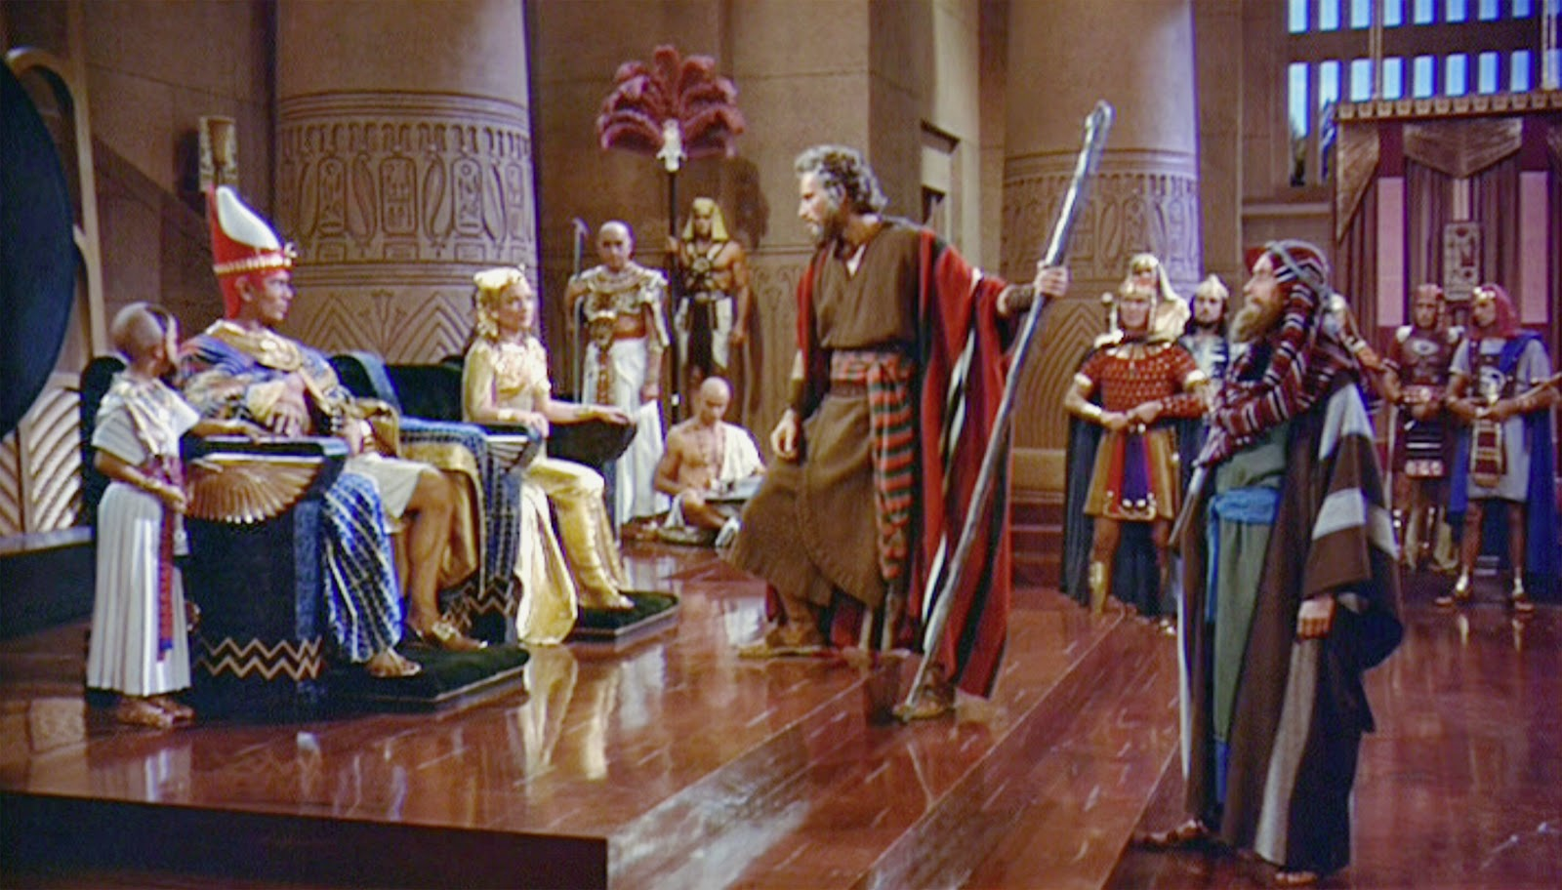
“Obey”
Moses/Israel disobeying Pharaoh

Slide 34
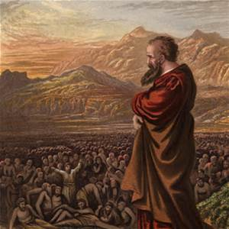
“Obey”
Moses/Israel disobeying Pharaoh
Jeremiah disobeying corrupt Jewish leaders

Slide 35
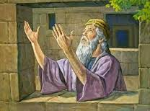
“Obey”
Moses/Israel disobeying Pharaoh
Jeremiah disobeying corrupt Jewish leaders
Daniel disobeying Nebuchadnezzar & Darius

Slide 36
Acts 5:33
When they heard this, they were furious and plotted to kill them.
“Furious” means to cut in half causing
extreme pain/torment/distress.

Slide 37
Acts 5:34
Then one in the council stood up, a Pharisee
named Gamaliel, a teacher of the law held in
respect by all the people, and commanded them
to put the apostles outside for a little while.
Who was Gamaliel?

Slide 38
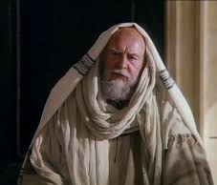
Gamaliel
Grandson of the great teacher Hillel the Elder
His name means “reward of God.”
Esteemed leader of the School of Hillel
His most famous student was the Apostle Paul (Acts 22:3).
When he died, the Mishnah* said, “Since Rabban Gamaliel the Elder died, there has been no more reverence for the law, and purity and piety died out at the same time.” *(Mishnah is the written Jewish oral tradition.)

Slide 39
Acts 5:35-36
And he said to them: “Men of Israel, take heed
to yourselves what you intend to do regarding
these men. For some time ago Theudas rose up,
claiming to be somebody. A number of men,
about four hundred, joined him. He was slain,
and all who obeyed him were scattered and
came to nothing…”

Slide 40
Acts 5:37-39
“…After this man, Judas of Galilee rose up in the
days of the census, and drew away many people
after him. He also perished, and all who obeyed him
were dispersed. And now I say to you, keep away
from these men and let them alone; for if this plan or
this work is of men, it will come to nothing; but if it is
of God, you cannot overthrow it—lest you even be
found to fight against God.”

Slide 41
Acts 5:40
And they agreed with him, and when they had
called for the apostles and beaten them, they
commanded that they should not speak in the
name of Jesus, and let them go.

Slide 42
Acts 5:40
And they agreed with him, and when they had
called for the apostles and beaten them, they
commanded that they should not speak in the
name of Jesus, and let them go.
Deut. 25:2-3 – “…then it shall be, if the wicked man deserves
to be beaten, that the judge will cause him to lie down and
be beaten in his presence…Forty blows he may give him…”

Slide 43
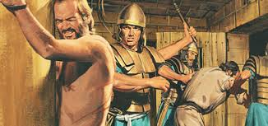
How many blows is that?
12 apostles x 39* blows = 468 blows!
*(39 blows because some could die from 40. They were not allowed to kill.)
To beat all 12, if each
blow took 3 seconds, this
took ~25 minutes. If
each blow took 5 seconds,
this took ~40 minutes.

Slide 44
Persecution Hot Spots Today
Northern Nigeria
Afghanistan
Yemen
Syria
Saudi Arabia
Pakistan
Egypt
North Korea

Slide 45
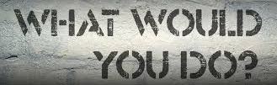
WWYD?
If you were one of the beaten
apostles, how would you feel?
What would you do?

Slide 46
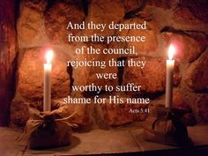
Acts 5:41-42
Here’s what they did.
So they departed from the presence of the council, rejoicing that they were counted worthy to suffer shame for his name. And daily in the temple, and in every house, they did not cease teaching and preaching Jesus as the Christ.

Slide 47
Acts 5:41-42
So they departed from the presence of the council, rejoicing that they were counted worthy to suffer shame for his name. And daily in the temple, and in every house, they did not cease teaching and preaching Jesus as the Christ.
In other words, to obey the Lord, they had to disobey their
national leaders because the leaders were wrong.

Slide 48
Acts 5:41-42
So they departed from the presence of the council, rejoicing that they were counted worthy to suffer shame for his name. And daily in the temple, and in every house, they did not cease teaching and preaching Jesus as the Christ.
1 Peter 4:13-14 – But rejoice to the extent that you partake of Christ’s sufferings, that when his glory is revealed, you may also be glad with exceeding joy. If you are reproached for the name of Christ, blessed are you, for the Spirit of glory and of God rests upon you.
Jesus: “Blessed are you when they revile and persecute you…Rejoice and be exceedingly glad…” Matt. 5:11-12.
Jesus: “In the world you will have tribulation; but be of good cheer, I have overcome the world.” John 16:33.

Slide 49
Remember:
When it’s bad here (on earth)
for Christ’s sake,
it’s better there (in heaven)
for our sake.

Slide 50
Remember:
When it’s bad here (on earth)
for Christ’s sake,
it’s better there (in heaven)
for our sake.
(We need the eyes of faith to ‘see’ and remember this!)

Slide 51
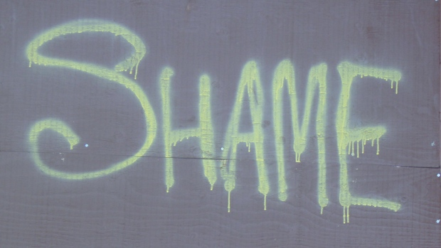
Acts 5:41-42
So they departed from the presence of the council, rejoicing that they were counted worthy to suffer shame for his name. And daily in the temple, and in every house, they did not cease teaching and preaching Jesus as the Christ.
Deut. 21:23 – “If a man has committed a sin deserving of death, and he is put to death, and you hang him on a tree, his body shall not remain overnight on the tree, but you shall surely bury him that day, so that you do not defile the land which the LORD your God is giving you as an inheritance; for he who is hanged is accursed of God.
Nothing was more shameful to a Jewish person than dying on a tree. Jews buried crucified people on the day of their death to prevent defiling the land. The apostles’ shame was not nearly as bad as Christ’s.

Slide 52
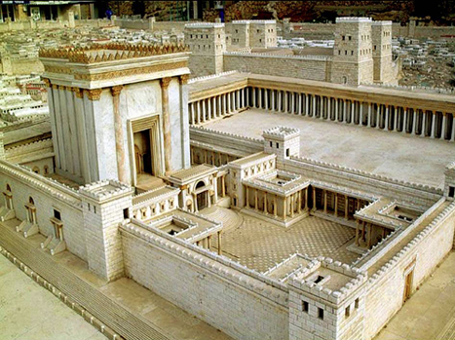
Acts 5:41-42
So they departed from the presence of the council, rejoicing that they were counted worthy to suffer shame for his name. And daily in the temple, and in every house, they did not cease teaching and preaching Jesus as the Christ.
The apostles did their preaching in the temple and their teaching in the houses of believers (“every house”).
A subtle shift begins at the end of
chapter 5. This is the last time the
temple in Jerusalem is the central
location for the activities of the
new church.

Slide 53
It doesn’t say, but…
If you were a person in the city, how would you feel about the apostles getting beating?
If you were part of the Sanhedrin, how would you
feel when you realized beating the apostles
did not stop or slow them down?

Slide 54
Push-back time!
Where do you see God working in the story?
What are your take home points?

