Slide 1
The Kingdom of God: Installment #3
Bill Perry

Slide 2
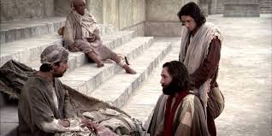
Review from last time
God healed a handicapped man miraculously through Peter and John in the Temple (the second installment). This healed man stood right next to them.

Slide 3
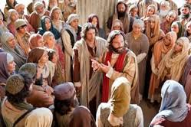
Review from last time
God healed a handicapped man miraculously through Peter and John in the Temple (the second installment). This healed man stood right next to them.
Peter gave a second spontaneous talk in Solomon’s Colonnade.

Slide 4
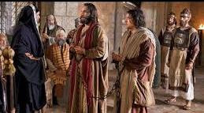
Review from last time
God healed a handicapped man miraculously through Peter and John in the Temple (the second installment). This healed man stood right next to them.
Peter gave a second spontaneous talk in Solomon’s Colonnade.
The Temple leaders detained them because their teaching of Jesus’ resurrection “greatly disturbed” them (Acts 4:2).

Slide 5
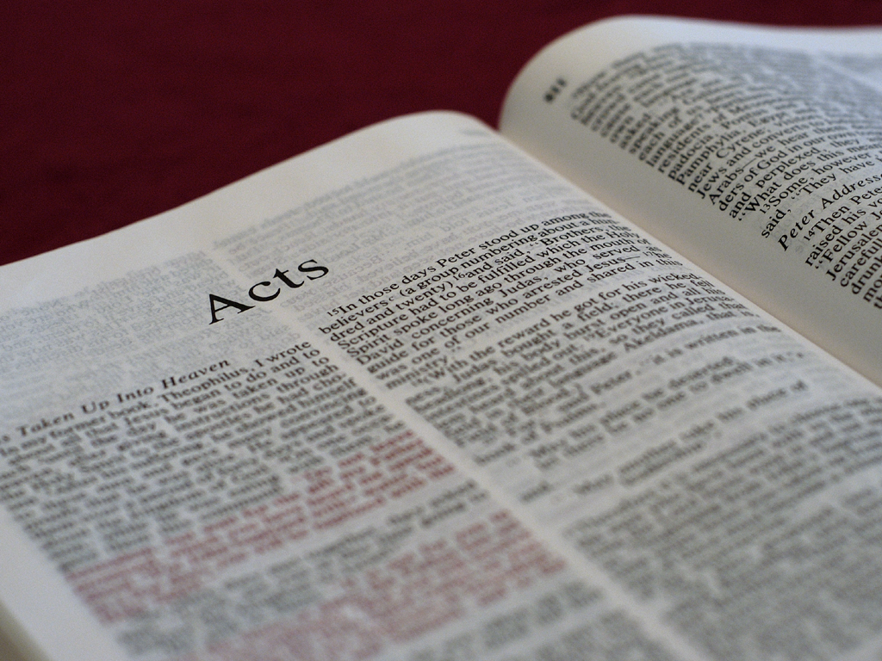
Acts 4:5-6
And it came to pass, on the next day, that their
rulers, elders, and scribes, as well as Annas the
high priest, Caiaphas, John, and Alexander, and
as many as were of the family of the high
priest, were gathered together at Jerusalem.

Slide 6
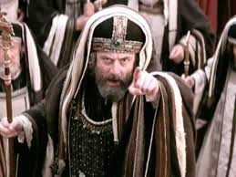
Who were these people?
Annas: High Priest 6-15AD (now HP Emeritus); father of 5 sons who became High Priest; father-in-law to Caiaphas, current High Priest; first to interview Jesus after his arrest (John 18:12-23)

Slide 7
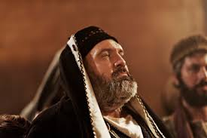
Who were these people?
Annas: High Priest 6-15AD (now HP Emeritus); father of 5 sons who became High Priest; father-in-law to Caiaphas, current High Priest; first to interview Jesus after his arrest (John 18:12-23)
Caiaphas: Current High Priest 17-36AD; son-in-law to Annas; condemned Jesus with Annas

Slide 8
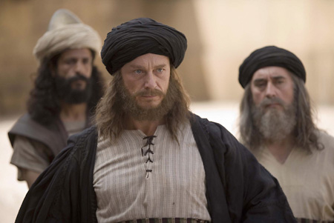
Who were these people?
John: could be Jonathan, son of Annas who replaced his brother-in-law Caiaphas in 36AD

Slide 9
Who were these people?
John: could be Jonathan, son of Annas who replaced his brother-in-law Caiaphas in 36AD
Alexander: no information available, but could be another son or relative of Annas, since the rest of verse 6 says, “and as many as were of the family of the high priest [Annas]…”

Slide 10
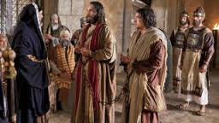
Acts 4:7
And when they had set them in the midst, they
asked, “By what power or by what name have
you done this?”

Slide 11
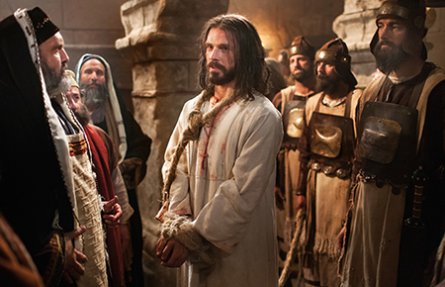
Acts 4:7
And when they had set them in the midst, they
asked, “By what power or by what name have
you done this?”
They were standing exactly where Jesus
stood when this same
group condemned him!

Slide 12
Acts 4:7
And when they had set them in the midst, they
asked, “By what power or by what name have
you done this?”
Acts 3:12, 16 – Or why look so intently at us, as
through our own power or godliness we had
made this man walk? … And his name, through
faith in his name, has made this man strong,
whom you see and know.
What they said:

Slide 13
Acts 4:8
Then Peter, filled with the Holy Spirit, said to
them, “Rulers of the people and elders of Israel…”

Slide 14
Acts 4:8
Jesus said:
Matt. 10:17-20 -- But beware of
men, for they will deliver
you up to councils and scourge
you in their synagogues.
You will be brought before
governors and kings for my
sake, as a testimony to them
and to the Gentiles. But
when they deliver you up, do
not worry about how or
what you should speak. For it
will be given to you in that
hour what you should speak;
for it is not you who speak,
but the Spirit of your Father
who speaks in you.
Then Peter, filled with the Holy Spirit, said to
them, “Rulers of the people and elders of Israel…”

Slide 15
Acts 4:9-10
“If we this day are judged for a good deed done
to a helpless man, by what means he has been
made well, let it be known to you all, and to all
the people of Israel, that by the name of Jesus
Christ of Nazareth, whom you crucified, whom
God raised from the dead, by him this man
stands here before you whole.”

Slide 16
A Consistent Message
“If we this day are judged for a
good deed done to a helpless
man, by what means he has
been made well, let it be
known to you all, and to all
the people of Israel, that by
the name of Jesus Christ of
Nazareth, whom you crucified,
whom God raised from the
dead, by him this man stands
here before you whole.”
“Jesus Christ of Nazareth” also used in 2:22 and 3:6.
“Name” used in 3:6 and 3:16.
“Crucified” used in 2:23 and 2:36.
“God raised from the dead” used in 2:24, 2:32 and 3:15.

Slide 17
A Consistent Message
“If we this day are judged for a
good deed done to a helpless
man, by what means he has
been made well, let it be
known to you all, and to all
the people of Israel, that by
the name of Jesus Christ of
Nazareth, whom you crucified,
whom God raised from the
dead, by him this man stands
here before you whole.”
“Jesus Christ of Nazareth” also used in 2:22 and 3:6.
“Name” used in 3:6 and 3:16.
“Crucified” used in 2:23 and 2:36.
“God raised from the dead” used in 2:24, 2:32 and 3:15.

Slide 18
A Consistent Message
“If we this day are judged for a
good deed done to a helpless
man, by what means he has
been made well, let it be
known to you all, and to all
the people of Israel, that by
the name of Jesus Christ of
Nazareth, whom you crucified,
whom God raised from the
dead, by him this man stands
here before you whole.”
“Jesus Christ of Nazareth” also used in 2:22 and 3:6.
“Name” used in 3:6 and 3:16.
“Crucified” used in 2:23 and 2:36.
“God raised from the dead” used in 2:24, 2:32 and 3:15.

Slide 19
A Consistent Message
“If we this day are judged for a
good deed done to a helpless
man, by what means he has
been made well, let it be
known to you all, and to all
the people of Israel, that by
the name of Jesus Christ of
Nazareth, whom you crucified,
whom God raised from the
dead, by him this man stands
here before you whole.”
“Jesus Christ of Nazareth” also used in 2:22 and 3:6.
“Name” used in 3:6 and 3:16.
“Crucified” used in 2:23 and 2:36.
“God raised from the dead” used in 2:24, 2:32 and 3:15.

Slide 20
Acts 4:11-12
“This is the ‘stone which was rejected by you
builders, which has become the chief
cornerstone.’ Nor is there salvation in any
other, for there is no other name
under heaven given among men
by which we must be saved.”

Slide 21
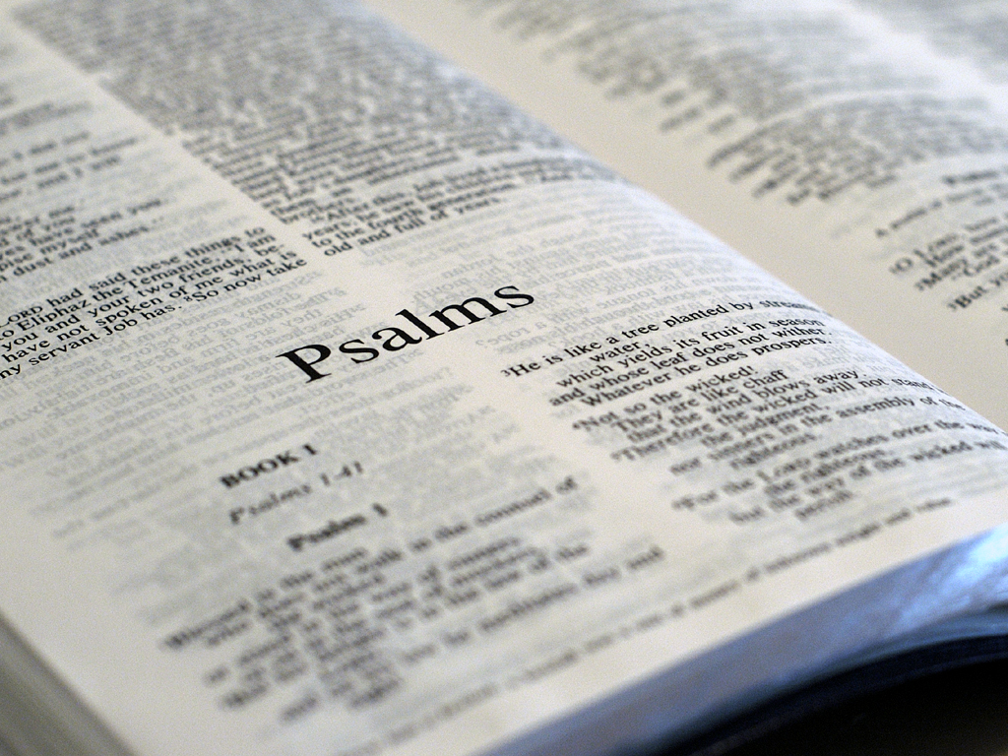
Psalm 118:22-26
The stone which the builders rejected
has become the chief cornerstone.
This was the LORD’s doing;
It is marvelous in our eyes.
This is the day the LORD has made;
we will rejoice and be glad in it.
Save now, I pray, O LORD;
O LORD, I pray, send now prosperity.
Blessed is he who comes in the name of the LORD!
Peter quoted this part of Psalm 118.

Slide 22
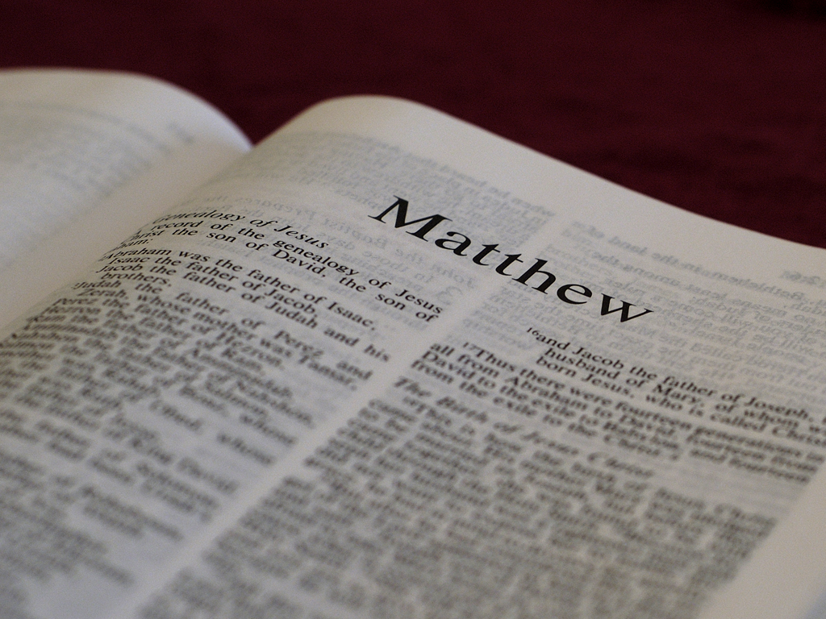
Matthew 21:42-45
Jesus said to them, “Have you never read in the Scriptures:
‘​The stone which the builders rejected
has become the chief cornerstone.
This was the LORD’s doing,
and it is marvelous in our eyes’ ?
“Therefore I say to you, the kingdom of God will be taken from you and given to a nation bearing the fruits of it. And whoever falls on this stone will be broken; but on whomever it falls, it will grind him to powder.” Now when the chief priests and the Pharisees heard his parables, they perceived that he was speaking of them.

Slide 23
Matthew 21:42-45
Jesus said to them, “Have you never read in the Scriptures:
‘​The stone which the builders rejected
has become the chief cornerstone.
This was the LORD’s doing,
and it is marvelous in our eyes’ ?
“Therefore I say to you, the kingdom of God will be taken from you and given to a nation bearing the fruits of it. And whoever falls on this stone will be broken; but on whomever it falls, it will grind him to powder.” Now when the chief priests and the Pharisees heard his parables, they perceived that he was speaking of them.
Jesus predicts his
coming kingdom
Won’t include
Jewish leaders!

Slide 24
Acts 4:11-12
“This is the ‘stone which was rejected by you
builders, which has become the chief
cornerstone.’ Nor is there salvation in any
other, for there is no other name
under heaven given among men
by which we must be saved.”
The healed man is proof of God’s saving power!

Slide 25
Acts 4:13-14
Now when they saw the boldness of Peter and
John, and perceived that they were uneducated
and untrained men, they marveled. And they
realized that they had been with Jesus. And
seeing the man who had been healed standing
with them, they could say nothing against it.

Slide 26
Acts 4:13-14
Now when they saw the
boldness of Peter and John,
and perceived that they were
uneducated and untrained
men, they marveled. And
they realized that they had
been with Jesus. And seeing
the man who had been
healed standing with them,
they could say nothing
against it.
“Uneducated” = not of letters/unschooled/illiterate. John 7:15, “And the Jews marveled saying, ‘How does this Man know letters having never studied?’”

Slide 27
Acts 4:13-14
Now when they saw the
boldness of Peter and John,
and perceived that they were
uneducated and untrained
men, they marveled. And
they realized that they had
been with Jesus. And seeing
the man who had been
healed standing with them,
they could say nothing
against it.
“Uneducated” = not of letters/unschooled/illiterate. John 7:15, “And the Jews marveled saying, ‘How does this Man know letters having never studied?’”
“Untrained” = private citizen, not public official; means ignorant; gives us the English word “idiot.”

Slide 28
Acts 4:13-14
Now when they saw the
boldness of Peter and John,
and perceived that they were
uneducated and untrained
men, they marveled. And
they realized that they had
been with Jesus. And seeing
the man who had been
healed standing with them,
they could say nothing
against it.
“Uneducated” = not of letters/unschooled/illiterate. John 7:15, “And the Jews marveled saying, ‘How does this Man know letters having never studied?’”
“Untrained” = private citizen, not public official; means ignorant; gives us the English word “idiot.”
“Realized” = a flash of recognition.

Slide 29
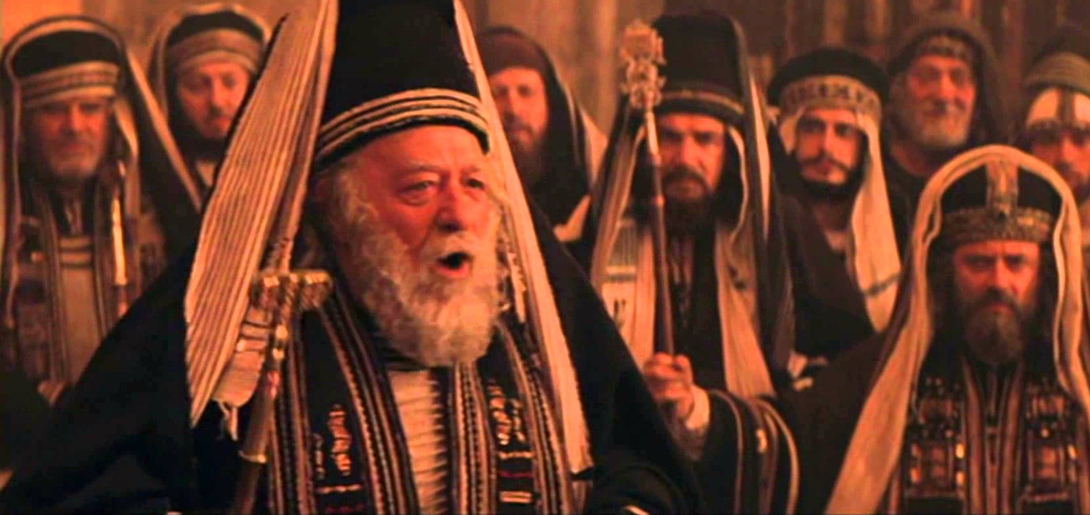
So these Jewish religious leaders knew that (1) Jesus said God’s kingdom would come without them, (2) Peter said a sign of that kingdom was the healed man standing before them, (3) Jesus’ followers were uneducated and untrained, (4) they had been with Jesus and (5) they had unexplainable courage.

Slide 30
What options do these
leaders have at this point?
What can they choose to do?

Slide 31
Acts 4:15-17
But when they had commanded them to go
aside out of the council, they conferred among
themselves, saying, “What shall we do to these
men? For, indeed, that a notable miracle has been
done through them is evident to all who dwell in
Jerusalem, and we cannot deny it. But so that it
spreads no further among the people, let us
severely threaten them, that from now on they
speak to no man in this name.”

Slide 32
Question:
Who did the leaders fail to question?

Slide 33
Answer:
Who did the leaders fail to question?
The healed man!

Slide 34
Question:
Why didn’t they question the healed man?

Slide 35
Answer:
Why didn’t they question the healed man?
His testimony could not be countered, thus destroying any basis to condemn Peter and John.

Slide 36
What about these?
Have Peter and John broken any of God’s laws?
Have they done anything immoral or unethical?
Have they made themselves dangerous to society?
Is there any ground to sanction them?

Slide 37
What about these?
Have Peter and John broken any of God’s laws?
Have they done anything immoral or unethical?
Have they made themselves dangerous to society?
Is there any ground to sanction them?
NO to all of the above!

Slide 38
Acts 4:18
So they called them and commanded
them not to speak at all nor teach in
the name of Jesus.

Slide 39
Where do we see today man
adding his laws to God’s laws
and/or replacing God’s laws
with man’s laws?

Slide 40
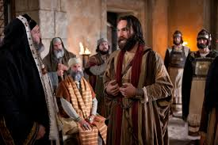
Acts 4:19-20
But Peter and John answered and said to them,
“Whether it is right in the sight of God to listen
to you more than to God, you judge. For we
cannot but speak the things which we
have seen
and heard.”

Slide 41
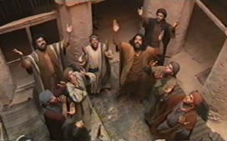
Acts 4:21-22
So when they had further threatened them, they
let them go, finding no way of punishing them,
because of the people, since they all glorified
God for what had been done. For the man was
over forty years old on
whom this miracle of
healing had been
performed.

Slide 42
Acts 4:23-24a
And being let go, they went to their own
companions and reported all that the chief
priests and elders had said to them. So when
they heard that, they raised their voice
to God with one accord and said:

Slide 43
Acts 4:23-24a
And being let go, they went to their own
companions and reported all that the chief
priests and elders had said to them. So when
they heard that, they raised their voice
to God with one accord and said:
(3rd Kingdom Installment –
God’s authority reigns
over man’s authority)

Slide 44
Acts 4:24b-26
“Lord, you are God, who made heaven and earth
and the sea, and all that is in them, who by the
mouth of your servant David have said:
​‘​Why did the nations rage,
​​and the people plot vain things?
The kings of the earth took their stand,
​​and the rulers were gathered together
​​against the LORD and against his Christ.’

Slide 45
Acts 4:24b-26
“Lord, you are God, who made heaven and earth
and the sea, and all that is in them, who by the
mouth of your servant David have said:
​‘​Why did the nations rage,
​​and the people plot vain things?
The kings of the earth took their stand,
​​and the rulers were gathered together
​​against the LORD and against his Christ.’
This is from the second psalm.

Slide 46
Why did they pray Psalm 2?
Acts 4:26 (Psalm 2)
Acts 4:27 (answer)
‘​Why did the nations rage,
and the people plot vain
things? The kings of the earth
took their stand, and the rulers
were gathered together
against the LORD and against
his Christ.’
“For truly against your holy
Servant Jesus, whom You
anointed, both Herod and
Pontius Pilate, with the
Gentiles and the people of
Israel, were gathered
together…”

Slide 47
Why did they pray Psalm 2?
Acts 4:26 (Psalm 2)
Acts 4:27 (answer)
‘​Why did the nations rage,
and the people plot vain
things? The kings of the earth
took their stand, and the rulers
were gathered together
against the LORD and against
his Christ.’
“For truly against your holy
Servant Jesus, whom You
anointed, both Herod and
Pontius Pilate, with the
Gentiles and the people of
Israel, were gathered
together…”

Slide 48
Why did they pray Psalm 2?
Acts 4:26 (Psalm 2)
Acts 4:27 (answer)
‘​Why did the nations rage,
and the people plot vain
things? The kings of the earth
took their stand, and the rulers
were gathered together
against the LORD and against
his Christ.’
“For truly against your holy
Servant Jesus, whom You
anointed, both Herod and
Pontius Pilate, with the
Gentiles and the people of
Israel, were gathered
together…”

Slide 49
Why did they pray Psalm 2?
Acts 4:26 (Psalm 2)
Acts 4:27 (answer)
‘​Why did the nations rage,
and the people plot vain
things? The kings of the earth
took their stand, and the rulers
were gathered together
against the LORD and against
his Christ.’
“For truly against your holy
Servant Jesus, whom You
anointed, both Herod and
Pontius Pilate, with the
Gentiles and the people of
Israel, were gathered
together…”
Mark 6:14, “King Herod”

Slide 50
Why did they pray Psalm 2?
Acts 4:26 (Psalm 2)
Acts 4:27 (answer)
‘​Why did the nations rage,
and the people plot vain
things? The kings of the earth
took their stand, and the rulers
were gathered together
against the LORD and against
his Christ.’
“For truly against your holy
Servant Jesus, whom You
anointed, both Herod and
Pontius Pilate, with the
Gentiles and the people of
Israel, were gathered
together…”

Slide 51
Acts 4:28
“…to do whatever your hand and your purpose
determined before to be done.”

Slide 52
Acts 4:28
“…to do whatever your hand and your purpose
determined before to be done.”
God’s sovereign purpose/will (to glorify himself,
to have Jesus’ death to pay for mankind’s sins,
etc.) were carried out according to prior decree.

Slide 53
Acts 4:29-30
Now, Lord, look on their threats, and grant to
your servants that with all boldness they may
speak your word, by stretching out your hand to
heal, and that signs and wonders may be done
through the name of your holy Servant Jesus.”

Slide 54
Acts 4:29-30
Now, Lord, look on their threats, and grant to
your servants that with all boldness they may
speak your word, by stretching out your hand to
heal, and that signs and wonders may be done
through the name of your holy Servant Jesus.”
What do they pray for?

Slide 55
Acts 4:29-30
Now, Lord, look on their threats, and grant to
your servants that with all boldness they may
speak your word, by stretching out your hand to
heal, and that signs and wonders may be done
through the name of your holy Servant Jesus.”
What don’t they pray for that
we often pray for?

Slide 56
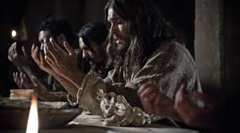
Acts 4:31
And when they had prayed, the place where
they were assembled together was shaken;
and they were all filled with the Holy Spirit,
and they spoke the word of God with boldness.

Slide 57
Where do you see God
working in this story?
What are your
take home points?

