Slide 1
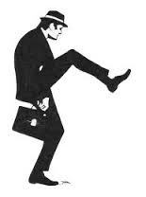
The Kingdom of God: Sin Steps In
Bill Perry

Slide 2
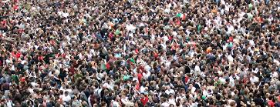
The Kingdom in Installments
Three installments so far:
The Holy Spirit came on Pentecost and 3,000 people trusted Jesus for salvation

Slide 3
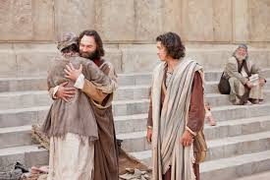
The Kingdom in Installments
Three installments so far:
The Holy Spirit came on Pentecost and 3,000 people trusted Jesus for salvation
The handicapped man by the Beautiful Gate was dramatically healed

Slide 4
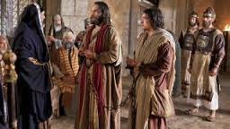
The Kingdom in Installments
Three installments so far:
The Holy Spirit came on Pentecost and 3,000 people trusted Jesus for salvation
The handicapped man by the Beautiful Gate was dramatically healed
God overrules human authority (Peter and John freed after a hearing by the Sanhedrin)

Slide 5
“Back at the ranch…” (Acts 4:29-31)
“Now, Lord, look on their threats, and grant to your
servants that with all boldness they may speak
your word, by stretching out your hand to heal,
and that signs and wonders may be done
through the name of your holy Servant Jesus.”
And when they had prayed, the place where
they were assembled together was shaken;
and they were all filled with the Holy Spirit,
and they spoke the word of God with boldness.

Slide 6
What they’re praying for
“Now, Lord, look on their threats, and grant to your
servants that with all boldness they may speak
your word, by stretching out your hand to heal,
and that signs and wonders may be done
through the name of your holy Servant Jesus.”
And when they had prayed, the place where
they were assembled together was shaken;
and they were all filled with the Holy Spirit,
and they spoke the word of God with boldness.

Slide 7
One thing they did not pray for:

Slide 8
One thing they did not pray for:
The Kingdom
to be restored
to Israel (1:6)!
[They’re finally getting it!]

Slide 9
Acts 4:32-35
Now the multitude of those who believed were of one heart and one soul; neither did anyone say that any of the things he possessed was his own, but they had all things in common. And with great power the apostles gave witness to the resurrection of the Lord Jesus. And great grace was upon them all. Nor was there anyone among them who lacked; for all who were possessors of lands or houses sold them, and brought the proceeds of the things that were sold, and laid them at the apostles’ feet; and they distributed to each as anyone had need.

Slide 10
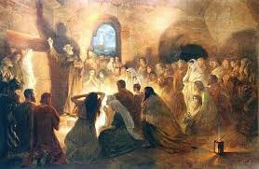
Acts 4:33
And with great power the apostles gave
witness to the resurrection of the
Lord Jesus. And great grace
was upon them all.

Slide 11
Acts 4:33
And with great power the apostles gave
witness to the resurrection of the
Lord Jesus. And great grace
was upon them all.
Witness gives us the English word “martyr.”
The apostles gave up their own lives for the
King and his Kingdom.

Slide 12
Acts 4:33
And with great power the apostles gave
witness to the resurrection of the
Lord Jesus. And great grace
was upon them all.
The “witness” they gave was for
the whole nation of Israel.

Slide 13
Acts 4:33
And with great power the apostles gave
witness to the resurrection of the
Lord Jesus. And great grace
was upon them all.
“You shall receive power…” – Acts 1:8

Slide 14
Acts 4:33
And with great power the apostles gave
witness to the resurrection of the
Lord Jesus. And great grace
was upon them all.
Great (megas, Grk) power
led to great (megas) grace!

Slide 15
Acts 4:33
And with great power the apostles gave
witness to the resurrection of the
Lord Jesus. And great grace
was upon them all.
This is the only time in the whole
Bible that “great grace” is used.

Slide 16
Acts 4:32, 34-35
Now the multitude of those who believed were of one heart and one soul; neither did anyone say that any of the things he possessed was his own, but they had all things in common… Nor was there anyone among them who lacked; for all who were possessors of lands or houses sold them, and brought the proceeds of the things that were sold, and laid them at the apostles’ feet; and they distributed to each as anyone had need.

Slide 17
Acts 4:32, 34-35
Now the multitude of those who believed were of one heart and one soul; neither did anyone say that any of the things he possessed was his own, but they had all things in common… Nor was there anyone among them who lacked; for all who were possessors of lands or houses sold them, and brought the proceeds of the things that were sold, and laid them at the apostles’ feet; and they distributed to each as anyone had need.
Is this communism?

Slide 18
“Communism” from Dictionary.com
1. a theory or system of social organization based on the holding of all property in common, actual ownership being ascribed to the community as a whole or to the state.
2. (often initial capital letter) a system of social organization in which all economic and social activity is controlled by a totalitarian state dominated by a single and self-perpetuating political party.

Slide 19
Let’s Ask
Acts 4:32, 34-35
Question #1
Now the multitude of those who believed were of one heart and one soul; neither did anyone say that any of the things he possessed was his own, but they had all things in common… Nor was there anyone among them who lacked; for all who were possessors of lands or houses sold them, and brought the proceeds of the things that were sold, and laid them at the apostles’ feet; and they distributed to each as anyone had need.
Who did the possessions
belong to?

Slide 20
Let’s Ask
Acts 4:32, 34-35
Question #2
Now the multitude of those who believed were of one heart and one soul; neither did anyone say that any of the things he possessed was his own, but they had all things in common… Nor was there anyone among them who lacked; for all who were possessors of lands or houses sold them, and brought the proceeds of the things that were sold, and laid them at the apostles’ feet; and they distributed to each as anyone had need.
Who still controlled the
possessions?

Slide 21
Let’s Ask
Acts 4:32, 34-35
Question #3
Now the multitude of those who believed were of one heart and one soul; neither did anyone say that any of the things he possessed was his own, but they had all things in common… Nor was there anyone among them who lacked; for all who were possessors of lands or houses sold them, and brought the proceeds of the things that were sold, and laid them at the apostles’ feet; and they distributed to each as anyone had need.
Did the government
receive the money?

Slide 22
Let’s Ask
Acts 4:32, 34-35
Question #4
Now the multitude of those who believed were of one heart and one soul; neither did anyone say that any of the things he possessed was his own, but they had all things in common… Nor was there anyone among them who lacked; for all who were possessors of lands or houses sold them, and brought the proceeds of the things that were sold, and laid them at the apostles’ feet; and they distributed to each as anyone had need.
So does this promote or teach communism?

Slide 23
Let’s Ask
Acts 4:32, 34-35
Question #4
Now the multitude of those who believed were of one heart and one soul; neither did anyone say that any of the things he possessed was his own, but they had all things in common… Nor was there anyone among them who lacked; for all who were possessors of lands or houses sold them, and brought the proceeds of the things that were sold, and laid them at the apostles’ feet; and they distributed to each as anyone had need.
So does this promote or teach communism?

Slide 24
Acts 4:32, 34-35
Now the multitude of those who believed were of one heart and one soul; neither did anyone say that any of the things he possessed was his own, but they had all things in common… Nor was there anyone among them who lacked; for all who were possessors of lands or houses sold them, and brought the proceeds of the things that were sold, and laid them at the apostles’ feet; and they distributed to each as anyone had need.

Slide 25
Observe
Acts 4:32, 34-35
Point
Now the multitude of those who believed were of one heart and one soul; neither did anyone say that any of the things he possessed was his own, but they had all things in common… Nor was there anyone among them who lacked; for all who were possessors of lands or houses sold them, and brought the proceeds of the things that were sold, and laid them at the apostles’ feet; and they distributed to each as anyone had need.
This is the last time we read “had all things in common.” Never anywhere outside of the Jerusalem church do we see any other church “having all things in common.”

Slide 26
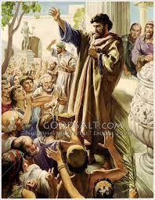
Acts 4:36-37
And Joses, who was also named Barnabas by
the apostles (which is translated Son of
Encouragement), a Levite of the country of
Cyprus, having land, sold it, and brought the
money and laid it at the apostles’ feet.

Slide 27
Barnabas
Acts 4:36-37
Points
And Joses, who was also
named Barnabas by the
apostles (which is translated
Son of Encouragement), a
Levite of the country of
Cyprus, having land, sold it,
and brought the ,money and
laid it at the apostles’ feet.
Barnabas was Cousin of
John Mark (Colossians
4:10) and had relatives
living in Jerusalem
(Acts 12:12).

Slide 28
Acts 5:1-2
But a certain man named Ananias, with Sapphira
his wife, sold a possession. And he kept back
part of the proceeds, his wife also being aware
of it, and brought a certain part and laid it
at the apostles’ feet.

Slide 29
Ananias and Sapphira
Acts 5:1-2
Points
But a certain man named
Ananias, with Sapphira
his wife, sold a possession.
And he kept back
part of the proceeds, his wife
also being aware of it, and
brought a certain part and laid
it at the apostles’ feet.
“Aware” = knowingly
‘with’ the idea

Slide 30
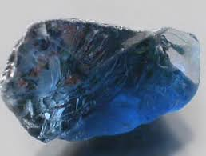
Ananias and Sapphira
Acts 5:1-2
Points
But a certain man named
Ananias, with Sapphira
his wife, sold a possession.
And he kept back
part of the proceeds, his wife
also being aware of it, and
brought a certain part and laid
it at the apostles’ feet.
“Sapphira” means blue
corundum.

Slide 31
Acts 5:3-4
But Peter said, “Ananias, why has Satan filled
your heart to lie to the Holy Spirit and keep
back part of the price of the land for yourself?
While it remained, was it not your own? And
after it was sold, was it not in your own control?
Why have you conceived this thing in your
heart? You have not lied to men but to God.”

Slide 32
Not Communism!
But Peter said, “Ananias, why has Satan filled
your heart to lie to the Holy Spirit and keep
back part of the price of the land for yourself?
While it remained, was it not your own? And
after it was sold, was it not in your own control?
Why have you conceived this thing in your
heart? You have not lied to men but to God.”

Slide 33
Compare
Acts 5:3-4
Point
But Peter said, “Ananias, why
has Satan filled your heart to lie
to the Holy Spirit and keep back
part of the price of the land for
yourself? While it remained,
was it not your own? And after
it was sold, was it not in your
own control? Why have you
conceived this thing in your
heart? You have not lied to men
but to God.”
“Keep back” = divide
something devoted to
someone/something else
for yourself.

Slide 34
Analyzing Sin Stepping In
Acts 5:3-4
James 1:14-15
But Peter said, “Ananias, why
has Satan filled your heart to lie
to the Holy Spirit and keep back
part of the price of the land for
yourself? While it remained,
was it not your own? And after
it was sold, was it not in your
own control? Why have you
conceived this thing in your
heart? You have not lied to men
but to God.”
But each one is tempted when
he is drawn away by his own
desires and enticed. Then,
when desire has conceived, it
gives birth to sin; and sin,
when it is full-grown [i.e.,
shows up in behavior], brings
forth death.

Slide 35
The downward progression
Everyone (including Ananias & Sapphira) said their possessions were “in common” (4:32).

Slide 36
The downward progression
Everyone (including Ananias & Sapphira) said their possessions were “in common” (4:32).
Ananais & Sapphira saw or heard about Barnabas’ contribution to the church and the esteem he received (Son of Encouragement).

Slide 37
The downward progression
Everyone (including Ananias & Sapphira) said their possessions were “in common” (4:32).
Ananais & Sapphira saw or heard about Barnabas’ contribution to the church and the esteem he received (Son of Encouragement).
Ananais wanted a similar kind of recognition.

Slide 38
The downward progression
Everyone (including Ananias & Sapphira) said their possessions were “in common” (4:32).
Ananais & Sapphira saw or heard about Barnabas’ contribution to the church and the esteem he received (Son of Encouragement).
Ananais wanted a similar kind of recognition.
He sold his possession and secretly kept a part that was “devoted to” God, but said the money he gave was the whole selling price.

Slide 39
Ironic!!
Ananias’ name means:
“whom Yahweh has
graciously given”!

Slide 40
Ironic!!
Ananias’ name means:
“whom Yahweh has
graciously given”!
So while God had graciously given Ananias wealth and riches, he had selfishly withheld some of the proceeds from God’s work while claiming he had given everything from the sale of the property like Barnabas had.

Slide 41
Acts 5:3-4
But Peter said, “Ananias, why has Satan filled
your heart to lie to the Holy Spirit and keep
back part of the price of the land for yourself?
While it remained, was it not your own? And
after it was sold, was it not in your own control?
Why have you conceived this thing in your
heart? You have not lied to men but to God.”

Slide 42
Who did Ananias lie to?
God (the Holy Spirit)

Slide 43
Who did Ananias lie to?
God (the Holy Spirit)
Men (but this was secondary to lying to God)

Slide 44
Who did Ananias lie to?
God (the Holy Spirit)
Men (but this was secondary to lying to God)
Himself (remember what his name means)

Slide 45
Acts 5:3-4
But Peter said, “Ananias, why has Satan filled
your heart to lie to the Holy Spirit and keep
back part of the price of the land for yourself?
While it remained, was it not your own? And
after it was sold, was it not in your own control?
Why have you conceived this thing in your
heart? You have not lied to men but to God.”

Slide 46
How did Peter know it was Satan?

Slide 47
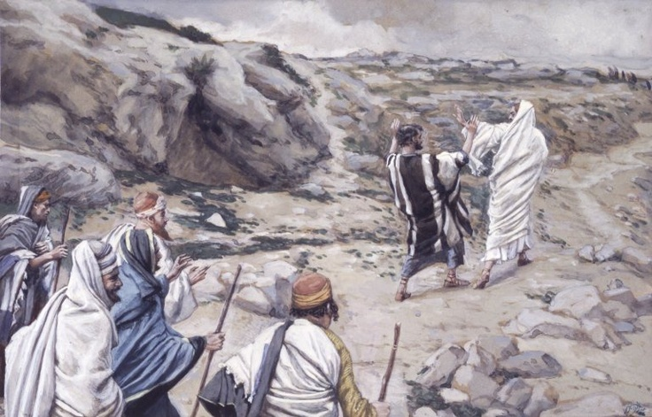
How did Peter know it was Satan?
Matthew 16:23 –
But [Jesus] turned and said to Peter, “Get behind
me, Satan! You are an offense to me, for you are
not mindful of the things of God, but the things
of men.”

Slide 48
Can Satan access our hearts?
Acts 5:3-4
Ephesians 4:27
But Peter said, “Ananias, why has
Satan filled your heart to lie to
The Holy Spirit and keep back
part of The price of the land for
yourself? While it remained, was
it not your own? And after it was
sold, was it not in your own
control? Why have You conceived
this thing in your heart? You have
not lied to men but to God.”
[Do not] give place to the
devil.
John 8:44
[Satan] is a liar and the father
of [lies/lying].
Ephesians 5:18
Be [being] filled with the Holy
Spirit.

Slide 49
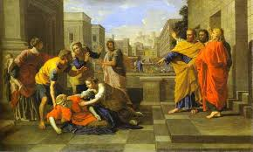
Acts 5:5-6
Then Ananias, hearing these words, fell down
and breathed his last. So great fear came upon
all those who heard these things. And the
young men arose and wrapped him up,
carried him out, and buried him.

Slide 50
Acts 5:5-6
Then Ananias, hearing these words, fell down
and breathed his last. So great fear came upon
all those who heard these things. And the
young men arose and wrapped him up,
carried him out, and buried him.
No morgue, no coroner’s report, no funeral!

Slide 51
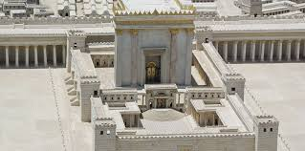
1 Corinthians 3:17
If anyone defiles the temple of God, God will
destroy him. For the temple of God is holy,
which temple you are.

Slide 52
Acts 5:7-8
Now it was about three hours later when his
wife came in, not knowing what had happened.
And Peter answered her, “Tell me whether you
sold the land for so much?” She said,
“Yes, for so much.”

Slide 53
Acts 5:7-8
Now it was about three hours later when his
wife came in, not knowing what had happened.
And Peter answered her, “Tell me whether you
sold the land for so much?” She said,
“Yes, for so much.”
Peter’s questioning simply followed
what Ananias planned to do.

Slide 54
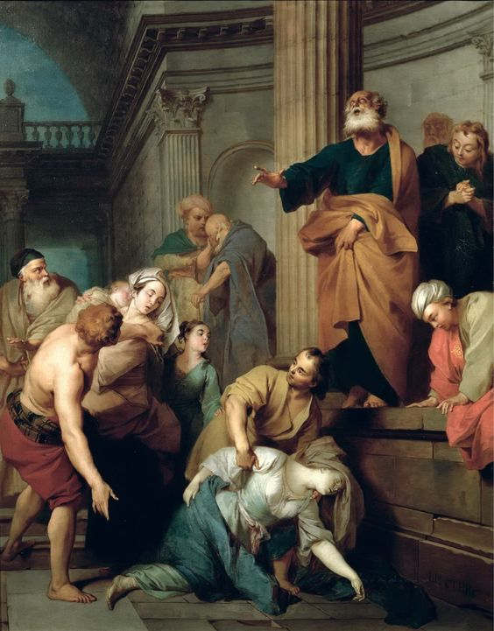
Acts 5:9-11
Then Peter said to her, “How is it that you have agreed together to test the Spirit of the Lord? Look, the feet of those who have buried your husband are at the door, and they will carry you out.” Then immediately she fell down at his feet and breathed her last. And the young men came in and found her dead, and carrying her out, buried her by her husband. So great fear came upon all the church and upon all who heard these things.

Slide 55
Ananias’ death
was an incident.
Sapphira’s death
made it a pattern!

Slide 56
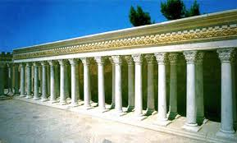
Acts 5:12-14
And through the hands of the apostles many
signs and wonders were done among the
people. And they were all with one accord in
Solomon’s Porch. Yet none of the rest dared join
them, but the people esteemed them highly.
And believers were increasingly added to the
Lord, multitudes of both men and women…

Slide 57
Acts 5:15-16
…so that they brought the sick out into the
streets and laid them on beds and couches, that
at least the shadow of Peter passing by might
fall on some of them. Also a multitude
gathered from the surrounding cities to
Jerusalem, bringing sick people and those who
were tormented by unclean spirits, and they
were all healed.

Slide 58
Compare
Acts 5:15-16 (Peter)
Matthew 4:24 (Jesus)
…so that they brought the sick out into the streets and laid them on beds and couches, that at least the shadow of Peter passing by might fall on some of them. Also a multitude gathered from the surrounding cities to Jerusalem, bringing sick people and those who were tormented by unclean spirits, and they were all healed.
…[A]nd they brought to him all sick people who were afflicted with various diseases and torments, and those who were demon- possessed, epileptics, and paralytics; and he healed them.

Slide 59
John 14:12
“Most assuredly, I say to you, he who believes in
me, the works that I do he will do also; and
greater works than these he will do,
because I go to my Father.”

Slide 60
God’s Kingdom people are to be
channels of God’s Kingdom power
from the King as a witness to
outsiders in the community.

Slide 61
Where do you see God working
in this story?
What are your take home points?

