Slide 1
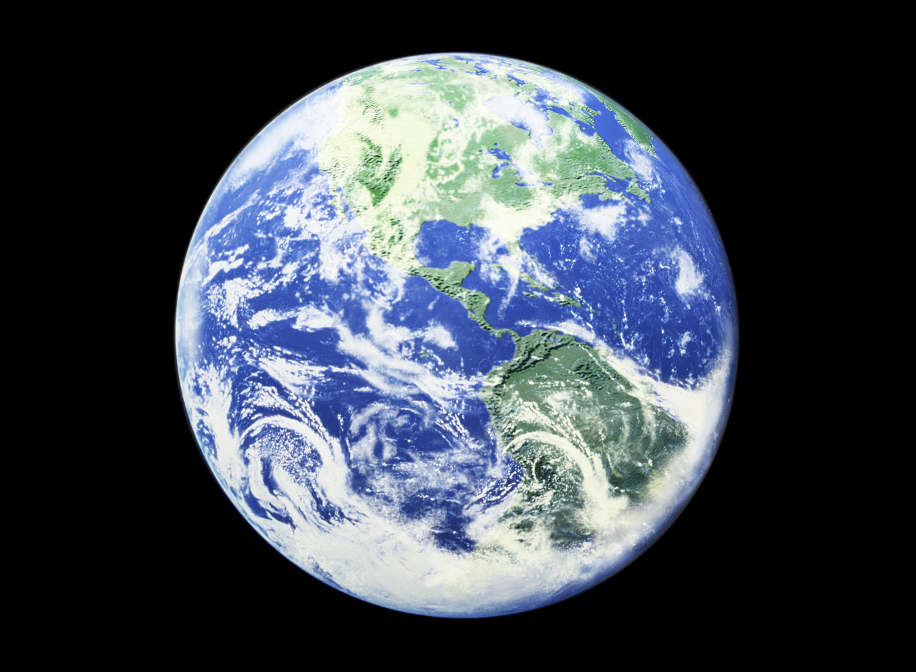
The Kingdom of God: The Church – Exhibit A
Bill Perry

Slide 2
Peter had just spoken the first Christian sermon in history.
In it he recounted the life, death and resurrection of Jesus, which proved he was their long anticipated Messiah and Lord.
He pointedly told them they had killed him and must repent to receive the Holy Spirit who was the primary evidence of God’s Kingdom on earth.
Review

Slide 3
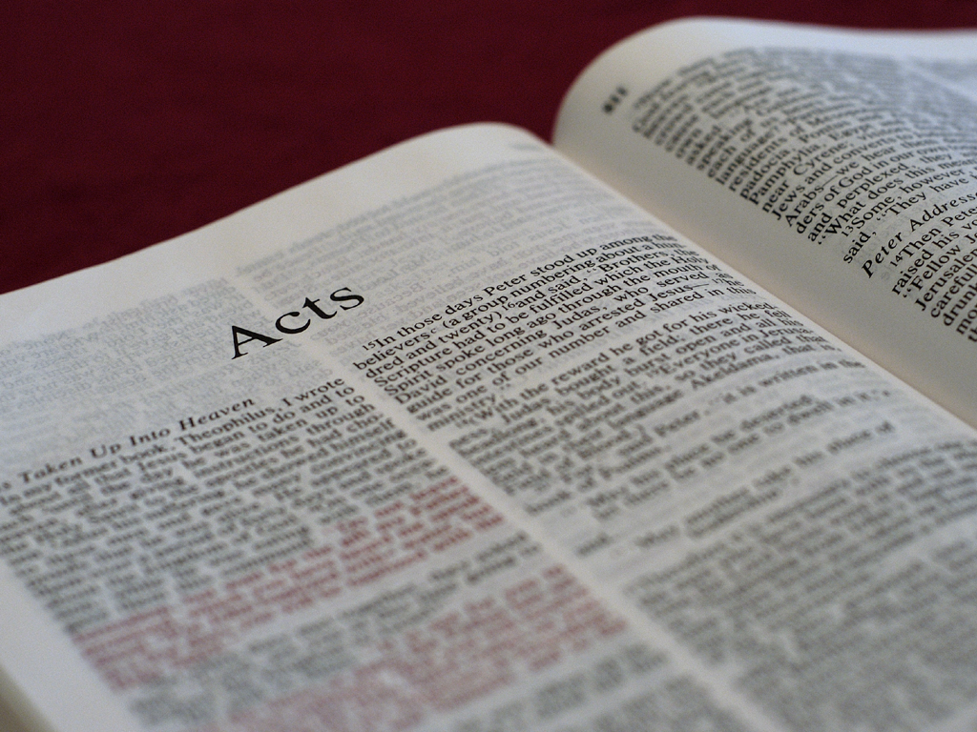
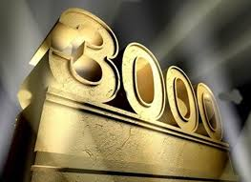
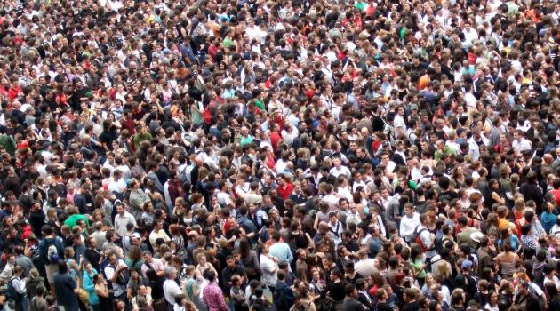
Acts 2:41b
“And that day about three thousand souls
were added to them.”

Slide 4
Acts 2:41b
“And that day about three thousand souls
were added to them.”
Is this number an exaggeration?

Slide 5
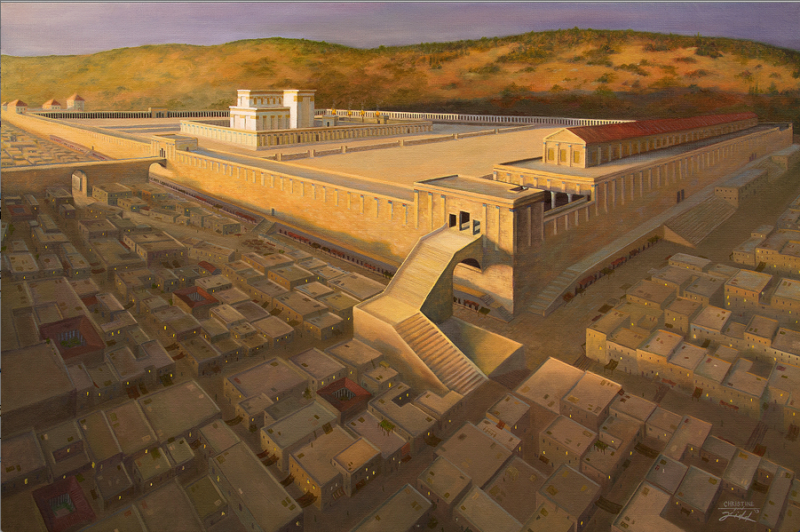
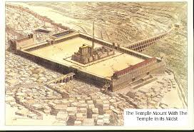
Views of Herod’s Temple
The Court of the Gentiles/Nations could hold up to 200,000 people.

Slide 6
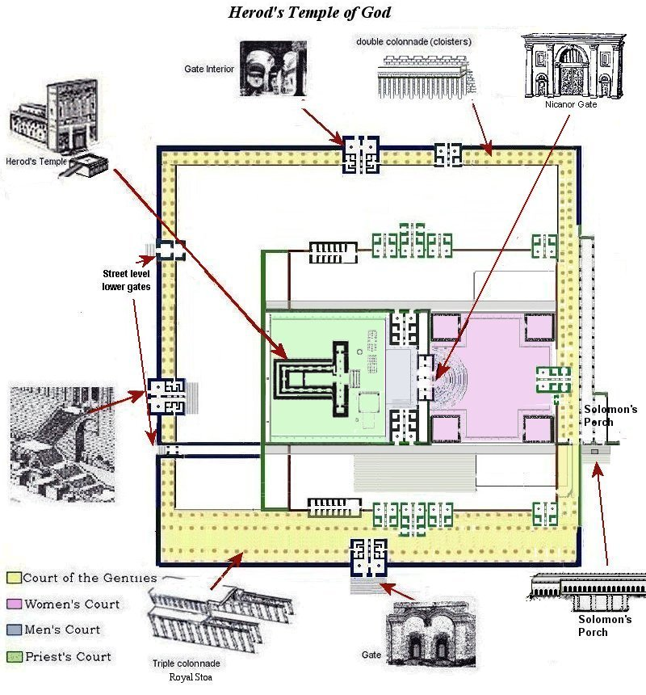
Bird’s Eye View
The Court of the Gentiles/Nations could hold up to 200,000 people.

Slide 7
N
3,000 ÷ 200,000 = 1.5% of the group.

Slide 8
N
Therefore, 3,000 is not an exaggeration.

Slide 9
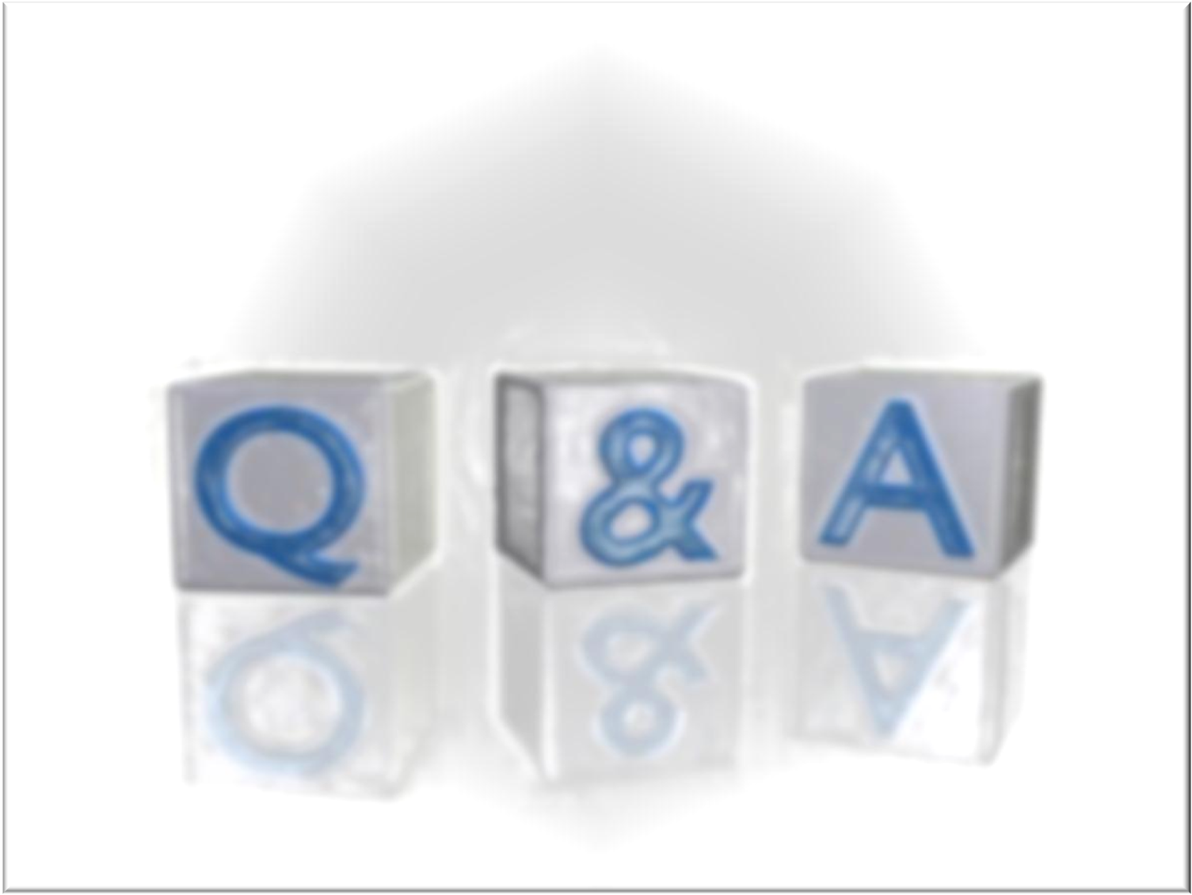
Q: What about baptizing 3,000 people?

Slide 10
Q: What about baptizing 3,000 people?
A1: Archaeologists have uncovered many
large mikvehs (baptismal structures)
along the south side of the Temple.
They would have been adequate for
baptizing this many people.

Slide 11
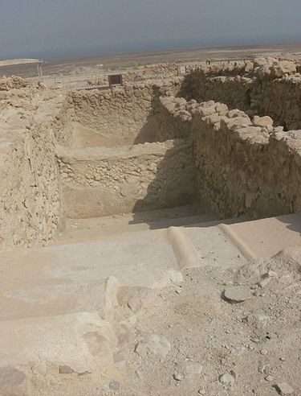
Ancient Mikvehs
Excavated in Q umran on the West Bank of the Dead Sea in Israel.
In Speyer, Rhineland-Palatinate, Germany dating back to 1128.

Slide 12
Q: What about baptizing 3,000 people?
A2: If each of the 12 Apostles had
baptized 250 new believers
simultaneously, that would
equal 3,000 baptisms.

Slide 13
Q: What about baptizing 3,000 people?
A3: If each baptism took 1 minute to
perform, it would take ~4 hours. If
each baptism took 30 seconds, it
would take ~2 hours.

Slide 14
Acts 2:42-45
And they continued steadfastly in the apostles’
doctrine and fellowship, in the breaking of
bread, and in prayers. Then fear came upon
every soul, and many wonders and signs were
done through the apostles. Now all who
believed were together, and had all things in
common, and sold their possessions and goods,
and divided them among all, as anyone had need.

Slide 15
EARLY Evidences of God’s Kingdom
Acts 2:42-44
Comment
And they continued steadfastly in the
apostles’ doctrine and fellowship, in
the breaking of bread, and in prayers.
Then fear came upon every soul, and
many wonders and signs were done
through the apostles. Now all who
believed were together, and had all
things in common, and sold their
possessions and goods, and divided
them among all, as anyone had need.
Outline of the purpose of the church
Backed up by God’s power
Resulted in unity, harmony and obedience

Slide 16
EARLY Evidences of God’s Kingdom
Acts 2:42-44
Comment
And they continued steadfastly in the
apostles’ doctrine and fellowship, in
the breaking of bread, and in prayers.
Then fear came upon every soul, and
many wonders and signs were done
through the apostles. Now all who
believed were together, and had all
things in common, and sold their
possessions and goods, and divided
them among all, as anyone had need.
Outline of the purpose of the church
Backed up by God’s power
Resulted in unity, harmony and obedience

Slide 17
EARLY Evidences of God’s Kingdom
Acts 2:42-44
Comment
And they continued steadfastly in the
apostles’ doctrine and fellowship, in
the breaking of bread, and in prayers.
Then fear came upon every soul, and
many wonders and signs were done
through the apostles. Now all who
believed were together, and had all
things in common, and sold their
possessions and goods, and divided
them among all, as anyone had need.
Outline of the purpose of the church
Backed up by God’s power
Resulted in unity, harmony and obedience

Slide 18
Lauderdale Community Church
Bylaws
Article 3, Section 1,
Part B:
“Four necessary components
to corporately achieve
edification are teaching,
fellowship, worship and
prayer. In utilizing these
components, the local church
will make disciples of those
who have already trusted
Christ through our witness.”

Slide 19
The Jerusalem Church was
the first New Testament
representation of God’s
Kingdom on earth.

Slide 20
The situation on the ground
3,000 brand new believers from Jewish background, many from the dispersion.
There are no churches, no rules, no structure, no precedents, nothing to appeal to (no New Testament yet).
Your Lord is in heaven, not with you here.

Slide 21
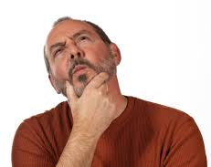
The situation on the ground
3,000 brand new believers from Jewish background, many from the dispersion.
There are no churches, no rules, no structure, no precedents, nothing to appeal to (no New Testament yet).
Your Lord is in heaven, not with you here.
So where do
you start??

Slide 22
Things to consider
John 14:26 – “But the Helper, the Holy Spirit, whom the Father will send in my name, he will teach you all things and bring to remembrance all things that I said to you.”

Slide 23
Things to consider
John 14:26 – “But the Helper, the Holy Spirit, whom the Father will send in my name, he will teach you all things and bring to remembrance all things that I said to you.”
Apostolic practice becomes apostolic precept.

Slide 24
Things to consider
John 14:26 – “But the Helper, the Holy Spirit, whom the Father will send in my name, he will teach you all things and bring to remembrance all things that I said to you.”
Apostolic practice becomes apostolic precept.
This means what the discipled did or practiced became what the disciples taught, whether or not we find it in Scripture. They were consistent.

Slide 25
Things to consider
John 14:26 – “But the Helper, the Holy Spirit, whom the Father will send in my name, he will teach you all things and bring to remembrance all things that I said to you.”
Apostolic practice becomes apostolic precept.
12 apostles/teachers (took responsibility for 250 persons per apostle/teacher (250 x 12 = 3,000). Or each apostle oversaw Jews by region (Acts 2:9-11).

Slide 26
What did the apostles teach?

Slide 27
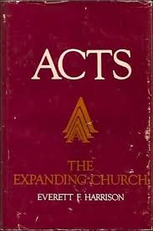
What did the apostles teach?
The high points of Jesus’ life and work
His ethics, such as the Sermon on the Mount
Old Testament prophecies (on the road to Emmaus, Luke 24:19-32)
The Kingdom of God (the topic Jesus spoke about after his resurrection, Acts 1:3)
New relationships in the spiritual family of God
(Suggested by Everett Harrison in Acts, the Expanding Church, p. 65)

Slide 28
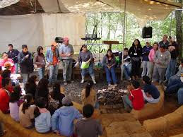
Their teaching resulted in
Fellowship (Grk: koinonia) = partnership, team membership, community sharing, contributing to others in the group (the Body of Christ)

Slide 29
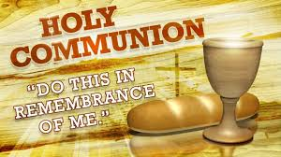
Their teaching resulted in
Fellowship (Grk: koinonia) = partnership, team membership, community sharing, contributing to others in the group (the Body of Christ)
Breaking of bread = worship/the Lord’s Table/Holy Communion, the highlight of corporate worship

Slide 30
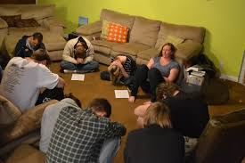
Their teaching resulted in
Fellowship (Grk: koinonia) = partnership, team membership, community sharing, contributing to others in the group (the Body of Christ)
Breaking of bread = worship/the Lord’s Table/Holy Communion, the highlight of corporate worship
Prayer = asking for God’s will to be done

Slide 31
Their teaching resulted in
Fellowship (Grk: koinonia) = partnership, team membership, community sharing, contributing to others in the group (the Body of Christ)
Breaking of bread = worship/the Lord’s Table/Holy Communion, the highlight of corporate worship
Prayer = asking for God’s will to be done
What do you think they prayed for?

Slide 32
Other results/Additional evidences
2:43 – “Then fear came upon every soul, and
many wonders and signs were done through the
apostles.”

Slide 33
Other results/Additional evidences
2:43 – “Then fear came upon every soul, and
many wonders and signs were done through the
apostles.”
Greek = phobia
The Phobia Continuum:
Terror/fear reverence/awe

Slide 34
Other results/Additional evidences
2:43 – “Then fear came upon every soul, and
many wonders and signs were done through the
apostles.”
2:44-45 – “Now all who believed were together,
and had all things in common, and sold their
possessions and goods, and divided them
among all, as anyone had need.”

Slide 35
Acts 2:46-47
So continuing daily with one accord in the
temple, and breaking bread from house to
house, they ate their food with gladness and
simplicity of heart, praising God and having
favor with all the people. And the Lord added
to the church daily those who were being saved.

Slide 36
Text and Comment
Acts 2:46-47
Comment
So continuing daily with one accord in
the temple, and breaking bread from
house to house, they ate their food with
gladness and simplicity of heart,
praising God and having favor with all
the people. And the Lord added to the
church daily those who were being
saved.
The true Pentecost joy (Holy Spirit for everyone) went from house to house.

Slide 37
Text and Comment
Acts 2:46-47
Comment
So continuing daily with one accord in
the temple, and breaking bread from
house to house, they ate their food with
gladness and simplicity of heart,
praising God and having favor with all
the people. And the Lord added to the
church daily those who were being
saved.
The true Pentecost joy (Holy Spirit for everyone) went from house to house.
Notice their attitudes resonated with “all the people.” They were being God’s witnesses first.

Slide 38
Text and Comment
Acts 2:46-47
Comment
So continuing daily with one accord in
the temple, and breaking bread from
house to house, they ate their food with
gladness and simplicity of heart,
praising God and having favor with all
the people. And the Lord added to the
church daily those who were being
saved.
The true Pentecost joy (Holy Spirit for everyone) went from house to house.
Notice their attitudes resonated with “all the people.” They were being God’s witnesses first.
As man did his part, God did his part by adding to their number.

Slide 39
Acts 2:46-47
Question: What does the Church use for
outreach today that the Apostles didn’t use?
So continuing daily with one accord in the temple, and breaking bread from house to house, they ate their food with gladness and simplicity of heart, praising God and having favor with all the people. And the Lord added to the church daily those who were being saved.

Slide 40
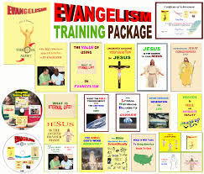
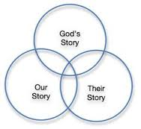
Acts 2:46-47
Question: What does the Church use for
outreach today that the Apostles didn’t use?
Evangelism programs
Evangelism training
Evangelism models
Mass advertising
Evangelism tracts & literature
Others?
So continuing daily with one accord in the temple, and breaking bread from house to house, they ate their food with gladness and simplicity of heart, praising God and having favor with all the people. And the Lord added to the church daily those who were being saved.

Slide 41
Acts 3:1-3
Now Peter and John went up together to the
temple at the hour of prayer, the ninth hour.
And a certain man lame from his mother’s
womb was carried, whom they laid daily at the
gate of the temple which is called Beautiful, to
ask alms from those who entered the temple;
who, seeing Peter and John about to go
into the temple, asked for alms.

Slide 42
Text and Comment
Acts 3:1-3
Comment
Now Peter and John went up
together to the temple at the
hour of prayer, the ninth hour.
And a certain man lame from his
mother’s womb was carried,
whom they laid daily at the gate
of the temple which is called
Beautiful, to ask alms from those
who entered the temple; who,
seeing Peter and John about to go
into the temple, asked for alms.
Ninth hour = 3:00PM

Slide 43
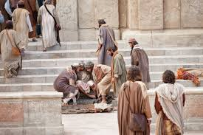
Text and Comment
Acts 3:1-3
Comment
Now Peter and John went up
together to the temple at the
hour of prayer, the ninth hour.
And a certain man lame from his
mother’s womb was carried,
whom they laid daily at the gate
of the temple which is called
Beautiful, to ask alms from those
who entered the temple; who,
seeing Peter and John about to go
into the temple, asked for alms.
Ninth hour = 3:00PM
This man was in his 40’s (4:22). He had never walked, since he was “born this way”

Slide 44
Text and Comment
Acts 3:1-3
Comment
Now Peter and John went up
together to the temple at the
hour of prayer, the ninth hour.
And a certain man lame from his
mother’s womb was carried,
whom they laid daily at the gate
of the temple which is called
Beautiful, to ask alms from those
who entered the temple; who,
seeing Peter and John about to go
into the temple, asked for alms.
Ninth hour = 3:00PM
This man was in his 40’s (4:22). He had never walked, since he was “born this way”
Where is the Beautiful Gate?

Slide 45
Back to the Temple
Beautiful
Gate

Slide 46
Acts 3:4-6a
And fixing his eyes on him, with John, Peter said,
“Look at us.” So he gave them his attention,
expecting to receive something from them.
Then Peter said, “Silver and gold I do not have,
but what I do have I give you…”

Slide 47
Acts 3:4-6a
And fixing his eyes on him, with John, Peter said,
“Look at us.” So he gave them his attention,
expecting to receive something from them.
Then Peter said, “Silver and gold I do not have,
but what I do have I give you…”
Matthew 10:9 – “Provide neither gold nor silver nor copper in your money belts…”

Slide 48
Acts 3:4-6a
And fixing his eyes on him, with John, Peter said,
“Look at us.” So he gave them his attention,
expecting to receive something from them.
Then Peter said, “Silver and gold I do not have,
but what I do have I give you…”
So what does Peter actually have to give?

Slide 49
Acts 3:4-6a
And fixing his eyes on him, with John, Peter said,
“Look at us.” So he gave them his attention,
expecting to receive something from them.
Then Peter said, “Silver and gold I do not have,
but what I do have I give you…”
Something that is not
physical or material!

Slide 50
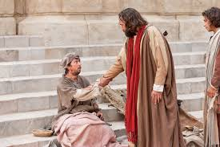
Acts 3:6b-7
“…In the name of Jesus Christ of Nazareth, rise
up and walk.” And he took him by the right
hand and lifted him up, and immediately
his feet and ankle bones received strength.

Slide 51
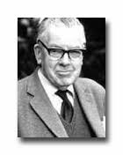
A little side story
Cornelius a Lapide* says Thomas Aquinas went
to visit Pope Innocent as he was counting out a
large amount of money. “You see, Thomas, the
Church can no longer say, ‘Silver and gold I do
not have’.” To which Thomas replied, “True,
holy father, and neither can she say now,
‘Rise up and walk’.”
(from F.F. Bruce, Commentary
on the Book of Acts, p. 84)
*1567-1637, FLEMISH JESUIT

Slide 52
Text and Comment
Acts 3:6b-7
Comment
In the name of Jesus Christ
of Nazareth, rise up and
walk.” And he took him by
the right hand and lifted him
up, and immediately his feet
and ankle bones received
strength.
Peter used the same name
for Jesus as he did in his
Pentecost sermon.

Slide 53
Acts 3:8-10
So he, leaping up, stood and walked and entered
the temple with them—walking, leaping, and
praising God. And all the people saw him
walking and praising God. Then they knew that it
was he who sat begging alms at the Beautiful
Gate of the temple; and they were filled with
wonder and amazement at what
had happened to him.

Slide 54
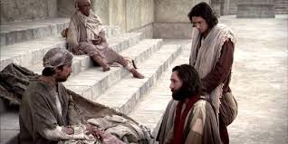
Why did God heal this man?

Slide 55
Why did God heal this man?
God healed this man because, as he set the
stage for an earlier sermon with the arrival
of the Holy Spirit, so he’s setting the stage
for another sermon from Peter.

Slide 56
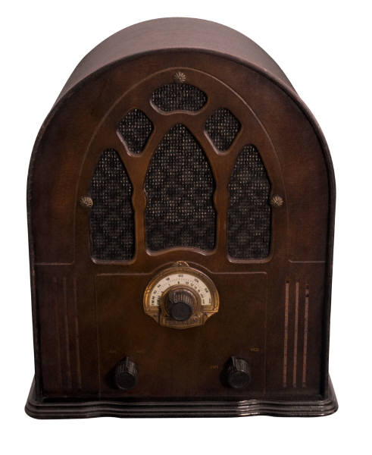
Why did God heal this man?
God healed this man because, as he set the
stage for an earlier sermon with the arrival
of the Holy Spirit, so he’s setting the stage
for another sermon from Peter.
So stay tuned!

Slide 57
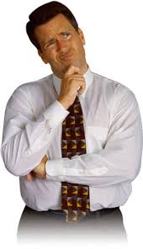
Back to Basics
Many people wonder why on earth doesn’t God do many miracles anymore among his people.

Slide 58
Back to Basics
Many people wonder why on earth doesn’t God do many miracles anymore among his people.
God must wonder why in heaven don’t his people live like they’re supposed to live and do what they’re supposed to do.

Slide 59
Summary
Life on planet Earth is all about accomplishing God’s will, not ours. When we eagerly yield to his will completely, expect the unexpected.

Slide 60
Summary
Life on planet Earth is all about accomplishing God’s will, not ours. When we eagerly yield to his will completely, expect the unexpected.
When God’s people embrace New Testament teaching, experience real fellowship, enjoy real worship and earnestly pray, you may gain favor with people. God will work and add members to (grow) his Body, the Church.

Slide 61
A Closing Picture
This handicapped man is like many people who
hang around church, but they don’t really
participate with the others. He is carried to and
from the meetings. His handicap speaks of
sinfulness. After this man was healed, he
walked and jumped and praised his way into the
meeting. Does this speak of anyone here today?

Slide 62
Pushback Time
Where do you see God at work in this story?
What are your take-home points?
What is God saying to you
in this story?
What are your take home points?

