Slide 1
The Kingdom of God: The First Installment, Part 2
Bill Perry

Slide 2
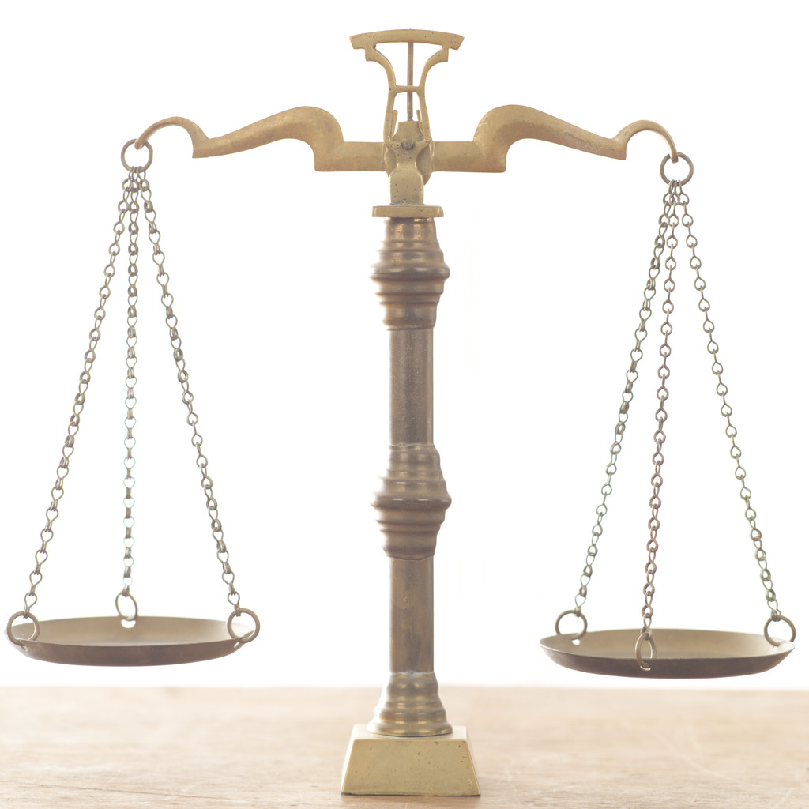
The Balance in teaching Acts
Doctrine
Narrative

Slide 3
Jesus talked about the Kingdom of God with the disciples after his resurrection.
The Holy Spirit was linked to the Kingdom.
The Holy Spirit came on Pentecost morning which caused the disciples to instantly speak many known languages.
The Spirit baptized and filled (controlled) all the disciples.
Review

Slide 4
Jerusalem was filled with Jews from all over the eastern Roman Empire attending the Pentecost festival.
When they heard the Galilean disciples speaking their own languages, they were “amazed and perplexed” (Acts 2:12).
Some thought the disciples were drunk with “new (sweet) wine” (v. 13)!
Review

Slide 5
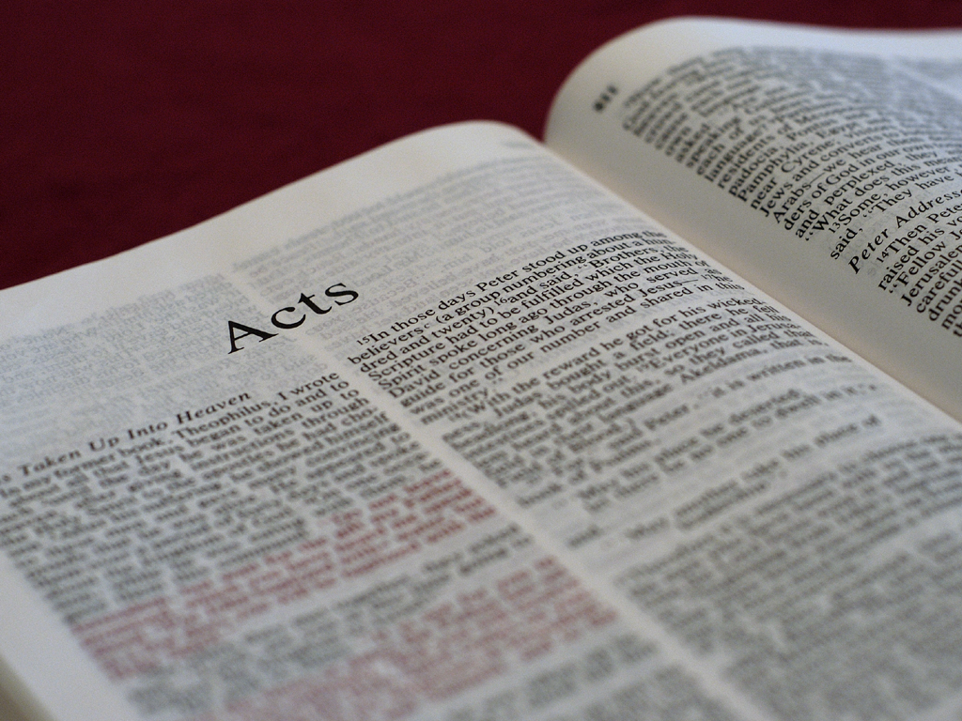
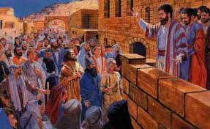
Acts 2:14-16
But Peter, standing up with the eleven, raised
his voice and said to them, “Men of Judea and
all who dwell in Jerusalem, let this be known
to you, and heed my words. For these are not
drunk, as you suppose, since
it is only the third hour of
The day. But this is what was
spoken by the prophet Joel:

Slide 6
Questions and Answers
But Peter, standing up with
the eleven, raised his voice
and said to them, “Men of
Judea and all who dwell in
Jerusalem, let this be known
to you, and heed my words.
For these are not drunk, as
you suppose, since it is only
the third hour of the day.
But this is what was spoken
by the prophet Joel:
Q: What language
did Peter speak?

Slide 7
Questions and Answers
But Peter, standing up with
the eleven, raised his voice
and said to them, “Men of
Judea and all who dwell in
Jerusalem, let this be known
to you, and heed my words.
For these are not drunk, as
you suppose, since it is only
the third hour of the day.
But this is what was spoken
by the prophet Joel:
Q: What language
did Peter speak?
A: Probably Hebrew,
Aramaic or Koine
Greek.

Slide 8
Questions and Answers
But Peter, standing up with
the eleven, raised his voice
and said to them, “Men of
Judea and all who dwell in
Jerusalem, let this be known
to you, and heed my words.
For these are not drunk, as
you suppose, since it is only
the third hour of the day.
But this is what was spoken
by the prophet Joel:
Q: What time was
the 3rd hour?

Slide 9
Questions and Answers
But Peter, standing up with
the eleven, raised his voice
and said to them, “Men of
Judea and all who dwell in
Jerusalem, let this be known
to you, and heed my words.
For these are not drunk, as
you suppose, since it is only
the third hour of the day.
But this is what was spoken
by the prophet Joel:
Q: What time was
the 3rd hour?
A: 9:00AM

Slide 10
Questions and Answers
But Peter, standing up with
the eleven, raised his voice
and said to them, “Men of
Judea and all who dwell in
Jerusalem, let this be known
to you, and heed my words.
For these are not drunk, as
you suppose, since it is only
the third hour of the day.
But this is what was spoken
by the prophet Joel:
Q: Why was the charge of being drunk false?

Slide 11
Questions and Answers
But Peter, standing up with
the eleven, raised his voice
and said to them, “Men of
Judea and all who dwell in
Jerusalem, let this be known
to you, and heed my words.
For these are not drunk, as
you suppose, since it is only
the third hour of the day.
But this is what was spoken
by the prophet Joel:
Q: Why was the charge of being drunk false?
A: Because on holy days and festivals, drinking and eating was not allowed until all the prayers were offered, sometimes not until 11:00AM or noon.

Slide 12
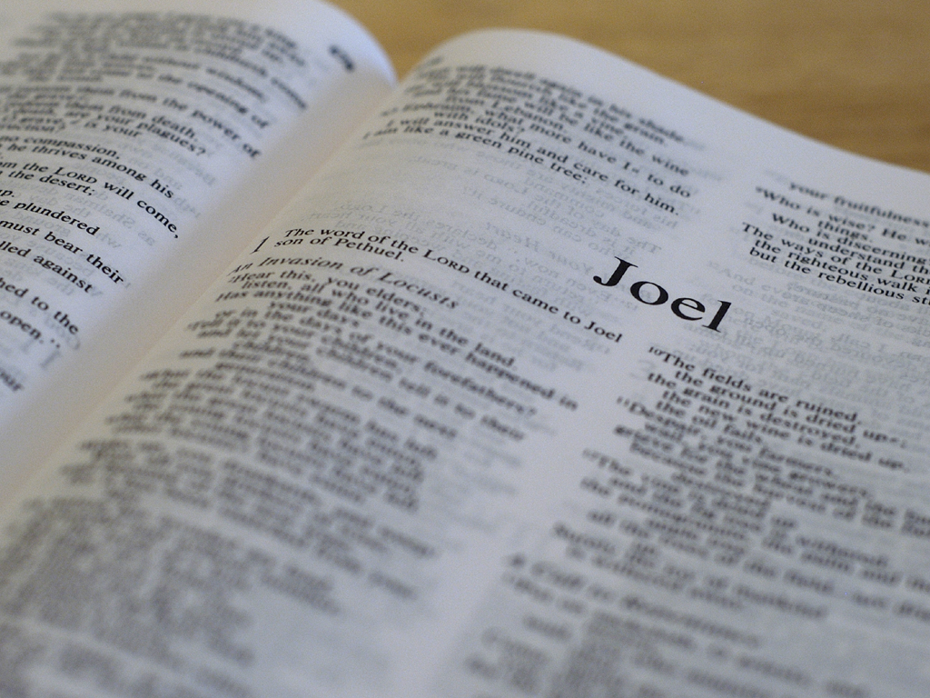
Acts 2:17-18 (quoting Joel 2:28-29).
‘​And it shall come to pass in the last days, says
God, that I will pour out of my Spirit on all flesh; ​​
your sons and your daughters shall prophesy,
your young men shall see visions, ​​your old men
shall dream dreams. ​​And on my menservants
and on my maidservants ​​I will pour out my
Spirit in those days; and they shall prophesy.’

Slide 13
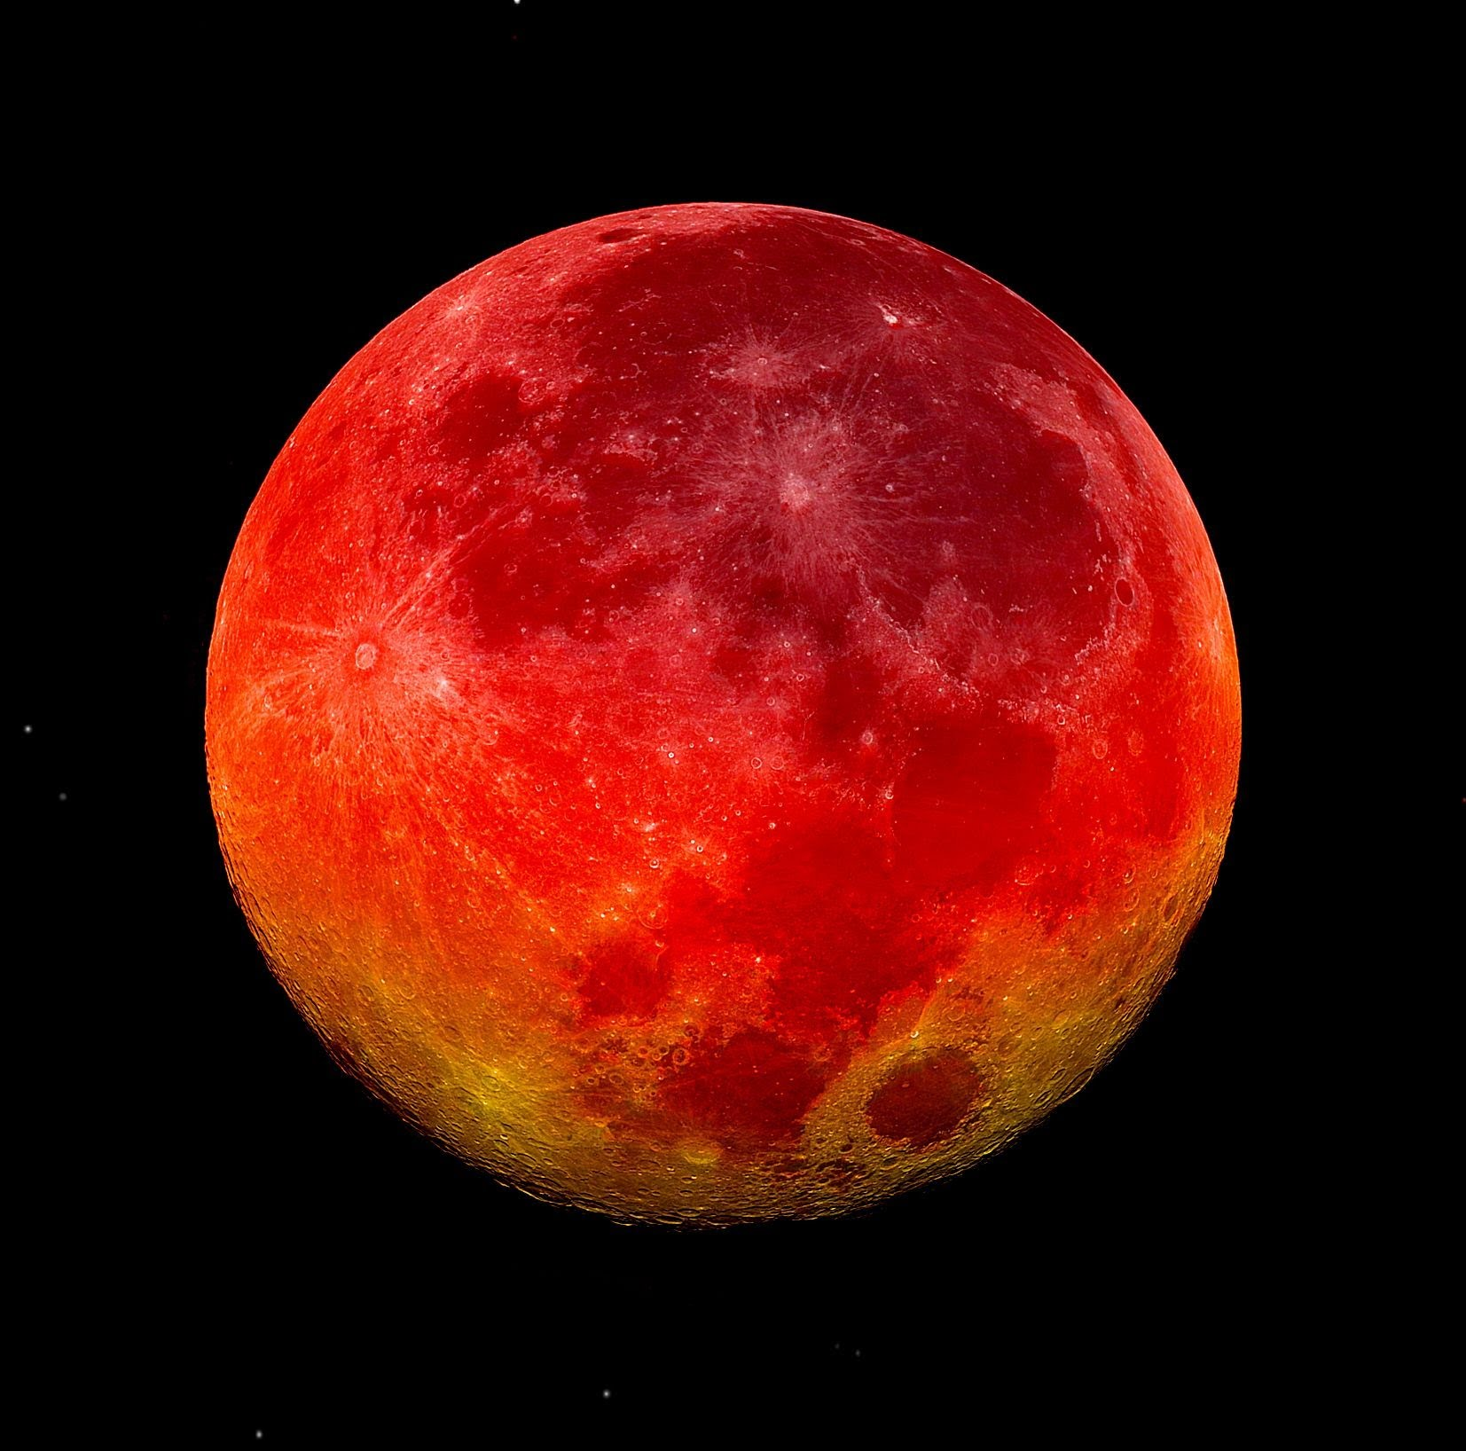
Acts 2:19-21 (quoting Joel 2:30-32).
‘I will show wonders in heaven above and
signs in the earth beneath: ​​blood and fire
and vapor of smoke. The sun shall be
turned into darkness, and the moon into
blood, before the coming of the great and awesome
day of the LORD. And it shall come
to pass that whoever calls on the
name of the LORD shall be saved.’

Slide 14
Verse 16
This is why Peter doesn’t say,
“This is the fulfillment of what was spoken
by the prophet Joel.”
Some predictions in Joel didn’t happen here.
Peter says,
“This is what was spoken by the prophet Joel.”

Slide 15
Changing Gears
‘​And it shall come to pass that whoever calls on the name of the LORD shall be saved.’ (v. 21)
Jesus speaking to the disciples:
“[The Holy Spirit] will testify of me. And you
also will bear witness because you have been
with me from the beginning.” (John 15:26b-27)

Slide 16
Acts 2:22-24
Men of Israel, hear these words: Jesus of Nazareth, a Man attested by God to you by miracles, wonders, and signs which God did through him in your midst, as you yourselves also know—him, being delivered by the determined purpose and foreknowledge of God, you have taken by lawless hands, have crucified, and put to death; whom God raised up, having loosed the pains of death, because it was not possible that he should be held by it.

Slide 17
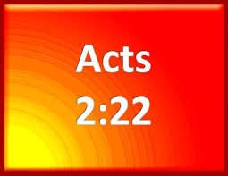
Text and Comment
Acts 2:22
Comment
Men of Israel, hear these
words: Jesus of Nazareth,
a Man attested by God to
you by miracles, wonders,
and signs which God did
through him in your midst,
as you yourselves also
know—
Of all the names Peter could
have used used to identify
Jesus, he used “Jesus of
Nazareth” because that is
what was written on the sign
on the cross (“Jesus of
Nazareth, the King of the
Jews”) found in John 19:19.

Slide 18
Text and Comment
Acts 2:22
Comment
Men of Israel, hear these
words: Jesus of Nazareth,
a Man attested by God to
you by miracles, wonders,
and signs which God did
through him in your midst,
as you yourselves also
know—
Since many of the festival
goers stayed in Jerusalem for
the time between festivals,
they had either seen some of
or heard about the miracles
Jesus had done.

Slide 19
Text and Comment
Acts 2:23
Comment
Him, being delivered by
the determined purpose
and foreknowledge of
God, you have taken by
lawless hands, have
crucified, and put to
death…
Peter first says that Christ died
according to God’s preordained
plan. At the same time he
blames the Jews for turning
Jesus over to “lawless hands,”
meaning the Romans (Gentiles),
because of their own rejection
of their Messiah.

Slide 20
Text and Comment
Acts 2:24
Comment
…[W]hom God raised up,
having loosed the pains of
death, because it was not
possible that he should be
held by it.
God reversed the outcome of
man’s rejection of Christ and
blew up death! Life conquers
death:
“Death is swallowed up in
victory” (1 Cor. 15:54).
“For to me, to live is Christ
and to die is gain” (Phil. 1:21).

Slide 21
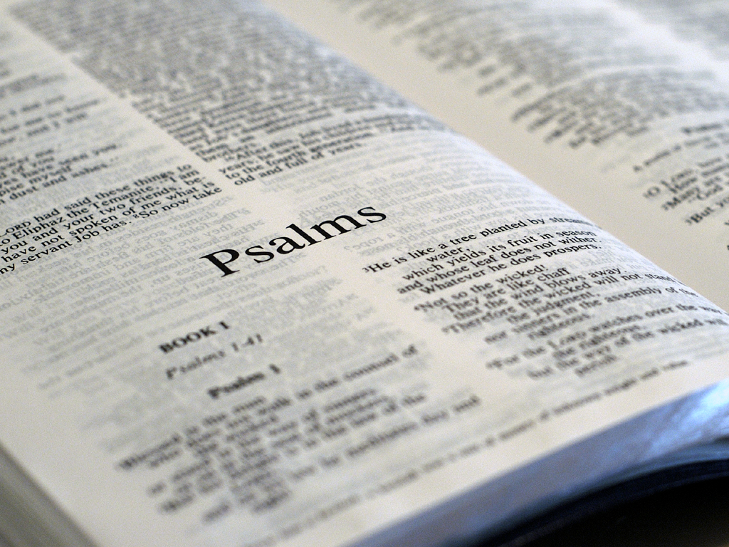
Acts 2:25-28 (quoting Ps. 16:8-11).
For David says concerning him: ​‘​I foresaw the
LORD always before my face, ​​for he is at my right
hand, that I may not be shaken. ​​Therefore my
heart rejoiced, and my tongue was glad;
moreover my flesh also will rest in hope. For you
will not leave my soul in Hades, nor will you allow
your Holy One to see corruption. You have made
known to me the ways of life; you will make me
full of joy in your presence.’

Slide 22
Acts 2:29-30 (quoting Ps. 132:11)
Men and brethren, let me speak freely to you of
the patriarch David, that he is both dead and
buried, and his tomb is with us to this day.
Therefore, being a prophet, and knowing that
God had sworn with an oath to him that of the
fruit of his body, according to the flesh, he
would raise up the Christ to sit on his throne…

Slide 23
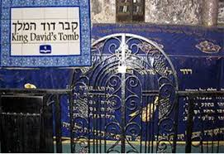
Text and Comment
Acts 2:29-30
Comment
Men and brethren, let me speak
freely to you of the patriarch
David, that he is both dead and
buried, and his tomb is with us to
this day. Therefore, being a
prophet, and knowing that God
had sworn with an oath to him
that of the fruit of his body,
according to the flesh, he would
raise up the Christ to sit on his
throne…
Jews knew where David’s
tomb was. In fact, it was a
monument at this time!

Slide 24
Text and Comment
Acts 2:29-30
Comment
Men and brethren, let me speak
freely to you of the patriarch
David, that he is both dead and
buried, and his tomb is with us to
this day. Therefore, being a
prophet, and knowing that God
had sworn with an oath to him
that of the fruit of his body,
according to the flesh, he would
raise up the Christ to sit on his
throne…
King David was an ancestor of
Christ (Messiah) and he was the
“fruit of his body” (2 Samuel
7:12 – “I will set up your seed
after you, who will come from
your body, and I will establish his
kingdom…forever”). Peter calls
David a prophet because he wrote
predictively about Christ rising
from the dead.

Slide 25
Acts 2:31-32.
…He, foreseeing this, spoke concerning the
resurrection of the Christ, that his soul was
not left in Hades, nor did his flesh see
corruption. This Jesus God has raised
up, of which we are all witnesses.

Slide 26
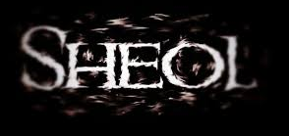
Text and Comment
Acts 2:31-32
Comment
…He foreseeing this,
spoke concerning the
resurrection of the Christ,
that his soul was not left in
Hades, nor did his flesh
corruption. This Jesus God
raised up, of which we are
all witnesses.
Peter quotes Ps. 16:10,
“For you will not leave my
soul in Sheol, nor will you
allow your Holy One to
see corruption,” not about
David but the Messiah.

Slide 27
Acts 2:33-35
Therefore being exalted to the right hand of
God, and having received from the Father the
promise of the Holy Spirit, he poured out this
which you now see and hear. For David did not
ascend into the heavens, but he says himself:
‘​The LORD said to my Lord, “Sit at my right
hand, till I make your enemies your footstool.” ’

Slide 28
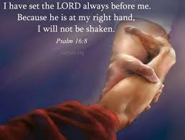
Text and Comment
Acts 2:33
Comment
Therefore being exalted to the right hand of God, and having received from the Father the promise of the Holy Spirit, he poured out this which you now see and hear.
Although many Jews had
seen or heard of some of
Jesus’ miracles, none of
them, not even the disciples,
had seen these events. Peter
proves them from predictive
Old Testament scriptures.

Slide 29
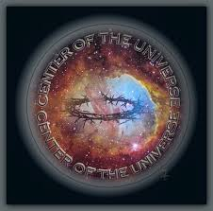
Text and Comment
Acts 2:33
Comment
Therefore being exalted to the right hand of God, and having received from the Father the promise of the Holy Spirit, he poured out this which you now see and hear.
The “right hand of God” is
the center of all power and
authority in the universe.
From that position the Father
gave him the promise of the
Holy Spirit, meaning it was
now his right to begin in-
stalling the Kingdom of God.

Slide 30
Text and Comment
Acts 2:33
Comment
Therefore being exalted to the right hand of God, and having received from the Father the promise of the Holy Spirit, he poured out this which you now see and hear.
The Proceeding Doctrine:
John 7:39 – “But this
[Jesus] spoke concerning
the Spirit, whom those
believing in him would
receive; for the Holy Spirit
was not yet given because
Jesus was not yet glorified.”

Slide 31
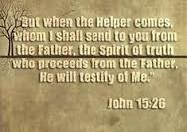
Text and Comment
Acts 2:33
Comment
Therefore being exalted to the right hand of God, and having received from the Father the promise of the Holy Spirit, he poured out this which you now see and hear.
The Proceeding Doctrine:
John 15:26 – “But when the
Comforter (Holy Spirit)
comes, whom I shall send to
you from the Father, the
Spirit of truth who proceeds
from the Father, he will
testify of me.”

Slide 32
Text and Comment
Acts 2:34-35
Comment
For David did not ascend
into the heavens, but he
says himself: ‘The LORD
said to my Lord, “Sit at my
right hand, till I make your
enemies your footstool.”’
Peter quotes Psalm 110:1,
“The LORD said to my Lord,
‘Sit at my right hand till I
make your enemies your
footstool,’” stating that this
prophecy has been fulfilled.

Slide 33
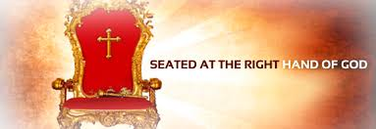
Text and Comment
Acts 2:34-35
Comment
For David did not ascend
into the heavens, but he
says himself: ‘The LORD
said to my Lord, “Sit at my
right hand, till I make your
enemies your footstool.”’
Jesus sitting at the right
hand of God means:
(1) His work was done.
(2) He has full equality
with the Father!
(3) Jesus directs the work
of the Holy Spirit’s
mission -- installing the
Kingdom -- on earth.

Slide 34
Text and Comment
Acts 2:34-35
Question
For David did not ascend
into the heavens, but he
says himself: ‘The LORD
said to my Lord, “Sit at my
right hand, till I make your
enemies your footstool.”’
How long is Jesus
supposed to sit at God’s
right hand?

Slide 35
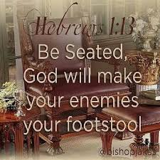
Text and Comment
Acts 2:34-35
Answer
For David did not ascend
into the heavens, but he
says himself: ‘The LORD
said to my Lord, “Sit at my
right hand, till I make your enemies your footstool.”’
How long is Jesus
supposed to sit at God’s
right hand?
Until he returns to do
the final installation
of the Kingdom!

Slide 36
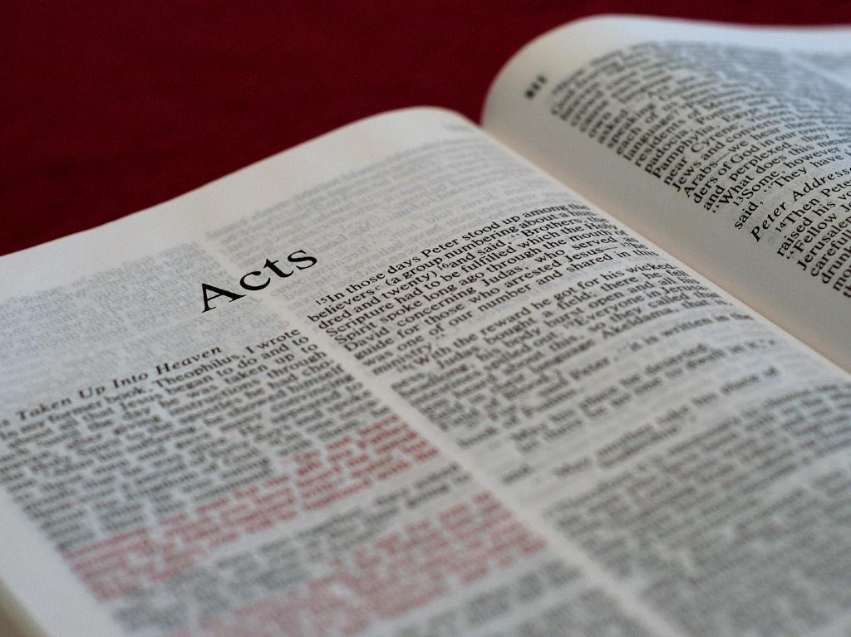
Acts 2:36-37
“Therefore let all the house of Israel know
assuredly that God has made this Jesus,
whom you crucified, both Lord and Christ.”
Now when they heard this, they were cut to
the heart, and said to Peter and the rest
of the apostles, “Men and brethren,
what shall we do?

Slide 37
Acts 2:38-39
Then Peter said to them, “Repent, and let every
one of you be baptized in the name of Jesus
Christ for the remission of sins; and you shall
receive the gift of the Holy Spirit. For the
promise is to you and to your children,
and to all who are afar off, as many
as the Lord our God will call.”

Slide 38
Baptismal Regeneration?
BR refers to the teaching that for salvation to take effect, one must be water baptized. Faith alone in Christ alone is not sufficient.

Slide 39
Baptismal Regeneration?
BR refers to the teaching that for salvation to take effect, one must be water baptized. Faith alone in Christ alone is not sufficient.
Whole denominations have risen up teaching this doctrine. If you don’t get water baptized, you are not saved!

Slide 40
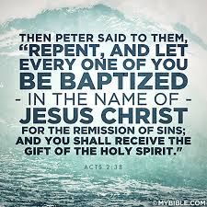
Baptismal Regeneration?
BR refers to the teaching that for salvation to take effect, one must be water baptized. Faith alone in Christ alone is not sufficient.
Whole denominations have risen up teaching this doctrine. If you don’t get water baptized, you are not saved!
All or nearly all of them use Acts 2:38 as proof saying since this was the first gospel presentation in the NT, it must mean this.

Slide 41
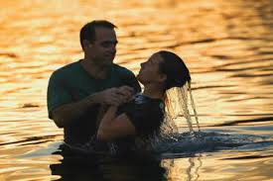
Baptismal Regeneration?
BR refers to the teaching that for salvation to take effect, one must be water baptized. Faith alone in Christ alone is not sufficient.
Whole denominations have risen up teaching this doctrine. If you don’t get water baptized, you are not saved!
All or nearly all of them use Acts 2:38 as proof saying since this was the first gospel presentation in the NT, it must mean this.
If you change churches, you may have to be baptized in the new church even if you were baptized in the old one.

Slide 42
Text and Comment
Acts 2:38-39
Comment
Then Peter said to them, “Repent,
and let every one of you be
baptized in the name of Jesus
Christ for the remission of sins;
and you shall receive the gift of
the Holy Spirit. For the promise is
to you and to your children, and
to all who are afar off, as many as
the Lord our God will call.”
This was a totally Jewish audience.
They were the same ones who
called for Jesus’ death. The only
way to undo that was to make a
public display of faith and
commitment (baptism in Jesus’
name).

Slide 43
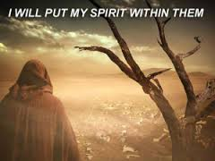
Text and Comment
Acts 2:38-39
Comment
Then Peter said to them, “Repent,
and let every one of you be
baptized in the name of Jesus
Christ for the remission of sins;
and you shall receive the gift of
the Holy Spirit. For the promise is
to you and to your children, and
to all who are afar off, as many as
the Lord our God will call.”
Salvation is described in terms of
receiving the Holy Spirit (sign of
the Kingdom), what all good Jews
longed for: “Are you zealous for
my sake? Oh, that all the LORD’s
people were prophets and that the
LORD would put his Spirit up
them!” (Moses to Joshua in
Numbers 11:29)

Slide 44
Text and Comment
Acts 2:38-39
Comment
Then Peter said to them, “Repent,
and let every one of you be
baptized in the name of Jesus
Christ for the remission of sins;
and you shall receive the gift of
the Holy Spirit. For the promise is
to you and to your children, and
to all who are afar off, as many as
the Lord our God will call.”
“Afar off” means Gentiles were to be included too.
Notice that Peter never says anything about eternal life or heaven. That would have made little sense to Jews expecting God’s kingdom to show up on earth as prophesied.
Therefore, this does not teach baptismal regeneration!

Slide 45
Acts 2:40-41
And with many other words he testified and
exhorted them, saying, “Be saved from this
perverse generation.” Then those who gladly
received his word were baptized; and
that day about three thousand
souls were added to them.

Slide 46
Text and Comment
Acts 2:40-41
Comment
And with many other words
he testified and exhorted
them, saying, “Be saved from
this perverse generation.”
Then those who gladly
received his word were
baptized and that day
about three thousand souls
were added to them.
Their generation was “perverse” because they had rejected their Messiah.
“Gladly” is irrelevant here.
Of the ~3,000 who were saved, there is no mention of any of them speaking in any tongue or language.
Joel 2:32 fulfilled.

Slide 47
Summary So Far
The Kingdom of God on earth began when Jesus sent the Holy Spirit on Pentecost.
The Spirit’s arrival was known by sight and sound: manifestations of fire and languages.
The power of the Spirit was demonstrated in lifting up Jesus and saving 3,000 people.
The Spirit wants to use you in continuing to install the Kingdom of God now!

Slide 48
Pushback Time
Where do you see God at work
in this story?
What are your take-home points?

