Slide 1
The Kingdom of God: The First Installment, Part 1
Bill Perry

Slide 2
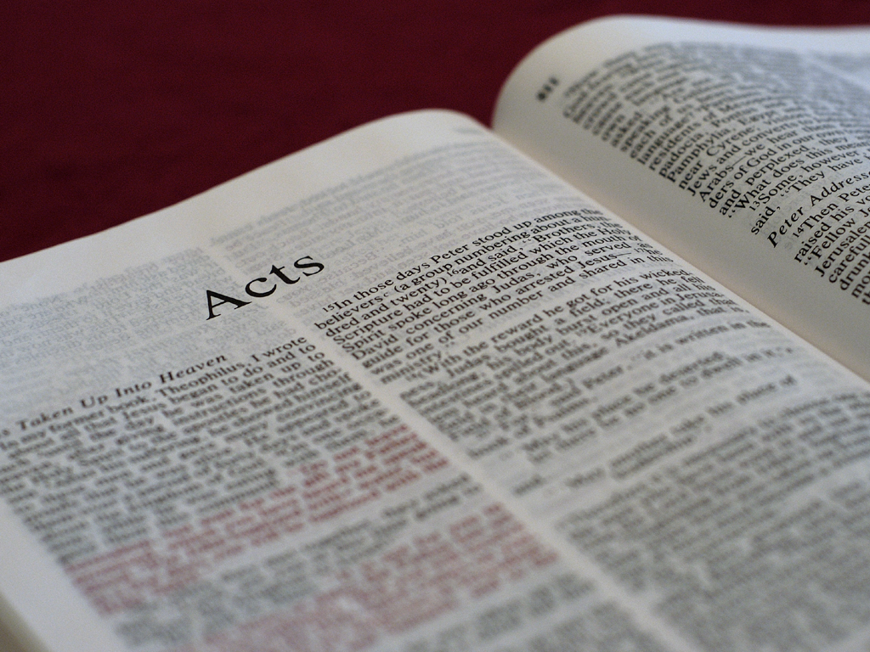
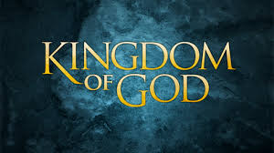
Reviewing Acts 1:1-11
After his resurrection Jesus spent his time with the disciples “speaking of…the kingdom of God” (1:3).

Slide 3
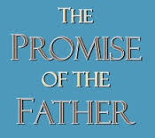
Reviewing Acts 1:1-11
After his resurrection Jesus spent his time with the disciples “speaking of…the kingdom of God” (1:3).
His command to them: “wait for the Promise of the Father” (the Holy Spirit, 1:4-5).

Slide 4
Reviewing Acts 1:1-11
After his resurrection Jesus spent his time with the disciples “speaking of…the kingdom of God” (1:3).
His command to them: “wait for the Promise of the Father” (the Holy Spirit, 1:4-5).
The disciples asked if he would “restore the kingdom to Israel at this time” (1:7).

Slide 5
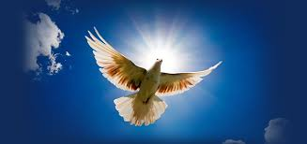
Reviewing Acts 1:1-11
The kingdom would come in installments first with the Holy Spirit (1:8)

Slide 6
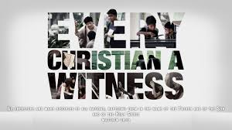
Reviewing Acts 1:1-11
The kingdom would come in installments first with the Holy Spirit (1:8)
Then they would be “witnesses to [Christ]” locally, regionally and globally (1:8)

Slide 7
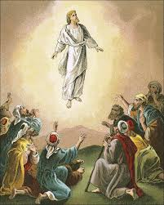
Reviewing Acts 1:1-11
The kingdom would come in installments first with the Holy Spirit (1:8)
Then they would be “witnesses to [Christ]” locally, regionally and globally (1:8)
Jesus ascended into heaven (1:9)

Slide 8
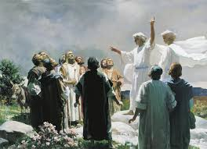
Reviewing Acts 1:1-11
The kingdom would come in installments first with the Holy Spirit (1:8)
Then they would be “witnesses to [Christ]” locally, regionally and globally (1:8)
Jesus ascended into heaven (1:9)
2 angels told the disciples that Jesus would return to earth as he left (1:10-11)

Slide 9
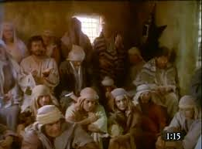
Summarizing Acts 1:12-21
The disciples returned to the upper room in Jerusalem and prayed (1:12-14)

Slide 10
Summarizing Acts 1:12-21
The disciples returned to the upper room in Jerusalem and prayed (1:12-14)
There were about 120 of them: the 11, Jesus’ half-brothers, 70 disciples, Jesus’ mother and women (~10?), and secret religious leaders like Nicodemus, Joseph of Arimathea (~20?).

Slide 11
Summarizing Acts 1:12-21
The disciples returned to the upper room in Jerusalem and prayed (1:12-14)
There were about 120 of them: the 11, Jesus’ half-brothers, 70 disciples, Jesus’ mother and women (~10?), and secret religious leaders like Nicodemus, Joseph of Arimathea (~20?).
They would be there for a week (43 days after Christ’s resurrection) to Pentecost (“50th”).

Slide 12
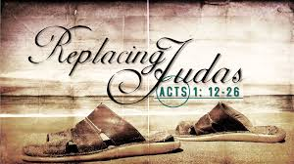
Summarizing Acts 1:12-21
Peter initiates a move to fill Judas’ place among the 12 (1:15-26). The 11 chose Matthias by drawing lots.

Slide 13
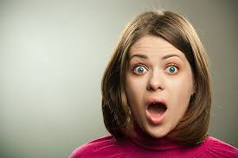
Summarizing Acts 1:12-21
Peter initiates a move to fill Judas’ place among the 12 (1:15-26). The 11 chose Matthias by drawing lots. Neither Matthias nor lots are ever mentioned again in the Bible!

Slide 14
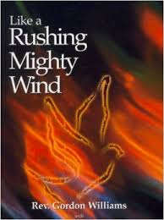
Acts 2:1-2
When the Day of Pentecost had fully come,
they were all with one accord in one place.
And suddenly there came a sound from
heaven, as of a rushing mighty wind, and
it filled the whole house where
they were sitting.

Slide 15
About Pentecost
Means | 50th (the 50th day was a Sunday)
Also called | Feast of Harvest (Ex. 23:16), Feast of Weeks (Ex. 34:22-23), and Day of Firstfruits (Num. 28:26)
Occurred | May/June (Lev. 23:15-22)
Activity | Offerings given in faith of the coming harvest (Lev. 23:20)
Importance | It was the second of 3 national festivals in Jerusalem

Slide 16
About Pentecost
Festival | Passover | Pentecost | Ingathering aka Harvest or Tabernacles
Meaning | Salvation | Sanctification | Completion
Initiated by | Deliverance from Egypt | Beginning of the harvest | End of the harvest
Illustrated by | Lord’s Supper | Baptism | End of the age

Slide 17
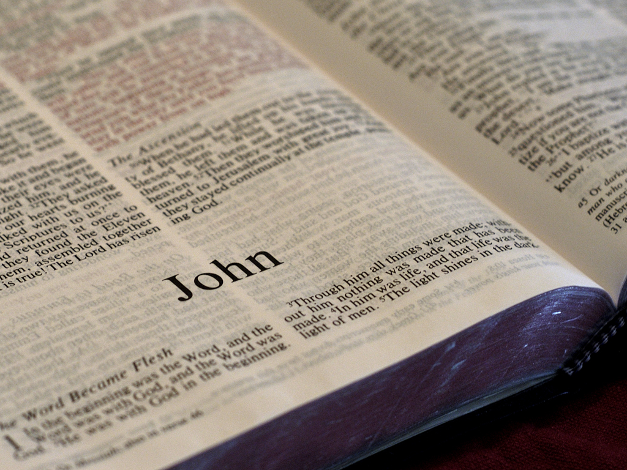
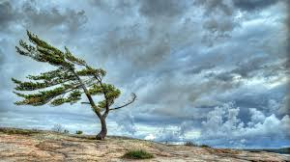
“A sound… as of a rushing mighty wind”
John 3:8 – “The wind blows where it wishes, and
you hear the sound of it, but cannot tell where it
comes from and where it goes. So is everyone
who is born of the Spirit.”

Slide 18
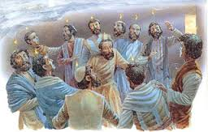
Acts 2:3-4
Then there appeared to them divided tongues,
as of fire, and one sat upon each of them. And
they were all filled with the Holy Spirit and
began to speak with other tongues,
as the Spirit gave them utterance.

Slide 19
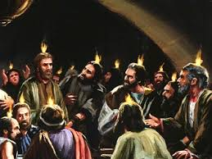
Considering Acts 2:3-4
“Divided tongues, as of fire, and one sat upon each of them” (not literal fire)

Slide 20
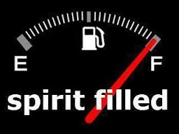
Considering Acts 2:3-4
“Divided tongues, as of fire, and one sat upon each of them” (not literal fire)
“And they were ALL FILLED with the Holy Spirit” (not “some,” not “baptized”)

Slide 21
Why does it say “filled” and not “baptized”?
Luke is writing about what everyone heard and saw. The filling of the Spirit brings evidence. The baptism of the Spirit does not.

Slide 22
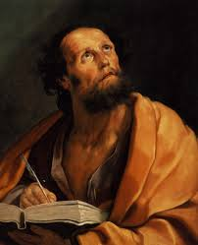
Why does it say “filled” and not “baptized”?
Luke is writing about what everyone heard and saw. The filling of the Spirit brings evidence. The baptism of the Spirit does not.
Luke is writing from a narrative perspective, not a doctrinal one.

Slide 23
How do we know this was the “baptism of the Spirit”?
Before: Earlier in the gospels and Acts 1:5, Jesus said they would be baptized “not many days from now.”

Slide 24
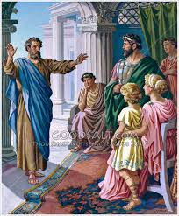
How do we know this was the “baptism of the Spirit”?
Before: Earlier in the gospels and Acts 1:5, Jesus said they would be baptized “not many days from now.”
After: In Acts 11:15-17 after the Holy Spirit fell on Cornelius’ family, Peter identifies what happened in Acts 2 (“as [the Holy Spirit fell]) upon us at the beginning” as being “baptized with the Holy Spirit.”

Slide 25
Considering Acts 2:3-4
“Divided tongues, as of fire, and one sat upon each of them” (not literal fire)
“And they were ALL FILLED with the Holy Spirit” (not “some,” not “baptized”)
“And they began to speak with other tongues as the Spirit gave them utterance” (either literal tongue (of the mouth) or a known language

Slide 26
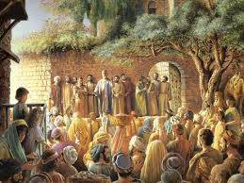
Acts 2:5-6
And there were dwelling in Jerusalem Jews,
devout men, from every nation under heaven.
And when this sound occurred, the multitude
came together, and were confused, because
everyone heard them speak
in his own language.

Slide 27
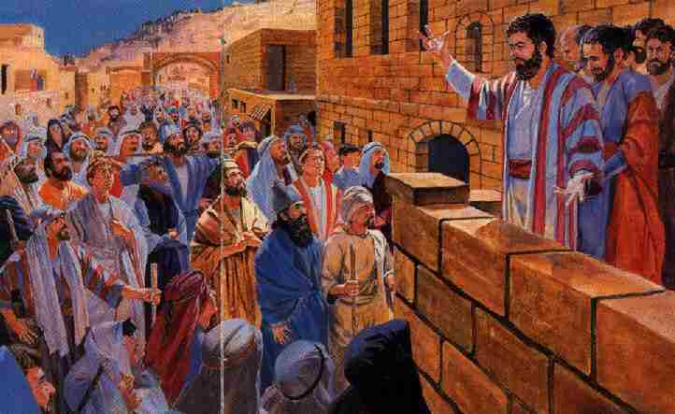
Acts 2:7-8
Then they were all amazed and marveled,
saying to one another, “Look, are not all these
who speak Galileans? And how is it that we
hear, each in our own language
in which we were born?

Slide 28
Acts 2:9-11a
Parthians and Medes and Elamites, those
dwelling in Mesopotamia, Judea and
Cappadocia, Pontus and Asia, Phrygia and
Pamphylia, Egypt and the parts of Libya
adjoining Cyrene, visitors from Rome, both
Jews and proselytes, Cretans and Arabs…

Slide 29
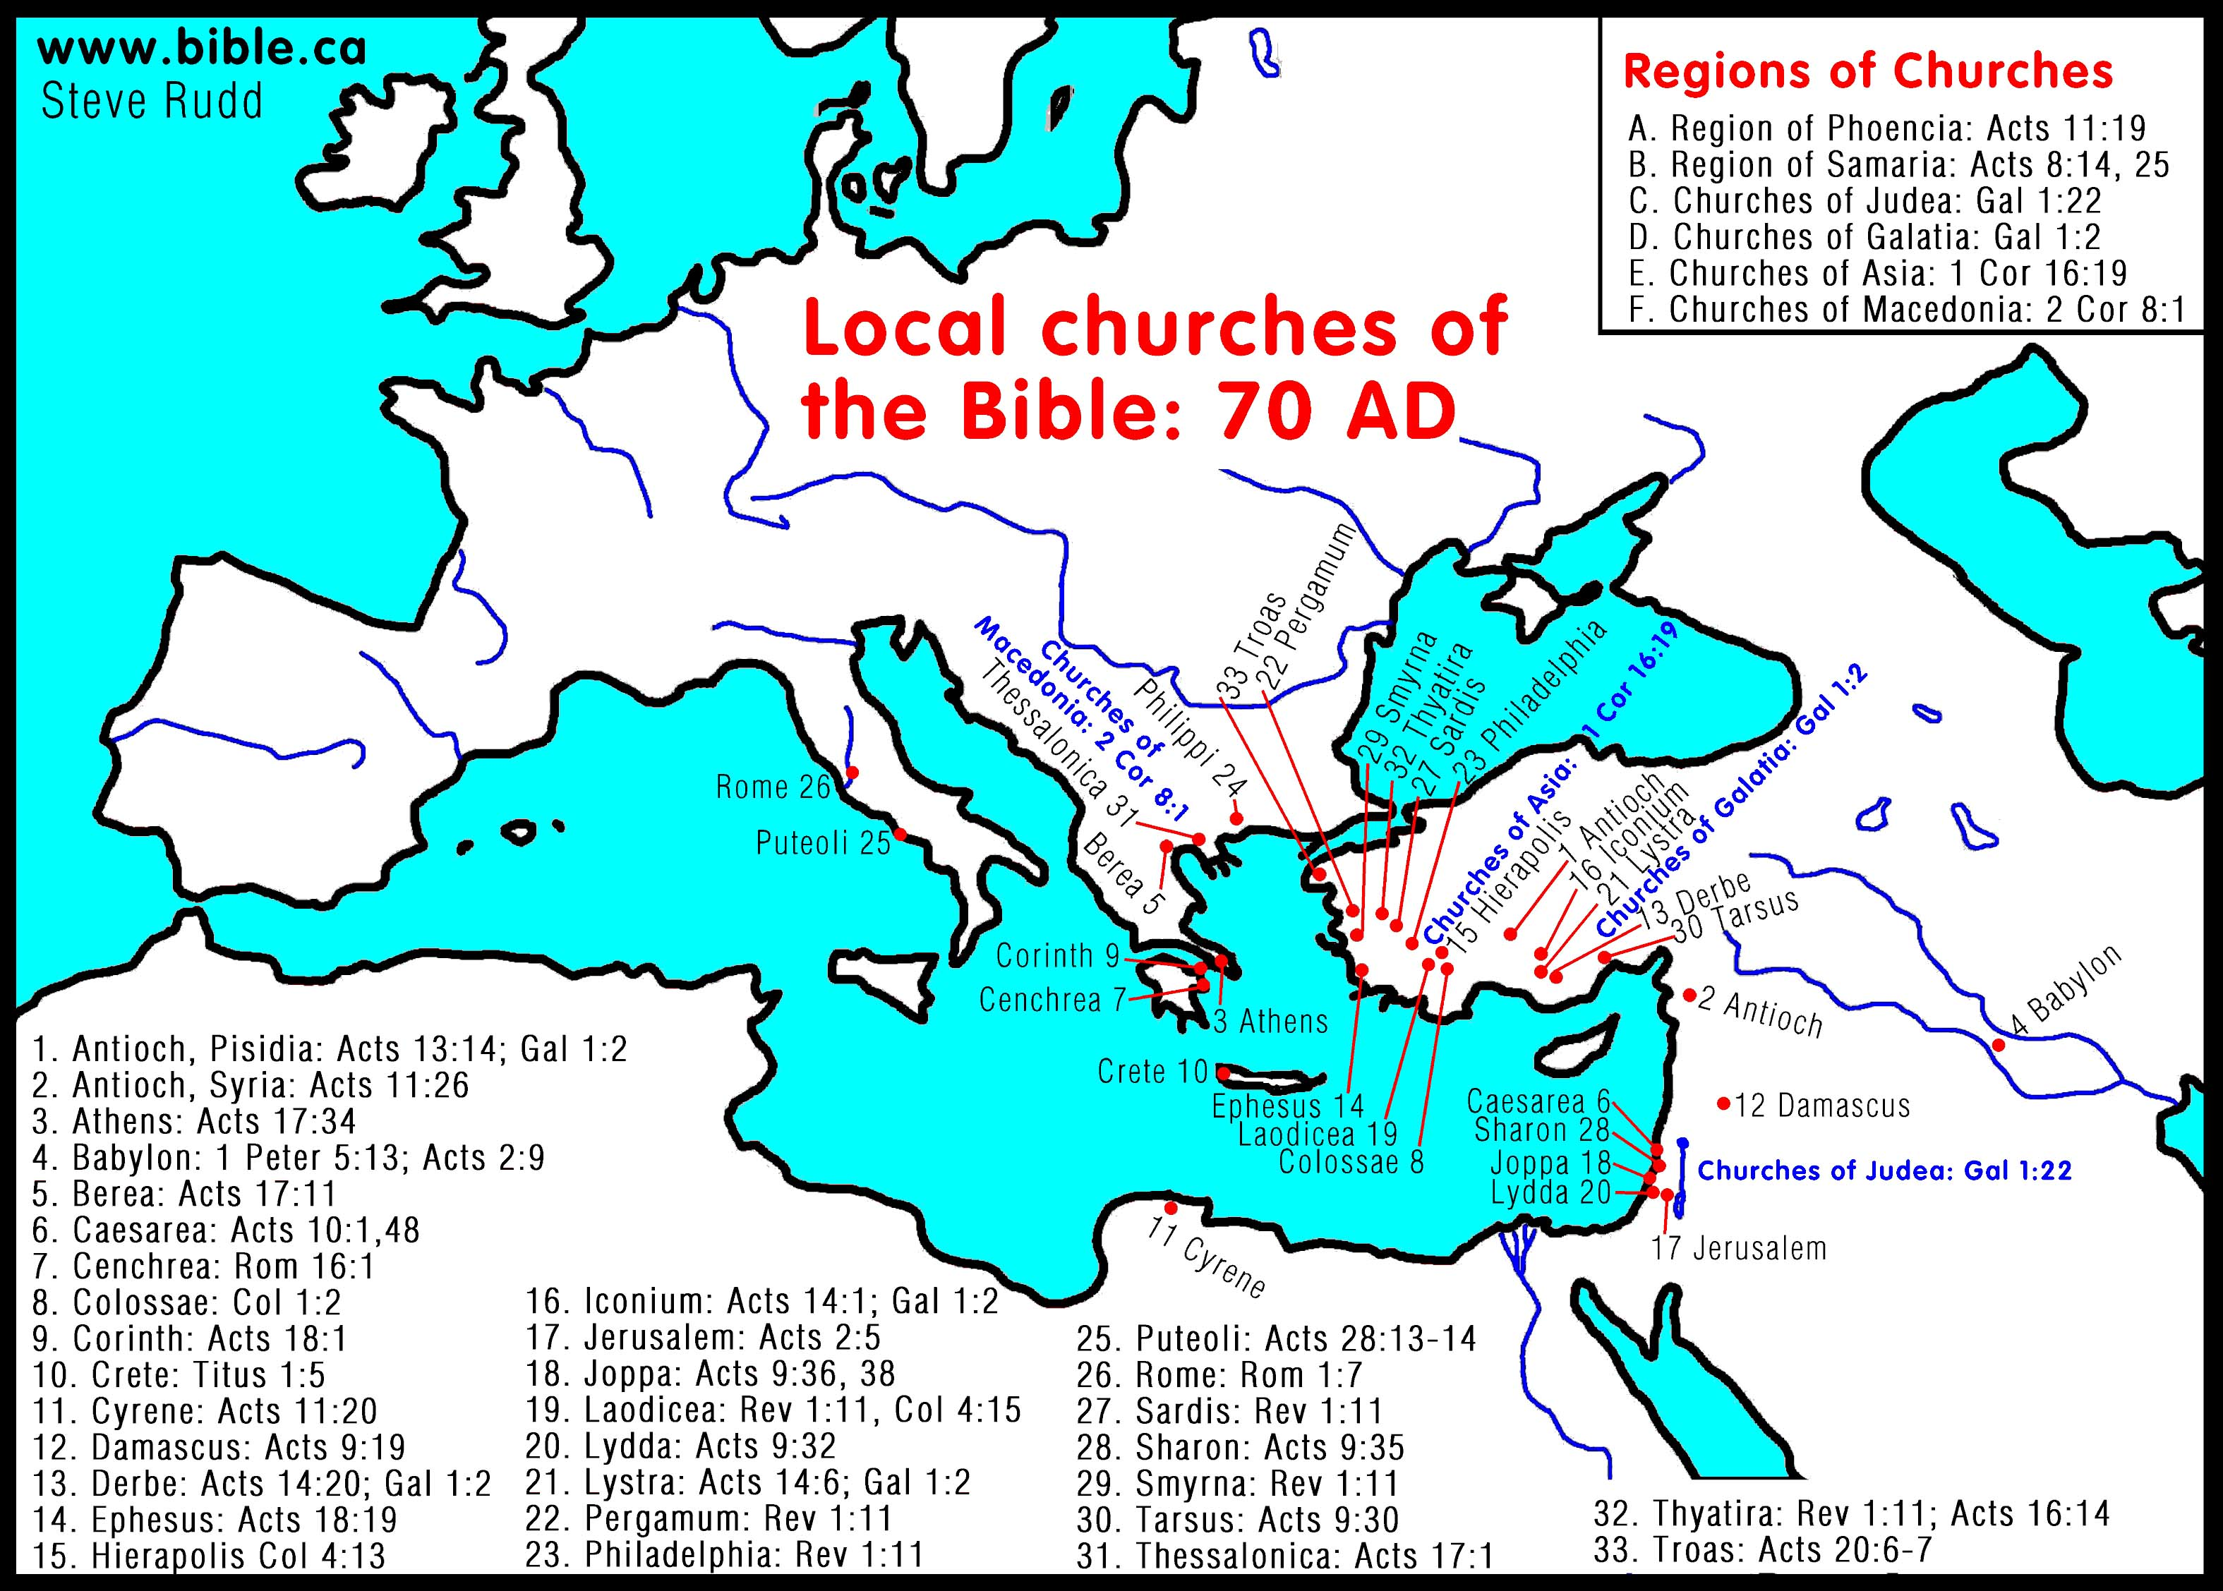
Parthians
Medes
Elamites
Mesopotamians
Judeans
Cappadocians
Pontus
Asians
Phrygia
Pamphylia
Egyptians
Libyans
Cyreneans
Romans
Cretans
Arabs

Slide 30
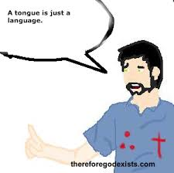
Points to consider:
These “tongues” were known languages that had multi-linguistic interpreters on the spot who understood everything that was said. This was not ecstatic or mystical speech.
A tongue is just
a language.

Slide 31
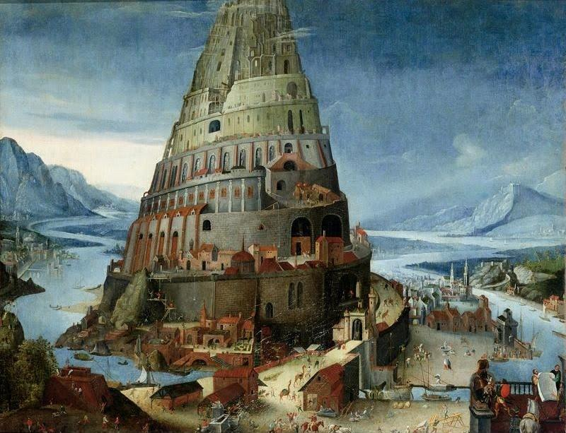
Points to consider:
These “tongues” were known languages that had multi-linguistic interpreters on the spot who understood everything that was said. This was not ecstatic or mystical speech.
This was a reversal of the effects of the Tower of Babel.

Slide 32
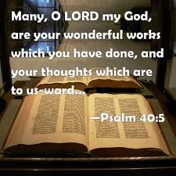
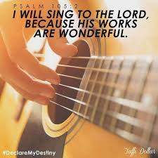
Acts 2:11b-13
“We hear them speaking in our own tongues
the wonderful works of God.” So they were
all amazed and perplexed, saying to one
another, “Whatever could this mean?”
Others mocking said, “They are full
of new wine.”

Slide 33
Why the Holy Spirit came
To fulfill many prophecies.

Slide 34
Why the Holy Spirit came
To fulfill many prophecies.
To visibly baptize and unite the first believers into one group, the Body of Christ.

Slide 35
Why the Holy Spirit came
To fulfill many prophecies.
To visibly baptize and unite the first believers into one group, the Body of Christ.
To reverse the effects of the Tower of Babel.

Slide 36
Why the Holy Spirit came
To fulfill many prophecies.
To visibly baptize and unite the first believers into one group, the Body of Christ.
To reverse the effects of the Tower of Babel.
To begin the activity of proclaiming “the wonderful works of God” (v. 10) beginning in Jerusalem (1:8).

Slide 37
Why the Holy Spirit came
5) To be the first visibly confirmed installment of the Kingdom of God on planet earth!

Slide 38
Mixed responses (vs. 11-12)
Some said, “Whatever could this mean?”

Slide 39
Mixed responses (vs. 11-12)
Some said, “Whatever could this mean?”
“Others mockingly said, ‘They are full of new
wine!’”

Slide 40
Question
Some said, “Whatever could this mean?”
“Others mockingly said, ‘They are full of new
wine!’”
How would you characterize
their comments?

Slide 41
Next time!
The Kingdom of God:
The First Installment, Part 2

Slide 42
Pushback Time
Where do you see God working in this story?
What are your take-home points?

