Slide 1
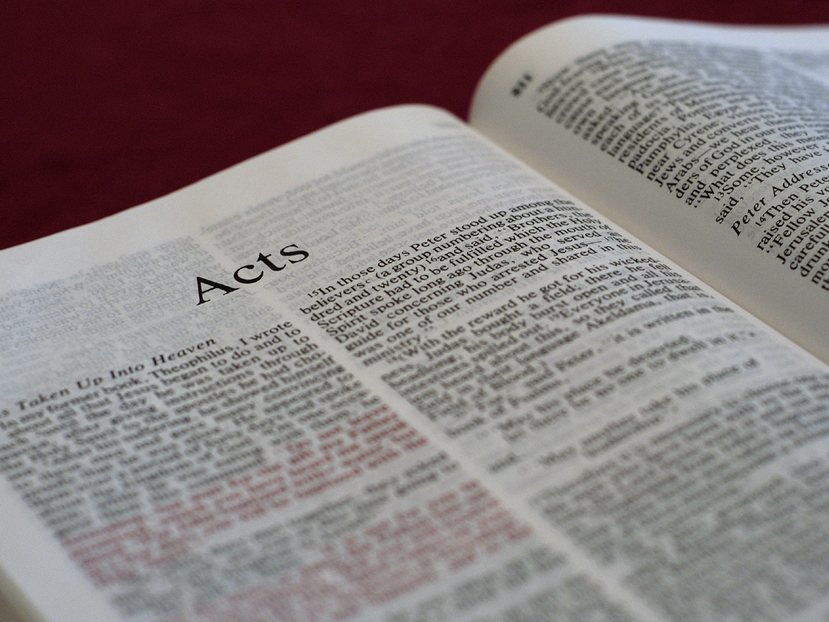
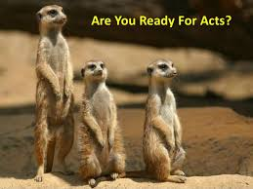
Acts: Luke Volume 2
Bill Perry

Slide 2
Acts 1:1-3
Acts 1:1-3
comment
The former account I made, O
Theophilus, of all that Jesus began
both to do and teach, until the day in
which he was taken up, after he
through the Holy Spirit had given
commandments to the apostles
whom he had chosen, to whom he
also presented himself alive after his
suffering by many infallible proofs,
being seen by them during forty days
and speaking of the things pertaining
to the kingdom of God.
Luke wrote this book
to a man named
Theophilus.
We find his name in
Luke’s gospel (1:1-4).

Slide 3
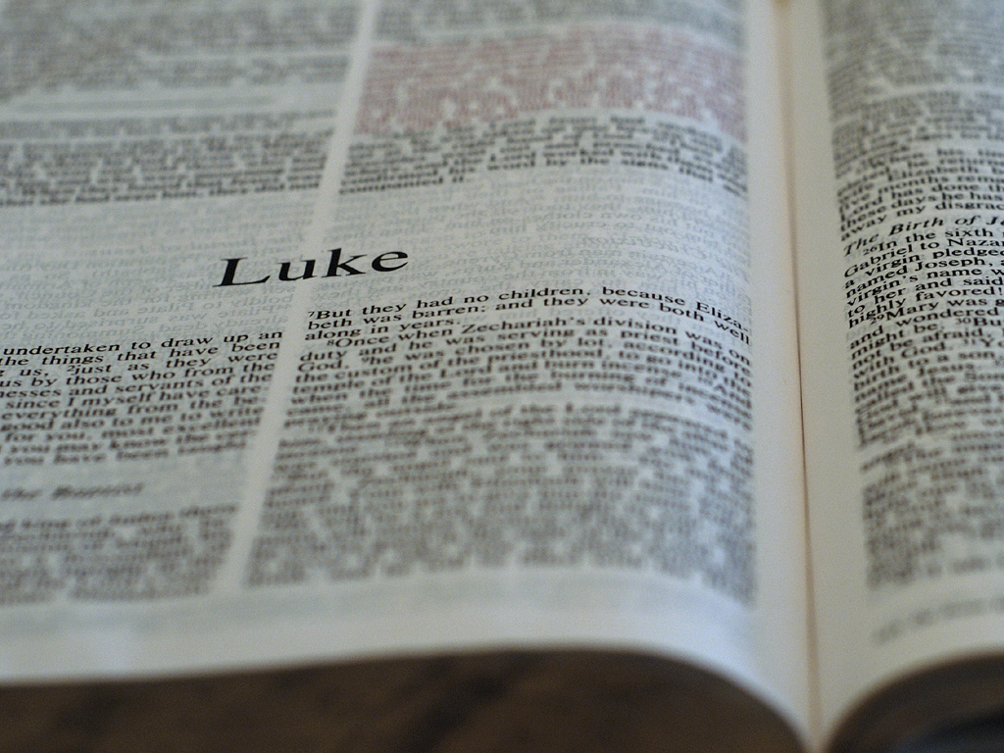
Luke 1:1-4
Inasmuch as many have taken in hand to set in
order a narrative of those things which have been
fulfilled among us, just as those who from the
beginning were eyewitnesses and ministers of the
word delivered them to us, it seemed good to me
also, having had perfect understanding of all things
from the very first, to write to you an orderly
account, most excellent Theophilus, that you may
know the certainty of those things in which you
were instructed.

Slide 4
Who was Theophilus?
Since there are several theories, this shows not
enough information has survived to say for
sure. He was obviously someone Luke knew.

Slide 5
Who was Theophilus?
Since there are several theories, this shows not
enough information has survived to say for
sure. He was obviously someone Luke knew.
* “Theophilus” means friend of God or loving God and thus could be any Christian.

Slide 6
Who was Theophilus?
Since there are several theories, this shows not
enough information has survived to say for
sure. He was obviously someone Luke knew.
* “Theophilus” means friend of God or loving God and thus could be any Christian.
* The title “most excellent” is used of Roman officials (Acts 26:25), so he might be one.

Slide 7
Who was Theophilus?
Since there are several theories, this shows not
enough information has survived to say for
sure. He was obviously someone Luke knew.
* “Theophilus” means friend of God or loving God and thus could be any Christian.
* The title “most excellent” is used of Roman officials (Acts 26:25), so he might be one.
* He could have been a Temple high priest, a Roman lawyer, etc.

Slide 8
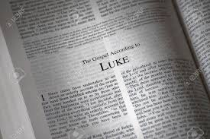
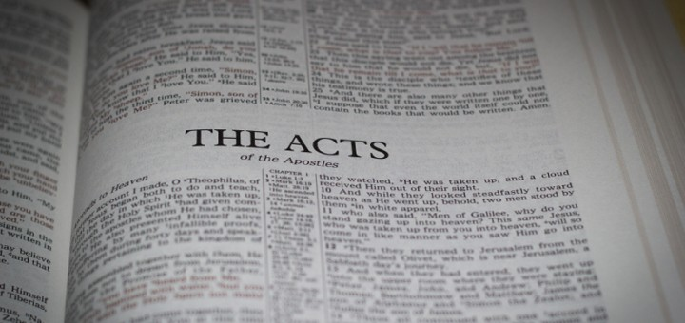
Luke’s “orderly account”
The Gospel of Luke =
History of Jesus of Nazareth
The Acts of the Apostles = History of the Growth of the Church

Slide 9
Acts 1:1-3
The former account I made, O Theophilus, of all
that Jesus began both to do and teach, until the day
in which he was taken up, after he through the
Holy Spirit had given commandments to the
apostles whom he had chosen, to whom he also
presented himself alive after his suffering by many
infallible proofs, being seen by them during forty
days and speaking of the things pertaining to the
kingdom of God.

Slide 10
“He also presented himself alive… by many infallible proofs”
Vanished from human sight (Luke 24:31)
Traveled far distances instantly (Luke 24:34)
Entered a locked room (John 20:19)
Showed his crucifixion wounds (Luke 24:39)
Ate and drank with his disciples (Luke 24:41-43)
Appeared to over 500 people (1 Cor. 15:6)
Appeared to James (1 Cor. 15:7)

Slide 11
“During forty days…”
Acts 1:1-3
Comment
The former account I made, O
Theophilus, of all that Jesus began
both to do and teach, until the day
in which he was taken up, after he
through the Holy Spirit had given
commandments to the apostles
whom he had chosen, to whom he
also presented himself alive after
his suffering by many infallible
proofs, being seen by them during
forty days and speaking of the
things pertaining to the kingdom
of God.
This is the only text that tells us how long Jesus was on the earth between his resurrection and ascension.

Slide 12
“During forty days…”
Acts 1:1-3
The former account I made, O
Theophilus, of all that Jesus began
both to do and teach, until the day
in which he was taken up, after he
through the Holy Spirit had given
commandments to the apostles
whom he had chosen, to whom he
also presented himself alive after
his suffering by many infallible
proofs, being seen by them during
forty days and speaking of the
things pertaining to the kingdom
of God.
Jesus came and went, probably coming as he saw opportunities to share/teach, and left when he was done, much like he had before his death. This adds to why the proof was unmistakable: the disciples were convinced!

Slide 13
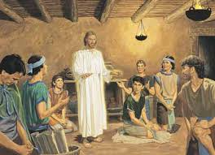
What did Jesus speak about?
“Things
pertaining
to the
kingdom
of God.”

Slide 14
What did Jesus speak about?
“Things
pertaining
to the
kingdom
of God.”
This is the only thing Luke records as subject matter!

Slide 15
The Kingdom of God
Extends to all of life at all time (Ps. 103:19)
Is most clearly seen when his people obey the will of the King (Luke 11:2).
In the Old Testament, it was visible when Israel kept their part of the covenant.

Slide 16
The Kingdom of God
When Israel fell, a new aspect of the kingdom was revealed (Dan. 2:44; 4:3; 7:13-14).
Includes all of life in heaven and on earth.
Jesus began his ministry by preaching the “kingdom of heaven” (Matt. 4:17).

Slide 17
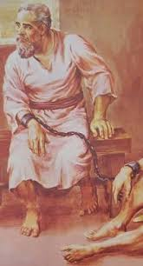
How Acts finishes (28:30-31)
Then Paul dwelt two whole years in his own
rented house, and received all
who came to him, preaching the
kingdom of God and teaching the
things which concern the Lord
Jesus Christ with all confidence,
no one forbidding him.

Slide 18
What must it have been like to listen to Jesus speak?

Slide 19

What must it have been like
TO LISTEN TO JESUS SPEAK?
And they said to one another, “Did not our
heart burn within us while he talked with us”

Slide 20
What must it have been like
TO LISTEN TO JESUS SPEAK?
And they said to one another, “Did not our
heart burn within us while he talked with us
on the road, and while he opened
the Scriptures to us?”
-- Luke 24:32

Slide 21
Acts 1:4-5
And being assembled together with them,
he commanded them not to depart from
Jerusalem, but to wait for the Promise of
the Father, “which,” he said, “you have heard
from me; for John truly baptized with water,
but you shall be baptized with the Holy Spirit
not many days from now.”

Slide 22
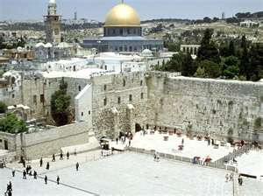
Why stay in Jerusalem?
It was the only city linked to God’s name (2 Chronicles 6:6).

Slide 23
Why stay in Jerusalem?
It was the only city linked to God’s name (2 Chronicles 6:6).
It was where Jesus died. God wouldn’t let the story end there in rejection and unbelief.

Slide 24
Why stay in Jerusalem?
It was the only city linked to God’s name (2 Chronicles 6:6).
It was where Jesus died. God wouldn’t let the story end there in rejection and unbelief.
He would counter their unbelief and rejection with overwhelming power.

Slide 25
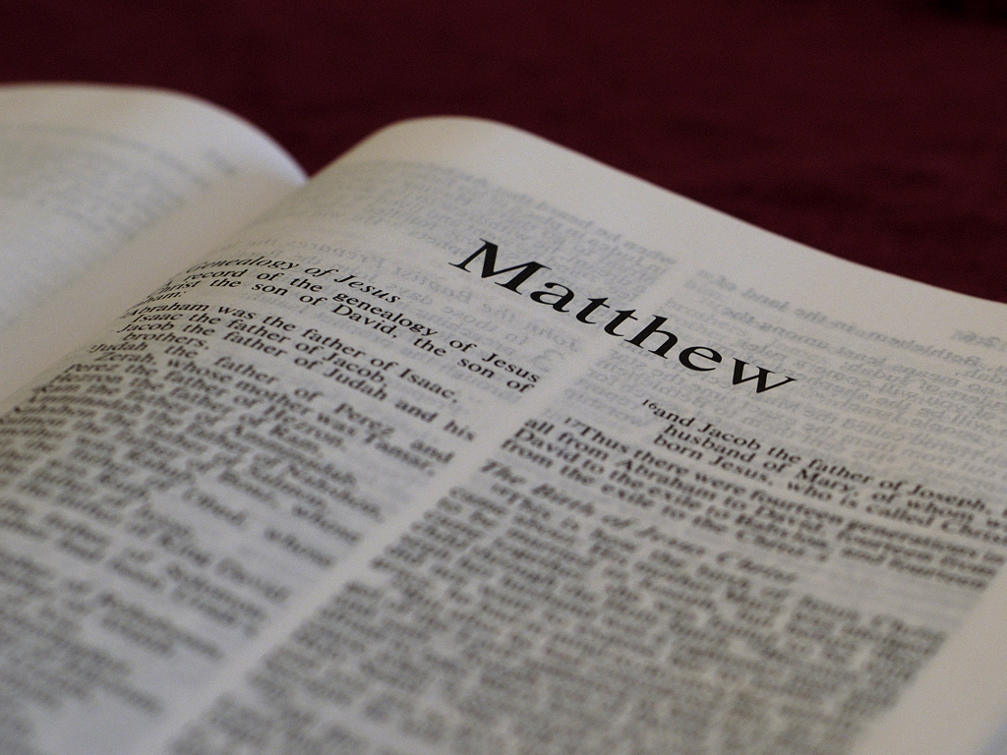
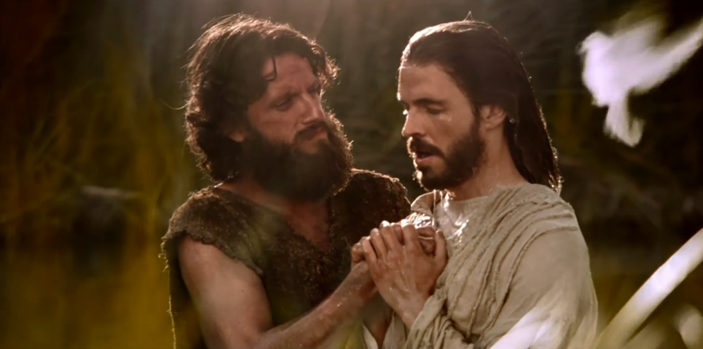
John the Baptist (2 years before):
I indeed baptize you with water unto
repentance, but he who is coming after me
is mightier than I, whose sandals I am not
worthy to carry. He will baptize you with
the Holy Spirit and fire.
-- Matthew 3:11

Slide 26
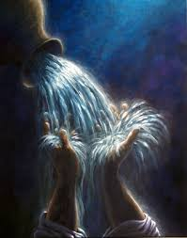
“The Promise of the Father”
“You shall be baptized with the Holy Spirit not many days from now.” (In only 10 days)
Predicted numerous times in the Old Testament:
❖ Isaiah 32:15, “Until the Spirit is poured upon us from on high…”
❖ Isaiah 44:3, “I will pour my Spirit on your descendants…”

Slide 27

“The Promise of the Father”
❖ Isaiah 59:21, “…My Spirit who is upon you, and my words which I have put in your mouth … shall not depart from your mouth … from this time and forevermore.”
❖ Ezekiel 36:27, “I will put my Spirit within you and cause you to walk in my statutes…”
❖ Ezekiel 37:14, “I will put my Spirit in you, and you shall live…”

Slide 28
“The Promise of the Father”
❖ Ezekiel 39:29, “…I shall have poured out my Spirit on the house of Israel, says the Lord.”
❖ Joel 2:28-29, “I will pour out my Spirit on all flesh…I will pour out my Spirit in those days.”
The context for all these verses is the Kingdom!

Slide 29
“The Promise of the Father”
❖ Ezekiel 39:29, “…I shall have poured out my Spirit on the house of Israel, says the Lord.”
❖ Joel 2:28-29, “I will pour out my Spirit on all flesh…I will pour out my Spirit in those days.”
The context for all these verses is the Kingdom!
❖ Luke 11:13, “…How much more will your heavenly Father give the Holy Spirit to those who ask him?”

Slide 30
“The Promise of the Father”
❖ John 14:15, “And I will pray the Father, and he will give you another Comforter that he may abide with you forever.”
❖ John 14:26, “But the Comforter, the Holy Spirit, whom the Father will send in my name, he will teach you all things…”
❖ John 15:26, “But when the Comforter comes …he will testify of me.”
❖ John 16:7, “If I do not go away, the Comforter will not come to you.”

Slide 31
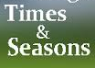
Acts 1:6-7
Therefore, when they had come together, they
asked him, saying, “Lord, will you at this time
restore the kingdom to Israel?” And he said to
them, “It is not for you to know times or
seasons which the Father has put
in his own authority.”

Slide 32
Not a “No”
Jesus didn’t give the disciples a “no” answer. That means two things:

Slide 33
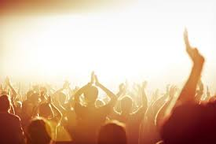
Not a “No”
Jesus didn’t give the disciples a “no” answer. That means two things:
They were thinking in the right direction (about God’s Kingdom coming soon).

Slide 34

Not a “No”
Jesus didn’t give the disciples a “no” answer. That means two things:
They were thinking in the right direction (about God’s Kingdom coming soon).
They were not thinking correctly about the Kingdom being primarily related “to Israel.” What is coming would be much different than their expectation.

Slide 35

“Times or Seasons”
English | Times | Seasons
Greek | Chronos
Meaning | Length of time period or duration
Identifies | Quantity (years, months, etc.)

Slide 36

“Times or Seasons”
English | Times | Seasons
Greek | Chronos | Kairos
Meaning | Length of time period or duration | Epoch with event markers
Identifies | Quantity (years, months, etc.) | Quality (planting, harvesting, etc.)

Slide 37
“Times or Seasons”
English | Times | Seasons
Greek | Chronos | Kairos
Meaning | Length of time period or duration | Epoch with event markers
Identifies | Quantity (years, months, etc.) | Quality (planting, harvesting, etc.)
Only God knows both!

Slide 38

Acts 1:8
But you shall receive power when the
Holy Spirit has come upon you; and you
shall be witnesses to me in Jerusalem,
and in all Judea and Samaria,
and to the end of the earth.

Slide 39
“Receive power” for 3 reasons:

Slide 40
“Receive power” for 3 reasons:
In the Bible, fear is the opposite of power. The Holy Spirit power eliminates fear.

Slide 41
“Receive power” for 3 reasons:
In the Bible, fear is the opposite of power. The Holy Spirit power eliminates fear.
To be “witnesses.” The Greek word is martus meaning observer or spectator in a legal, historical or ethical sense. It gives us the English word “martyr.”

Slide 42
“Receive power” for 3 reasons:
In the Bible, fear is the opposite of power. The Holy Spirit power eliminates fear.
To be “witnesses.” The Greek word is martus meaning observer or spectator in a legal, historical or ethical sense. It gives us the English word “martyr.”
To travel: “…in all Judea and Samaria, and to the end of the earth.”

Slide 43
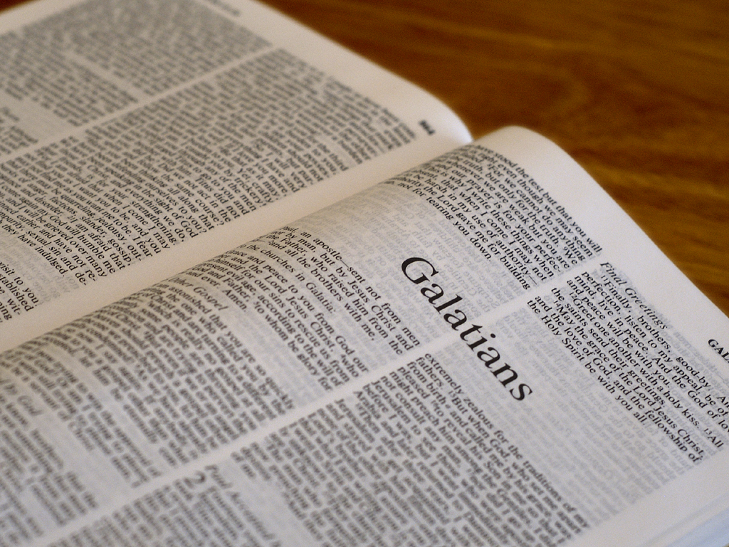

Galatians 3:13-14 (18 yrs later)
Christ has redeemed us from the curse of the
law, having become a curse for us … that the
blessing of Abraham might come upon the
Gentiles in Christ Jesus, that we might receive
the promise of the Spirit
through faith.

Slide 44

“Witnesses in…and to…”
Place | Acts chapters | Group | Culture/Language | Evangelism designation
Jerusalem | 1:1 – 8:3 | Jews | Same | E-0
Judea | 8:4 – 11:18 | Jews | Same, little farther away | E-1
Samaria | 8:4 – 11:18 | Samaritans (half Jew/half Gentile) | Different, little farther away | E-2
End of the earth | 11:19 – 28:31 | Gentiles (nations: many of them!) | Vastly different; very far away | E-3

Slide 45
“Witnesses in…and to…”
Place | Acts chapters | Group | Culture/Language | Evangelism designation
Jerusalem | 1:1 – 8:3 | Jews | Same | E-0
Judea | 8:4 – 11:18 | Jews | Same, little farther away | E-1
Samaria | 8:4 – 11:18 | Samaritans (half Jew/half Gentile) | Different, little farther away | E-2
End of the earth | 11:19 – 28:31 | Gentiles (nations: many of them!) | Vastly different; very far away | E-3
Realize that when God speaks of geography he is means people in that geography (17:26 – “[God] has made from one every nation of men
to dwell on all the face of the earth”).

Slide 46
“Witnesses in…and to…”
Place | Acts chapters | Group | Culture/Language | Evangelism designation
Jerusalem | 1:1 – 8:3 | Jews | Same | E-0
Judea | 8:4 – 11:18 | Jews | Same, little farther away | E-1
Samaria | 8:4 – 11:18 | Samaritans (half Jew/half Gentile) | Different, little farther away | E-2
End of the earth | 11:19 – 28:31 | Gentiles (nations: many of them!) | Vastly different; very far away | E-3
In other words, the Kingdom of God would come in installments that include every nation worldwide.

Slide 47
Matthew 28:18-20
And Jesus came and spoke to them, saying,
"All authority has been given to me in
heaven and on earth. "Go therefore and
make disciples of all the nations, baptizing
them in the name of the Father and of the Son
and of the Holy Spirit, "teaching them to observe
all things that I have commanded you; and lo, I
am with you always, even to the end of the age."

Slide 48
Acts 1:9-11
Now when he had spoken these things, while
they watched, he was taken up, and a cloud
received him out of their sight. And while they
looked steadfastly toward heaven as he went up,
behold, two men stood by them in white apparel,
who also said, “Men of Galilee, why do you stand
gazing up into heaven? This same Jesus, who was
taken up from you into heaven, will so come in like
manner as you saw him go into heaven.”

Slide 49
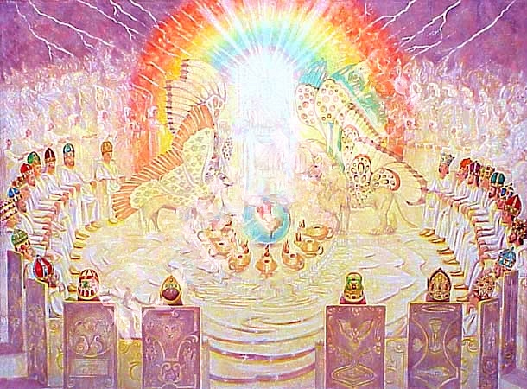
Contrast the scenes
What was it like in heaven at that moment when Jesus arrived back in heaven? What was going on?

Slide 50
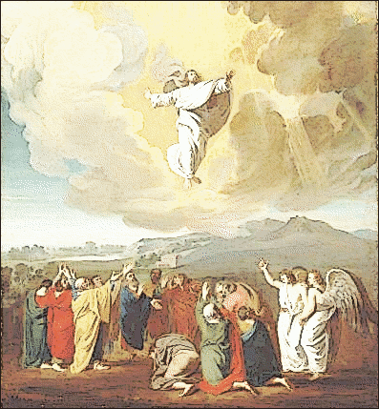
Contrast the scenes
What was it like for the disciples back on the mountaintop after Jesus left them (v. 12)?

Slide 51
“Taken up…out of their sight.”
How must the disciples walk now?

Slide 52
“Taken up…out of their sight.”
How must the disciples walk now?
By faith!

Slide 53
“Taken up…out of their sight.”
How must the disciples walk now?
By faith! (no more sight!)

Slide 54
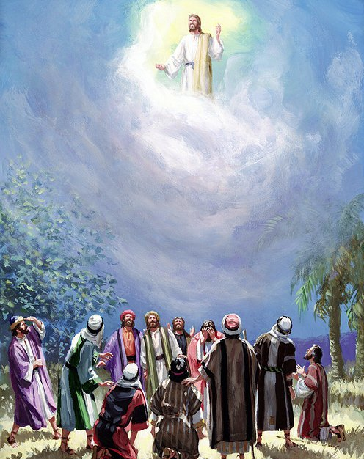
We’re just getting started!
Another ‘promise from the Father’: “This same
Jesus, who was taken up from you into heaven,
will so come in like manner as you saw him go
into heaven.”
What does this mean?

Slide 55
We’re just getting started!
Another ‘promise from the Father’: “This same
Jesus, who was taken up from you into heaven,
will so come in like manner as you saw him go
into heaven.”
He will return to the same place in the same
way and finish installing the Kingdom of God
and reclaim everything as his!

Slide 56
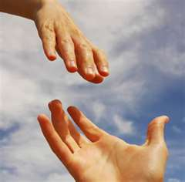
If you have trusted Christ:

Slide 57
If you have trusted Christ:
1) Christ defines you as his witness. That is your identity! That is who you are.

Slide 58
If you have trusted Christ:
1) Christ defines you as his witness. That is your identity! That is who you are.
2) What you do for the Kingdom every day brings a Kingdom reward. So be diligent.

Slide 59
If you have trusted Christ:
1) Christ defines you as his witness. That is your identity! That is who you are.
2) What you do for the Kingdom every day brings a Kingdom reward. So be diligent.
3) Like the apostles, the King calls you to walk by faith. You have received power because the (invisible) Holy Spirit has come upon you.

Slide 60
Pushback Time
Where do you see God working in this story?
What are your take-home points?

