Slide 1
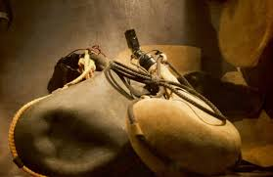
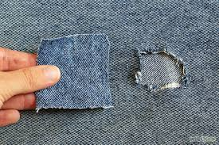
Parable of the Garments and Wineskins
Mark 2:13-22
Bill Perry

Slide 2
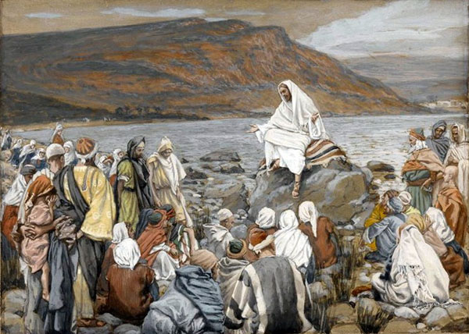
Simply put, a parable is an earthly story with a heavenly meaning.

Slide 3
Text: Mark 2:13-15
“Then he went out again by the sea; and all the multitude came to him, and he taught them. As he passed by, he saw Levi the son of Alphaeus sitting at the tax office. And he said to him, ‘Follow me.’ So he arose and followed him.
Now it happened, as he was dining in Levi's house, that many tax collectors and sinners also sat together with Jesus and his disciples; for there were many, and they followed him.

Slide 4
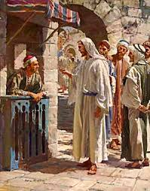
Observe
Mark 2:13-15
Insight
“Then he went out again by the sea; and all the multitude came to him, and he taught them. As he passed by, he saw Levi the son of Alphaeus sitting at the tax office. And he said to him, ‘Follow me.’ So he arose and followed him.
Now it happened, as he was dining in Levi's house, that many tax collectors and sinners also sat together with Jesus and his disciples; for there were many, and they followed him.
Jesus calls Levi (Matthew) to follow him.

Slide 5
Observe
Mark 2:13-15
Insight
“Then he went out again by the sea; and all the multitude came to him, and he taught them. As he passed by, he saw Levi the son of Alphaeus sitting at the tax office. And he said to him, ‘Follow me.’ So he arose and followed him.
Now it happened, as he was dining in Levi's house, that many tax collectors and sinners also sat together with Jesus and his disciples; for there were many, and they followed him.
Levi throws a dinner party. Jews thought tax collectors were traitors. “Sinners” were ones like drunks, drug addicts, street people, etc.

Slide 6
Text: Mark 2:16-17
“And when the scribes and Pharisees saw him eating with the tax collectors and sinners, they said to his disciples, ‘How is it that he eats and drinks with tax collectors and sinners?’ When Jesus heard it, he said to them, ‘Those who are well have no need of a physician, but those who are sick. I did not come to call the righteous, but sinners, to repentance.’”

Slide 7
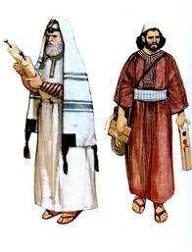
Observe
Mark 2:16-17
Insight
“And when the scribes and Pharisees saw him eating with the tax collectors and sinners, they said to his disciples, ‘How is it that he eats and drinks with tax collectors and sinners?’ When Jesus heard it, he said to them, ‘Those who are well have no need of a physician, but those who are sick. I did not come to call the righteous, but sinners, to repentance.’”
The scribes and Pharisees were legalists and purists. They thought if Jesus were really a prophet, he would not eat with such people.

Slide 8
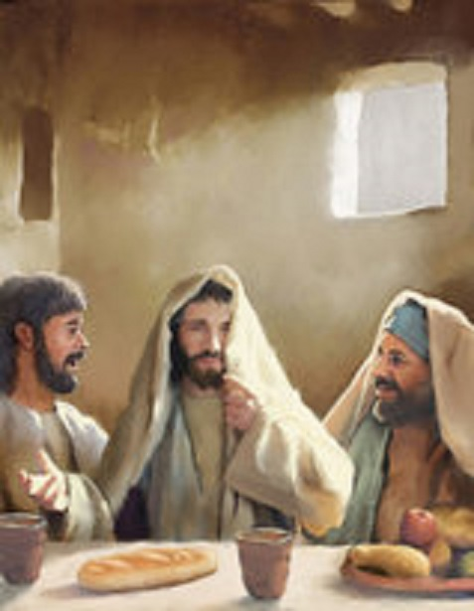
Observe
Mark 2:16-17
Insight
“And when the scribes and Pharisees saw him eating with the tax collectors and sinners, they said to his disciples, ‘How is it that he eats and drinks with tax collectors and sinners?’ When Jesus heard it, he said to them, ‘Those who are well have no need of a physician, but those who are sick. I did not come to call the righteous, but sinners, to repentance.’”
Jesus responded with a short parable about sick people needing a doctor. “Righteous” here means spiritually healthy; “sinners” means spiritually sick. He obviously is the physician.

Slide 9
Text: Mark 2:18-19
“The disciples of John and of the Pharisees were fasting. Then they came and said to him, ‘Why do the disciples of John and of the Pharisees fast, but your disciples do not fast?’
And Jesus said to them, ‘Can the friends of the bridegroom fast while the bridegroom is with them? As long as they have the bridegroom with them they cannot fast.’”

Slide 10
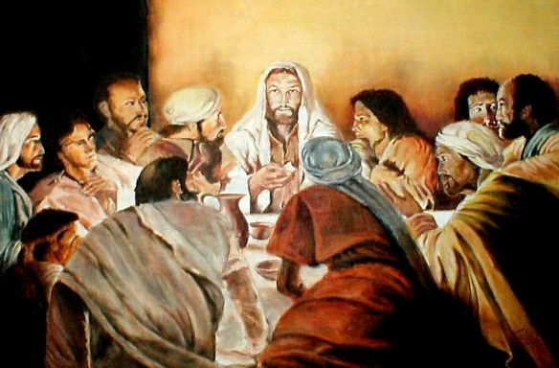
Observe
Mark 2:18-19
Insight
“The disciples of John and of the Pharisees were fasting. Then they came and said to him, ‘Why do the disciples of John and of the Pharisees fast, but your disciples do not fast?’
And Jesus said to them, ‘Can the friends of the bridegroom fast while the bridegroom is with them? As long as they have the bridegroom with them they cannot fast.’”
John the Baptist’s disciples were another group asking Jesus why his followers feasted while they fasted.

Slide 11
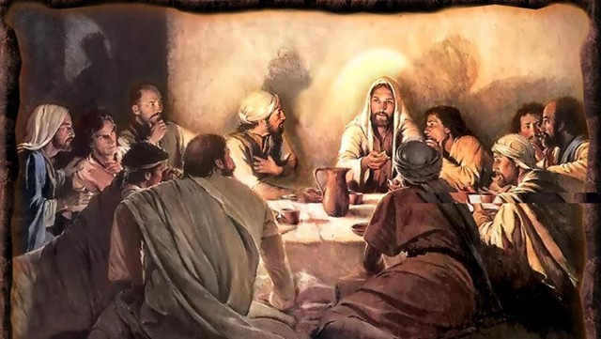
Observe
Mark 2:18-19
Insight
“The disciples of John and of the Pharisees were fasting. Then they came and said to him, ‘Why do the disciples of John and of the Pharisees fast, but your disciples do not fast?’
And Jesus said to them, ‘Can the friends of the bridegroom fast while the bridegroom is with them? As long as they have the bridegroom with them they cannot fast.’”
Jesus answers with another parable about a wedding. The bridegroom is here so we feast, not fast. Jesus obviously is the bridegroom.

Slide 12
Text: Mark 2:20-22
“‘But the days will come when the bridegroom will be taken away from them, and then they will fast in those days. No one sews a piece of unshrunk cloth on an old garment; or else the new piece pulls away from the old, and the tear is made worse. And no one puts new wine into old wineskins; or else the new wine bursts the wineskins, the wine is spilled, and the wineskins are ruined. But new wine must be put into new wineskins.’”

Slide 13
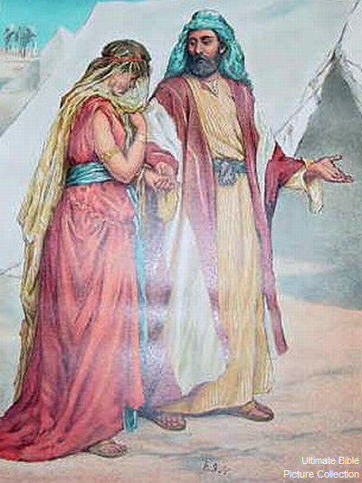
Observe
Mark 2:20-22
Insight
“‘But the days will come when the bridegroom will be taken away from them, and then they will fast in those days. No one sews a piece of unshrunk cloth on an old garment; or else the new piece pulls away from the old, and the tear is made worse. And no one puts new wine into old wineskins; or else the new wine bursts the wineskins, the wine is spilled, and the wineskins are ruined. But new wine must be put into new wineskins.’”
Jesus extends this parable saying his disciples will fast when he is taken away.

Slide 14
Observe
Mark 2:20-22
Insight
“‘But the days will come when the bridegroom will be taken away from them, and then they will fast in those days. No one sews a piece of unshrunk cloth on an old garment; or else the new piece pulls away from the old, and the tear is made worse. And no one puts new wine into old wineskins; or else the new wine bursts the wineskins, the wine is spilled, and the wineskins are ruined. But new wine must be put into new wineskins.’”
Jesus introduces a new parable about an old garment with a tear in it. Common sense said you don’t sew on a patch made of new (unshrunk) cloth because when it shrinks the original tear will become bigger (worse).

Slide 15
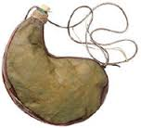
Observe
Mark 2:20-22
Insight
“‘But the days will come when the bridegroom will be taken away from them, and then they will fast in those days. No one sews a piece of unshrunk cloth on an old garment; or else the new piece pulls away from the old, and the tear is made worse. And no one puts new wine into old wineskins; or else the new wine bursts the wineskins, the wine is spilled, and the wineskins are ruined. But new wine must be put into new wineskins.’”
Jesus introduces still another parable about an old wineskin that is stiff. If new wind (that is still fermenting) expands, this expansion/fermenting process will crack an old stiff wineskin, which causes the loss of both.

Slide 16
Observations: 4 illustrations

Slide 17
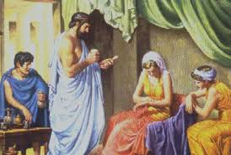
Observations: 4 illustrations
1. The physician

Slide 18
Observations: 4 illustrations
1. The physician
2. The bridegroom

Slide 19
Observations: 4 illustrations
1. The physician
2. The bridegroom
3. The unshrunk patch on old garment

Slide 20
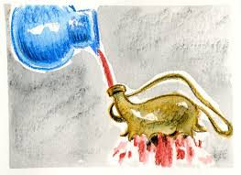
Observations: 4 illustrations
1. The physician
2. The bridegroom
3. The unshrunk patch on old garment
4. New wine in old wineskins

Slide 21
Observations: 4 illustrations
1. The physician
2. The bridegroom
3. The unshrunk patch on old garment
4. New wine in old wineskins
All 4 stories are about common everyday situations that everyone knows about. It appeals to common sense.

Slide 22
The two illustrations of the physician and the bridegroom introduce and ‘set the table’ for the main meal of the double parable of the garments and the wineskins.

Slide 23
Do We See A Pattern Here?

Slide 24
Do We See A Pattern Here?

Slide 25
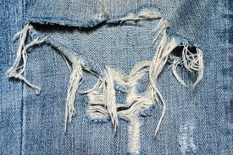
Do We See A Pattern Here?

Slide 26
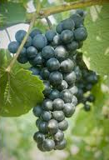
Do We See A Pattern Here?

Slide 27
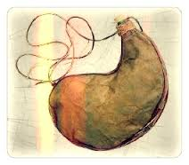
Do We See A Pattern Here?

Slide 28
Do We See A Pattern Here?

Slide 29
Do We See A Pattern Here?

Slide 30
Let’s Interpret This Parable
Unshrunk cloth | New wine | ?
Old garment | Old wineskins | ?
Tear made worse | Spilled wine; ruined wineskin | ?

Slide 31
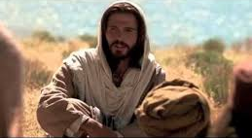
Let’s Interpret This Parable
Unshrunk cloth | New wine | Jesus
Old garment | Old wineskins | ?
Tear made worse | Spilled wine; ruined wineskin | ?

Slide 32
Let’s Interpret This Parable
Unshrunk cloth | New wine | Jesus
Old garment | Old wineskins | Scribes & Pharisees, and John’s disciples
Tear made worse | Spilled wine; ruined wineskin | ?

Slide 33
Let’s Interpret This Parable
Unshrunk cloth | New wine | Jesus
Old garment | Old wineskins | Scribes & Pharisees, and John’s disciples
Tear made worse | Spilled wine; ruined wineskin | Mixing old and new breaks both

Slide 34
Going One Step Further

Slide 35
Going One Step Further

Slide 36
Going Two Steps Further
Jesus doesn’t operate within the Old Testament. He is the fulfillment of it! (Colossians & Hebrews)

Slide 37
Going Two Steps Further
This is one reason why Jesus and other religious Jewish leaders were constantly at odds.

Slide 38
Going Three Steps Further
If you try to understand Jesus only in Old Testament terms, Jesus and the OT are lost like new wine in an old wineskin.

Slide 39
Going Three Steps Further
Instead of anticipating the Messiah predicted in the Old Testament, the scribes, Pharisees and John’s disciples were blinded to him by it!

Slide 40
Consider
While not speaking of this, here is a verse that would have helped the Pharisees, the scribes and John’s disciples to better understand Jesus and what he was doing:

Slide 41
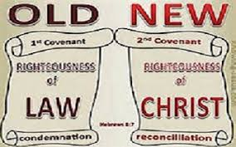
Consider
While not speaking of this, here is a verse that would have helped the Pharisees, the scribes and John’s disciples to better understand Jesus and what he was doing:
2 Corinthians 5:17b(NIV):
“The old has gone, the new is here!”

Slide 42
What is this parable’s focus?
Jesus’ claim of being the physician, bridegroom, new cloth to repair an old garment and the new wine means he is unlike anything or anyone else. He cannot be mixed with anything or anyone else, even when that which was old and inadequate (garment, wineskins, the Old Testament, even John the Baptist) are from God himself! New wine (Jesus) only fits with a new wineskin (New Testament).

Slide 43
Remember
In these parables the main figure is the physician, the
bridegroom, the unshrunk cloth and the new wine. All are
related to something else (patients, bride, old garment, old
wineskin). The first 2 are humans. The last 2 indicate a
proper pairing. Thus in all 4, they indicate the
reality and necessity of a relationship.

Slide 44
Application
We must take Jesus on his terms only (the new).
We can not take him on our terms (the old).
If we do the latter, we will lose both
and thus lose everything!

Slide 45
Application
Our old ideas about ourselves, morality, legalism, religiosity, all
the negatives of our past whether they came from our growing
up family, “friends” and other peers, our culture, etc. must be
scrapped and replaced by Jesus who came to set us free. He
is the only One we need. And a relationship with him is
absolutely paramount for us to be free indeed.

Slide 46
If you would like a free copy of this presentation, please email Bill Perry at bill@billperry.tv

