Slide 1
Why Do We Celebrate Christmas?

Slide 2
Christmas is the holiday that focuses on Jesus coming to earth.
The record of his birth is found in the New Testament books of Matthew and Luke.
Matthew and Luke along with Mark and John are the first 4 books in the New Testament. They are biographies of Jesus. They tell us about the his life.

Slide 3
Why have 4 biographies?

Slide 4
Why have 4 biographies?

Slide 5
Why have 4 biographies?
Witness #1
Witness #3
Witness #2
Witness #4

Slide 6
What do these
biographies
tell us about Jesus?

Slide 7
What do these
biographies
tell us about Jesus?
3 things:

Slide 8
Jesus was tested in the desert by Satan in 3 areas:
a) his needs
b) his purpose
c) his loyalty to God

Slide 9
Jesus was tested in the desert by Satan in 3 areas:
a) his needs
b) his purpose
c) his loyalty to God
He responded to each one by
quoting verses from God’s Word.

Slide 10
Jesus displayed God’s power by helping and healing many people.

Slide 11
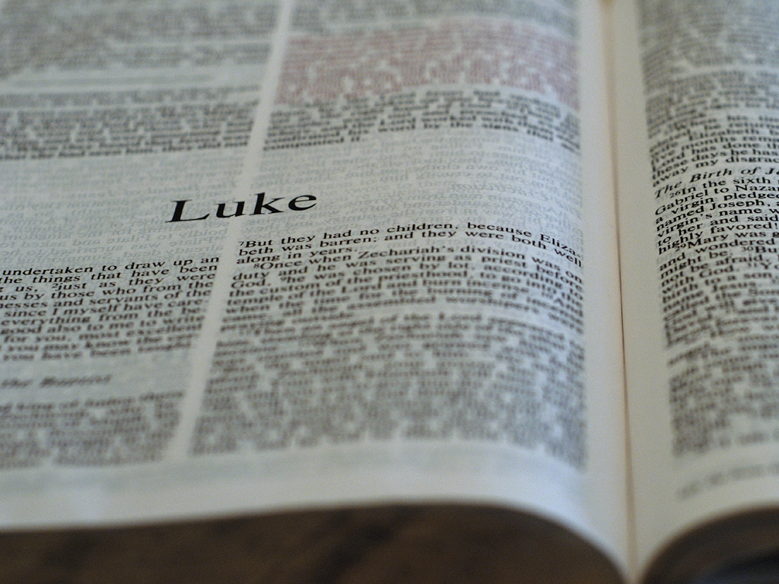
Jesus displayed God’s power by helping and healing many people.
At sunset, the people brought to Jesus all who
had various kinds of sickness, and laying his
hands on each one, he healed them.
--Luke 4:40

Slide 12
Jesus obeyed all of the laws of God:

Slide 13
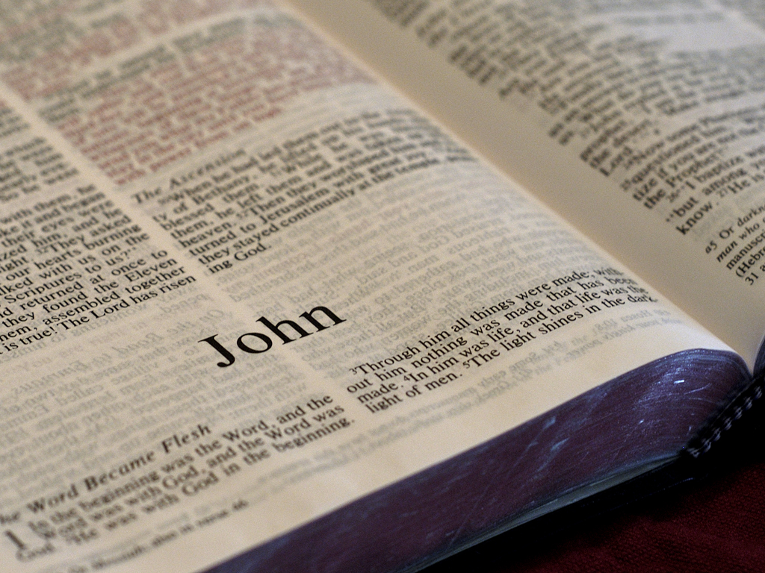
Jesus obeyed all of the laws of God:
“And he who sent me is with me.
The Father has not left me alone,
for I always do those things that
please him.”
-- Jesus in John 8:29

Slide 14
Jesus obeyed all of the laws of God:
“And he who sent me is with me.
The Father has not left me alone,
for I always do those things that
please him.”
-- Jesus in John 8:29
Remember: 1,500 years of Jewish history
proved no one could completely obey the law!

Slide 15
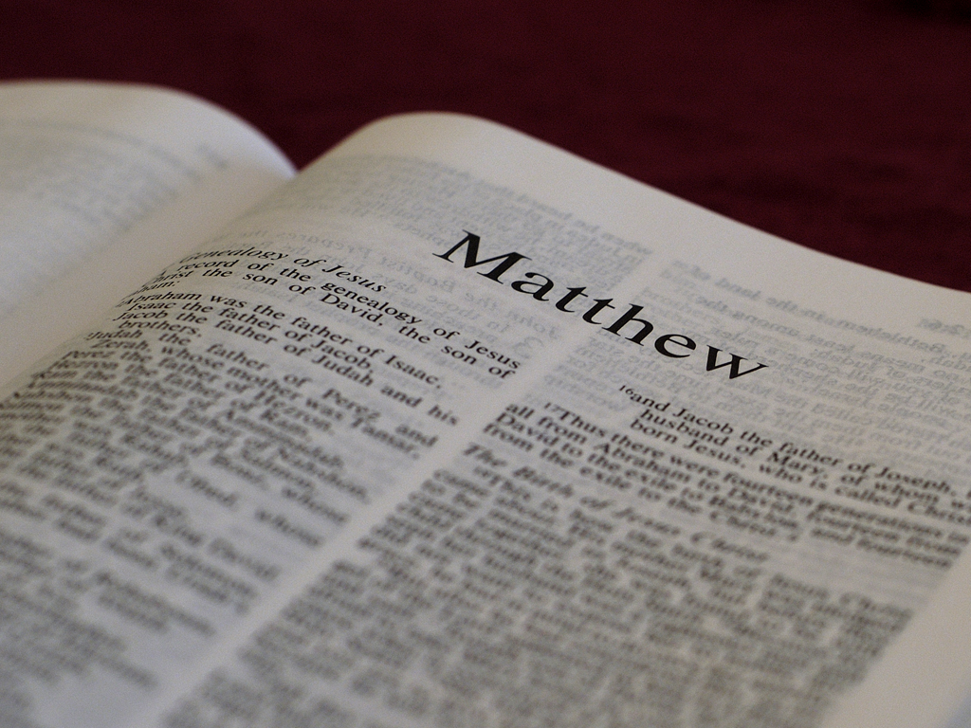
Jesus became very popular with the people who believed he was a prophet from God:
The crowds answered, “This is Jesus, the
prophet from Nazareth in Galilee.”… The
[religious leaders] looked for a way to arrest
him, but they were afraid of the crowd because
the people held that he was a prophet.
-- Matthew 21:11, 46

Slide 16
As a prophet and as the Son of God, Jesus predicted the future:
“No one takes my life from me, but I lay it down
of myself. I have power to lay it down and I have
power to take it again. This command I have
received from my Father.” – Jesus in John 10:18

Slide 17
Despite the popularity Jesus had, God tested him in the Garden of Gethsemane:
Then they came to a place which was named Gethsemane; and he said to his disciples, “Sit here while I pray.” -- Mark 14:32
Jesus knelt down and prayed, “Father, if it is your will, take this cup away from me; nevertheless not my will, but yours, be done.” -- Luke 22:41-42
Note: Gethsemane is called a garden in John 18:26.

Slide 18
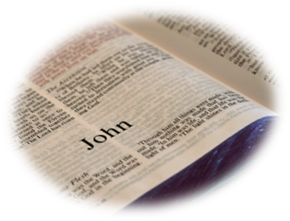
The religious leaders became jealous of Jesus’ popularity:
The Pharisees therefore said among themselves,
“You see that you are accomplishing nothing.
Look, the world has gone after him!”
-- John 12:19

Slide 19
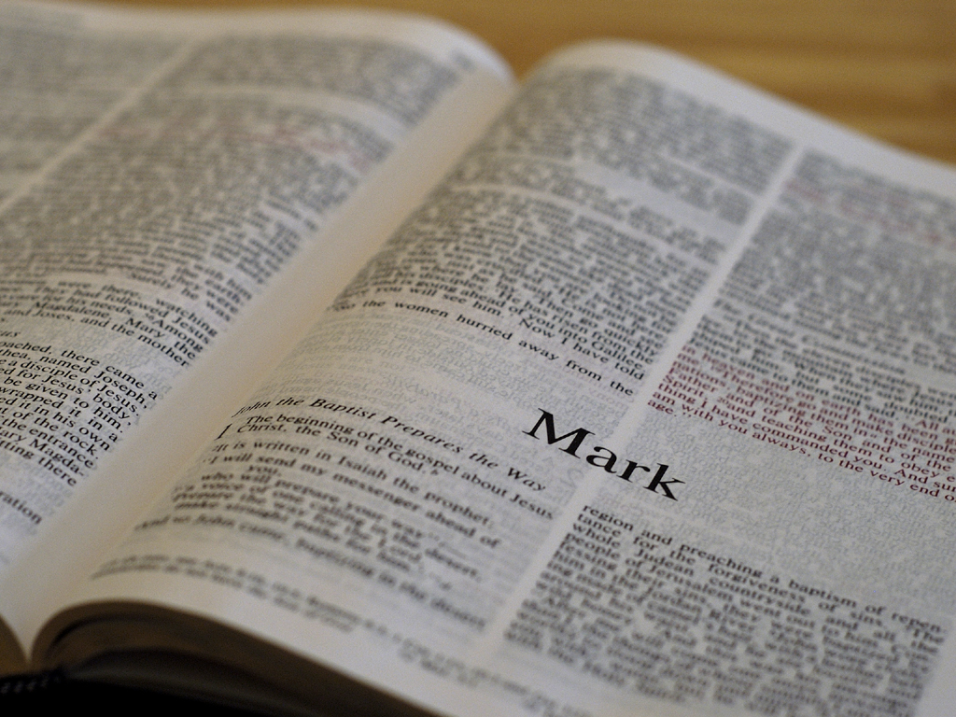
The religious leaders became jealous of Jesus’ popularity:
For [Roman governor Pontius Pilate] knew
that the chief priests had handed Jesus
over because of envy.
-- Mark 15:10

Slide 20
The religious leaders accused Jesus of being a king rebelling against Rome:
Then the whole assembly [of religious leaders]
rose and led Jesus off to Pilate…saying, “We
have found this man subverting our nation…
and claims to be Messiah, a king.” -- Luke 23:1-2

Slide 21
Pontius Pilate interviewed Jesus and said three times he was innocent:
So Pilate asked Jesus, “Are you the king of the Jews?” “You have said so,” Jesus replied. Then Pilate announced, “I find no basis for a charge against this man… I have found no basis for your charges against him. Neither has Herod, for he sent him back to us; as you can see, he has done nothing to deserve death… I have found in him no grounds for the death penalty. -- Luke 23:3-4, 14, 22

Slide 22
By this time, the people had turned against him, following their religious leaders:
Pilate said to the crowd, “What then shall I do
with Jesus who is called the Christ?” They all
said to him, “Let him be crucified.” Then the
governor said, “Why, what evil has he done?”
But they cried out all the more, saying, “Let him
be crucified!” – Matthew 27:22-23

Slide 23
Then for no good reason other than to satisfy the people, Pilate condemns Jesus to death:
Pilate took water and washed his hands in
front of the crowd. “I am innocent of this man’s
blood,” he said. “It is your responsibility!” All
the people answered, “His blood is on us and on
our children!” -- Matthew 27:24-25

Slide 24
Jesus was not angry after he was nailed to a cross:
And when they had come to the place called
Calvary, there they crucified him and the
criminals, one on the right hand and the other
on the left. Then Jesus said, “Father, forgive
them, for they do not know what they do.”
– Luke 23:33-34

Slide 25
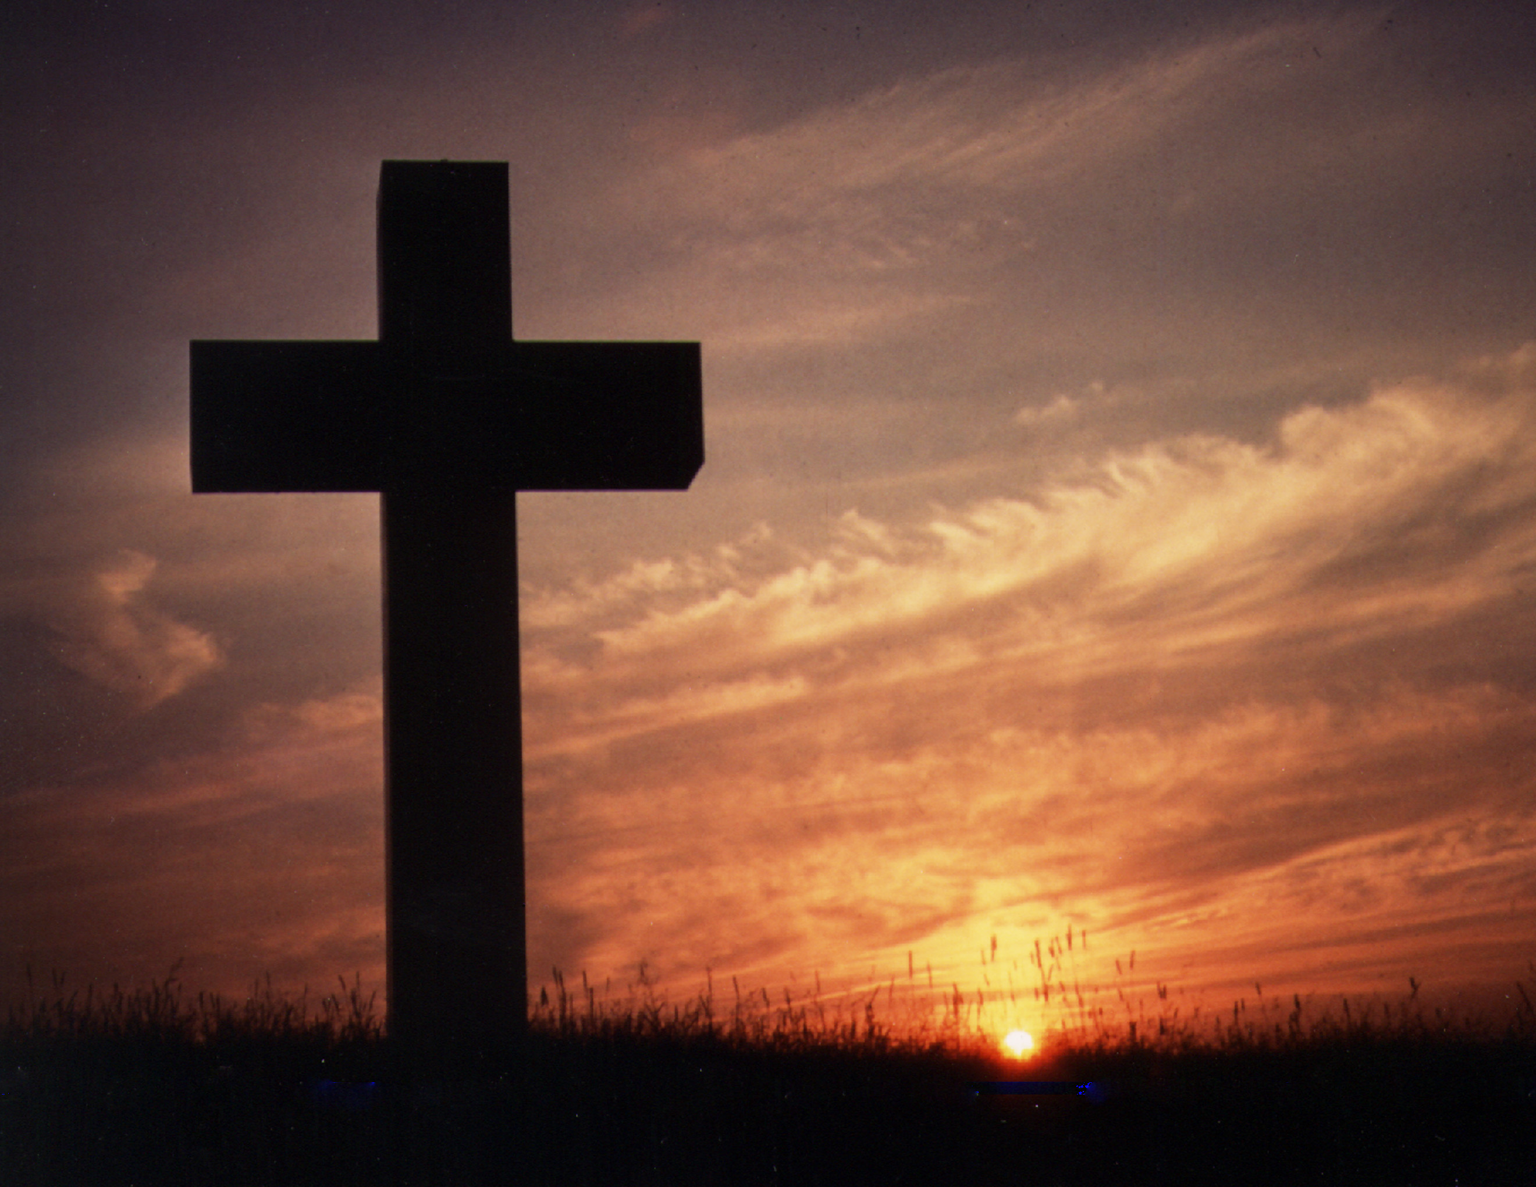
Jesus died on the cross:
Jesus said, “It is finished!” With that, he bowed his head and gave up his spirit.”

Slide 26
Jesus died on the cross:
Jesus said, “It is finished!” With that, he bowed his head and gave up his spirit.”
What was finished?
Jesus had finished paying
the death penalty for us!

Slide 27
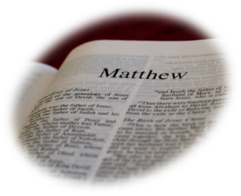
After Jesus died, look what the Roman soldiers said:
Now when the centurion, and they that were
with him, watching Jesus, saw the earthquake,
and those things that were done, they feared
greatly, saying, “Truly this was the Son of God.”
-- Matthew 27:54

Slide 28
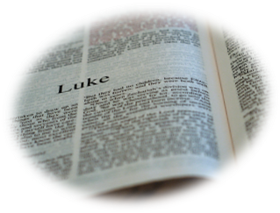
Joseph buried the body of Jesus:
Going to Pilate, [Joseph of Arimathea] asked
for Jesus’ body. Then he took it down, wrapped
it in linen cloth and placed it in a tomb cut in
the rock, one in which no one had yet been laid.
– Luke 22:52-53

Slide 29
Three days later, Jesus rose from the dead:
And entering the tomb, the women saw a young man clothed in a long white robe sitting on the right side; and they were alarmed. But he said to them, “Do not be alarmed. You seek Jesus of Nazareth, who was crucified. He is risen! He is not here. See the place where they laid him. But go, tell his disciples, and Peter, that he is going before you into Galilee; there you will see him as he said to you.” -- Mark 16:6-7

Slide 30
Jesus’ main message after his resurrection:
Rejoice! Do not be afraid. -- Matthew 28:9
“Peace be with you.” – John 20:19
“Peace to you. Why are you troubled and why do doubts rise in your minds? Look at my hands and my feet. It is I myself! Touch me and see: a ghost does not have flesh and bones, as you see I have.”
-- Luke 24:36-39

Slide 31
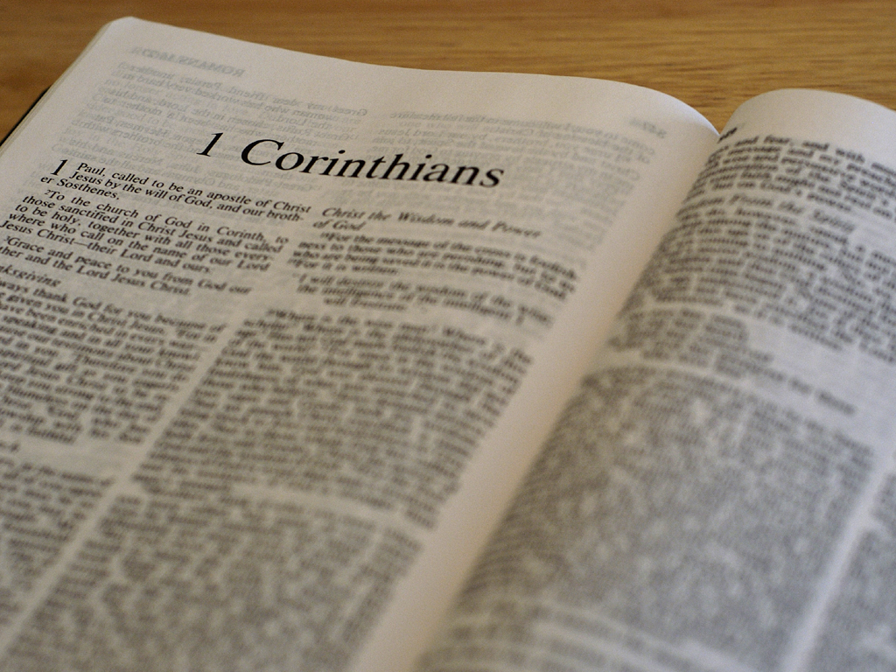
The resurrected Jesus was seen by many:
[Jesus] appeared to Peter, and then to the Twelve
[disciples]. After that, he appeared to more than
five hundred of the brothers and sisters at the
same time, most of whom are still living... Then
he appeared to James, then to all the apostles. -- 1 Corinthians 15:5-7

Slide 32
After 40 days, Jesus returned to heaven:
After the Lord Jesus had spoken to them, he
was taken up into heaven and he sat at the
right hand of God. – Mark 16:19

Slide 33
Why did Jesus have to die?
Adam and Eve disobeyed God and experienced shame, guilt and
fear as evidence of death in broken human beings before they died
physically. God said, “In dying you will really die.” If we die physically,
we will also die spiritually (no hope of returning to God). Since Jesus
died in our place and became our innocent death substitute, his
death can count as our death penalty. Then God could forgive us
and restore us to himself not just after death, but right now!
There is no spiritual death after physical death for
those who trust Jesus Christ.

Slide 34
Why did Jesus rise from the dead?
If Jesus did not rise from the dead, we would never know if God
accepted his death as sufficient for our death penalty. Since Jesus
did rise from the dead, we not only know that God was satisfied
with what Jesus did on the cross, we also know that he
overcame spiritual death for us by demonstrating his
resurrected life on the earth in front of witnesses!
Jesus is stronger than death!

Slide 35
The Two Adams
So it is written: “The first man Adam became a
living being”; the last Adam became a life-
giving spirit…. The first man was of the dust of
the earth; the second man is the Lord of heaven.
– 1 Corinthians 15:45, 47

Slide 36
Compare
The First Man (Adam)
The Last Man (Jesus)
Made in God’s image
Began in innocence and gave life to others (children)
Was given a realm (earth) suitable for him
Suffered a wound in his side
Tested in Eden
Adam failed the test, was banished and died
Made in man’s image
Began in innocence and gives life to others (who trust him)
Was given a realm (kingdom of God) suitable for him
Suffered a wound in his side
Tested in Gethsemane
Jesus passed the test by dying, rising and offering life

Slide 37
What Jesus did for human beings after coming
to earth makes Christmas all the more special for
people who believe and follow him. He came for
us so that evil, guilt, shame, fear and death
would not be the end of our story. Jesus
brought a happy turn-around in God’s
relationship with humanity that
goes on forever for his people!

Slide 38
How do we get that life?
In the Garden of Eden, Adam broke his trust in God. He eventually died physically and so will we.
Because Jesus paid for our shame, guilt and fear by dying, God invites us to trust him by putting our faith in Jesus for eternal life. God wants us to have it now and forever.
Simple trust in Jesus is all that God requires to gain eternal life. Who do you trust? Who do you believe?

Slide 39
Jesus said this to his disciples after he rose from
the dead:
“Because you have seen me, you have believed;
blessed are those who have not seen and
have yet believed.”
-- John 20:29

Slide 40
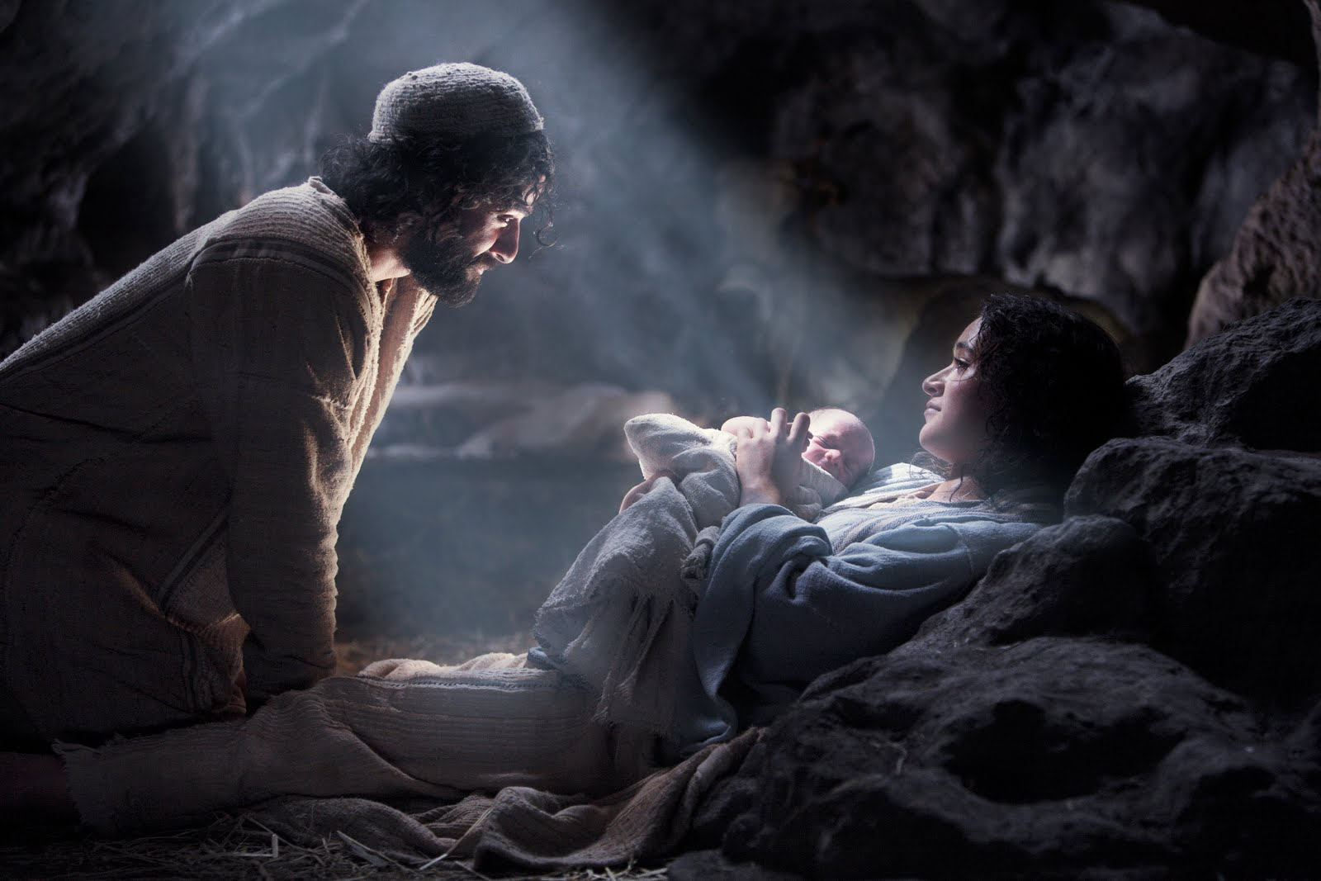
Here is the meaning of Christmas:
Jesus came to our home at his birth so we could go to his home at our death. This is the reason to celebrate!

Slide 41
FREE!
If you would like to receive all 4 powerpoint
presentations for free, please email Bill at:
bill@billperry.tv
Thank you. Merry Christmas
and Happy New Year!

