Slide 1
Christmas: The Promised One Arrives!

Slide 2
About the Bible
It claims to be God’s message to all people.
It has 2 main parts:
First Part – Old Testament: about God’s people, the Jews
Second Part – New Testament: about God’s people, the Christians

Slide 3
The Old Testament
Abraham is the main historical character in Genesis. He is the father of the Jewish nation.
Moses is another main character in the Old Testament. God gave his laws to Moses. He wrote them down for the Jewish people.
The Jewish people told God they would obey his laws. For 1,500 years the Old Testament records their total failure to obey them. It was impossible!

Slide 4
The Prophets
A prophet is a person like Moses who hears God speaking to him and writes down what he says. There were about 30 writing prophets that contributed to the Old Testament.
Much of what the prophets wrote were predictions: God telling the future before it happened. Up to 40% of the Bible contains predictions and their fulfillment.

Slide 5
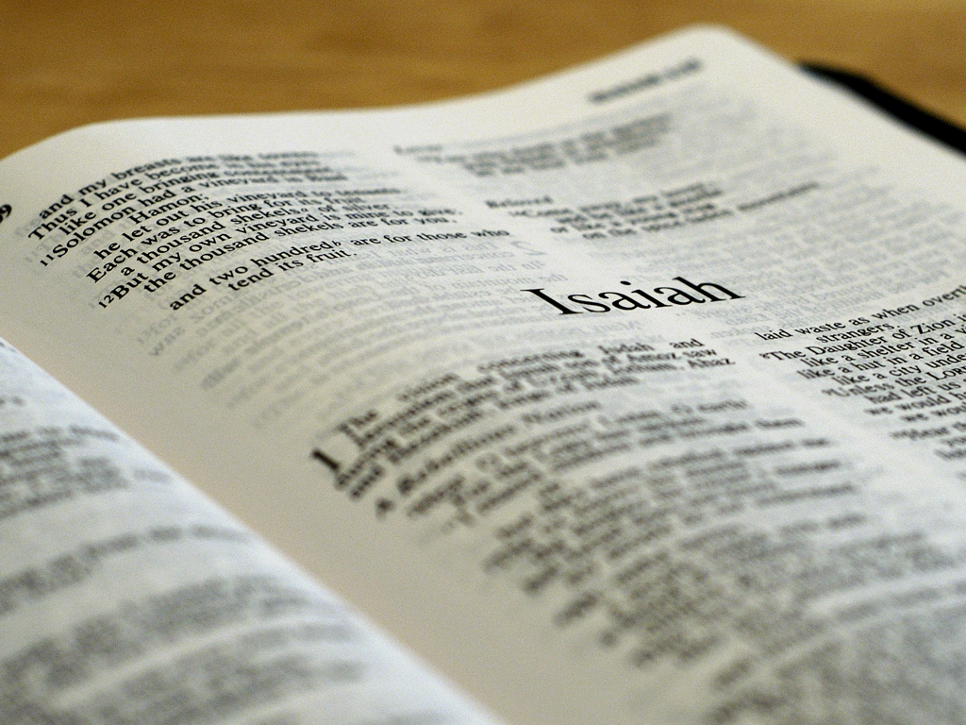
The Prophet Isaiah chapter 48
Verse 3: I foretold the former things long ago, my mouth announced them and I made them known; then suddenly I acted, and they came to pass.
Verse 5: Therefore I told you these things long ago; before they happened I announced them to you so that you could not say, 'My images brought them about; my wooden image and metal god ordained them.'

Slide 6
The Prophet Isaiah chapter 48
Verse 6: You have heard these things; look at them all. Will you not admit them? From now on I will tell you of new things, of hidden things unknown to you.
Verse 7: They are created now, and not long ago; you have not heard of them before today. So you cannot say, 'Yes, I knew of them.'

Slide 7
Predictions about the Promised One
The Old Testament has over 300 predictions of the Promised One. Most are very specific.
Some of these prophecies were made as far back as 2,000 years before they occurred, or 4,000 years ago!

Slide 8
Predictions about the Promised One
Here is a brief sample of only 10 predictions:
★ A virgin mother ★ Betrayed by friend
★ His family line ★ Hated unreasonably
★ His birth town ★ Pierced hands & feet
★ Called from Egypt ★ Buried among rich
★ Rejected by the Jews ★ Returned to heaven

Slide 9
Luke 2:1-3
And it came to pass in those
days that a decree went out
from Caesar Augustus that
all the world should be
registered. This census first
took place while Quirinius
was governing Syria. So all
went to be registered,
everyone to his own city.

Slide 10
Luke 2:1-3
And it came to pass in those
days that a decree went out
from Caesar Augustus that
all the world should be
registered. This census first
took place while Quirinius
was governing Syria. So all
went to be registered,
everyone to his own city.
Caesar Augustus (63 BC –
14AD) founded the Roman
Empire. He ordered this
registration in 8BC. But
political troubles in Syria
delayed the registration for
several years.

Slide 11
Luke 2:1-3
And it came to pass in those
days that a decree went out
from Caesar Augustus that
all the world should be
registered. This census first
took place while Quirinius
was governing Syria. So all
went to be registered,
everyone to his own city.
Quirinius (~51BC – 21AD)
was the governor of Syria
twice. This registration
occurred in his second term
around 4BC.

Slide 12
Luke 2:1-3
This registration was to
count the people by tribes,
clans and families. It would
then be used for taxing
purposes.
And it came to pass in those
days that a decree went out
from Caesar Augustus that
all the world should be
registered. This census first
took place while Quirinius
was governing Syria. So all
went to be registered,
everyone to his own city.

Slide 13
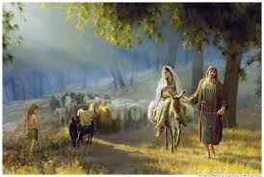
Luke 2:4-5
Joseph also went up from
Galilee, out of the city of
Nazareth, into Judea, to
the city of David, which is
called Bethlehem, because
he was of the house and
lineage of David, to be
registered with Mary, his
betrothed [wife], who was
with child.

Slide 14
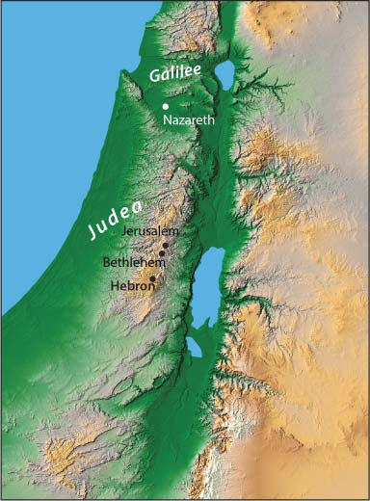
Luke 2:4-5
Joseph also went up from
Galilee, out of the city of
Nazareth, into Judea, to
the city of David, which is
called Bethlehem, because
he was of the house and
lineage of David, to be
registered with Mary, his
betrothed [wife], who was
with child.
Traveling
from Nazareth to Bethlehem
required going over
mountainous roads. The trip
normally took about 3 days
by walking.

Slide 15
Luke 2:4-5
Bethlehem
was the
birthplace
of Israel’s most famous king,
David. Both Joseph and Mary
were members of the royal
family and descendants of
David (Matthew 1 and Luke 3).
Joseph also went up from
Galilee, out of the city of
Nazareth, into Judea, to
the city of David, which is
called Bethlehem, because
he was of the house and
lineage of David, to be
registered with Mary, his
betrothed [wife], who was
with child.

Slide 16
Luke 2:4-5
Joseph also went up from
Galilee, out of the city of
Nazareth, into Judea, to
the city of David, which is
called Bethlehem, because
he was of the house and
lineage of David, to be
registered with Mary, his
betrothed [wife], who was
with child.
Mary was not completely
Joseph’s wife at this time.
She was legally bound to
Joseph to become his wife
(betrothed), but they had
not formally married yet .

Slide 17
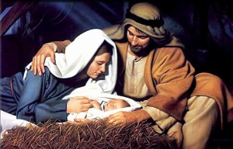
Luke 2:6-7
So it was, that while they
were there, the days were
completed for her to be
delivered. And she brought
forth her firstborn son, and
wrapped him in swaddling
cloths, and laid him in a
manger, because there was
no room for them in the inn.

Slide 18
Luke 2:6-7
So it was, that while they
were there, the days were
completed for her to be
delivered. And she brought
forth her firstborn son, and
wrapped him in swaddling
cloths, and laid him in a
manger, because there was
no room for them in the inn.
Christians think Joseph and
Mary arrived just as she was
ready to give birth. NOT
TRUE! The “days were
completed for her to be
delivered” means that
Joseph had time to make
the necessary preparations.

Slide 19
Luke 2:6-7
So it was, that while they
were there, the days were
completed for her to be
delivered. And she brought
forth her firstborn son, and
wrapped him in swaddling
cloths, and laid him in a
manger, because there was
no room for them in the inn.
Christians think Joseph had
trouble finding a place because
he and Mary were not married
yet, so relatives would not
welcome them. NOT TRUE!
Both Joseph and Mary were
“royals,” descendants of King
David. Relatives would quickly
take them in.

Slide 20
Luke 2:6-7
So it was, that while they
were there, the days were
completed for her to be
delivered. And she brought
forth her firstborn son, and
wrapped him in swaddling
cloths, and laid him in a
manger, because there was
no room for them in the inn.
“Swaddling cloths” are strips
of linen (cloth material) used
to wrap the baby to keep him
still and warm.

Slide 21
Comment
People all over the world will help a woman
who is ready to give birth. Why would those in
Bethlehem be any different? If Joseph could
not find anyone to take them in, Mary had
relatives in a nearby village. They could have
gone there to find lodging. The fact is, they
must have found a ‘host family’ in Bethlehem.

Slide 22
Luke 2:6-7
So it was, that while they
were there, the days were
completed for her to be
delivered. And she brought
forth her firstborn son, and
wrapped him in swaddling
cloths, and laid him in a
manger, because there was
no room for them in the inn.
Christians think “no room in
the inn” means that Joseph
could only find a stable (or
barn) or a cave for Jesus to
be born in. NOT TRUE!
People in Israel did not keep
their animals in open
stables, and caves are not
common in that area.

Slide 23
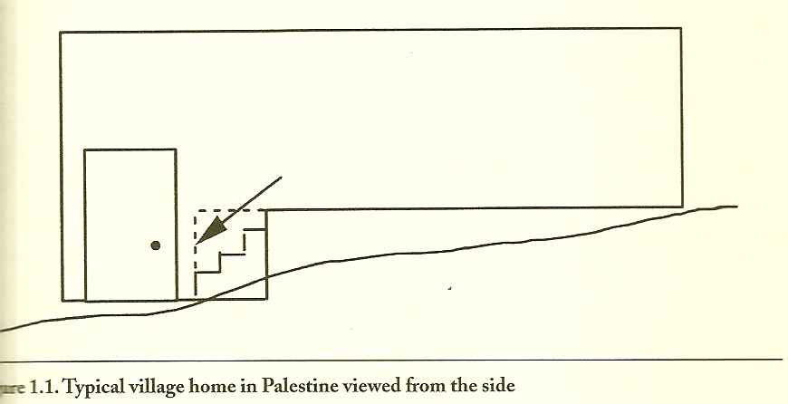
Common Housing in Israel

Slide 24
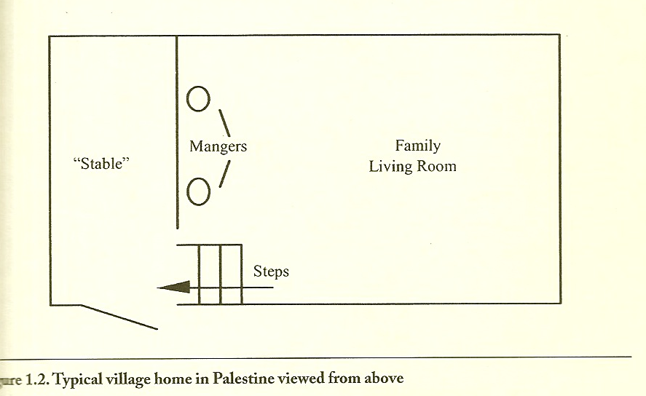
Common Housing in Israel

Slide 25
Luke 2:6-7
So it was, that while they
were there, the days were
completed for her to be
delivered. And she brought
forth her firstborn son, and
wrapped him in swaddling
cloths, and laid him in a
manger, because there was
no room for them in the inn.
Christians think “no room in
the inn” means that this was
a place like an ancient motel
where guests could pay
money to spend the night.
NOT TRUE! The word “inn”
means a guest room built as
part of a private home,
either on the side or on top.

Slide 26
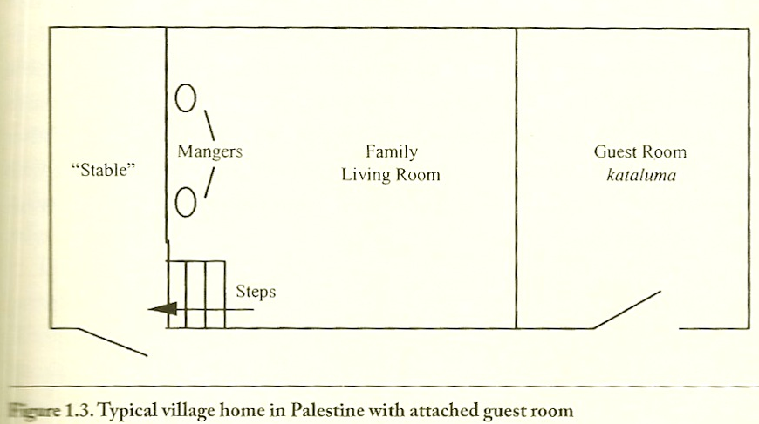
Common Housing in Israel

Slide 27
Comment
As the host family welcomed Joseph and Mary,
someone ran to get the village midwife (every
village had a midwife). The men in the ‘host
family’ left Mary, the midwife and any other
female helpers in the home for the birth of
Baby Jesus. After he was born, they laid
Jesus in one of the mangers.

Slide 28
For the ladies: If you are very pregnant and a family opens their home for you to give birth, how would you feel?
For the guys: If you must leave your home for a woman to give birth in your home, how would you feel?

Slide 29
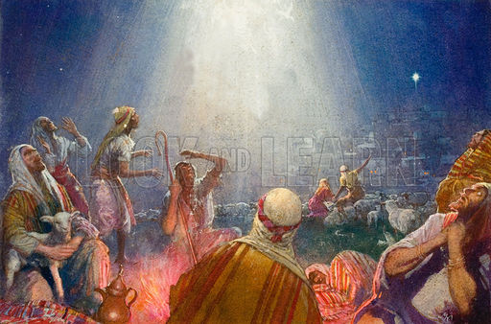
Luke 2:8-9
Now there were in the same
country shepherds living out
in the fields, keeping watch
over their flock by night.
And behold, an angel of the
Lord stood before them, and
the glory of the Lord shone
around them, and they were
greatly afraid.

Slide 30
Luke 2:8-9
Socially speaking,
shepherds were on the same
level as trash collectors.
Their job in the fields kept
them out of the towns and
cities. Some cities refused
them admission. Some people
thought shepherds were law
breakers by trespassing on
private property.
Now there were in the same
country shepherds living out
in the fields, keeping watch
over their flock by night.
And behold, an angel of the
Lord stood before them, and
the glory of the Lord shone
around them, and they were
greatly afraid.

Slide 31
Luke 2:8-9
Now there were in the same
country shepherds living out
in the fields, keeping watch
over their flock by night.
And behold, an angel of the
Lord stood before them, and
the glory of the Lord shone
around them, and they were
greatly afraid.
Angels are spiritual beings
that look like men dressed
in white robes. Angels on
earth do not appear with
wings.

Slide 32
Luke 2:10-12
Then the angel said to them,
“Do not be afraid, for behold, I
bring you good tidings of great
joy which will be to all people.
For there is born to you this
day in the city of David a
Savior, who is Christ the Lord.
And this will be the sign to
you: You will find a Babe
wrapped in swaddling cloths,
lying in a manger.”

Slide 33
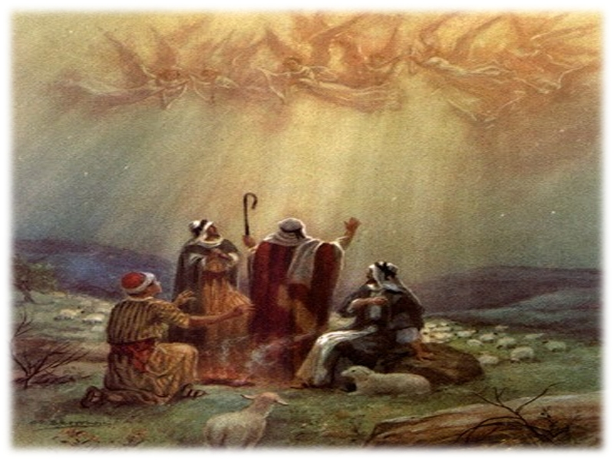
Luke 2:13-14
And suddenly there was
with the angel a multitude
of the heavenly host
praising God and saying:
“Glory to God in the
highest, and on earth
peace, goodwill toward
men!”

Slide 34
Luke 2:13-14
And suddenly there was
with the angel a multitude
of the heavenly host
praising God and saying:
“Glory to God in the
highest, and on earth
peace, goodwill toward
men!”
In the Bible, a “heavenly
host” is an army or large
number of soldiers or
angels.

Slide 35
Luke 2:13-14
And suddenly there was
with the angel a multitude
of the heavenly host
praising God and saying:
“Glory to God in the
highest, and on earth
peace, goodwill toward
men!”
Many Christians think this
large group of angels was
singing their praise to
God. POSSIBLY! They
were either speaking or
singing their praise. What
does music do to our
talk?

Slide 36
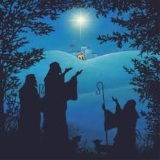
Luke 2:15-16
So it was, when the angels had
gone away from them into
heaven, that the shepherds
said to one another, “Let us
now go to Bethlehem and see
this thing that has come to
pass, which the Lord has made
known to us.” And they came
with haste and found Mary
and Joseph, and the Babe
lying in a manger.

Slide 37
Luke 2:15-16
So it was, when the angels had
gone away from them into
heaven, that the shepherds
said to one another, “Let us
now go to Bethlehem and see
this thing that has come to
pass, which the Lord has made
known to us.” And they came
with haste and found Mary
and Joseph, and the Babe
lying in a manger.
Since Joseph was back in the
house with Mary and Jesus,
this means that any males in
the ‘host family’ had returned
to their home.

Slide 38
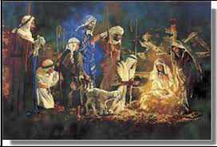
Luke 2:17-18
Now when they had seen
him, they made widely
known the saying which
was told them concerning
this Child. And all those
who heard it marveled at
those things which were
told them by the
shepherds.

Slide 39
Luke 2:17-18
Now when they had seen
him, they made widely
known the saying which
was told them concerning
this Child. And all those
who heard it marveled at
those things which were
told them by the
shepherds.
What made people marvel
was that angels would talk
to lowly shepherds telling
them about the birth of a baby
King in a royal family who
was not born in a palace but
a normal or common house
and laid in a manger!

Slide 40
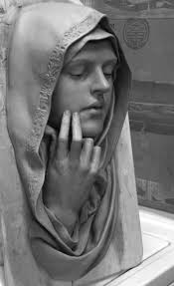
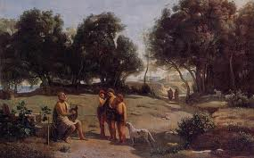
Luke 2:19-20
But Mary kept all these
things and pondered them
in her heart. Then the
shepherds returned,
glorifying and praising
God for all the things that
they had heard and seen,
as it was told them.

Slide 41
If you are in the lower end of society like a
shepherd, how would you feel now that
angels visited you at night, told you about
the birth of a king, told you to visit this
newborn king, and you were the first
non-family members to see him?

Slide 42
Luke 2:19-20
But Mary kept all these
things and pondered them
in her heart. Then the
shepherds returned,
glorifying and praising
God for all the things that
they had heard and seen,
as it was told them.
If the shepherds had seen a
newborn King in an open
stable or cave, they could
not have praised God for
that. They would have
taken Jesus and his parents
to their own homes, which
would be better lodging.

Slide 43
Luke 2:19-20
But Mary kept all these
things and pondered them
in her heart. Then the
shepherds returned,
glorifying and praising
God for all the things that
they had heard and seen,
as it was told them.
Besides Joseph and Mary and
the host family, the shepherds
were the first people to see the
newborn Jesus. They were very
excited to be his witnesses!
God had promised long ago to
send someone to the earth to
defeat our enemy. Now they
were part of his story!

Slide 44
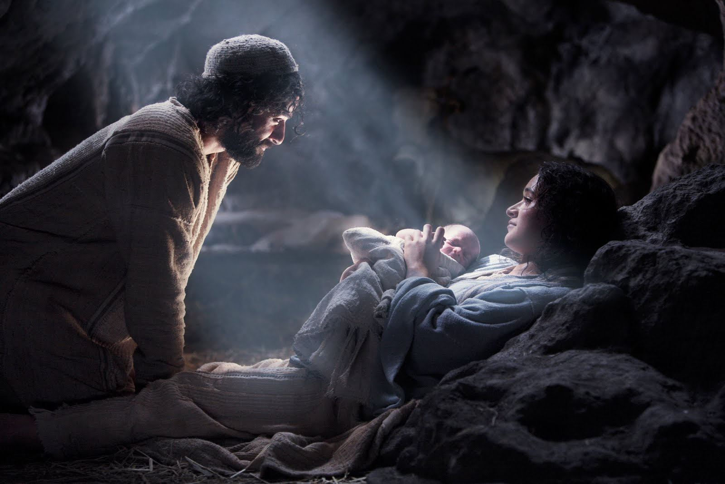
Conclusion
The Christmas story is amazing because God kept his promise and sent the Promised One, Jesus, a Lord and King and Savior. He was born in humble conditions and worshiped by shepherds and common people, meaning he was approachable, even as a baby. God fulfilled many of his predictions made over thousands of years. This is the true meaning of Christmas. Jesus’ birth on earth was the first step in God’s plan. What happened next? Come back for more!

