Slide 1
The Language of Sovereignty (Predestination, part 3)
Bill Perry

Slide 2
Review of Predestination
The Synod of Dort first synthesized the 5 Points of Calvinism in their meetings (1618-1619).
God’s “elect” people are always and only those of the nation of Israel in both Old and New Testaments.
Romans 8:29-30 simply identifies the process of salvation that was planned before time began and was meant originally for the Jews. It does not present evidence for the Calvinistic “Golden Chain of Redemption,” allegedly describing God’s choosing only to save some for salvation and letting the ‘unchosen’ spend eternity in the lake of fire.

Slide 3
For this final talk we will consider how
many Bible verses contain “the language of
sovereignty,” or language that describes
actions of God who is not limited by time
or space and therefore difficult to fully
describe in the limitations of language.

Slide 4
Terms
There are a few words that Calvinists focus on.
The following are the most frequently used.
Elect/Election/Chose/Chosen
Foreknow/Foreknowledge
Predestined
Call/Called

Slide 5
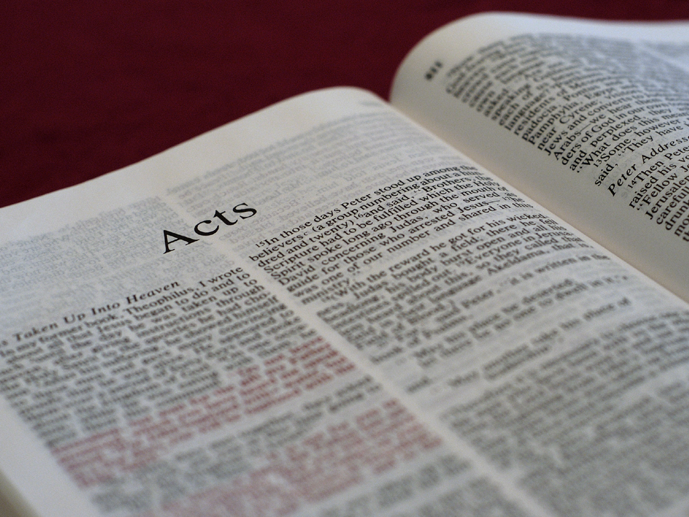
Acts 26:4-5
“My manner of life from my youth, which was
spent from the beginning among my own
nation at Jerusalem, all the Jews know. They
knew me from the first, if they were willing to
testify, that according to the strictest sect of
our religion I lived a Pharisee.”

Slide 6
Consider
Acts 26:4-5
Comment
“My manner of life from my
youth, which was spent from
the beginning among my own
nation at Jerusalem, all the
Jews know. They knew me
from the first, if they were
willing to testify, that according
to the strictest sect of our
religion I lived a Pharisee.”
“Knew” here in the Greek is foreknow (proginōskō προγινώσκ). It speaks of Jews knowing something about Paul. By knowing people well, we can expect or predict certain behaviors or trends. This has nothing to do with predestining anyone (Romans 8:29).

Slide 7
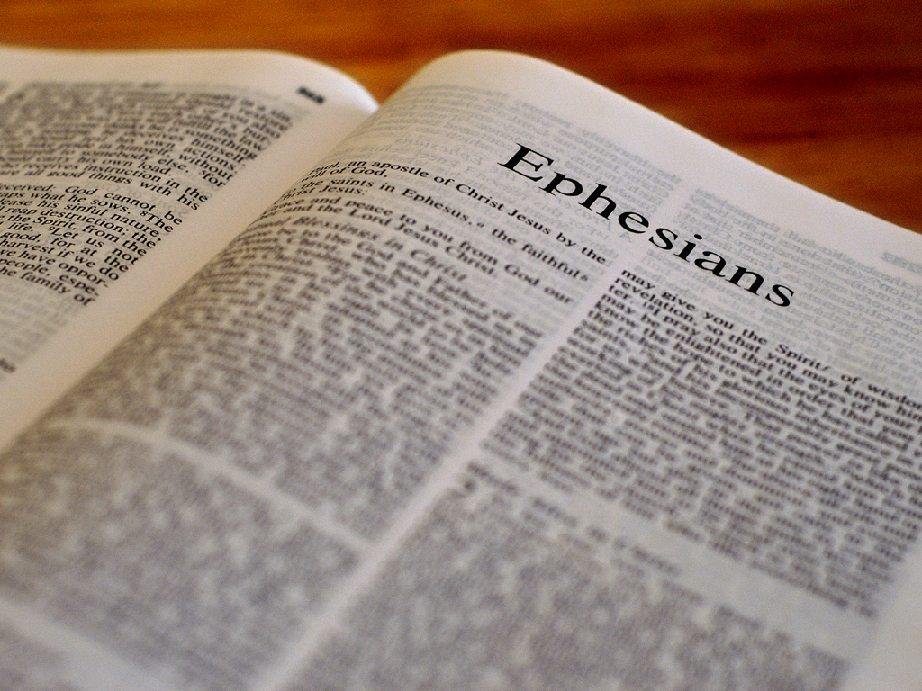
Ephesians 1:4-5
Just as he chose us in him before the
foundation of the world, that we should
be holy and without blame before him in
love, having predestined us to adoption
as sons by Jesus Christ to himself,
according to the good pleasure of his will…

Slide 8
Consider
Ephesians 1:4-5
Comment
Just as he chose us in him
before the foundation of the
world, that we should be holy
and without blame before him
in love, having predestined us
to adoption as sons by Jesus
Christ to himself, according to
the good pleasure of his will…
All of God’s sovereign acts happened “before the foundation of the world.” “Us” in “chose us” means believers in Jesus were put into Christ after taken out of Adam, a major theme in Romans and Ephesians. This is part of the salvation intended (first) for Jews and (then) Gentiles alike.

Slide 9
Consider
Ephesians 1:4-5
Comment
Just as he chose us in him
before the foundation of the
world, that we should be holy
and without blame before him
in love, having predestined us
to adoption as sons by Jesus
Christ to himself, according to
the good pleasure of his will…
The “adoption as sons by Jesus Christ to himself” is another blessing of the salvation intended for Jews first. Like being chosen to be in Christ’s body, God predetermined this benefit of salvation for believers before time began.

Slide 10
Ephesians 1:11-12
In him also we have obtained an inheritance,
being predestined according to the purpose
of him who works all things according to the
counsel of his will, that we who first trusted
in Christ should be to the praise of his glory.

Slide 11
Consider
Ephesians 1:11-12
Comment
In him also we have obtained
an inheritance, being
predestined according to the
purpose of him who works
all things according to the
counsel of his will, that we
who first trusted in Christ
should be to the praise of his
glory.
What God predestines is according to his purpose and according to his will for Jews first. But Jews widely rejected God’s offer, so Gentiles became the first beneficiaries. His working all things by the counsel of his will is for all those “who first trusted Christ.”

Slide 12
Consider
Ephesians 1:11-12
Comment
In him also we have obtained
an inheritance, being
predestined according to the
purpose of him who works
all things according to the
counsel of his will, that we
who first trusted in Christ
should be to the praise of his
glory.
These words remind us of Romans 8:28, “And we know that all things work together for good to those who love God, to those who are the called according to his purpose.” While thousands of Jews trusted their Messiah initially (see Acts), the vast majority of Jews rejected him following their leaders.

Slide 13
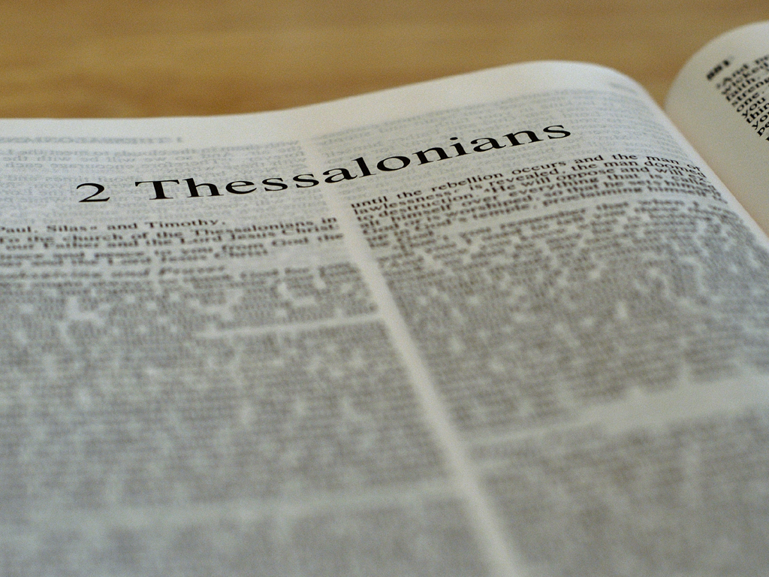
2 Thessalonians 2:13-14
But we are bound to give thanks to God
always for you, brethren beloved by the Lord,
because God from the beginning chose you
for salvation through sanctification by the
Spirit and belief in the truth, to which he
called you by our gospel, for the obtaining
of the glory of our Lord Jesus Christ.

Slide 14
Consider
2 Thessalonians 2:13-14
Comment
But we are bound to give thanks
to God always for you, brethren
beloved by the Lord, because God
from the beginning chose you for
salvation through sanctification
by the Spirit and belief in the
truth, to which he called you by
our gospel, for the obtaining of
the glory of our Lord Jesus Christ.
The church in Thessalonica began after Jews and Gentiles believed Paul’s Jesus-is-the-Messiah type of message over 3 Sabbaths. Some Jews and “a great multitude of the devout Greeks” joined Paul (Acts 17:1-4). So this was a Jewish- Gentile congregation.

Slide 15
Consider
2 Thessalonians 2:13-14
Comment
But we are bound to give thanks
to God always for you, brethren
beloved by the Lord, because God
from the beginning chose you for
salvation through sanctification
by the Spirit and belief in the
truth, to which he called you by
our gospel, for the obtaining of
the glory of our Lord Jesus Christ.
As already shown, God chose Israel as Abraham’s descendants for salvation. Israel’s disobedience opened up salvation for Gentiles. Thus, “from the beginning” God sanctified all those who believe “in the truth” as he predestined all along.

Slide 16
Consider
2 Thessalonians 2:13-14
Comment
But we are bound to give thanks
to God always for you, brethren
beloved by the Lord, because God
from the beginning chose you for
salvation through sanctification
by the Spirit and belief in the
truth, to which he called you by
our gospel, for the obtaining of
the glory of our Lord Jesus Christ.
When the gospel is shared it is the way God calls outsiders to himself. Not everyone hears the gospel partly because they have not believed in the heavens’ declaration of “the glory of God” (Psalm 19:1), showing their hearts are not ready. Jesus told parables to seeing and hearing people who didn’t see or hear or even understand (Matthew 13:13) because they were not ready.

Slide 17
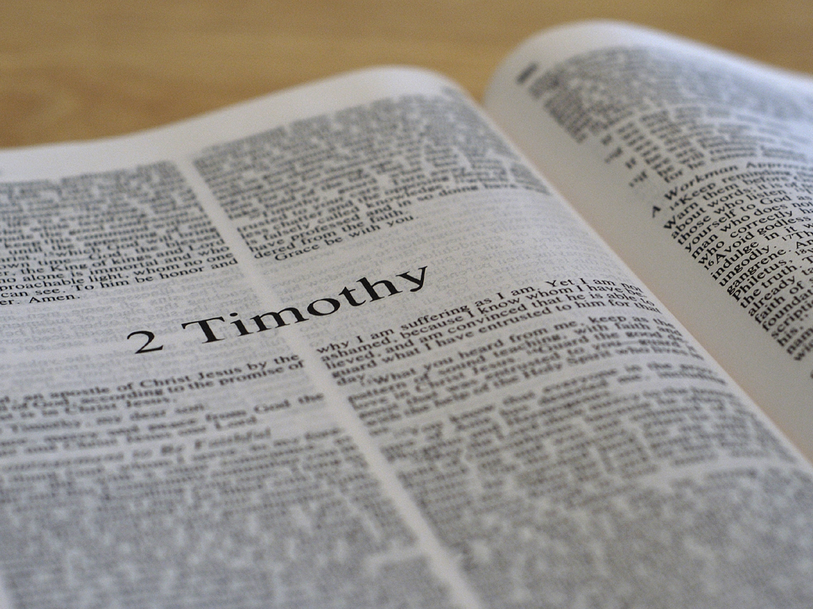
2 Timothy 1:9
[God] has saved us and called us with a
holy calling, not according to our works,
but according to his own purpose
and grace which was given to us in
Christ Jesus before time began…

Slide 18
Consider
2 Timothy 1:9
Comment
[God] has saved us and called
us with a holy calling, not
according to our works, but
according to his own purpose
and grace which was given to
us in Christ Jesus before time
began…
Paul refers to being “called” as part of the redeemed community of believers meant first for Jews and then Gentiles. It was a call to holiness, a call to be like God who is holy (Leviticus 11:44-45, 19:2, 20;7; 1 Peter 1:15).

Slide 19
Consider
2 Timothy 1:9
Comment
[God] has saved us and called
us with a holy calling, not
according to our works, but
according to his own purpose
and grace which was given to
us in Christ Jesus before time
began…
From the perspective of God who lives in eternity, he sees everything all at once. From that perspective God made his calling to be in Christ. He always foreknew who would trust him, and in that sense we see the language of sovereignty spoken here as to when believers receive salvation and a holy calling.

Slide 20
1 Peter 1:1-2
Peter, an apostle of Jesus Christ, To the
pilgrims of the Dispersion in Pontus, Galatia,
Cappadocia, Asia, and Bithynia, elect according
to the foreknowledge of God the Father, in
sanctification of the Spirit, for obedience
and sprinkling of the blood of Jesus Christ:
Grace to you and peace be multiplied.

Slide 21
Consider
1 Peter 1:12
Comment
Peter, an apostle of Jesus Christ,
To the pilgrims of the Dispersion
in Pontus, Galatia, Cappadocia,
Asia, and Bithynia, elect
according to the foreknowledge
of God the Father, in
sanctification of the Spirit, for
obedience and sprinkling of the
blood of Jesus Christ: Grace to
you and peace be multiplied.
“The pilgrims of the Dispersion” were scattered Jews in 5 provinces of Asia Minor (present day Turkey) who also had trusted Christ. Jews were God’s elected/chosen people. These Jews received the salvation benefits first promised to their ancestor Abraham.

Slide 22
1 Peter 1:20
He [Jesus] indeed was foreordained
before the foundation of the world, but
was manifest in these last times for you…

Slide 23
Consider
1 Peter 1:20
Comment
He [Jesus] indeed was
foreordained before the
foundation of the world, but
was manifest in these last
times for you…
“Foreordained” here means foreknown. The members of the Godhead planned out salvation in Jesus for fallen mankind before the world began. Jesus fulfilled everything perfectly. We see the language of sovereignty at work here, but it’s clear because Jesus is eternal.

Slide 24
1 Peter 5:10
But may the God of all grace, who called
us to his eternal glory by Christ Jesus,
after you have suffered a while, perfect, establish, strengthen, and settle you.

Slide 25
Consider
1 Peter 5:10
Comment
But may the God of all grace,
who called us to his eternal
glory by Christ Jesus, after you
have suffered a while, perfect,
establish, strengthen, and
settle you.
As a Jewish believer Peter simply says that God called Jewish believers to what they (and thus Gentile believers too) could never achieve on their own: his eternal glory. Nothing more, nothing less. There are no Calvinistic nuances here.

Slide 26
2 Peter 3:17
You therefore, beloved, since you know
this beforehand, beware lest you also fall
from your own steadfastness, being led
away with the error of the wicked…

Slide 27
Consider
2 Peter 3:17
Comment
You therefore, beloved, since
you know this beforehand,
beware lest you also fall from
your own steadfastness, being
led away with the error of the
wicked…
Like the Jews in Acts 26 who foreknew Paul, Jewish believers know ahead of time that false teachers will appear (v. 16). This too has no Calvinistic overtones.

Slide 28
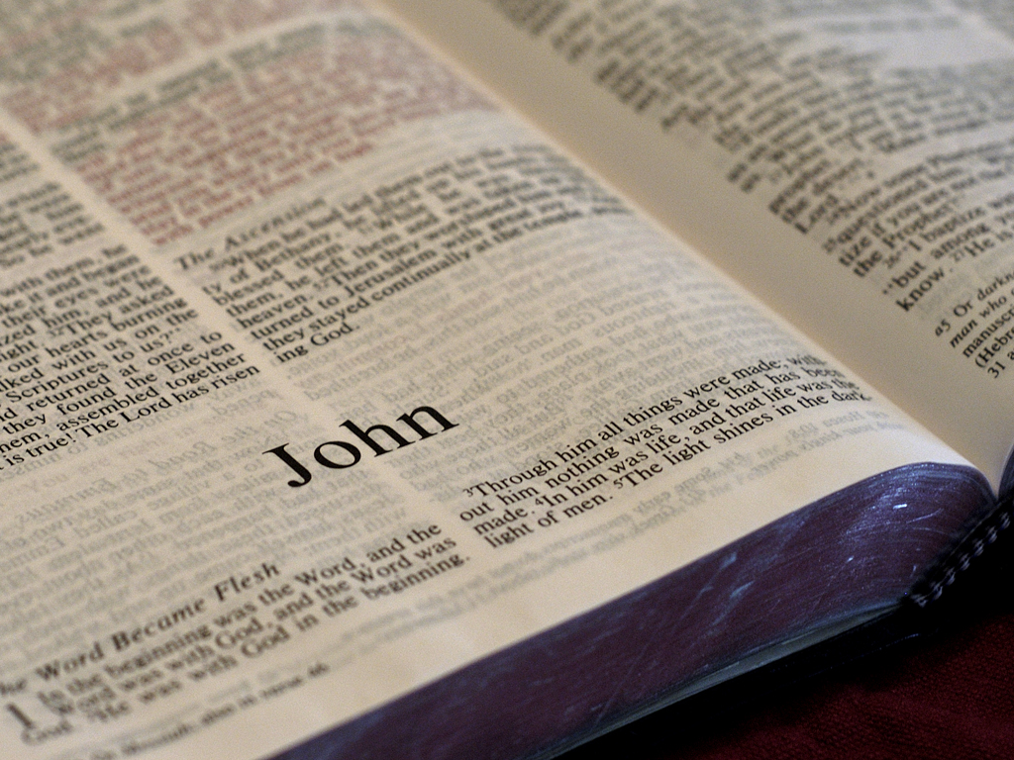
John 1:12-13
But as many as received him, to them he gave
the right to become children of God, to those
who believe in his name: who were born, not
of blood, nor of the will of the flesh, nor
of the will of man, but of God.

Slide 29
Consider
John 1:12-13
Comment
But as many as received him,
to them he gave the right to
become children of God, to
those who believe in his
name: who were born, not of
blood, nor of the will of the
flesh, nor of the will of man,
but of God.
Calvinists like to make much of the fact that believers did not “will” themselves to be saved. We already know that it was God’s will to give salvation promised long ago to Jews. Once man’s will aligns with God’s will, God gives them new birth. Man’s will outside of God’s will is useless for spiritual things.

Slide 30
John 6:37,39
“All that the Father gives me will come to me,
and the one who comes to me I will by no
means cast out…This is the will of the Father
who sent me, that of all he has given me I
should lose nothing, but should raise
it up at the last day…

Slide 31
Consider
John 6:37, 39
Comment
“All that the Father gives me
will come to me, and the one
who comes to me I will by no
means cast out…This is the will
of the Father who sent me,
that of all he has given me I
should lose nothing, but
should raise it up at the last
day…
These verses indicate that at some point in time or eternity the Father gave believers to the Son for the purpose that Jesus would lose none of them. Since the timing of this is not clear, we should see this as another example of the language of sovereignty.

Slide 32
John 6:44-45, 65
No one can come to me unless the Father who
sent me draws him; and I will raise him up at the
last day. It is written in the prophets, ‘And they
shall all be taught by God.’ Therefore everyone
who has heard and learned from the Father
comes to me.”… And he said, “Therefore I have
said to you that no one can come to me unless it
has been granted to him by my Father.”

Slide 33
Consider
John 6:44-45, 65
Comment
No one can come to me unless
the Father who sent me draws
him; and I will raise him up at the
last day. It is written in the prophets,
‘And they shall all be taught by God.’
Therefore everyone who has heard
and learned from the Father comes
to me.”… And he said, “Therefore I
have said to you that no one can
come to me unless it has been
granted to him by my Father.”
These verses say clearly that (1) All believers are drawn by the Father to come to Christ, (2) believers hear/learn from the Father, and (3) believers are “granted” (give, bestow, add, etc.) by the Father. This describes the Father’s part in the process but does not say when such actions occur.

Slide 34
Consider
John 6:44-45, 65
Comment
No one can come to me unless
the Father who sent me draws
him; and I will raise him up at the
last day. It is written in the prophets,
‘And they shall all be taught by God.’
Therefore everyone who has heard
and learned from the Father comes
to me.”… And he said, “Therefore I
have said to you that no one can
come to me unless it has been
granted to him by my Father.”
Since Jesus also draws (same Greek word) people when on the cross (John 12:32), and Jesus spoke the words of the Father (8:28, 38; 12:49-50; 14:10; 16:13), it is likely that in John 6 he is pointing to the involvement of the Godhead in salvation promised first to the Jews.

Slide 35
John 17:2,6,9,11b,12b,24a
…[A]s you have given him authority over all flesh, that he should
give eternal life to as many as you have given him…I have
manifested your name to the men whom you have given me out
of the world. They were yours, you gave them to me, and they
have kept your word…I pray for them. I do not pray for the world
but for those whom you have given me, for they are yours…Holy
Father, keep through your name those whom you have given me,
that they may be one as we are…Those whom you gave me I
have kept…Father, I desire that they also whom you gave me
may be with me where I am…

Slide 36
John 17:2,6,9,11b,12b,24a
…[A]s you have given him authority over all flesh, that he should
give eternal life to as many as you have given him…I have
manifested your name to the men whom you have given me out
of the world. They were yours, you gave them to me, and they
have kept your word…I pray for them. I do not pray for the world
but for those whom you have given me, for they are yours…Holy
Father, keep through your name those whom you have given me,
that they may be one as we are…Those whom you gave me I
have kept…Father, I desire that they also whom you gave me
may be with me where I am…

Slide 37
Consider
John 17:2,6,9,11b,12b,24a
Comment
…[A]s you have given him authority over all flesh, that he should give eternal life to as many as you have given him…I have manifested your name to the men whom you have given me out of the world. They were yours, you gave them to me, and they have kept your word…I pray for them. I do not pray for the world but for those whom you have given me, for they are yours…Holy Father, keep through your name those whom you have given me, that they may be one as we are…Those whom you gave me I have kept…Father, I desire that they also whom you gave me may be with me where I am…
These 7 references of the Father giving believers to Christ is a major point in this prayer and repeats what Jesus said in chapter 6. But again it does not say when this giving occurred. This appears to be another example of the language of sovereignty.

Slide 38
John 15:16
“You did not choose me, but I chose you and
appointed you that you should go and bear
fruit, and that your fruit should remain,
that whatever you ask the Father
in my name he may give you.

Slide 39
Consider
John 15:16
Comment
“You did not choose me, but I
chose you and appointed you
that you should go and bear
fruit, and that your fruit
should remain, that whatever
you ask the Father in my name
he may give you.
Jesus tells his disciples that they did not make themselves his disciples by their choice. No, he chose them for discipleship training. Notice: their goal was not to be saved but to “bear fruit.” They were already saved by God’s grace through faith. Fruit is a disciple’s goal.

Slide 40
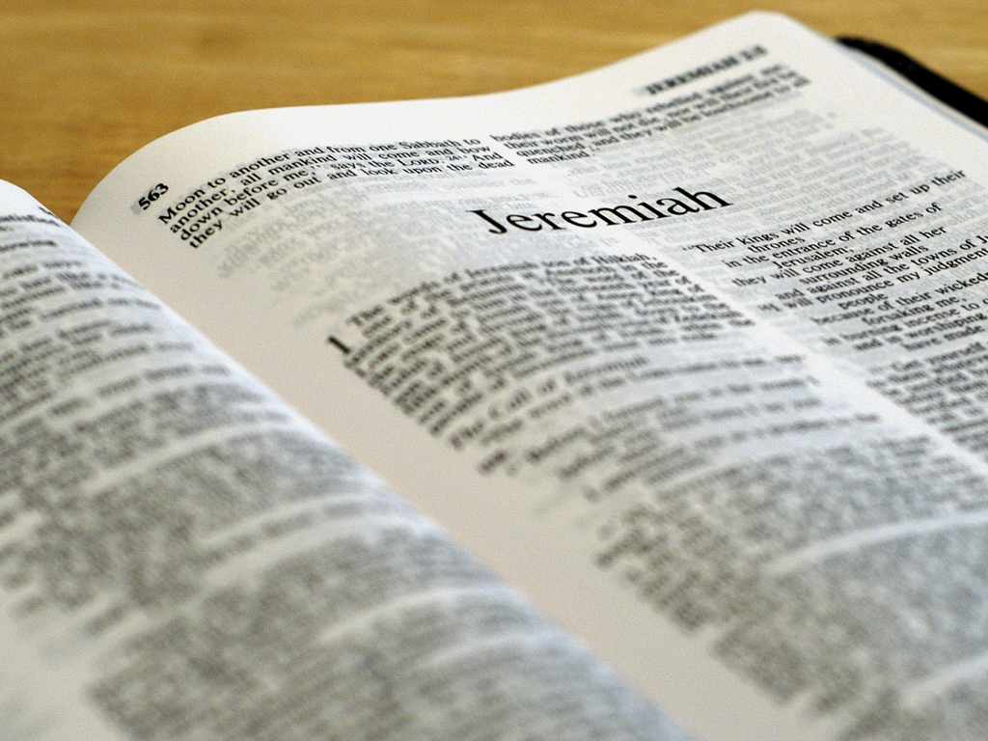
Jeremiah 1:4-5
Then the word of the LORD came to me, saying:
“Before I formed you in the womb I knew you;
Before you were born I sanctified you; I
ordained you a prophet to the nations.”

Slide 41
Jeremiah 1:4-5
Jeremiah 1:4-5
Comment
Then the word of the LORD
came to me, saying: “Before I
formed you in the womb I
knew you; Before you were
born I sanctified you; I
ordained you a prophet to
the nations.”
Calvinists like to use this verse to support their idea of God’s foreknowing people before their birth. Non-Calvinists don’t dispute this point because God is omniscient. How could God not know a person but know that person’s job description?

Slide 42
Jeremiah 1:4-5
Jeremiah 1:4-5
Comment
Then the word of the LORD
came to me, saying: “Before I
formed you in the womb I
knew you; Before you were
born I sanctified you; I
ordained you a prophet to
the nations.”
Calvinists make foreknowing equal to predestining (Rom. 8:29). This is not true. Two different unrelated words have two distinct meanings. Notice again, salvation is not in view here. God says, “Among my elect people (the Jews) I ordain Jeremiah to be a prophet to the nations (not to the Jews).”

Slide 43
Jeremiah 1:4-5
Jeremiah 1:4-5
Comment
Then the word of the LORD
came to me, saying: “Before I
formed you in the womb I
knew you; Before you were
born I sanctified you; I
ordained you a prophet to
the nations.”
“Sanctified” means set apart for God’s purpose. For Jeremiah it was to be “a prophet to the nations.” While all saved people are sanctified (Hebrews 10:10,14), not all sanctified things are related to our salvation (Genesis 2:3; 1 Chr. 15:14; 2 Chr. 7:16, 30:8; 1 Cor. 7:14; 1 Tim. 4:5; 2 Tim. 2:21).

Slide 44
Summary
In this final session we have looked at many of the
Bible verses that Calvinists appeal to when defending
their theological claims. We have seen that when the
Bible speaks for itself, it doesn’t support such claims.
The omniscient eternal God does a marvelous job of
using finite language that fallen human beings can
understand. We do see a few verses that point to the
sovereignty of language, and that is certainly
expected with a great God like ours!

Slide 45
Conclusion
I believe Calvinists by and large are our brothers and
sisters in Christ. They believe in the one true God the
Father, Jesus his Son and the Holy Spirit. They believe that
Jesus died on the cross for our sins and rose from the dead.
They believe in salvation by grace through faith. They
believe in spiritual growth, discipleship and Bible study.
They believe that Jesus will return to earth. So when we
have opportunity let’s welcome their fellowship and
learn what we can from them. And as God permits,
let’s pray they will do the same for us.

