Slide 1
Welcome To Perspectives on the World Christian Movement
September 24, 2016
FIU Miami Campus

Slide 2
Perspectives Lesson 5: “Unleashing the Gospel”
Bill Perry
Chief of Staff
Director of Training Materials
InterFACE Ministries

Slide 3
Session #1
The gist of Lesson 5 is the “breakthrough” or the “turning point” for the gospel as a result of the Council that met in Jerusalem in Acts 15. I would suggest that the council’s conclusion was not so much a breakthrough or turning point as it was a dawning realization that the apostles were catching up to God’s plan revealed earlier.

Slide 4
We will see this plan revealed earlier by
looking first at Jesus’ Gentile encounters
and his statements about the nations
before his death and after his resurrection.

Slide 5
Jesus’ Gentile Encounters:

Slide 6
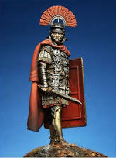
Jesus’ Gentile Encounters:
Roman Centurion (Matt. 8)

Slide 7
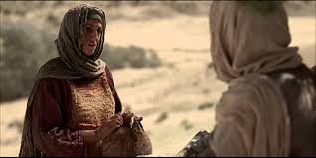
Jesus’ Gentile Encounters:
Roman Centurion (Matt. 8)
Samaritan woman/village (John 4)

Slide 8
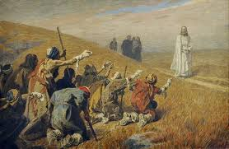
Jesus’ Gentile Encounters:
Roman Centurion (Matt. 8)
Samaritan woman/village (John 4)
Samaritan leper (1 of 10, Luke 17)

Slide 9
Jesus’ Gentile Encounters:
Roman Centurion (Matt. 8)
Samaritan woman/village (John 4)
Samaritan leper (1 of 10, Luke 17)
Canaanite woman (Matt. 15)

Slide 10
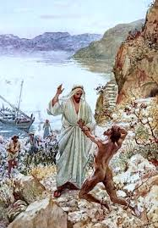
Jesus’ Gentile Encounters:
Roman Centurion (Matt. 8)
Samaritan woman/village (John 4)
Samaritan leper (1 of 10, Luke 17)
Canaanite woman (Matt. 15)
Gadarene demoniac (Matt. 8)

Slide 11
Jesus’ statements about the nations before his death:

Slide 12
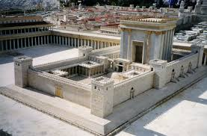
Jesus’ statements about the nations before his death:
“My house shall be called a house of prayer for all nations” (Mark 11:17).

Slide 13
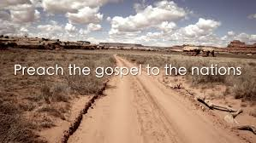
Jesus’ statements about the nations before his death:
“My house shall be called a house of prayer for all nations” (Mark 11:17).
“This gospel of the kingdom will be preached in all the world as a witness to all the nations…” (Matt. 24:14).

Slide 14
Jesus’ statements about the nations after his resurrection:

Slide 15
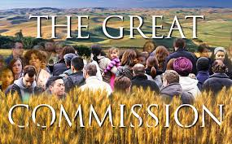
Jesus’ statements about the nations after his resurrection:
“Go, therefore, and make disciples of all the nations…” (Matthew 28:19).

Slide 16
Jesus’ statements about the nations after his resurrection:
“Go, therefore, and make disciples of all the nations…” (Matthew 28:19).
“Repentance and remission should be preached in his name to all nations (Luke 24:47).

Slide 17
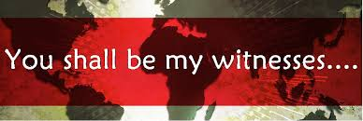
Jesus’ statements about the nations after his resurrection:
“Go, therefore, and make disciples of all the nations…” (Matthew 28:19).
“Repentance and remission should be preached in his name to all nations” (Luke 24:47).
“…[Y]ou shall be witnesses to me in Jerusalem, and in all Judea and Samaria and to the end of the earth” (Acts 1:8).

Slide 18
Jesus’ Actions & Words
Jesus had Gentile encounters and said
what he did about the nations because
it pictured and foreshadowed what
the Old Testament predicted.

Slide 19
The Old Testament

Slide 20
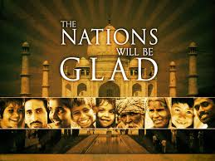
The Old Testament
Ps 22:27b – All the families of the nations shall worship before you.

Slide 21
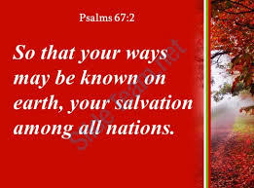
The Old Testament
Ps 22:27b – All the families of the nations shall worship before you.
Ps 67:2 – That your way may be known on earth, your salvation among all nations.

Slide 22
The Old Testament
Ps 22:27b – All the families of the nations shall worship before you.
Ps 67:2 – That Your way may be known on earth, your salvation among all nations.
Ps 86:9 – All nations whom you have made shall come and worship before you, O Lord, and shall glorify your name.

Slide 23
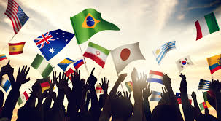
The Old Testament
Ps 102:15 – So the nations shall fear the name of the LORD, and all the kings of the earth your glory.

Slide 24
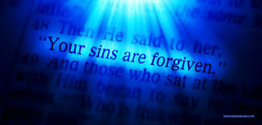
The Old Testament
Ps 102:15 – So the nations shall fear the name of the LORD, and all the kings of the earth your glory.
Isa 52:10 – The LORD has made bare his holy arm in the eyes of all the nations; and all the ends of the earth shall see the salvation of our God.

Slide 25
The Old Testament
Ps 102:15 – So the nations shall fear the name of the LORD, and all the kings of the earth your glory.
Isa 52:10 – The LORD has made bare his holy arm in the eyes of all the nations; and all the ends of the earth shall see the salvation of our God.
Isa 61:11b – So the Lord GOD will cause righteousness and praise to spring forth before all the nations.

Slide 26
The Old Testament
Isa 11:10 – So the Lord GOD will cause righteousness and praise to spring forth before all the nations.

Slide 27
The Old Testament
Isa 11:10 – So the Lord GOD will cause righteousness and praise to spring forth before all the nations.
Isa 49:6 – …‘I will also give you as a light to the Gentiles, that you should be my salvation to the ends of the earth.’

Slide 28
The Old Testament
Isa 11:10 – So the Lord GOD will cause righteousness and praise to spring forth before all the nations.
Isa 49:6 – …‘I will also give you as a light to the Gentiles, that you should be my salvation to the ends of the earth.’
Isa 55:5 – Surely you shall call a nation you do not know, and nations who do not know you shall run to you, because of the LORD your God, and the Holy One of Israel…

Slide 29
Summary
There are scores of such verses in the Old
Testament predicting and anticipating
the salvation of the nations.

Slide 30
Acts: A Crossroad
The Gospel: to the Jew first, and then…?

Slide 31
Acts: A Crossroad
The Gospel: to the Jew first, and then…?
How will a salvation story about a Hebrew
Messiah told by Jewish followers who
consider Gentiles “unclean” or common
(at best) play out when Gentiles hear it?

Slide 32
M. R. Thomas’ “The Turning Point: Setting the Gospel Free”
His claim:
The gospel was bound up in Jewish forms and customs and therefore wasn’t entirely “free” to be accepted by non-Jews.

Slide 33
M. R. Thomas’ conclusion:
“The purity and mobility of the gospel was at stake that day [of the Jerusalem Council]. The essence of the gospel was distinguished from its Judaic cultural background. How far would the good news have gone if Paul had lost this debate? The entire movement of Christ-followers called ‘The Way’ would have ended up like some of the hundreds of splinter sects in Judaism which are now defunct” (p. 145).

Slide 34
Having taught through the book of
Acts in our church, I would like to
offer a different interpretation
of the Council at Jerusalem.

Slide 35
Hints of “and then to the Greeks [Gentiles]” in Acts
Acts 8:4-17: Samaritans believe the gospel (Philip). Peter & John confirm with prayer and the coming of the Holy Spirit.

Slide 36
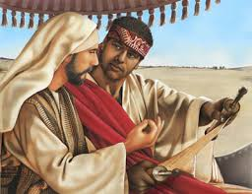
Hints of “and then to the Greeks [Gentiles]” in Acts
Acts 8:4-17: Samaritans believe the gospel (Philip). Peter & John confirm with prayer and the coming of the Holy Spirit.
Acts 8:26-38: Philip on the Gaza road leads the Ethiopian eunuch to Christ and baptizes him (Philip goes on to live in Caesarea, 21:8).

Slide 37
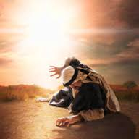
Hints of “and then to the Greeks [Gentiles]” in Acts
Acts 8:4-17: Samaritans believe the gospel (Philip). Peter & John confirm with prayer and the coming of the Holy Spirit.
Acts 8:26-38: Philip on the Gaza road leads the Ethiopian eunuch to Christ and baptizes him (Philip goes on to live in Caesarea, 21:8).
Acts 9:15: Saul’s conversion and calling – “He [will] bear my name to Gentiles, kings and the children of Israel.”

Slide 38
Hints of “and then to the Greeks [Gentiles]” in Acts
Acts 10:1-48: Peter’s vision of the animals on a sheet in Joppa, his foray (not Philip’s) into Caesarea to Cornelius’ house and the conversion of Cornelius and his family.

Slide 39
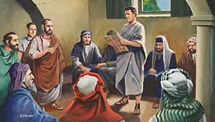
Hints of “and then to the Greeks [Gentiles]” in Acts
Acts 10:1-48: Peter’s vision of the animals on a sheet in Joppa, his foray (not Philip’s) into Caesarea to Cornelius’ house and the conversion of Cornelius and his family.
Acts 11:20: “a great number” of Hellenists (Greeks) believe the gospel in Antioch (as per M. R. Thomas).

Slide 40
Hints of “and then to the Greeks [Gentiles]” in Acts
Acts 10:1-48: Peter’s vision of the animals on a sheet in Joppa, his foray (not Philip’s) into Caesarea to Cornelius’ house and the conversion of Cornelius and his family.
Acts 11:20: “a great number” of Hellenists (Greeks) believe the gospel in Antioch (as per M. R. Thomas).
Acts 13:1-2: The church in Antioch had Jewish leadership responsible for both Jewish and Gentile believers (11:19-21).

Slide 41
Hints of “and then to the Greeks [Gentiles]” in Acts
Acts 13:1-2: God calls for Paul and Barnabas to his work, precisely because of his (Paul’s) previous calling (9:15) and success teaching the cross- and multi-cultural believers in Antioch.

Slide 42
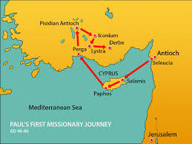
Hints of “and then to the Greeks [Gentiles]” in Acts
Acts 13:1-2: God calls for Paul and Barnabas to his work, precisely because of his (Paul’s) previous calling (9:15) and success teaching the cross- and multi- cultural believers in Antioch.
Acts 13:4-14:26: Paul’s first missionary journey (Cyprus and Asia Minor). The Jews had a mixed response but the Gentiles understood and believed.

Slide 43
Hints of “and then to the Greeks [Gentiles]” in Acts
Acts 13:1-2: God calls for Paul and Barnabas to his work, precisely because of his (Paul’s) previous calling (9:15) and success teaching the cross- and multi- cultural believers in Antioch.
Acts 13:4-14:26: Paul’s first missionary journey (Cyprus and Asia Minor). The Jews had a mixed response and the Gentiles understood and believed.
Acts 14:27: Conclusion of his trip – “[God] opened the door of faith to the Gentiles.”

Slide 44
Summary
All of this cross-cultural evangelism, teaching, discipleship and starting new churches, many of which included Jews and Gentiles, had already occurred
before
the Jerusalem council!

Slide 45
Questions
1) Does this history point to or indicate that, according to M. R. Thomas, “The gospel was bound up in Jewish forms and customs and therefore wasn’t entirely ‘free’ to be accepted by non-Jews”?

Slide 46
Questions
2) What does all this evidence point to or indicate?

Slide 47
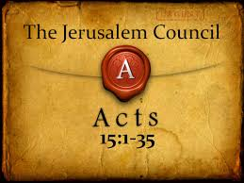
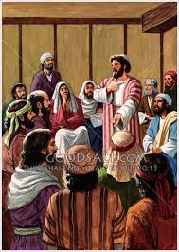
Acts 15: Jerusalem Council

Slide 48
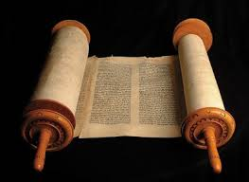
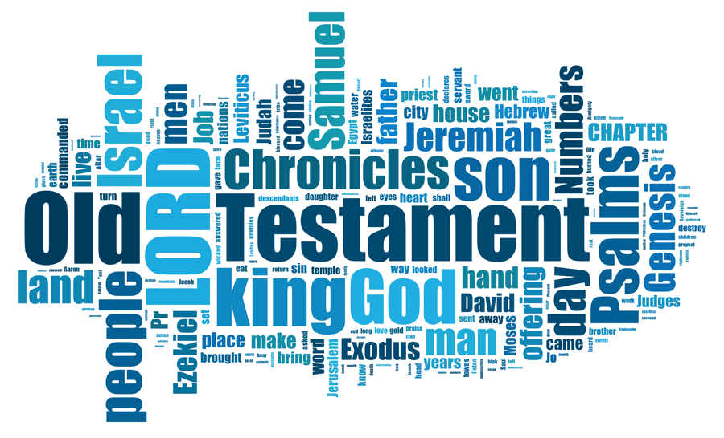
Acts 15: Jerusalem Council
The a priori witness was the Old Testament.

Slide 49
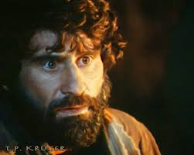
Acts 15: Jerusalem Council
The a priori witness was the Old Testament.
The primary witness was Peter, not Paul.

Slide 50
Acts 15: Jerusalem Council
The a priori witness was the Old Testament.
The primary witness was Peter, not Paul.
The corroborating witnesses were Paul and Barnabas. They are not even quoted.

Slide 51
Acts 15: Jerusalem Council
The a priori witness was the Old Testament.
The primary witness was Peter, not Paul.
The corroborating witnesses were Paul and Barnabas. They are not even quoted.
The Council was more a recognition or realization of what the Spirit was already doing and how they (Jewish believers) should catch up to that, and respond in a way that glorified God and his bigger-than-only-Jewish purposes (i.e., the Kingdom of God, Acts 1:3).

Slide 52
Acts 15: Jerusalem Council
James quotes from Amos 9:11-12, “Gentiles who called by my name,” and comes full circle to the a priori witness of God’s Word) where God predicted all along that Gentiles would receive God’s salvation and thus be part of his kingdom with Jewish believers.

Slide 53
Observation
It was Jewish legalists (Acts 15:1, “certain
men from Judea”, v. 5, “Pharisees who
believed”) who wanted to drape the gospel
in Jewish garb by requiring Gentile converts
to be circumcised. The Holy Spirit was the
One who had already unleashed the
gospel among the Gentiles.

Slide 54
Conclusion
If there were a “breakthrough,” or “turning point” at the Council of Jerusalem, it was in the minds of Jewish church leaders and others in the Jerusalem church. The 4 prohibitions that James requests among Gentile believers were idolatry, adultery, and 2 food limitations, things that most newly saved Gentile believers would eventually recognize anyway.

Slide 55
Session #2
Models,
Persecution
and Resources

Slide 56
Topic Contents
1) Wall of Communication, E-scale, “Become like.”
2) Canyon of Conversion, P-scale, “Remain like.”
3) Engel’s Scale showing spiritual “distance”
4) Storyteller’s Bible Study
5) The Big Three
6) Add to Your Faith
7) Simply The Story
8) Church Planting
9) Sacrifice, Suffering, Persecution & Martyrdom

Slide 57
“Become Like, Remain Like”
Become Like: 1 Corinthians 9:19-22
Remain Like: 1 Corinthians 7:17-20

Slide 58
Definitions
The E Scale represents the cultural distance Christians go or need to go to share the gospel.
http://www.beyondoutreach.com/2012/03/e-scale.html

Slide 59
Definitions
The E Scale represents the cultural distance Christians go or need to go to share the gospel.
The P Scale represents the cultural distance potential believers need to go to join a church.
http://www.beyondoutreach.com/2012/03/e-scale.html
http://www.beyondoutreach.com/2012/06/p-scale.html

Slide 60
The Wall of Communication
Barrier of Understanding
Challenge faced by missionaries to communicate the Gospel
“Become Like”
E-Scale

Slide 61
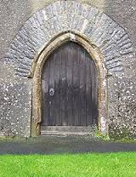
The Canyon of Conversion
Barrier of acceptance
Challenge faced by respondents to follow Christ
“Remain Like”
P-Scale

Slide 62
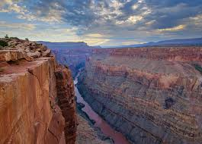
The Canyon of Conversion
Barrier of acceptance
Challenge faced by respondents to follow Christ
“Remain Like”
P-Scale
Sometimes it feels like this!

Slide 63
E-Scale and P-Scale
EVANGELIST PERSPECTIVE:
Crossing Barriers to
Communicate Gospel
POTENTIAL CONVERT PERSPECTIVE:
Crossing Barriers to
Join Existing Church

Slide 64
The Engel’s Scale
The Engel’s Scale was developed by James F. Engel of Wheaton College. It illustrates steps in the spiritual journey of an outsider moving from no knowledge of God to a growing/maturing believer. It was first published in What’s Gone Wrong With The Harvest (1975).
(http://www.hazelden.org.uk/pt02/art_pt068_modified_engel_full.htm)

Slide 65
The Engel’s Scale
God’s Initiative | Christian’s Role | Spiritual Journey | Doubt Level about God
Preserves | Ministry Outreach | +9 Vision for future
 |  | +8 Effective outreach
Witness of God’s Spirit | Encourage each other | +7 Leadership Development
Disciplines | Build up each other | +6 Stewardship growth
 |  | +5 Discover Spiritual gifts
Guards | Christian fellowship | +4 Biblical application
 | Serve each other | +3 Concept growth
Seals | Equip each other | +2 Adopt Chr identity
Sanctifies | Personal growth | +1 Salvation assurance
Gives life | Harvesting | 0 New life
Draws |  | -1 Repentance/Faith | Certainty
 |  | -2 Decision to act/believe | Obvious
Convicts | Cultivating | -3 Recognize personal sins | Beyond reasonable doubt
 |  | -4 Positive toward gospel | Likely
 | Watering | -5 Grasp implications of gospel
Enlightens |  | -6 Learn more about God/ Jesus
 | Planting the seed | -7 Aware of God | Probable
Reveals himself | Removing the rocks | -8 Questions God concept
 | Plowing the soil | -9 Unsure about God | Possible
 |  | -10 Denies God’s existence | Impossible

Slide 66
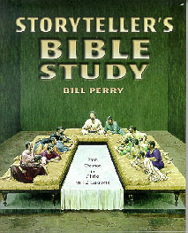
Storyteller’s Bible Study
This chronological study
features 12 Bible stories
from Gen. 1:1 to Acts 1.
It is a complete teacher
manual. All appendices
are reproducible. Highly
effective in multicultural
audiences and all ages.

Slide 67
The Big Three
These 3 negative emotions were the result of the fall in the Garden of Eden:

Slide 68
The Big Three
These 3 negative emotions were the result of the fall in the Garden of Eden:
Genesis 3:7a – “Then they eyes of both of them were opened.” Guilt of disobedience.

Slide 69
The Big Three
These 3 negative emotions were the result of the fall in the Garden of Eden:
Genesis 3:7a – “Then they eyes of both of them were opened.” Guilt of disobedience.
Genesis 3:7b – “…they knew they were naked.” Shame in feeling exposed.

Slide 70
The Big Three
These 3 negative emotions were the result of the fall in the Garden of Eden:
Genesis 3:7a – “Then they eyes of both of them were opened.” Guilt of disobedience.
Genesis 3:7b – “…they knew they were naked.” Shame in feeling exposed.
Genesis 3.10 – “I was afraid…and hid myself.” Fear of being powerlessness.

Slide 71
Summary of the Big Three
Broke God’s | Fallout | Looking for
(1) Law | Guilt | Innocence/Righteousness
(2) Relationship | Shame | Honor
(3) Trust | Fear | Power

Slide 72
Guilt, Shame and Fear around the globe

Slide 73
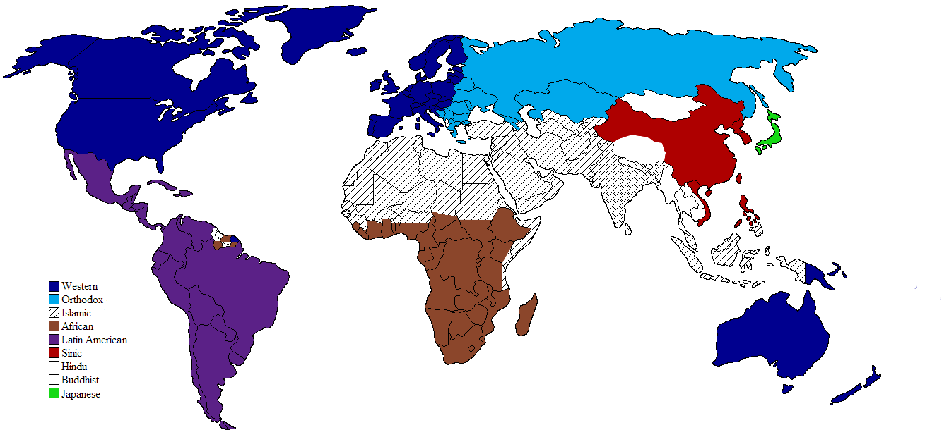
Guilt, Shame & Fear

Slide 74
Guilt, Shame & Fear
GUILT

Slide 75
Guilt, Shame & Fear
SHAME

Slide 76
Guilt, Shame & Fear
FEAR

Slide 77
Add to Your Faith
This is a survey of the
New Testament letters in
chronological order to
teach new believers from
multicultural backgrounds
without transferring
culturally oriented
response patterns.

Slide 78
Add to Your Faith
1 Cor 1`3:13 | 2 Peter 1:5-7 | Dates (AD) | Acts Chapters | NT Books | Themes
F | Faith | <45 | 1-9 | Introduction
A | Goodness | 45 | 10-12 | James | Faith for living
I | Knowledge | 48 | 13:1 – 15:35 | Galatians | Freedom in Christ
T |  | 52 | 15:36-17:34 | 1 Thessalonians | Christ will return…
H |  | 53 |  | 2 Thessalonians | But not yet!
 | Self-control | 55 | 18:1 | 1 Corinthians | No divisions
H |  | 56 |  | 2 Corinthians | Personal ministry
 |  | 57 | -21:16 | Romans | The Spiritual Life
O | Perseverance | 61 |  | Colossians | Christ is all
 |  | 61 |  | Ephesians | Christ and the Church
P |  | 61 |  | Philemon | Call to forgive
 |  | 61 |  | Philippians | Life in Christ
E | Godliness | 62 | 21:17 | 1 Timothy | Godly leadership
 |  | 62 |  | Titus | Godly doctrine
 |  | 64 | -28:31 | 1 Peter | Godly living in trials
L | Brotherly kindness | 65 |  | Hebrews | Consider Jesus
 |  | 67 |  | 2 Timothy | Ministry endurance
O |  | 67 |  | 2 Peter | True/False prophecy
 |  | 68 |  | Jude | Guard yourself
V | Love | 90 |  | 1 John | Fellowship with God and the Church
 |  | 92 |  | 2 John | Truth and Children
E |  | 92 |  | 3 John | Spiritual prosperity
 |  | 95 |  | Revelation | Revelation of Jesus
1 Cor 13:13 | 2 Peter 1:5-7 | Dates (AD) | Acts Chaps | NT Books | Themes

Slide 79
Simply The Story
STS is an interactive biblical storytelling method designed by Dorothy Miller. It works with virtually any group of outsiders regardless of ethnic origin, tribal group, literate fluency, language, age, gender, geographical location.
SimplyTheStory.com

Slide 80
A Thought About
Church Planting

Slide 81
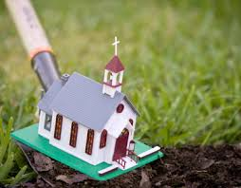
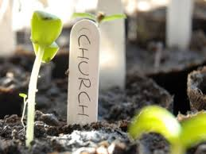
Church Planting
Where does it say in the Bible that we should “plant churches”?

Slide 82
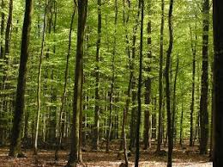
Church Planting
Where does it say in the Bible that we should “plant churches”?
If a church is a community of Christians and trees are people, could we say that a forest is a “community of trees”?

Slide 83
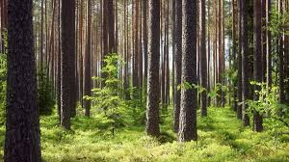
Church Planting
Where does it say in the Bible that we should “plant churches”?
If a church is a community of Christians and trees are people, could we say that a forest is a “community of trees”?
How do we plant a forest?

Slide 84
Church Planting
Where does it say in the Bible that we should “plant churches”?
If a church is a community of Christians and trees are people, could we say that a forest is a “community of trees”?
How do we plant a forest?
Answer: By believers reaching out simultaneously. Jesus said, “Make disciples.” So if all believers do outreach and make disciples, a new church becomes the forest by gathering and organizing the new “trees.”

Slide 85
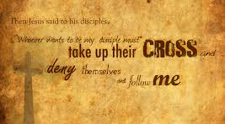
Sacrifice, Suffering, Persecution and Martyrdom
“And he who does not take his cross and follow me is not worthy of me. He who finds his life will lose it, and he who loses his life for my sake will find it” (Matt. 10:39).

Slide 86
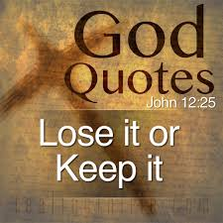
Sacrifice, Suffering, Persecution and Martyrdom
“And he who does not take his cross and follow me is not worthy of me. He who finds his life will lose it, and he who loses his life for my sake will find it” (Matt. 10:39).
“He who loves his life will lose it, and he who hates his life in this world will keep it for eternal life” (John 12:25).

Slide 87
Sacrifice, Suffering, Persecution and Martyrdom
“And he who does not take his cross and follow me is not worthy of me. He who finds his life will lose it, and he who loses his life for my sake will find it” (Matt. 10:39).
“He who loves his life will lose it, and he who hates his life in this world will keep it for eternal life” (John 12:25).
God to Ananias about Paul: “For I will show him how many things he must suffer for my name’s sake” (Acts 9:16).

Slide 88
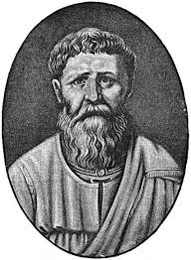
Sacrifice, Suffering, Persecution and Martyrdom
“If you love your soul, there is a danger of its being destroyed. Therefore, you may not love it, since you do not want it to be destroyed. But in not wanting it to be destroyed, you love it.”
-- St. Augustine (354-430), North
African theologian and philosopher

Slide 89
Sacrifice, Suffering, Persecution and Martyrdom
“In the evening I was unexpectedly visited by a considerable number of people, with whom I was enabled to converse profitably of divine things. Took pains to describe the difference between a regular and irregular self love; the one consisting with a supreme love to God, but the other not; the former uniting God’s glory and the soul’s happiness that they become one common interest, but the latter disjoining and separating God’s glory and man’s happiness, seeking the larger with the neglect of the former.”
-- David Brainerd (1718-1747), American missionary

Slide 90
Sacrifice, Suffering, Persecution and Martyrdom
“For my own part, I have never ceased to rejoice that God has appointed me to such an office [as missionary]. People talk of the sacrifice of spending so much of my life in Africa. Can that be called a sacrifice…? Is that a sacrifice which brings its own blest reward in healthful activity, the consciousness of doing good, peace of mind, and a bright hope of a glorious destiny hereafter? Away with the word in such a view, and with such a thought! …

Slide 91
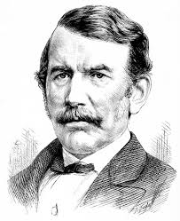
Sacrifice, Suffering, Persecution and Martyrdom
“It is emphatically no sacrifice. Say rather it is a privilege. Anxiety, sickness, suffering, or danger, now and then, with a foregoing of the common conveniences and charities of this life, may make us pause, and cause the spirit to waver, and the soul to sink; but let this only be for a moment. All these are nothing when compared with the glory which shall be revealed in and for us. I never made a sacrifice.”
-- David Livingstone (1813-1873), British missionary to Africa

Slide 92
Conclusion: Paul’s View
“Therefore we do not lose heart. Even though our outward man is perishing, yet the inward man is being renewed day by day. For our light affliction, which is but for a moment, is working for us a far more exceeding and eternal weight of glory, while we do not look at the things which are seen, but at the things which are not seen. For the things which are seen are temporary, but the things which are not seen are eternal.”
-- 2 Corinthians 4:16-18

Slide 93
Thank you for studying with me today. If you would like a free email copy of this powerpoint, email Bill Perry at
bill@billperry.tv
For a new, free resource site coming soon,
please go to www.KingdomServants.com
May God bless you as you continue through Perspectives to be better Kingdom servants!

