Slide 1
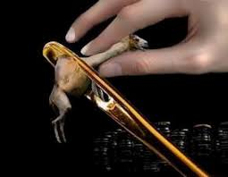
The Parable of the Camel and the Eye of the Needle
Matthew 19:16-30
Bill Perry

Slide 2
What is a Parable?

Slide 3
What is a Parable?
An earthly story with
a heavenly meaning

Slide 4
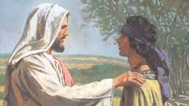
Matthew 19:16-18a
“Now behold, one came and said to him, ‘Good Teacher, what good thing shall I do that I may have eternal life?’ So he said to him, ‘Why do you call me good? No one is good but One, that is, God. But if you want to enter into life, keep the commandments.’ He said to him, ‘Which ones?’”

Slide 5
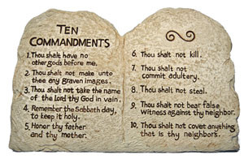
Matthew 19:18b-22
“Jesus said, ‘You shall not murder, You shall not commit adultery, You shall not steal, You shall not bear false witness, Honor your father and your mother, and, You shall love your neighbor as yourself.’ The young man said to him, ‘All these things I have kept from my youth. What do I still lack?’ Jesus said to him, ‘If you want to be perfect, go, sell what you have and give to the poor, and you will have treasure in heaven; and come, follow me.’ But when the young man heard that saying, he went away sorrowful, for he had great possessions.”

Slide 6
Compare
Verse 16
Comment
“Now behold, one came and said to him, ‘Good Teacher, what good thing shall I do that I may have eternal life?’
We know from verse 22 that this man “had great possessions.” In Jewish thinking having wealth indicated God’s blessing. So this rich man asks a great question. His desire is very good but his premise is very wrong.

Slide 7
Matthew 19:17
“So he said to him, ‘Why do you call me good?
No one is good but One, that is, God. But if
you want to enter into life, keep the
commandments.’

Slide 8
Compare
Matthew 19:17
Comment
“So he said to him, ‘Why do you call me good? No one is good but One, that is, God. But if you want to enter into life, keep the commandments.’
Jesus refers to God as being the only good One. He does this for at least 2 reasons:
(1)
(2)

Slide 9
Compare
Matthew 19:17
Comment
“So he said to him, ‘Why do you call me good? No one is good but One, that is, God. But if you want to enter into life, keep the commandments.’
Jesus refers to God as being the only good One. He does this for at least 2 reasons:
(1) To appeal to the highest authority.
(2)

Slide 10
Compare
Matthew 19:17
Comment
“So he said to him, ‘Why do you call me good? No one is good but One, that is, God. But if you want to enter into life, keep the commandments.’
Jesus refers to God as being the only good One. He does this for at least 2 reasons:
(1) To appeal to the highest authority.
(2) To move the discussion to the commandments.

Slide 11
Matthew 19:18-20
“He said to him, ‘Which ones?’ Jesus said, ‘You
shall not murder, You shall not commit adultery,
You shall not steal, You shall not bear false
witness, Honor your father and your mother,
and, You shall love your neighbor as yourself.’
The young man said to him, ‘All these things I
have kept from my youth. What do I still lack?’”

Slide 12
Compare
Matthew 19:18-20
Comment
“He said to him, ‘Which ones?’ Jesus said, ‘You shall not murder, You shall not commit adultery, You shall not steal, You shall not bear false witness, Honor your father and your mother, and, You shall love your neighbor as yourself.’ The young man said to him, ‘All these things I have kept from my youth. What do I still lack?’”
Notice that Jesus lists most of the second half of the 10 Commandments (#6, #7, #8, #9, #5 (in that order), and then adds a summary of the whole law from Leviticus 19:18, ones dealing directly with human relationships .

Slide 13
Compare
Matthew 19:18-20
Comment
“He said to him, ‘Which ones?’ Jesus said, ‘You shall not murder, You shall not commit adultery, You shall not steal, You shall not bear false witness, Honor your father and your mother, and, You shall love your neighbor as yourself.’ The young man said to him, ‘All these things I have kept from my youth. What do I still lack?’”
Jesus did not include those commandments dealing directly with God (#1—no other gods, #2—make no images, #3—honor God’s name , #4—the Sabbath day) because he knew already the man had not kept them.

Slide 14
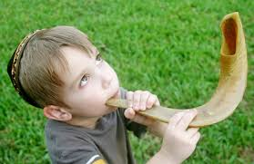
Compare
Matthew 19:18-20
Comment
“He said to him, ‘Which ones?’ Jesus said, ‘You shall not murder, You shall not commit adultery, You shall not steal, You shall not bear false witness, Honor your father and your mother, and, You shall love your neighbor as yourself.’ The young man said to him, ‘All these things I have kept from my youth. What do I still lack?’”
The man claims to have obeyed all of these commandments since a young boy (!) but still lacks a knowledge/assurance of eternal life.

Slide 15
Observation:
The man claims to have obeyed these
commandments since a young boy (!) but still
lacks a knowledge/assurance of eternal life.
Have you met someone
like this in your life?

Slide 16
Compare
Matthew 19:18-20
Comment
“He said to him, ‘Which ones?’ Jesus said, ‘You shall not murder, You shall not commit adultery, You shall not steal, You shall not bear false witness, Honor your father and your mother, and, You shall love your neighbor as yourself.’ The young man said to him, ‘All these things I have kept from my youth. What do I still lack?’”
Despite his efforts to keep the law, this young man still has no assurance of eternal life and freely confesses his shortfall. This looks to be a promising potential convert!

Slide 17
Matthew 19:24
“Jesus said to him, ‘If you want to be perfect,
go, sell what you have and give to the poor,
and you will have treasure in heaven;
and come, follow me.’”

Slide 18
Compare
Matthew 19:24
Comment
“Jesus said to him, ‘If you want to be perfect, go, sell what you have and give to the poor, and you will have treasure in heaven; and come, follow me.’”
With the man having confessed his need, Jesus adds more commands – “go, sell…, give to the poor…and follow” him, gaining treasure in heaven, appealing to the man’s inclination toward wealth. What could be better than eternal treasure in heaven?

Slide 19
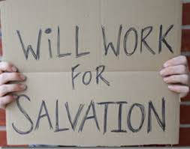
Compare
Matthew 19:24
Comment
“Jesus said to him, ‘If you want to be perfect, go, sell what you have and give to the poor, and you will have treasure in heaven; and come, follow me.’”
At the same time Jesus is moving this man’s thinking toward its logical outcome of works-based salvation. Can he do by himself what Jesus tells him to do?

Slide 20
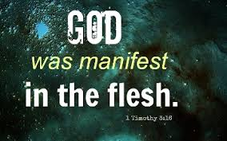
What is Jesus doing??
First, for Jesus to add his own commands to the 10 Commandments is nothing short of blasphemy…if he is not God in the flesh.

Slide 21
What is Jesus doing??
Second, why is Jesus telling this man who is
asking what he must do to gain eternal life
to keep the Old Testament law and then
adding more commands to it?

Slide 22
What is Jesus doing??
Second, why is Jesus telling this man who is
asking what he must do to gain eternal life
to keep the Old Testament law and then
adding more commands to it?
Is this the way people
gain eternal life?

Slide 23
What is Jesus doing??
Second, why is Jesus telling this man who is
asking what he must do to gain eternal life
to keep the Old Testament law and then
adding more commands to it?
Would you share
the gospel this way?

Slide 24
Observations:
In Middle Eastern cultures, 3 values were of supreme importance:
(1)
(2)
(3)

Slide 25
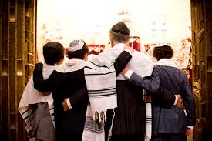
Observations:
In Middle Eastern cultures, 3 values were of supreme importance:
(1) Family
(2)
(3)

Slide 26
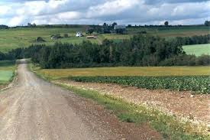
Observations:
In Middle Eastern cultures, 3 values were of supreme importance:
(1) Family
(2) Property
(3)

Slide 27
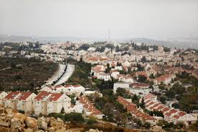
Observations:
In Middle Eastern cultures, 3 values were of supreme importance:
(1) Family
(2) Property
(3) Community

Slide 28
Observations:
In Middle Eastern cultures, 3 values were of supreme importance:
(1) Family
(2) Property
(3) Community
All three of these together gave
people a strong sense of identity.

Slide 29
Question
What is Jesus not doing by adding his
commands, “go…sell…give…and
come, follow me”?

Slide 30
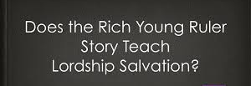
Answer
Jesus is not:
calling this man to a discipleship based gospel or presenting Lordship salvation.

Slide 31
Answer
Jesus is not:
calling this man to a discipleship based gospel or presenting Lordship salvation.
sharing the gospel with him with these statements.

Slide 32
Answer
Jesus is not:
calling this man to a discipleship based gospel or presenting Lordship salvation.
sharing the gospel with him with these statements.
misleading this man.

Slide 33
What Jesus is doing:
Jesus is knocking down all the supports this
man’s family and culture provide for him. It
will take faith for this man to accept Jesus as
his new family leader and new support system.
Jesus will decide what property he’ll need
and will give it to him. His disciples will
become this man’s new community.

Slide 34
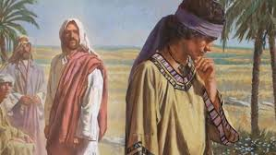
Matthew 19:22
“But when the young man heard that saying,
he went away sorrowful, for he had
great possessions.”

Slide 35
Compare
Matthew 19:22
Comment
“But when the young man heard that saying, he went away sorrowful, for he had great possessions.”
The rich man heard Jesus’ second list of commands and went away sorrowful because he had “great possessions” and had greater faith in his current supports – family, property, and community – than in Jesus.

Slide 36
Observations:
This rich man looked at pure life straight in
the eyes and turned Jesus down! Because
Jesus knew this man didn’t have the faith
to trust Jesus for his lack, he let him go.
This is why Jesus didn’t chase after
him or try to convince
him otherwise.

Slide 37
Question
What does this tell us about
our evangelism efforts today
if Jesus let this guy go?

Slide 38
Matthew 19:23-26
“Then Jesus said to his disciples, ‘Assuredly, I say to you that it is hard for a rich man to enter the kingdom of heaven. And again I say to you, it is easier for a camel to go through the eye of a needle than for a rich man to enter the kingdom of God.’ When his disciples heard it, they were greatly astonished, saying, ‘Who then can be saved?’ But Jesus looked at them and said to them, ‘With men this is impossible, but with God all things are possible.’”

Slide 39
Compare
Matthew 19:23-24
Comment
“Then Jesus said to his disciples, ‘Assuredly, I say to you that it is hard for a rich man to enter the kingdom of heaven. And again I say to you, it is easier for a camel to go through the eye of a needle than for a rich man to enter the kingdom of God.’
Some people have proposed the idea that a small hole in the wall of Jerusalem was called the “eye of the needle.” This is pure fiction. A hole in the wall would be a security breach and would be sealed up immediately upon discovery.

Slide 40
Compare
Matthew 19:23-24
Comment
“Then Jesus said to his disciples, ‘Assuredly, I say to you that it is hard for a rich man to enter the kingdom of heaven. And again I say to you, it is easier for a camel to go through the eye of a needle than for a rich man to enter the kingdom of God.’
Matthew, Mark and Luke all use the same Greek word rhaphis, meaning sewing needle. Jesus spoke literally of a needle, not figuratively.

Slide 41
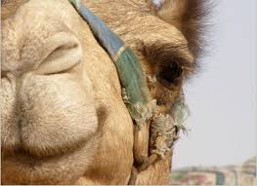
Compare
Matthew 19:23-24
Comment
“Then Jesus said to his disciples, ‘Assuredly, I say to you that it is hard for a rich man to enter the kingdom of heaven. And again I say to you, it is easier for a camel to go through the eye of a needle than for a rich man to enter the kingdom of God.’
The camel was the largest animal common in the Middle East. The eye of a needle was the smallest thing Middle Easterners could think of.

Slide 42
Compare
Matthew 19:23-24
Comment
“Then Jesus said to his disciples, ‘Assuredly, I say to you that it is hard for a rich man to enter the kingdom of heaven. And again I say to you, it is easier for a camel to go through the eye of a needle than for a rich man to enter the kingdom of God.’
Jesus provides commentary to his disciples of what just took place, saying how “hard it is for a rich man to enter the kingdom of heaven” and gives the camel and the eye of the needle parable. In fact, it is easier for the camel than the rich man!

Slide 43
Compare
Matthew 19:25-26
Comment
“When his disciples heard it, they were greatly astonished, saying, ‘Who then can be saved?’ But Jesus looked at them and said to them, ‘With men this is impossible, but with God all things are possible.’”
The disciples’ question reflects typical Jewish thinking: if a rich man (supposedly blessed by God, which was evident by his riches) can’t be saved, then who can?

Slide 44
Compare
Matthew 19:25-26
Comment
“When his disciples heard it, they were greatly astonished, saying, ‘Who then can be saved?’ But Jesus looked at them and said to them, ‘With men this is impossible, but with God all things are possible.’”
Jesus’ answer speaks about people in general, not just wealthy people. That includes even poor people who don’t have wealth and money but still want it. So they are “wannabe wealthy people.” And it is impossible for them also to be saved with this kind of thinking.

Slide 45
Let’s Be Honest!
How many people here think
they would be better off with
a little more money?

Slide 46
Let’s Be Honest!
How many people here think
they would be better off with
a little more money?
“For the love of money is a root of all evil…”
– 1 Timothy 6:10

Slide 47
John D. Rockefeller
When John D. Rockefeller, co-founder of Standard Oil Company, gave a rare interview, the reporter was shocked when Rockefeller said he didn’t have enough money. When the reporter asked how much more is enough, Rockefeller said, “Just a little bit more.”
https://starwinar.wordpress.com/daily-short-story/just-a-little-bit-more/

Slide 48
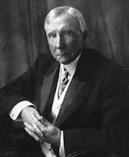
John D. Rockefeller
“It is wrong to assume that men
of immense wealth
are always happy.”
http://www.brainyquote.com/quotes/authors/j/john_d_rockefeller.html

Slide 49
Observation
Trust in material riches frequently
prevails over faith in spiritual matters,
especially faith in God and Jesus, and
keeps many wealthy and “wannabe
wealthy” people out of heaven.

Slide 50
Observation
Trust in material riches frequently
prevails over faith in spiritual matters,
especially faith in God and Jesus, and
keeps many wealthy and “wannabe
wealthy” people out of heaven.
Their “faith” is in only what they see!

Slide 51
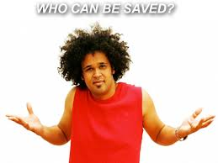
Compare
Matthew 19:25-26
Comment
“When his disciples heard it, they were greatly astonished, saying, ‘Who then can be saved?’ But Jesus looked at them and said to them, ‘With men this is impossible, but with God all things are possible.’”
The disciples are astonished at the impossible situation the parable describes and ask a great question. Jesus’ reply shows that only God can truly impact what happens in the human heart.

Slide 52
Observation
Since only God can truly work inside
the human heart and we cannot, we must
trust him to work where we cannot work!

Slide 53
Matthew 19:27-30
“Then Peter answered and said to him, ‘See, we have left all and followed you. Therefore what shall we have?’ So Jesus said to them, ‘Assuredly I say to you, that in the regeneration, when the Son of Man sits on the throne of his glory, you who have followed me will also sit on twelve thrones, judging the twelve tribes of Israel. And everyone who has left houses or brothers or sisters or father or mother or wife or children or lands, for my name's sake, shall receive a hundredfold, and inherit eternal life. But many who are first will be last, and the last first.’”

Slide 54
Compare
Matthew 19:27
Comment
“Then Peter answered and said to him, ‘See, we have left all and followed you. Therefore what shall we have?’”
After Peter says that they “left all and followed” Jesus, he asks what will they have (in other words, “What’s in it for us?”), obviously remembering what Jesus told the rich man, “You’ll have treasure in heaven.”

Slide 55
Compare
Matthew 19:28-29
Comment
So Jesus said to them, ‘Assuredly I say to you, that in the regeneration, when the Son of Man sits on the throne of his glory, you who have followed me will also sit on twelve thrones, judging the twelve tribes of Israel. And everyone who has left houses or brothers or sisters or father or mother or wife or children or lands, for my name's sake, shall receive a hundredfold, and inherit eternal life.
Notice: Jesus doesn’t rebuke him for such an apparently self-centered question! On the contrary, Jesus affirms such thinking by rewarding his disciples 100 times what they left, including family, property and community “in the regeneration,” or Kingdom of God (heaven).

Slide 56
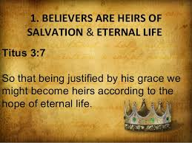
Compare
Matthew 19:28-29
Comment
So Jesus said to them, ‘Assuredly I say to you, that in the regeneration, when the Son of Man sits on the throne of his glory, you who have followed me will also sit on twelve thrones, judging the twelve tribes of Israel. And everyone who has left houses or brothers or sisters or father or mother or wife or children or lands, for my name's sake, shall receive a hundredfold, and inherit eternal life.
When Jesus says eternal life is an inheritance, it means that this is what believers receive being heirs of God (Romans 8:16-17, Titus 3:7). The rest of his description here indicates rewards for sacrifices made.

Slide 57
Compare
Matthew 19:30
Comment
“But many who are first will be last, and the last first.”
This means that those who put material things first will be last in the spiritual realm, and those who are thought to be the “last” on earth (i.e., poor believers who don’t have many material blessings of the rich) will be first in “the regeneration”
(God’s Kingdom, v. 28).

Slide 58
Compare
Matthew 19:30
Comment
“But many who are first will be last, and the last first.”
Jesus used this saying many times. At the very least it shows just how much human and worldly thinking is contrary to God’s thinking and therefore is upside down.

Slide 59
What does this parable teach?
The impossibility of a camel going through the
eye of a needle focuses on the impossible work
that only God can do in the hearts of people.
The conversations before and after this brief
parable highlight the vast difference between
the ways of the world and the ways of God.
Only God can do what is impossible to man!

