Slide 1
Matthew 7:21-29
Parable
Of the
2 Builders

Slide 2
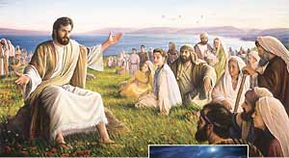
Jesus told many parables
to the people of Israel.
These are stories of
everyday life that have a
heavenly meaning. The earthly illustrates the spiritual.

Slide 3
He concluded his
Sermon on the Mount
(Matthew 5-7) with a
parable about two home
builders. We’ll begin with the portion before the parable.

Slide 4
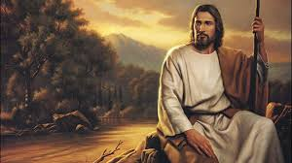
Matthew 7:21-23
“Not everyone who says to me, ‘Lord, Lord,’ shall enter the kingdom of heaven, but he who does the will of my Father in heaven. Many will say to me in that day, ‘Lord, Lord, have we not prophesied in your name, cast out demons in your name, and done many wonders in your name?’ And then I will declare to them, ‘I never knew you; depart from me, you who practice lawlessness!’”

Slide 5
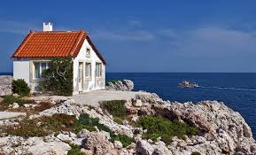
Matthew 7:24-27
“Therefore whoever hears these sayings of mine, and does them, I will liken him to a wise man who built his house on the rock: and the rain descended, the floods came, and the winds blew and beat on that house; and it did not fall, for it was founded on the rock. But everyone who hears these sayings of mine, and does not do them, will be like a foolish man who built his house on the sand: and the rain descended, the floods came, and the winds blew and beat on that house; and it fell. And great was its fall.”

Slide 6
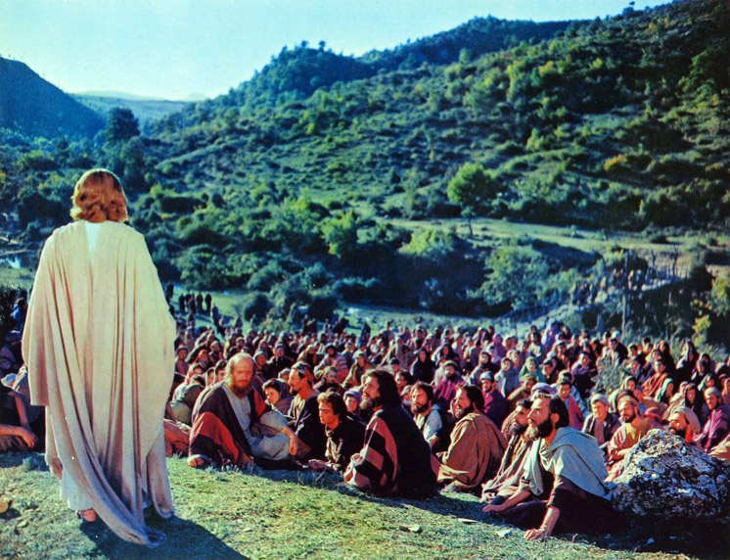
Matthew 7:28-29
And so it was, when Jesus had ended these sayings, that the people were astonished at his teaching, for he taught them as one having authority, and not as the scribes.

Slide 7
Setting Up the Parable
Matthew 7:21
Comment
“Not everyone who says to me, ‘Lord, Lord,’ shall enter the kingdom of heaven, but he who does the will of my Father in heaven.”
Jesus says that those simply calling him “Lord” doesn’t automatically mean they will enter into God’s kingdom:
“Therefore the Lord said: ‘Inasmuch as these people draw near with their mouths and honor me with their lips, but have removed their hearts far from me…’” Isa 29:13.

Slide 8
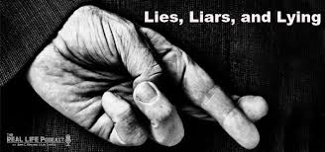
Setting Up the Parable
Matthew 7:21
Psalm 78:36-37
“Not everyone who says to me, ‘Lord, Lord,’ shall enter the kingdom of heaven, but he who does the will of my Father in heaven.”
Nevertheless they flattered him [God] with their mouth, and they lied to him with their tongue; for their heart was not steadfast with him, nor were they faithful in his covenant.

Slide 9
Setting Up the Parable
Matthew 7:21
Comment
“Not everyone who says to me, ‘Lord, Lord,’ shall enter the kingdom of heaven, but he who does the will of my Father in heaven.”
Jesus will quote Isaiah 29:13 to them later: “Hypocrites! Well did Isaiah prophesy about you, saying: ‘These people draw near to me with their mouth, and honor me with their lips, but their heart is far from me’” in Matthew 15:7-8.

Slide 10
Setting Up the Parable
Matthew 7:21
Comment
“Not everyone who says to me, ‘Lord, Lord,’ shall enter the kingdom of heaven, but he who does the will of my Father in heaven.”
Jesus earlier said in his Sermon on the Mount, “Your kingdom come, your will be done on earth as it is in heaven” (6:10). Only those obeying God like God is obeyed in heaven (angels) qualify for heaven. This is an impossible task for fallen human beings!

Slide 11
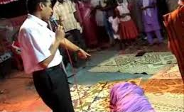
Setting Up the Parable
Matthew 7:22
Comment
“‘Many will say to me in that day, ‘Lord, Lord, have we not prophesied in your name, cast out demons in your name, and done many wonders in your name?’”
Jesus anticipates people’s response by citing their obedience doing spectacular, even miraculous things like speaking God’s word, casting out demons and other miracles. Shouldn’t they count for something? You would think it would.

Slide 12
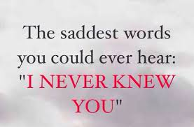
Setting Up the Parable
Matthew 7:23
Comment
“‘And then I will declare to them, ‘I never knew you; depart from me, you who practice lawlessness!’”
Jesus now tells them why such “obedience” is insufficient: he “never knew” them. These are the worst words anyone can ever hear. He knows them as his creatures but not as his children because “their hearts were far from him” (Isaiah 29:13).

Slide 13
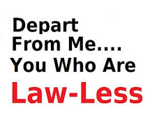
Setting Up the Parable
Matthew 7:23
Comment
“‘And then I will declare to them, ‘I never knew you; depart from me, you who practice lawlessness!’”
Because the Jews’ hearts were hardened and still alienated from God/Jesus, they are still in rebellion to him. That is why all their “good” works are lawless deeds, done in their own power, not God’s. This is not doing God’s will on earth like it’s done in heaven.

Slide 14
Now, on to the parable!

Slide 15
Telling the Parable
Matthew 7:24
Comment
“Therefore whoever hears these sayings of mine, and does them, I will liken him to a wise man who built his house on the rock…”
Jesus the master Rabbi (Teacher) says that hearing and doing as he says equates to wisdom. In fact, he is the personification of all wisdom.

Slide 16
Telling the Parable
Matthew 7:24
Comment
“Therefore whoever hears these sayings of mine, and does them, I will liken him to a wise man who built his house on the rock…”
In fact, Jesus says that wisdom is seen in choices and behavior. With this man, he chose to build his house on a rock. Smart not overlooking the necessity of a proper foundation.
Proverb 9:1 says, “Wisdom has built her house…”

Slide 17
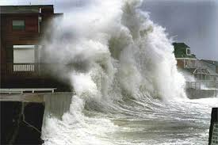
Telling the Parable
Matthew 7:25
Comment
“…[A]nd the rain descended, the floods came, and the winds blew and beat on that house; and it did not fall, for it was founded on the rock.”
Primarily because of the stable foundation the rock made for the house, the house withstood the violent storm. Everyone and everything inside the house were fully protected and did more than simply survive.

Slide 18
Telling the Parable
Matthew 7:26
Comment
“But everyone who hears these sayings of mine, and does not do them, will be like a foolish man who built his house on the sand…”
There are 2 kinds of people: those who hear Jesus’ words and follow them and those who hear and don’t. Jesus equates the latter with foolishness. And for good reason – he is wisdom personified. Anyone ignores him to his/her own peril.

Slide 19
Telling the Parable
Matthew 7:26
Comment
“But everyone who hears these sayings of mine, and does not do them, will be like a foolish man who built his house on the sand…”
As with the wise man, the foolish man’s foolishness is evident by his choices and behaviors. He builds his house obviously during good weather and gives no consideration that weather changes and his current foundation won’t withstand intense violent weather.

Slide 20
Telling the Parable
Matthew 7:27
Comment
“And the rain descended, the floods came, and the winds blew and beat on that house; and it fell. And great was its fall.”
The poorly planned and poorly constructed house is no match for the devastating winds and rising tides of the violent storm. Everything of value in the house is destroyed.

Slide 21
The parable’s similarities (in order)

Slide 22
The parable’s similarities (in order)
Two builders

Slide 23
The parable’s similarities (in order)
Two builders
Two houses

Slide 24
The parable’s similarities (in order)
Two builders
Two houses
Two storms

Slide 25
The parable’s similarities (in order)
Two builders
Two houses
Two storms
Two foundations

Slide 26
The parable’s similarities (in order)
Two builders
Two houses
Two storms
Two foundations
Two outcomes for the houses

Slide 27
The parable’s similarities (in order)
Two builders
Two houses
Two storms
Two foundations
Two outcomes for the houses
Two types of men
Wise
Foolish

Slide 28
The parable’s similarities (in order)
Two builders
Two houses
Two storms
Two foundations
Two outcomes for the houses
Two types of men
Which of these 6 things do you think is the focus of this parable?
Wise
Foolish

Slide 29
What does the parable focus on?

Slide 30
What does the parable focus on?
Two houses – they represent our lives

Slide 31
What does the parable focus on?
Two houses – they represent our lives
✓ Our house is where we live, our home

Slide 32
What does the parable focus on?
Two houses – they represent our lives
✓ Our house is where we live, our home
✓ They are visible (foundations are not)

Slide 33
What does the parable focus on?
Two houses – they represent our lives
✓ Our house is where we live, our home
✓ They are visible (foundations are not)
✓ What we value is in our house (family, etc.)

Slide 34
What does the parable focus on?
Two houses – they represent our lives
✓ Our house is where we live, our home
✓ They are visible (foundations are not)
✓ What we value is in our house (family, etc.)
✓ We want them to last/endure

Slide 35
What does the parable focus on?
Two houses – they represent our lives
✓ Our house is where we live, our home
✓ They are visible (foundations are not)
✓ What we value is in our house (family, etc.)
✓ We want them to last/endure
✓ We make efforts to maintain them

Slide 36
However, even though the picture of
the collapsing house was shocking
enough and clearly the focus of
the parable, the difference is the
foundation of each structure:
the rock and the sand.

Slide 37
Foundation Importance!
Matthew 7:24
Comment
“Whoever hears these words of mine, and does them is like a wise man who built his house on the rock.”
Clearly the words of Jesus, which flow with wisdom, is what the man builds upon. Thus they are his foundation for his “house,” or life, livelihood and future. This makes all the difference in the world and helps avoid disaster.

Slide 38
Foundation Importance!
Matthew 7:26
Comment
“But everyone who hears these words of mine, and does not do them, will be like a foolish man who built his house on the sand.”
Again, the words of Jesus, rich with wisdom and available to everyone, are ignored. Thus this man’s own understanding is the foundation for his “house,” or life, livelihood and future. This makes him vulnerable to disaster and cannot prevent the results.

Slide 39
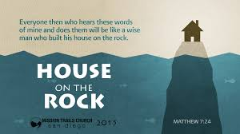
Spiritual Application
Words of Jesus = foundational life wisdom
Words of Jesus

Slide 40
Spiritual Application
Words of Jesus = foundational life wisdom
House = one’s life, family, possessions, future, etc.
Life, family, etc.
Words of Jesus

Slide 41
Spiritual Application
Words of Jesus = foundational life wisdom
House = one’s life, family, possessions, future, etc.
Storms = trials/challenges/difficulties in life that everyone faces
Spiritual attacks
Economic hardship
Domestic issues
Church dysfunction
Etc.

Slide 42
Spiritual Application
Words of Jesus = foundational life wisdom
House = one’s life, family, possessions, future, etc.
Storms = trials/challenges/difficulties in life that everyone faces
Outcome after the storm = our same or new “normal” – continuation or devastation?

Slide 43
Spiritual Application
The parable is on an earthly level but speaks of spiritual truth: will we listen to Jesus and trust him for salvation or listen to ourselves and find eternal condemnation?

Slide 44
Following Up the Parable
Matthew 7:28-29
Comment
And so it was, when Jesus had ended these sayings, that the people were astonished at his teaching, for he taught them as one having authority, and not as the scribes.
To make such all encompassing statements like these that Jesus said is to claim to be God. Who else could make such claims all human lives to follow him or face total destruction?

Slide 45
Conclusion
Matthew 7:28-29
Comment
And so it was, when Jesus had ended these sayings, that the people were astonished at his teaching, for he taught them as one having authority, and not as the scribes.
The scribes and rabbis never made such statements and never would because they lacked the authority. Not Jesus! He is God’s Son, came from heaven to earth, and knows what and for whom he speaks. Let’s trust his word today to be saved from eternal disaster.

