Slide 1
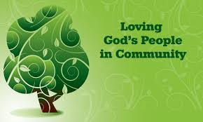
God’s People in Community
Bill Perry

Slide 2
Salvation
Jesus: “I tell you the truth, whoever hears my
word and believes him who sent me has
eternal life and will not be condemned;
he has crossed over from death to life.”
(John 5:24)

Slide 3
Salvation
Jesus: “I tell you the truth, he who believes
in me has everlasting life.” (John 6:47)

Slide 4
Salvation
John 6:47
Comment
Jesus: “I tell you the truth,
he who believes in me has
everlasting life.”
“Believes” means trusts,
relies, depends on, counts
on, puts his/her faith in
some thing or someone.
Believing in Jesus and in
the one who sent him
(5:24) is the same thing.

Slide 5
Benefits of Salvation
“God said, ‘I will give you a new heart and put
a new spirit in you. I will remove from you
your heart of stone and give you a heart
of flesh. I will put my Spirit in you and
move you to follow my laws.’”
(Prediction in Ezekiel 36:26-27 ~600BC.)

Slide 6
Benefits of Salvation
Jesus: “And I will ask the Father, and he will give
you another advocate to help you and be with
you forever--the Spirit of truth. The world
cannot accept him, because it neither sees
him nor knows him. But you know him, for he
lives with you and will be in you. I will not leave
you as orphans; I will come to you.”
(Prediction in John 14:16-18)

Slide 7
Benefits of Salvation
John 14:16-18
Comment
Jesus: “And I will ask the Father,
and he will give you another
advocate to help you and be with
you forever--the Spirit of truth.
The world cannot accept him,
because it neither sees him nor
knows him. But you know him,
for he lives with you and will be
in you. I will not leave you as
orphans; I will come to you.”
“Advocate” can mean helper, counselor and comforter.

Slide 8
Benefits of Salvation
John 14:16-18
Comment
Jesus: “And I will ask the Father,
and he will give you another
advocate to help you and be with
you forever--the Spirit of truth.
The world cannot accept him,
because it neither sees him nor
knows him. But you know him,
for he lives with you and will be
in you. I will not leave you as
orphans; I will come to you.”
“Advocate” can mean helper, counselor and comforter.
“Another” means one of the same or similar kind.

Slide 9
Benefits of Salvation
John 14:16-18
Comment
Jesus: “And I will ask the Father,
and he will give you another
advocate to help you and be with
you forever--the Spirit of truth.
The world cannot accept him,
because it neither sees him nor
knows him. But you know him,
for he lives with you and will be
in you. I will not leave you as
orphans; I will come to you.”
“Advocate” can mean helper, counselor and comforter.
“Another” means one of the same or similar kind.
“The Spirit of truth” is the Spirit of God who is like Jesus.

Slide 10
Benefits of Salvation
John 14:16-18
Comment
Jesus: “And I will ask the Father,
and he will give you another
advocate to help you and be with
you forever--the Spirit of truth.
The world cannot accept him,
because it neither sees him nor
knows him. But you know him,
for he lives with you and will be
in you. I will not leave you as
orphans; I will come to you.”
“Advocate” can mean helper, counselor and comforter.
“Another” means one of the same or similar kind.
“The Spirit of truth” is the Spirit of God who is like Jesus.
God’s Spirit is with us and in us forever!

Slide 11
The Spirit Brings Power
“I pray that out of his glorious riches he may strengthen you with power through his Spirit in your inner being…” (Ephesians 3:16)
“May the God of hope fill you with all joy and peace as you trust in him, so that you may overflow with hope by the power of the Holy Spirit.” (Romans 15:13)
For the Spirit God gave us does not make us timid, but gives us power, love and self-discipline. (2 Tim 1:7)

Slide 12
The Spirit Brings Power
“But if the Spirit of him who raised Jesus from the dead dwells in you, he who raised Christ from the dead will also give life to your mortal bodies through his Spirit who dwells in you. Therefore, brethren, we are debtors—not to the flesh, to live according to the flesh. For if you live according to the flesh you will die; but if by the Spirit you put to death the deeds of the body, you will live.” (Romans 8:11-13)

Slide 13
The Spirit Brings Power
Romans 8:11-13
Comment
“But if the Spirit of him who raised Jesus from the dead dwells in you, he who raised Christ from the dead will also give life to your mortal bodies through his Spirit who dwells in you. Therefore, brethren, we are debtors—not to the flesh, to live according to the flesh. For if you live according to the flesh you will die; but if by the Spirit you put to death the deeds of the body, you will live.”
“Flesh” means the inside part of us that wants to disobey God.

Slide 14
The Spirit Brings Power
Romans 8:11-13
Comment
“But if the Spirit of him who raised Jesus from the dead dwells in you, he who raised Christ from the dead will also give life to your mortal bodies through his Spirit who dwells in you. Therefore, brethren, we are debtors—not to the flesh, to live according to the flesh. For if you live according to the flesh you will die; but if by the Spirit you put to death the deeds of the body, you will live.”
“Deeds of the body” are the thoughts, words and actions that go against God’s ways.

Slide 15
The Spirit Brings Power
Romans 8:11-13
Comment
“But if the Spirit of him who raised Jesus from the dead dwells in you, he who raised Christ from the dead will also give life to your mortal bodies through his Spirit who dwells in you. Therefore, brethren, we are debtors—not to the flesh, to live according to the flesh. For if you live according to the flesh you will die; but if by the Spirit you put to death the deeds of the body, you will live.”
It is by the power of the Spirit that we can keep ourselves from doing evil.

Slide 16
The Spirit Teaches Us
Jesus: “But the Advocate, the Holy Spirit,
whom the Father will send in my name, will
teach you all things and will remind you
of everything I have said to you.”
(John 14:26)

Slide 17
The Spirit Teaches Us
As for you, the anointing [of the Spirit] you
received from him remains in you, and you
do not need anyone to teach you. But as his
anointing teaches you about all things and
as that anointing is real, not counterfeit—
just as it has taught you, remain in him.
(1 John 2:27)

Slide 18
The Spirit Brings Fruit
“But the fruit of the Spirit is love, joy,
peace, forbearance, kindness, goodness,
faithfulness, gentleness and self-control.
Against such things there is no law.”
(Galatians 5:22-23)

Slide 19
The Spirit Brings Gifts
“Now about the gifts of the Spirit, brothers and
sisters, I do not want you to be uninformed…
There are different kinds of gifts, but the same
Spirit distributes them… Now to each one the
manifestation of the Spirit is given for the
common good… All these are the work of one
and the same Spirit, and he distributes them
to each one, just as he determines.”
(I Corinthians 12:1, 4, 7, 11)

Slide 20
The Spirit Brings Gifts
I Corinthians 12:1, 4, 7, 11
Comment
“Now about the gifts of the Spirit,
brothers and sisters, I do not want
you to be uninformed… There are
different kinds of gifts, but the same
Spirit distributes them… Now to each
one the manifestation of the Spirit is
given for the common good… All
these are the work of one and the
same Spirit, and he distributes them
to each one, just as he determines.”
These “gifts” are skills and/or abilities that God gives to each believer.

Slide 21
The Spirit Brings Gifts
I Corinthians 12:1, 4, 7, 11
Comment
“Now about the gifts of the Spirit,
brothers and sisters, I do not want
you to be uninformed… There are
different kinds of gifts, but the same
Spirit distributes them… Now to each
one the manifestation of the Spirit is
given for the common good… All
these are the work of one and the
same Spirit, and he distributes them
to each one, just as he determines.”
These “gifts” have different functions, but all are equal and necessary.

Slide 22
The Spirit Brings Gifts
I Corinthians 12:1, 4, 7, 11
Comment
“Now about the gifts of the Spirit,
brothers and sisters, I do not want
you to be uninformed… There are
different kinds of gifts, but the same
Spirit distributes them… Now to each
one the manifestation of the Spirit is
given for the common good… All
these are the work of one and the
same Spirit, and he distributes them
to each one, just as he determines.”
Every single believer receives at least one gift from the Spirit.

Slide 23
The Spirit Brings Gifts
I Corinthians 12:1, 4, 7, 11
Comment
“Now about the gifts of the Spirit,
brothers and sisters, I do not want
you to be uninformed… There are
different kinds of gifts, but the same
Spirit distributes them… Now to each
one the manifestation of the Spirit is
given for the common good… All
these are the work of one and the
same Spirit, and he distributes them
to each one, just as he determines.”
The gifts are to help the community of God’s people grow spiritually.

Slide 24
Names of God’s Community
Body of Christ (1 Corinthians 12:7)
Bride of Christ [the Lamb] (Revelation 19:7,9
God’s family/household (Ephesians 2:19)
The Church of God (1 Corinthians 10:32)
Children/Sons of God (1 John 3:1)
Citizens of heaven (Philippians 3:20)
Heirs of God (Romans 8:17)
Joint-heirs with Christ (Romans 8:17)
One new man (Ephesians 2:15)
One flock (John 10:10:16)

Slide 25
All of these spell “relationships!”
Body of Christ (1 Corinthians 12:7)
Bride of Christ [the Lamb] (Revelation 19:7,9)
God’s family/household (Ephesians 2:19)
The Church of God (1 Corinthians 10:32)
Children/Sons of God (1 John 3:1)
Citizens of heaven (Philippians 3:20)
Heirs of God (Romans 8:17)
Joint-heirs with Christ (Romans 8:17)
One new man (Ephesians 2:15)
One flock (John 10:10:16)

Slide 26
The Vertical Relationship
God
Believer

Slide 27
The Horizontal Relationship
Believer
Believer

Slide 28
Together they make
The Community of Jesus!
Jesus

Slide 29
How Do Christians grow relationally?
Individually with God
Corporately -- others
Growing in your faith and knowledge of God’s will through Bible study, prayer and worship.
Serving people around you.
Being God’s witnesses and answering questions.
All by the Spirit’s power.
Using your spiritual gift(s) to bless others in their growth.
Participating in fellowship, prayer and worship.
Being God’s collective witnesses in the larger community.
All by the Spirit’s power.

Slide 30
How far does this growth go?
What is the ultimate goal?

Slide 31
Answer
Let’s focus on two of the earlier descriptions of God’s Community:
One new man (Ephesians 2:15)
One flock (John 10:16)
They speak of the same idea.

Slide 32
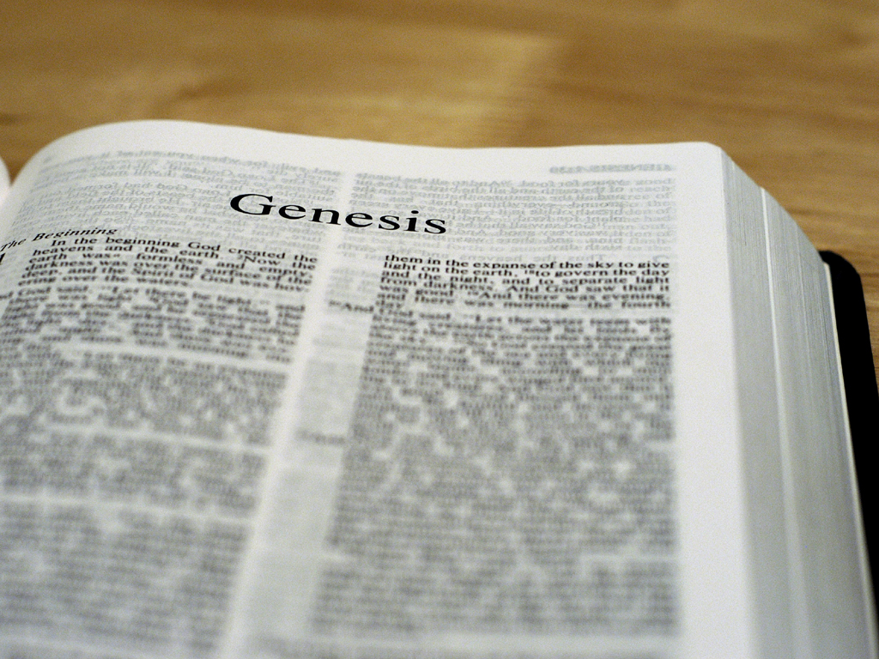
Genesis 12:1-3
The LORD had said to Abram, “Go from your
country, your people and your father’s household
to the land I will show you. I will make you into a
great nation, and I will bless you; I will make your
name great, and you will be a blessing. I will bless
those who bless you, and whoever curses you I
will curse; and all peoples on earth
will be blessed through you.”

Slide 33
Genesis 12:1-3
Genesis 12:1-3
Comment
The LORD had said to Abram, “Go
from your country, your people and
your father’s household to the land
I will show you. I will make you into
a great nation, and I will bless you;
I will make your name great, and
you will be a blessing. I will bless
those who bless you, and whoever
curses you I will curse; and all
peoples on earth will be blessed
through you.” [Predicted 2,000 BC]
“A great nation” and “all peoples on earth” make up an extremely large group of people worldwide. It speaks of one united group.

Slide 34
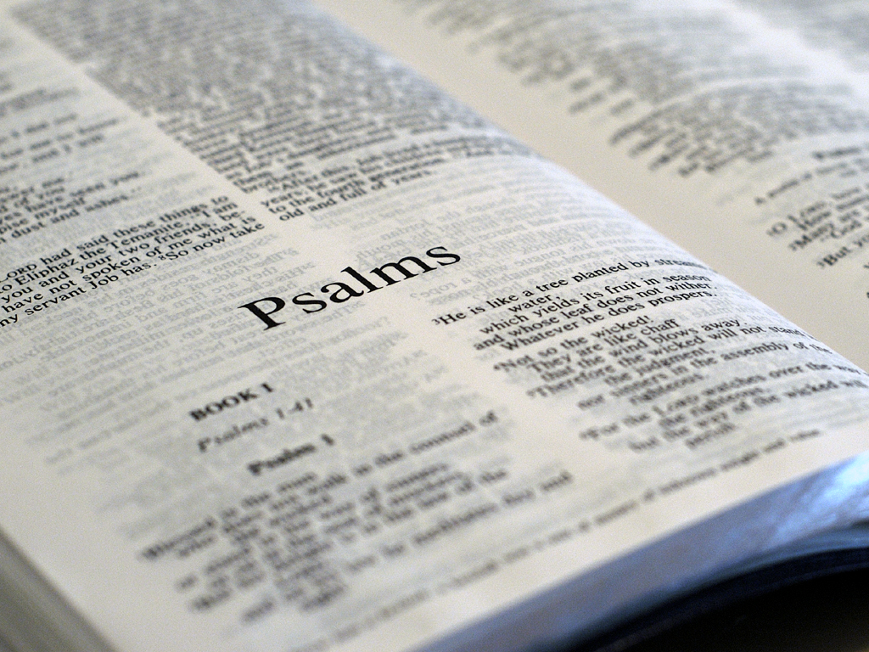
Psalm 22:27
“All the ends of the world shall remember and
turn to the LORD, and all the families of the
nations (Gentiles) shall worship before you.”
[Predicted ~1000 BC]

Slide 35
Psalm 47:8-9
“God reigns over the nations; God is seated
on his holy throne. The nobles of the nations
assemble as the people of the God of Abraham,
for the kings of the earth belong to God;
he is greatly exalted.”
[Predicted ~1000 BC]

Slide 36
Psalm 86:9
“All nations whom you have made shall
come and worship before you, O Lord,
and shall glorify your name.”
[Predicted ~1000 BC]

Slide 37
Psalm 98:2
“The LORD has made his salvation known and
revealed his righteousness to the nations.”
[Predicted ~1000 BC]

Slide 38
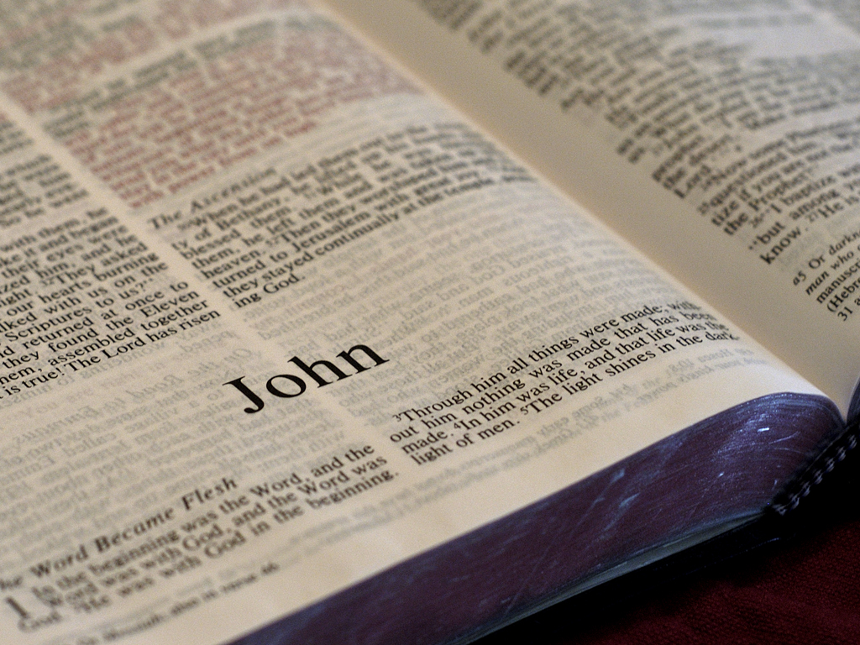
John 10:16
Jesus: “I have other [Gentile] sheep that are
not of this [Jewish] sheep pen. I must bring
them also. They too will listen to my voice,
and there shall be one flock
and one shepherd.”

Slide 39
John 10:16
John 10:16
Comment
Jesus: “I have other [Gentile]
sheep that are not of this
[Jewish] sheep pen. I must
bring them also. They too will
listen to my voice, and there
shall be one flock and one
shepherd.”
In God’s eyes, the biggest difference among people groups on earth was between Jews and Gentiles (non-Jews). All other differences (ethnic, tribal, cultural linguistic, etc.) are comparatively minor.

Slide 40
John 10:16
John 10:16
Comment
Jesus: “I have other [Gentile]
sheep that are not of this
[Jewish] sheep pen. I must
bring them also. They too will
listen to my voice, and there
shall be one flock and one
shepherd.”
Jesus says that if he can bring together the two groups of people who are the most different from each other, he is also able to bring other less different people groups together. There is one flock gathered around one shepherd.

Slide 41
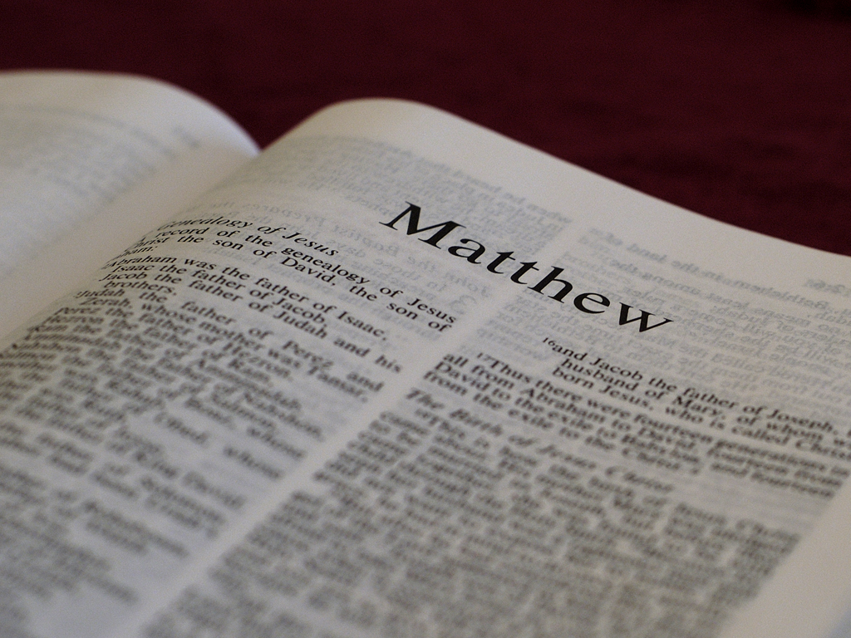
Matthew 24:13-14
Jesus: “And this gospel of the kingdom will be
preached in the whole world as a
testimony to all nations…”

Slide 42
Matthew 24:13-14
Matthew 24:13-14
Comment
Jesus: “And this gospel of
the kingdom will be
preached in the whole
world as a testimony to all
nations…”
There is one “gospel” or good news message about one kingdom for all people.

Slide 43
Matthew 24:13-14
Matthew 24:13-14
Comment
Jesus: “And this gospel of
the kingdom will be
preached in the whole
world as a testimony to all
nations…”
This one kingdom will include people from the entire world.

Slide 44
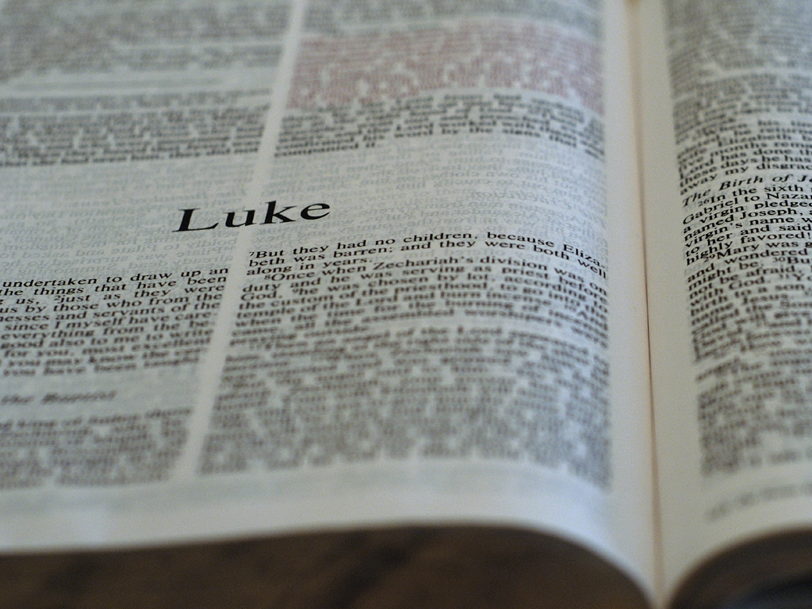
Luke 24:47
Jesus: …“And repentance and forgiveness of sins will be preached in his name to all nations, beginning at Jerusalem.”

Slide 45
Luke 24:47
Luke 24:47
Comment
Jesus: …“And repentance
and forgiveness of sins will
be preached in his name to
all nations, beginning at
Jerusalem.”
The one message about forgiveness in Jesus’ name means all people can respond equally.

Slide 46
Luke 24:47
Luke 24:47
Comment
Jesus: …“And repentance
and forgiveness of sins will
be preached in his name to
all nations, beginning at
Jerusalem.”
This message is for everyone and to take it to every nation.

Slide 47
Revelation 5:9-10
And [the elders] sang a new song, saying:
“You [Jesus] are worthy to take the scroll
and to open its seals, because you were slain,
and with your blood you purchased for God
persons from every tribe and language and
people and nation. You have made them to
be a kingdom and priests to serve our God,
and they will reign on the earth.”

Slide 48
Revelation 5:9-10
Revelation 5:9-10
Comment
And [the elders] sang a new song,
saying: “You [Jesus] are worthy
to take the scroll and to open its
seals, because you were slain,
and with your blood you
purchased for God persons from
every tribe and language and
people and nation. You have
made them to be a kingdom and
priests to serve our God, and they
will reign on the earth.”
Jesus is being honored because he died for all people.

Slide 49
Revelation 5:9-10
Revelation 5:9-10
Comment
And [the elders] sang a new song,
saying: “You [Jesus] are worthy to
take the scroll and to open its
seals, because you were slain,
and with your blood you
purchased for God persons
from every tribe and language
and people and nation. You have
made them to be a kingdom and
priests to serve our God, and they
will reign on the earth.”
Jesus’ death succeeded in making sure that God’s promise to Abraham came true: he will bless all the nations of the earth. In other words, every nation on earth will be represented in heaven at the end of time.

Slide 50
Revelation 5:9-10
Revelation 5:9-10
Comment
And [the elders] sang a new song,
saying: “You [Jesus] are worthy to
take the scroll and to open its
seals, because you were slain,
and with your blood you
purchased for God persons from
every tribe and language and
people and nation. You have
made them to be a kingdom and
priests to serve our God, and
they will reign on the earth.”
Believers in Jesus from every nation will be part of God’s perfect kingdom serving him and ruling on the earth.

Slide 51
Conclusion
Christian believers have life that never ends.
They have the power of God (his Spirit) who gives them strength to do God’s will.
They have a spiritual gift that is meant to help them grow personally and to be a part of growing God’s kingdom.
Their vertical relationship is with God and horizontal relationship with all believers.

Slide 52
Conclusion
A church should be a local group of believers designed to help them share their lives in community with each other and be a larger witness to others outside the church.
A church meets to help believers grow together to prepare for life in the kingdom.
At the end of time, all the nations of the world will live and reign with Jesus forever.

Slide 53
Questions?
We have covered a lot of material in a very
short time. Perhaps your head is too full or
spinning! That’s OK. Please feel free to ask
questions about anything that might be
confusing, unsettling or simply unclear.
Thank you!

Slide 54
Contact Bill Perry
Email: bill@billperry.tv

