Slide 1
Qualifications of church leaders
Bill Perry

Slide 2
1 Timothy 3:1
This is a faithful saying: If a man desires the
position of a bishop, he desires a good work.

Slide 3
1 Timothy 3:1
This is a faithful saying: If a man desires the
position of a bishop, he desires a good work.
“Bishop” = episkope (Grk) =
“look (scope) over (epi)”
Gives us the name “Episcopal” Church.

Slide 4
1 Timothy 3:1
This is a faithful saying: If a man desires the
position of a bishop, he desires a good work.
1st “desires” = to stretch and reach out for (external action or ambition)
2nd “desires” = to have a passion for
(internal motivation or focus)

Slide 5
Requirements you don’t see

Slide 6
Requirements you don’t see
Formal Bible training in a Bible college or seminary

Slide 7
Requirements you don’t see
Formal Bible training in a Bible college or seminary
A knowledge of Greek or Hebrew

Slide 8
Requirements you don’t see
Formal Bible training in a Bible college or seminary
A knowledge of Greek or Hebrew
Ordination by a theological committee

Slide 9
Requirements you don’t see
Formal Bible training in a Bible college or seminary
A knowledge of Greek or Hebrew
Ordination by a theological committee
Advanced theological degrees

Slide 10
Requirements you don’t see
Formal Bible training in a Bible college or seminary
A knowledge of Greek or Hebrew
Ordination by a theological committee
Advanced theological degrees
Leading a youth group, teaching a Bible study or other ministry experience

Slide 11
Requirements you don’t see
Formal Bible training in a Bible college or seminary
A knowledge of Greek or Hebrew
Ordination by a theological committee
Advanced theological degrees
Leading a youth group, teaching a Bible study or other ministry experience
Strong literacy skills

Slide 12
1 Timothy 3:2
A bishop then must be blameless, the husband
of one wife, temperate, sober-minded, of good
behavior, hospitable, able to teach…

Slide 13
1 Timothy 3:2
A bishop then must be blameless, the husband
of one wife, temperate, sober-minded, of good
behavior, hospitable, able to teach…
“Blameless” = irreproachable, unable to be
accused of criminal or major wrongdoing

Slide 14
1 Timothy 3:2
A bishop then must be blameless, the husband
of one wife, temperate, sober-minded, of good
behavior, hospitable, able to teach…
“Blameless” is the one word that represents
what a pastor’s life of should be; every other
qualification is part of being blameless.

Slide 15
1 Timothy 3:2
A bishop then must be blameless, the husband
of one wife, temperate, sober-minded, of good
behavior, hospitable, able to teach…
“The husband of one wife” = a one-woman man
It does not address marital status (singleness,
polygamy or remarriage), but having a single
focus on his wife if he is married.

Slide 16
1 Timothy 3:2
A bishop then must be blameless, the husband
of one wife, temperate, sober-minded, of good
behavior, hospitable, able to teach…
“Temperate” = wineless; vigilant, clearheaded
“Sober-minded” = sound-minded,
self-controlled, disciplined

Slide 17
1 Timothy 3:2
A bishop then must be blameless, the husband
of one wife, temperate, sober-minded, of good
behavior, hospitable, able to teach…
“Of good behavior” = kosmeos (Grk) = well
ordered, appropriate, modest;

Slide 18
1 Timothy 3:2
A bishop then must be blameless, the husband
of one wife, temperate, sober-minded, of good
behavior, hospitable, able to teach…
“Of good behavior” = kosmeos (Grk) = well
ordered, appropriate, modest;
English words: cosmos, cosmetics

Slide 19
1 Timothy 3:2
A bishop then must be blameless, the husband
of one wife, temperate, sober-minded, of good
behavior, hospitable, able to teach…
“Hospitable” = love for strangers

Slide 20
1 Timothy 3:2
A bishop then must be blameless, the husband
of one wife, temperate, sober-minded, of good
behavior, hospitable, able to teach…
“Able to teach” = teachable;
skilled at and disposed to teaching

Slide 21
2 Timothy 2:23-25a
But avoid foolish and ignorant disputes,
knowing that they generate strife. And
a servant of the Lord must not quarrel
but be gentle to all, able to teach,
patient, in humility correcting those
who are in opposition…

Slide 22
1 Timothy 3:3
…Not given to wine, not violent, not greedy for
money, but gentle, not quarrelsome, not
covetous…
“Not given to wine” = having no reputation
as a drunk, thus never controlled by it

Slide 23
1 Timothy 3:3
…Not given to wine, not violent, not greedy for
money, but gentle, not quarrelsome, not
covetous…
“Not violent” = not a fighter; not a contentious or argumentative person

Slide 24
1 Timothy 3:3
…Not given to wine, not violent, not greedy for
money, but gentle, not quarrelsome, not
covetous…
“Not greedy for money” = free from
financial motivation

Slide 25
1 Timothy 3:3
…Not given to wine, not violent, not greedy for
money, but gentle, not quarrelsome, not
covetous…
“Gentle” = considerate, mild, suitable

Slide 26
1 Timothy 3:3
…Not given to wine, not violent, not greedy for
money, but gentle, not quarrelsome, not
covetous…
“Not quarrelsome” = not a fighter

Slide 27
1 Timothy 3:3
…Not given to wine, not violent, not greedy for
money, but gentle, not quarrelsome, not
covetous…
“Not covetous” = doesn’t love money

Slide 28
1 Timothy 3:4-5
…One who rules his own house well, having
his children in submission with all reverence
(for if a man does not know how to rule his
own house, how will he take care of the
church of God?)

Slide 29
Life at a Glance
25%
75%
Youth
Young
Adult
Middle Age
Elderly
0
20
40
60
80
Sphere/Circle =
Generation =
Responsibility =
Family
Children
Great
Church
Grandchildren
Greater
City/State/Nation
Great Grandchildren
Greatest

Slide 30
Practice these at home first!
Blameless
the husband of one wife
temperate
sober-minded
of good behavior
hospitable
able to teach
not given to wine
not violent
not greedy for money
gentle
not quarrelsome
not covetous
One who rules his own house well, having his children in submission with all reverence (for if a man does not know how to rule his own house, how will he take care of the church of God?)

Slide 31
Practice these at home first!
Blameless
the husband of one wife
temperate
sober-minded
of good behavior
hospitable
able to teach
not given to wine
not violent
not greedy for money
gentle
not quarrelsome
not covetous
One who rules his own house well, having his children in submission with all reverence (for if a man does not know how to rule his own house, how will he take care of the church of God?)
Wife

Slide 32
Practice these at home first!
Blameless
the husband of one wife
temperate
sober-minded
of good behavior
hospitable
able to teach
not given to wine
not violent
not greedy for money
gentle
not quarrelsome
not covetous
One who rules his own house well, having his children in submission with all reverence (for if a man does not know how to rule his own house, how will he take care of the church of God?)
Wife
Small children

Slide 33
Practice these at home first!
Blameless
the husband of one wife
temperate
sober-minded
of good behavior
hospitable
able to teach
not given to wine
not violent
not greedy for money
gentle
not quarrelsome
not covetous
One who rules his own house well, having his children in submission with all reverence (for if a man does not know how to rule his own house, how will he take care of the church of God?)
Wife
Small children
Teenagers

Slide 34
“Kids are what God gives to adults
to help them finish growing up.”

Slide 35
“The path my kids will most likely follow
is the one I thought I covered up.”

Slide 36
1 Timothy 3:6
…Not a novice, lest being puffed up with pride
he fall into the same condemnation as
the devil.
“Novice” = new believer

Slide 37
1 Timothy 3:6
…Not a novice, lest being puffed up with pride
he fall into the same condemnation as
the devil.
“The same condemnation as the devil” =
fall from honor and authority

Slide 38
1 Timothy 3:7
Moreover he must have a good testimony
among those who are outside, lest he fall
into reproach and the snare of the devil.
“Those who are outside” = unbelievers

Slide 39
1 Timothy 3:7
Moreover he must have a good testimony
among those who are outside, lest he fall
into reproach and the snare of the devil.
“the snare of the devil” = the devil’s trap;
he wants church leaders to fail because when
they do, they trip up other believers

Slide 40
Summary from 2 Timothy 2:20-22
But in a great house there are not only vessels of gold
and silver, but also of wood and clay, some for honor
and some for dishonor. Therefore if anyone cleanses
himself from the latter, he will be a vessel for honor,
sanctified and useful for the Master, prepared for
every good work. Flee also youthful lusts; but pursue
righteousness, faith, love, peace with those who call
on the Lord out of a pure heart.

Slide 41
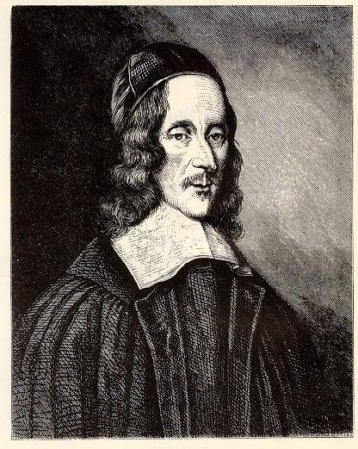
“One father is more than a
hundred schoolmasters.
--George Herbert,
Outlandish Proverbs, 1640

Slide 42
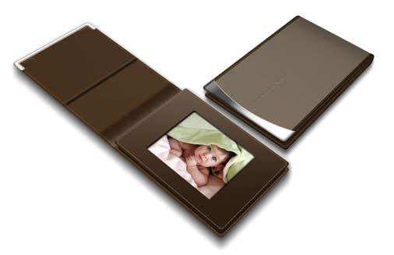
Conclusion
“A father carries pictures where
his money used to be.”
--Author Unknown

