Slide 1
The Backstory of Christmas, Part 1
Bill Perry

Slide 2
Christmas is an annual holiday celebrated around the world in various ways.

Slide 3
Japan

Slide 4
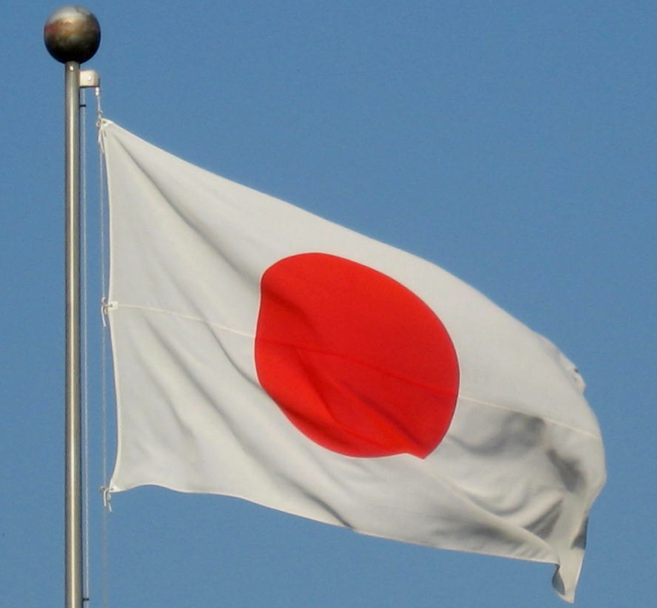
Japan
Christmas is a time to spread happiness

Slide 5
Japan
Christmas is a time to spread happiness
Happy/Merry Christmas is Meri Kurisumasu

Slide 6
Japan
Christmas is a time to spread happiness
Happy/Merry Christmas is Meri Kurisumasu
Santa Claus is Santa-san (Mr. Santa)

Slide 7
Japan
Christmas is a time to spread happiness
Happy/Merry Christmas is Meri Kurisumasu
Santa Claus is Santa-san (Mr. Santa)
Fried chicken is often eaten on Christmas Day

Slide 8
Japan
Christmas is a time to spread happiness
Happy/Merry Christmas is Meri Kurisumasu
Santa Claus is Santa-san (Mr. Santa)
Fried chicken is often eaten on Christmas Day
Christmas Eve is more of a romantic time where couples exchange gifts

Slide 9
China

Slide 10
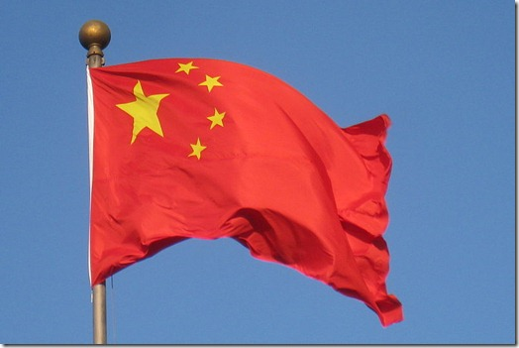
China
Christmas is celebrated mainly in bigger cities

Slide 11
China
Christmas is celebrated mainly in bigger cities
Happy/Merry Christmas is Sheng Dan Kuai Le in Mandarin and Seng Dan Fai Lok in Cantonese

Slide 12
China
Christmas is celebrated mainly in bigger cities
Happy/Merry Christmas is Sheng Dan Kuai Le in Mandarin and Seng Dan Fai Lok in Cantonese
Santa Claus is Sheng dan lao ren (Old Christmas Man) in Mandarin

Slide 13
China
Christmas is celebrated mainly in bigger cities
Happy/Merry Christmas is Sheng Dan Kuai Le in Mandarin and Seng Dan Fai Lok in Cantonese
Santa Claus is Sheng dan lao ren (Old Christmas Man) in Mandarin
Most Christmas trees are seen in shopping malls

Slide 14
China
Christmas is celebrated mainly in bigger cities
Happy/Merry Christmas is Sheng Dan Kuai Le in Mandarin and Seng Dan Fai Lok in Cantonese
Santa Claus is Sheng dan lao ren (Old Christmas Man) in Mandarin
Most Christmas trees are seen in shopping malls
Jingle Bells is a popular Christmas song

Slide 15
Nigeria

Slide 16
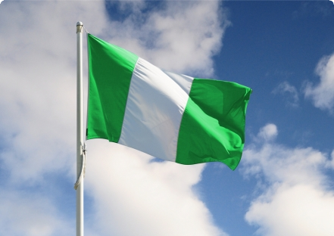
Nigeria
Christmas is a big family celebration; families in cities visit grandparents in villages

Slide 17
Nigeria
Christmas is a big family celebration; families in cities visit grandparents in villages
Happy/Merry Christmas is barka dà Kirsìmatì in Hausa, and Jabbama be salla Kirismati in Fulani

Slide 18
Nigeria
Christmas is a big family celebration; families in cities visit grandparents in villages
Happy/Merry Christmas is barka dà Kirsìmatì in Hausa, and Jabbama be salla Kirismati in Fulani
Christmas Eve parties last all night; then families go to church and thank God

Slide 19
Nigeria
Christmas is a big family celebration; families in cities visit grandparents in villages
Happy/Merry Christmas is barka dà Kirsìmatì in Hausa, and Jabbama be salla Kirismati in Fulani
Christmas Eve parties last all night; then families go to church and thank God
People often decorate their homes and streets

Slide 20
Nigeria
Christmas is a big family celebration; families in cities visit grandparents in villages
Happy/Merry Christmas is barka dà Kirsìmatì in Hausa, and Jabbama be salla Kirismati in Fulani
Christmas Eve parties last all night; then families go to church and thank God
People often decorate their homes and streets
Children often play with firecrackers

Slide 21
Indonesia

Slide 22
Indonesia
Christmas is celebrated by attending church services Christmas Eve and Christmas Day

Slide 23
Indonesia
Christmas is celebrated by attending church services Christmas Eve and Christmas Day
Happy/Merry Christmas is Selamat Natal

Slide 24
Indonesia
Christmas is celebrated by attending church services Christmas Eve and Christmas Day
Happy/Merry Christmas is Selamat Natal
Santa Claus is Sinterklas

Slide 25
Indonesia
Christmas is celebrated by attending church services Christmas Eve and Christmas Day
Happy/Merry Christmas is Selamat Natal
Santa Claus is Sinterklas
An annual Christmas event is broadcast on the national television station TVRI

Slide 26
Indonesia
Christmas is celebrated by attending church services Christmas Eve and Christmas Day
Happy/Merry Christmas is Selamat Natal
Santa Claus is Sinterklas
An annual Christmas event is broadcast on the national television station TVRI
Some specialized Christmas trees are made from chicken feathers (on Bali island)

Slide 27
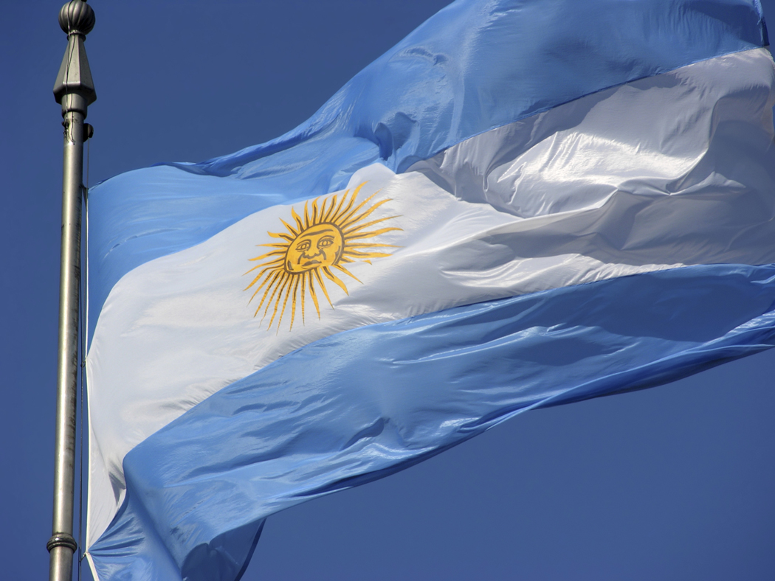
Argentina

Slide 28
Argentina
Christmas is celebrated on Christmas Eve with a big meal that might include barbeque followed by fireworks at midnight

Slide 29
Argentina
Christmas is celebrated on Christmas Eve with a big meal that might include barbeque followed by fireworks at midnight
After midnight Christmas Eve globos (paper lanterns with a candle) are released into the sky

Slide 30
Argentina
Christmas is celebrated on Christmas Eve with a big meal that might include barbeque followed by fireworks at midnight
After midnight Christmas Eve globos (paper lanterns with a candle) are released into the sky
Families decorate their homes with various items and some trees have cotton balls on them

Slide 31
Argentina
Christmas is celebrated on Christmas Eve with a big meal that might include barbeque followed by fireworks at midnight
After midnight Christmas Eve globos (paper lanterns with a candle) are released into the sky
Families decorate their homes with various items and some trees have cotton balls on them
Happy/Merry Christmas is Feliz Navidad

Slide 32
Argentina
Christmas is celebrated on Christmas Eve with a big meal that might include barbeque followed by fireworks at midnight
After midnight Christmas Eve globos (paper lanterns with a candle) are released into the sky
Families decorate their homes with various items and some trees have cotton balls on them
Happy/Merry Christmas is Feliz Navidad
Some people stay up all night Christmas Eve and sleep during Christmas day

Slide 33
How do Americans celebrate Christmas?
What have you seen?

Slide 34
In the United States several
characters are famous during
the Christmas season.

Slide 35
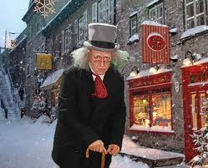
Ebenezer Scrooge
A Christmas Carol written
by Charles Dickens (1843)
Bob Cratchit
Tiny Tim
Ghosts of Christmas Past,
Christmas Present, and
Christmas Future

Slide 36
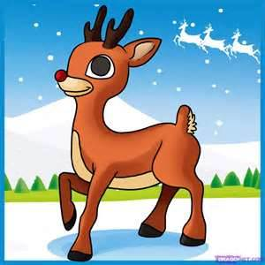
Rudolph the Red-Nosed Reindeer
First appeared in a book written by Robert L. May in 1939. It
is about Santa Claus needing a light to guide his
trip around the world to deliver
presents on Christmas Eve in
bad weather. Rudolph is
also known as Santa’s ninth
reindeer. It has been turned
into a song and TV programs.

Slide 37
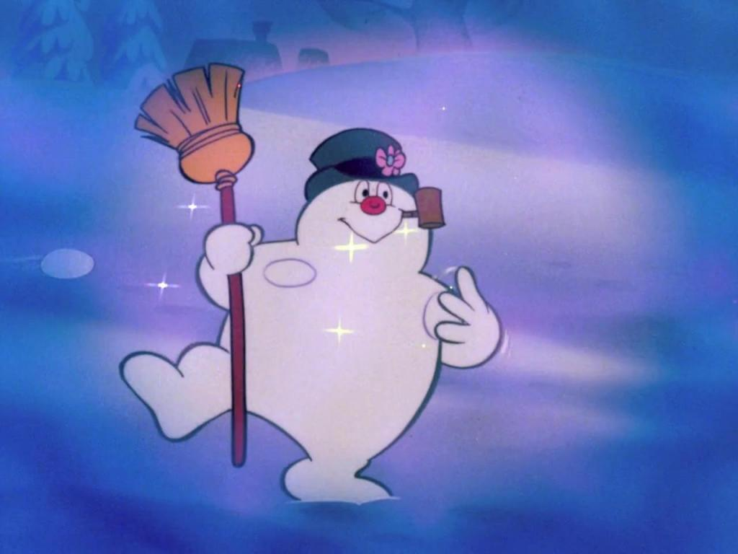
Frosty the Snowman
First appeared as a song written by Walter
Rollins and Steve Nelson,
and recorded by singer
Gene Autry in 1950.
Since then the Frosty
character has been adapted
into children’s books and TV programs.

Slide 38
The Grinch
Appears in the Dr. Seuss book,
How the Grinch Stole
Christmas (1957). He is
the main enemy of the
residents of a town called
“Whoville” who want to
celebrate Christmas.

Slide 39
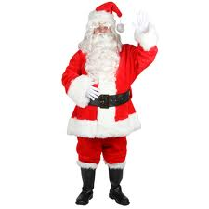
Santa Claus / Saint Nicholas
St. Nicholas was a real person who lived in Asia Minor (modern day Turkey) in the 4th Century. He was a wealthy church leader who used his money to help sailors, the poor and children, especially orphans. His generosity made him famous. Greek and Russian Orthodox churches made him an official saint.

Slide 40
Santa Claus / Saint Nicholas
Early Dutch immigrants in New York called Saint Nicholas “Sinterklass,” which is where the name “Santa Claus” comes from.
**************
The modern idea of Santa Claus having a long white beard and wearing a red and white winter suit came from Twas the Night Before Christmas, a poem written by Clement Moore in 1822.

Slide 41
What is the origin of
this famous holiday
celebrated worldwide?

Slide 42
The backstory of Christmas
is found in the Bible.

Slide 43
Genesis 1:1
In the beginning God
created the heaven
and the earth.

Slide 44
What kind of God is this?
A little story about
“Bill the Baker”

Slide 45
The God of the Bible is:
Living before he created anything
Perfectly powerful
Perfectly intelligent
Separate from his creation
The owner of all he makes
Personal

Slide 46
The God of the Bible made:
Light, water, land and atmosphere (1:3-10)
All the plants (1:11-13)
Planets and stars (1:14-19)
All the sea creatures (1:20-23)
All the land animals (1:24-25)

Slide 47
Then God made humans
Genesis 1:26-27
Then God said, “Let us make man in our image, in our likeness… Male and female he created them.”

Slide 48
Then God made humans
Genesis 1:26-27
Then God said, “Let us make man in our image, in our likeness… Male and female he created them.”
Comment:
Human beings are unique and different than any other form of life because they carry God’s image.

Slide 49
Then God made humans
Genesis 1:29
And God said, “See, I have given you every herb… and every tree…for food.”

Slide 50
Then God made humans
Genesis 1:29
And God said, “See, I have given you every herb… and every tree…for food.”
Comment:
God provides for them. He also speaks to them demonstrating a relationship with both of them.

Slide 51
Genesis 1:31
Then God saw everything he had made,
and indeed it was very good.

Slide 52
Genesis 1:31– “Then God saw everything he had made, and indeed it was very good.”
The story of human beings in the Bible starts with life in perfect harmony and peace with God. But then something terribly wrong occurred.

Slide 53
Next time:
What went wrong?

