Slide 1
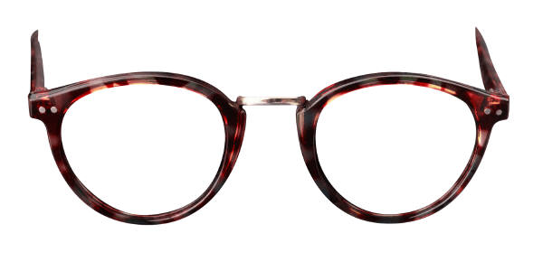
Is Always
Hindsight 20/20?
Bill Perry
回顧 是否永遠都如二十二十的視力

Slide 2
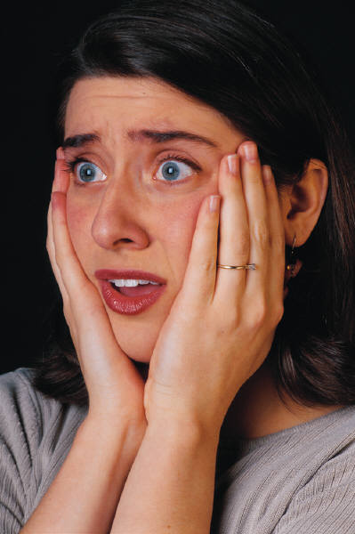
“Seeing
is NOT
always
believing!”
眼見不能
為憑!

Slide 3
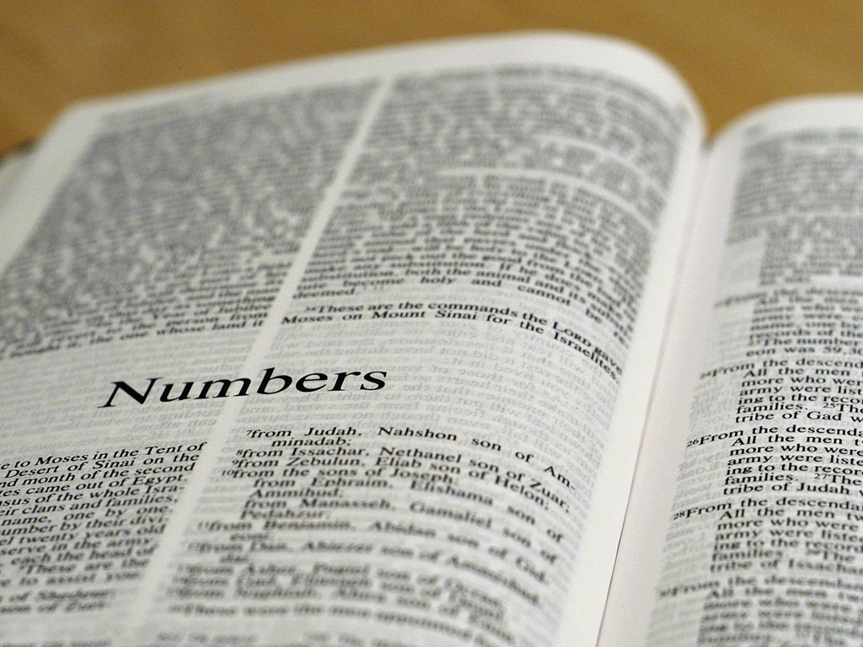
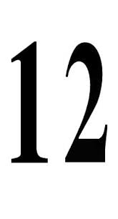
Numbers 13:1-3 (NKJV) 民數記 13:1-3
And the LORD spoke to Moses, saying,
"Send men to spy out the land of Canaan,
which I am giving to the children of Israel;
from each tribe of their fathers you shall
send a man, every one a leader among them.”
So Moses sent them from the Wilderness of
Paran according to the command of the
LORD, all of them men who were heads
of the children of Israel.
耶和華曉諭摩 西說：「你 打發人去窺探我所賜給以色列人的迦南地，他們每支派中要打發一個人，都要作首領的。」 摩 西就照耶和華的吩咐，從巴蘭的曠野打發他們去，他們都是以色列的族長。

Slide 4
Numbers 13:17-18 民數記 13:17-18
Then Moses sent them to spy out the land
of Canaan, and said to them, "Go up this
way into the South, and go up to the
mountains, "and see what the land is like:
whether the people who dwell in it are
strong or weak, few or many; …
摩西打發他們 去窺探迦南地說：「你們從南地上山地去，看 那地如何：其中所住的民是強是弱，是多是少，

Slide 5
Numbers 13:19-20 民數記 13:19-20
"whether the land they dwell in
is good or bad; whether the cities they inhabit
are like camps or strongholds; whether the land
is rich or poor; and whether there are forests
there or not. Be of good courage. And bring
some of the fruit of the land." Now the time
was the season of the first ripe grapes.
所住之地是好 是歹，所住之處是營盤是堅城？又 看那地土是肥美是瘠薄，其中有樹木沒有？你們要放開膽量，把那地的果子帶些來。」（那時正是葡萄初熟的時候。）

Slide 6
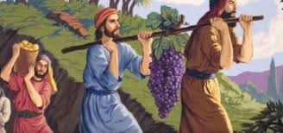
Numbers 13:23 民數記 13:23
Then they came to the Valley of Eshcol,
and there cut down a branch with one
cluster of grapes; they carried it between
two of them on a pole. They also brought
some of the pomegranates and figs.
他們到了以實各谷，從那裏砍了葡萄樹的一枝，上頭有一掛葡萄，兩個人用槓抬著， 又帶了些石榴和無花果來。

Slide 7
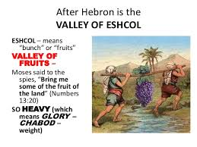
Numbers 13:24 民數記 13:24
The place was called the
Valley Of Eshcol, because of
the cluster which the men
of Israel cut down there.
因 為以色列人從那裏砍來的那掛葡萄，所以那地方叫作以實各谷。

Slide 8
Numbers 13:25-26 民數記 13:25-26
And they returned from spying out the
land after forty days. Now they departed
and came back to Moses and Aaron and all
the congregation of the children of Israel
in the Wilderness of Paran, at Kadesh; they
brought back word to them and to all
the congregation, and showed them
the fruit of the land.
過了四十天， 他們窺探那地才回來。到 了巴蘭曠野的加低斯，見摩西、亞倫並以色列的全會眾，回報摩西、亞倫並全會眾，又把那地的果子給他們看。

Slide 9
The Initial Report 初次報告
The Claim 申稱 | True 是 | False 否
v. 27: The land “flows with milk and honey” 是流奶與密之地

Slide 10
The Initial Report 初次報告
The Claim 申稱 | True 是 | False 否
v. 27: The land “flows with milk and honey” 是流奶與密之地 | ✔

Slide 11
The Initial Report 初次報告
The Claim 申稱 | True 是 | False 否
v. 27: The land “flows with milk and honey”是流奶與密之地 | ✔
v. 28: The people are strong 住那地的民強壯

Slide 12
The Initial Report 初次報告
The Claim 申稱 | True 是 | False 否
v. 27: The land “flows with milk and honey”是流奶與密之地 | ✔
v. 28: The people are strong 住那地的民強壯 | -- | --

Slide 13
The Initial Report 初次報告
The Claim 申稱 | True 是 | False 否
v. 27: The land “flows with milk and honey”是流奶與密之地 | ✔
v. 28: The people are strong 住那地的民強壯 | -- | --
v. 28: The cities are fortified 城邑也堅固

Slide 14
The Initial Report 初次報告
The Claim 申稱 | True 是 | False 否
v. 27: The land “flows with milk and honey”是流奶與密之地 | ✔
v. 28: The people are strong 住那地的民強壯 | -- | --
v. 28: The cities are fortified 城邑也堅固 | ✔

Slide 15
The Initial Report 初次報告
The Claim 申稱 | True 是 | False 否
v. 27: The land “flows with milk and honey”是流奶與密之地 | ✔
v. 28: The people are strong 住那地的民強壯 | -- | --
v. 28: The cities are fortified 城邑也堅固 | ✔
v. 28: The cities are very large 城邑也寬大

Slide 16
The Initial Report 初次報告
The Claim 申稱 | True 是 | False 否
v. 27: The land “flows with milk and honey”是流奶與密之地 | ✔
v. 28: The people are strong 住那地的民強壯 | -- | --
v. 28: The cities are fortified 城邑也堅固 | ✔
v. 28: The cities are very large 城邑也寬大 |  | ✔

Slide 17
The Initial Report 初次報告
The Claim 申稱 | True 是 | False 否
v. 27: The land “flows with milk and honey”是流奶與密之地 | ✔
v. 28: The people are strong 住那地的民強壯 | -- | --
v. 28: The cities are fortified 城邑也堅固 | ✔
v. 28: The cities are very large 城邑也寬大 |  | ✔
v. 28: The descendants of Anak [giants] are there 那裏見了亞衲族的人

Slide 18
The Initial Report 初次報告
The Claim 申稱 | True 是 | False 否
v. 27: The land “flows with milk and honey”是流奶與密之地 | ✔
v. 28: The people are strong 住那地的民強壯 | -- | --
v. 28: The cities are fortified 城邑也堅固 | ✔
v. 28: The cities are very large 城邑也寬大 |  | ✔
v. 28: The descendants of Anak [giants] are there那裏見了亞衲族的人 | ✔

Slide 19
The Initial Report 初次報告
The Claim 申稱 | True 是 | False 否
v. 27: The land “flows with milk and honey”是流奶與密之地 | ✔
v. 28: The people are strong 住那地的民強壯 | -- | --
v. 28: The cities are fortified 城邑也堅固 | ✔
v. 28: The cities are very large 城邑也寬大 |  | ✔
v. 28: The descendants of Anak [giants] are there那裏見了亞衲族的人 | ✔
v. 29: The Amalekites, Hittites, Jebusites, Amorites & Canaanites are there too from the plains to the Jordan River to the sea 亞 瑪 力 人 住 在 南 地 、 赫 人 、 耶 布 斯 人 、 亞 摩 利 人 、 住 在 山 地 、 迦 南 人 住 在 海 邊 、 並 約 但 河 旁 。

Slide 20
The Initial Report 初次報告
The Claim 申稱 | True 是 | False 否
v. 27: The land “flows with milk and honey”是流奶與密之地 | ✔
v. 28: The people are strong 住那地的民強壯 | -- | --
v. 28: The cities are fortified 城邑也堅固 | ✔
v. 28: The cities are very large 城邑也寬大 |  | ✔
v. 28: The descendants of Anak [giants] are there那裏見了亞衲族的人 | ✔
v. 29: The Amalekites, Hittites, Jebusites, Amorites & Canaanites are there too from the plains to the Jordan River to the sea 亞 瑪 力 人 住 在 南 地 、 赫 人 、 耶 布 斯 人 、 亞 摩 利 人 、 住 在 山 地 、 迦 南 人 住 在 海 邊 、 並 約 但 河 旁 。 | ✔

Slide 21
The Initial Report 初次報告
The Claim 申稱 | True 是 | False 否
v. 27: The land “flows with milk and honey”是流奶與密之地 | ✔
v. 28: The people are strong 住那地的民強壯 | -- | --
v. 28: The cities are fortified 城邑也堅固 | ✔
v. 28: The cities are very large 城邑也寬大 |  | ✔
v. 28: The descendants of Anak [giants] are there那裏見了亞衲族的人 | ✔
v. 29: The Amalekites, Hittites, Jebusites, Amorites & Canaanites are there too from the plains to the Jordan River to the sea 亞 瑪 力 人 住 在 南 地 、 赫 人 、 耶 布 斯 人 、 亞 摩 利 人 、 住 在 山 地 、 迦 南 人 住 在 海 邊 、 並 約 但 河 旁 。 | ✔
How many positives and how many negatives?
多少正面與多少負面點?

Slide 22
Numbers 13:30
Then Caleb quieted the people before
Moses, and said, "Let us go up at once
and take possession, for we are well
able to overcome it."

Slide 23
Numbers 13:31-32a
But the men who had gone up with him
said, "We are not able to go up against
the people, for they are stronger than
we.” And they gave the children of Israel
a bad report of the land which they
had spied out...

Slide 24
The Amended Report 經修訂的報告
The Claim 申稱 | True 是 | False 否
v. 27: The land “flows with milk and honey”是流奶與密之地 | ✔
v. 28: The people are strong 住那地的民強壯 | -- | --
v. 28: The cities are fortified 城邑也堅固 | ✔
v. 28: The cities are very large 城邑也寬大 |  | ✔
v. 28: The descendants of Anak [giants] are there那裏見了亞衲族的人 | ✔
v. 29: The Amalekites, Hittites, Jebusites, Amorites & Canaanites are there too from the plains to the river to the sea 亞 瑪 力 人 住 在 南 地 、 赫 人 、 耶 布 斯 人 、 亞 摩 利 人 、 住 在 山 地 、 迦 南 人 住 在 海 邊 、 並 約 但 河 旁 。 | ✔
v. 32: The land devours its inhabitants

Slide 25
The Amended Report 經修訂的報告
The Claim 申稱 | True 是 | False 否
v. 27: The land “flows with milk and honey”是流奶與密之地 | ✔
v. 28: The people are strong 住那地的民強壯 | -- | --
v. 28: The cities are fortified 城邑也堅固 | ✔
v. 28: The cities are very large 城邑也寬大 |  | ✔
v. 28: The descendants of Anak [giants] are there那裏見了亞衲族的人 | ✔
v. 29: The Amalekites, Hittites, Jebusites, Amorites & Canaanites are there too from the plains to the river to the sea 亞 瑪 力 人 住 在 南 地 、 赫 人 、 耶 布 斯 人 、 亞 摩 利 人 、 住 在 山 地 、 迦 南 人 住 在 海 邊 、 並 約 但 河 旁 。 | ✔
v. 32: The land devours its inhabitants 是 吞 喫 居 民 之 地 |  | ✔

Slide 26
The Amended Report 經修訂的報告
The Claim 申稱 | True 是 | False 否
v. 27: The land “flows with milk and honey”是流奶與密之地 | ✔
v. 28: The people are strong 住那地的民強壯 | -- | --
v. 28: The cities are fortified 城邑也堅固 | ✔
v. 28: The cities are very large 城邑也寬大 |  | ✔
v. 28: The descendants of Anak [giants] are there那裏見了亞衲族的人 | ✔
v. 29: The Amalekites, Hittites, Jebusites, Amorites & Canaanites are there too from the plains to the river to the sea 亞 瑪 力 人 住 在 南 地 、 赫 人 、 耶 布 斯 人 、 亞 摩 利 人 、 住 在 山 地 、 迦 南 人 住 在 海 邊 、 並 約 但 河 旁 。 | ✔
v. 32: The land devours its inhabitants 是 吞 喫 居 民 之 地 |  | ✔
v. 32: All the people are of great stature 人 民 都 身 量 高 大

Slide 27
The Amended Report 經修訂的報告
The Claim 申稱 | True 是 | False 否
v. 27: The land “flows with milk and honey”是流奶與密之地 | ✔
v. 28: The people are strong 住那地的民強壯 | -- | --
v. 28: The cities are fortified 城邑也堅固 | ✔
v. 28: The cities are very large 城邑也寬大 |  | ✔
v. 28: The descendants of Anak [giants] are there那裏見了亞衲族的人 | ✔
v. 29: The Amalekites, Hittites, Jebusites, Amorites & Canaanites are there too from the plains to the river to the sea 亞 瑪 力 人 住 在 南 地 、 赫 人 、 耶 布 斯 人 、 亞 摩 利 人 、 住 在 山 地 、 迦 南 人 住 在 海 邊 、 並 約 但 河 旁 。 | ✔
v. 32: The land devours its inhabitants 是 吞 喫 居 民 之 地 |  | ✔
v. 32: All the people are of great stature人 民 都 身 量 高 大 |  | ✔

Slide 28
The Amended Report 經修訂的報告
The Claim 申稱 | True 是 | False 否
v. 27: The land “flows with milk and honey”是流奶與密之地 | ✔
v. 28: The people are strong 住那地的民強壯 | -- | --
v. 28: The cities are fortified 城邑也堅固 | ✔
v. 28: The cities are very large 城邑也寬大 |  | ✔
v. 28: The descendants of Anak [giants] are there 那裏見了亞衲族的人 | ✔
v. 29: The Amalekites, Hittites, Jebusites, Amorites & Canaanites are there too from the plains to the river to the sea 亞 瑪 力 人 住 在 南 地 、 赫 人 、 耶 布 斯 人 、 亞 摩 利 人 、 住 在 山 地 、 迦 南 人 住 在 海 邊 、 並 約 但 河 旁 。 | ✔
v. 32: The land devours its inhabitants 是 吞 喫 居 民 之 地 |  | ✔
v. 32: All the people are of great stature人 民 都 身 量 高 大 |  | ✔
v. 33: We were like grasshoppers in our own sight 看自己就如蚱蜢一樣

Slide 29
The Amended Report 經修訂的報告
The Claim 申稱 | True 是 | False 否
v. 27: The land “flows with milk and honey”是流奶與密之地 | ✔
v. 28: The people are strong 住那地的民強壯 | -- | --
v. 28: The cities are fortified 城邑也堅固 | ✔
v. 28: The cities are very large 城邑也寬大 |  | ✔
v. 28: The descendants of Anak [giants] are there那裏見了亞衲族的人 | ✔
v. 29: The Amalekites, Hittites, Jebusites, Amorites & Canaanites are there too from the plains to the river to the sea 亞 瑪 力 人 住 在 南 地 、 赫 人 、 耶 布 斯 人 、 亞 摩 利 人 、 住 在 山 地 、 迦 南 人 住 在 海 邊 、 並 約 但 河 旁 。 | ✔
v. 32: The land devours its inhabitants 是 吞 喫 居 民 之 地 |  | ✔
v. 32: All the people are of great stature人 民 都 身 量 高 大 |  | ✔
v. 33: We were like grasshoppers in our own sight 看自己就如蚱蜢一樣 | ✔

Slide 30
The Amended Report 經修訂的報告
The Claim 申稱 | True 是 | False 否
v. 27: The land “flows with milk and honey”是流奶與密之地 | ✔
v. 28: The people are strong 住那地的民強壯 | -- | --
v. 28: The cities are fortified 城邑也堅固 | ✔
v. 28: The cities are very large 城邑也寬大 |  | ✔
v. 28: The descendants of Anak [giants] are there那裏見了亞衲族的人 | ✔
v. 29: The Amalekites, Hittites, Jebusites, Amorites & Canaanites are there too from the plains to the river to the sea 亞 瑪 力 人 住 在 南 地 、 赫 人 、 耶 布 斯 人 、 亞 摩 利 人 、 住 在 山 地 、 迦 南 人 住 在 海 邊 、 並 約 但 河 旁 。 | ✔
v. 32: The land devours its inhabitants 是 吞 喫 居 民 之 地 |  | ✔
v. 32: All the people are of great stature人 民 都 身 量 高 大 |  | ✔
v. 33: We were like grasshoppers in our own sight看自己就如蚱蜢一樣 | ✔
v. 33: We were like grasshoppers in their sight 他們看我們也是如此

Slide 31
The Amended Report 經修訂的報告
The Claim 申稱 | True 是 | False 否
v. 27: The land “flows with milk and honey”是流奶與密之地 | ✔
v. 28: The people are strong 住那地的民強壯 | -- | --
v. 28: The cities are fortified 城邑也堅固 | ✔
v. 28: The cities are very large 城邑也寬大 |  | ✔
v. 28: The descendants of Anak [giants] are there那裏見了亞衲族的人 | ✔
v. 29: The Amalekites, Hittites, Jebusites, Amorites & Canaanites are there too from the plains to the river to the sea 亞 瑪 力 人 住 在 南 地 、 赫 人 、 耶 布 斯 人 、 亞 摩 利 人 、 住 在 山 地 、 迦 南 人 住 在 海 邊 、 並 約 但 河 旁 。 | ✔
v. 32: The land devours its inhabitants 是 吞 喫 居 民 之 地 |  | ✔
v. 32: All the people are of great stature人 民 都 身 量 高 大 |  | ✔
v. 33: We were like grasshoppers in our own sight 看自己就如蚱蜢一樣 | ✔
v. 33: We were like grasshoppers in their sight 他們看我們也是如此 |  | ✔

Slide 32
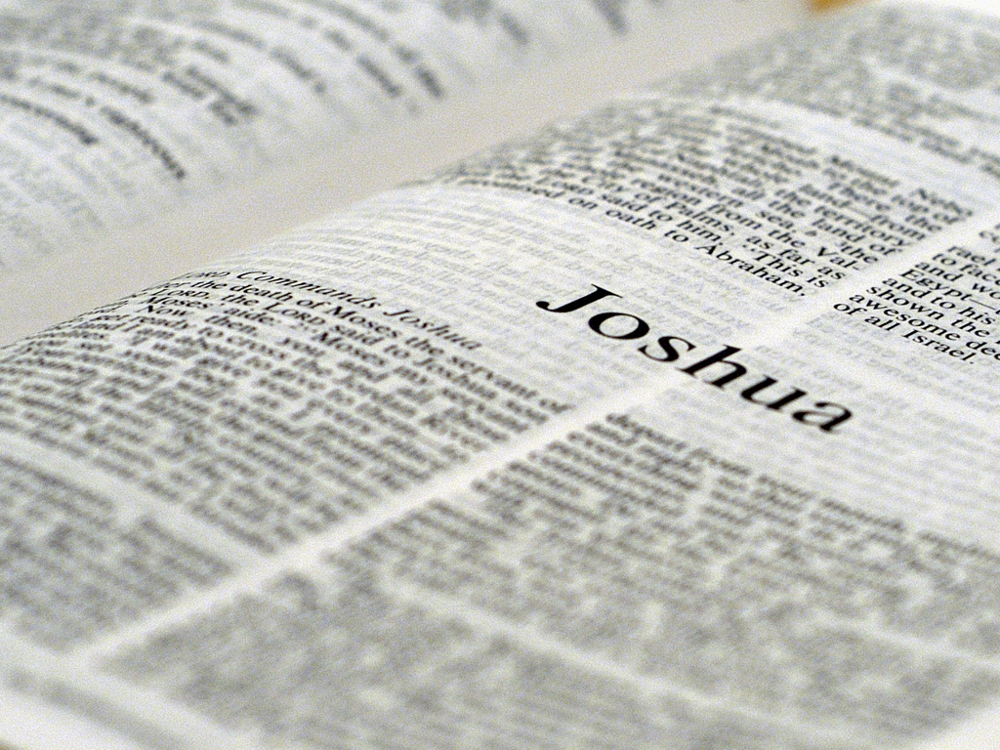
Joshua 2:11 約書亞記 2:11
The testimony of Rahab inside Jericho:
喇合在耶利哥的見證:
“And as soon as we heard these things,
our hearts melted; neither did there
remain any more courage in anyone
because of you, for the LORD your
God, he is God in heaven above
and on earth beneath.
我們一聽見這些事，心就消化了。因你們的緣故，並無一人有膽氣。耶和華你們的 神，本是上天下地的 神。

Slide 33
Numbers 14:1-2 民數記 14:1-2
So all the congregation lifted up their voices
and cried, and the people wept that night.
And all the children of Israel complained
against Moses and Aaron, and the whole
congregation said to them, "If only we
had died in the land of Egypt! Or if only
we had died in this wilderness!
當下全會眾大 聲喧嚷；那夜百姓都哭號。以 色列眾人向摩西、亞倫發怨言，全會眾對他們說：「巴不得我們早死在埃及地，或是死在這曠野。

Slide 34
Numbers 14:3-4 民數記
"Why has the LORD brought us to this land
to fall by the sword, that our wives and
children should become victims? Would it
not be better for us to return to Egypt?"
So they said to one another, "Let us
select a leader and return to Egypt."
耶和華為甚麼 把我們領到那地，使我們倒在刀下呢？我們的妻子和孩子必被擄掠，我們回埃及去豈不好嗎？」眾 人彼此說：「我們不如立一個首領，回埃及去吧！」

Slide 35
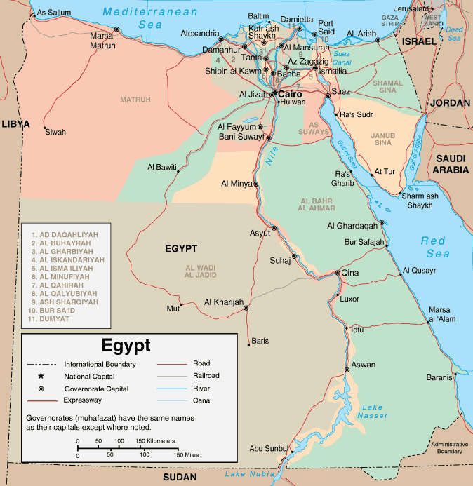
Question: 問題:
What was left in Egypt?
在埃及還剩下甚麼?

Slide 36
Question: 問題:
What was left in Egypt?
在埃及還剩下甚麼?
Nothing!!

Slide 37
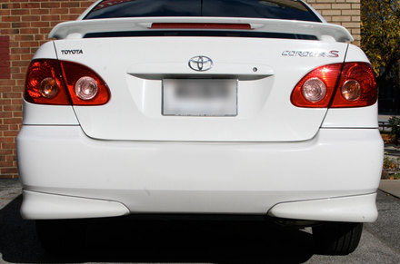
“Never underestimate the power
of stupid people in large groups.”
永遠不要低估愚蠢人在眾人裡的影響力!

Slide 38
Numbers 14:5-6 民數記 14:5-6
Then Moses and Aaron fell on their faces
before all the assembly of the congregation
of the children of Israel. But Joshua the son
of Nun and Caleb the son of Jephunneh,
who were among those who had spied
out the land, tore their clothes…
摩西、亞倫就 俯伏在以色列全會眾面前。窺 探地的人中，嫩的兒子約書亞和耶孚尼的兒子迦勒撕裂衣服，

Slide 39
Numbers 14:7-8 民數記 14:7-8
…and they spoke to all the congregation
of the children of Israel, saying: "The
land we passed through to spy out is
an exceedingly good land. "If the LORD
delights in us, then he will bring us into
this land and give it to us, 'a land
which flows with milk and honey.‘
對以色列全會 眾說：「我們所窺探經過之地是極美之地。耶 和華若喜悅我們，就必將我們領進那地，把地賜給我們。那地原是流奶與蜜之地。

Slide 40
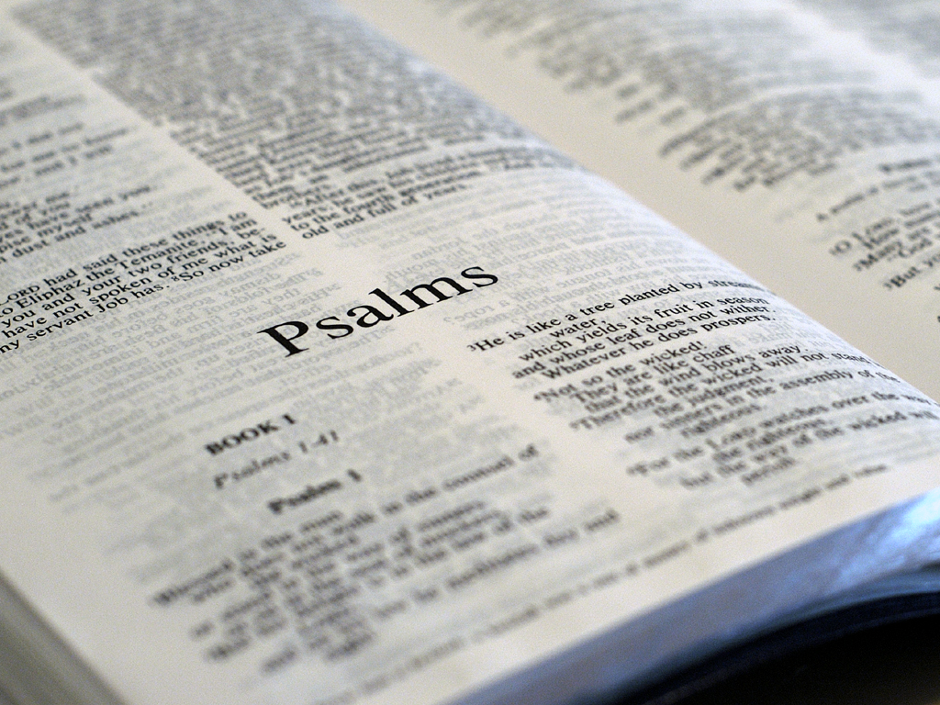
Psalm 147:10-11 詩篇 147:10-11
[The Lord] does not delight in the strength
of the horse; he takes no pleasure in the
legs of a man. The Lord takes pleasure in
those who fear him, in those who hope
in his mercy.
祂不喜悅馬的 力大，不喜愛人的腿快。
耶 和華喜愛敬畏祂和盼望祂慈愛的人。

Slide 41
Numbers 14:9 民數記 14:9
"Only do not rebel against the LORD, nor
fear the people of the land, for they are
our bread; their protection has departed
from them, and the LORD is with us.
Do not fear them.“
但你們不可背叛耶和華，也不要怕那地的居民，因為他們是我們的食物，並且蔭庇他們的已經離開他們。有耶和華與我們同在，不要怕他們。」

Slide 42
Joshua 2:11 約書亞記 2:11
The testimony of Rahab inside Jericho:
喇合在耶利哥的見證:
“And as soon as we heard these things,
our hearts melted; neither did there
remain any more courage in anyone
because of you, for the LORD your
God, he is God in heaven above
and on earth beneath.
我們一聽見這些事，心就消化了。因你們的緣故，並無一人有膽氣。耶和華你們的 神，本是上天下地的 神。

Slide 43
How did Joshua and Caleb know? 約書亞和迦勒是如何得知?

Slide 44
How did Joshua and Caleb know? 約書亞和迦勒是如何得知?
Remembered the devastating miracles in Egypt and knew they were not to return.
記得那些在埃及裡毀滅性的神蹟也知道他們不可以再回去.

Slide 45
How did Joshua and Caleb know?
Remembered the devastating miracles in Egypt and knew they were not to return.
記得那些在埃及裡毀滅性的神蹟也知道他們不可以再回去.
Heard the promises of God about the Promised Land and knew it was theirs.
聽到神的應許並知道應許之地是他們的.

Slide 46
How did Joshua and Caleb know? 約書亞和迦勒是如何得知?
Remembered the devastating miracles in Egypt and knew they were not to return.
記得那些在埃及裡毀滅性的神蹟也知道他們不可以再回去.
Heard the promises of God about the Promised Land and knew it was theirs.
聽到神的應許並知道應許之地是他們的.
Experienced the power of God in Egypt’s destruction and their protection.
經歷毀滅性的神蹟中神的大能與保守.

Slide 47
How did Joshua and Caleb know? 約書亞和迦勒是如何得知?
Remembered the devastating miracles in Egypt and knew they were not to return.
記得那些在埃及裡毀滅性的神蹟也知道他們不可以再回去.
Heard the promises of God about the Promised Land and knew it was theirs.
聽到神的應許並知道應許之地是他們的.
Experienced the power of God in Egypt’s destruction and their protection.
經歷毀滅性的神蹟中神的大能與保守.
Personally saw the land and its blessings and knew that God would give them victory.
親自看到應許之地和當中的祝福也知道神會賜給他們勝利!

Slide 48
How did Joshua and Caleb know? 約書亞和迦勒是如何得知?
By Faith!
信心!

Slide 49
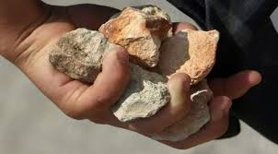
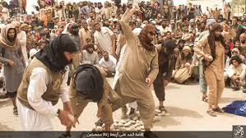
Numbers 14:10 民數記 14:10
And all the congregation said to
stone them with stones.
但全會眾說：「拿石頭打死他們二人。」

Slide 50
Numbers 14:10 民數記 14:10
And all the congregation said to
stone them with stones.
但全會眾說：「拿石頭打死他們二人。」
Unbelief frequently spreads
more quickly than faith!
不信通常比信心傳達的更快!

Slide 51
Numbers 14:10 民數記 14:10
And all the congregation said to
stone them with stones. Now the glory
of the LORD appeared in the tabernacle of
meeting before all the children of Israel.
但全會眾說：「拿石頭打死他們二人。」忽然，耶和華的榮光在會幕中向以色列眾人顯現。

Slide 52
Numbers 14:11 民數記 14:11
Then the LORD said to Moses: "How long
will these people reject me? And how long
will they not believe me, with all the signs
which I have performed among them?
耶和華對摩西 說：「這百姓藐視我要到幾時呢？我在他們中間行了這一切神蹟，他們還不信我要到幾時呢？

Slide 53
Numbers 14:12 民數記 14:12
"I will strike them with the pestilence and
disinherit them, and I will make of you a
nation greater and mightier than they.“
我 要用瘟疫擊殺他們，使他們不得承受那地，叫你的後裔成為大國，比他們強勝。」

Slide 54
Numbers 14:20-22 民數記14:20-22
Then the LORD said: "I have pardoned,
according to your word; "but truly, as I live,
all the earth shall be filled with the glory
of the LORD— "because all these men who
have seen my glory and the signs which I
did in Egypt and in the wilderness, and
have put me to the test now these ten
times, and have not heeded my voice…
耶和華說： 「我照著你的話赦免了他們。 然 我指著我的永生起誓，遍地要被我的榮耀充滿。 這 些人雖看見我的榮耀和我在埃及與曠野所行的神蹟，仍然試探我這十次，不聽從我的話，

Slide 55
“These ten times”
Verse | Place | The testing
Exodus 14:10-12 | Red Sea | “Better to serve the Egyptians”
Exodus 15:22-24 | Wilderness of Shur | Complained about no water
Exodus 16:1-3 | Wilderness of Sin | “Oh that we would have died in Egypt!”
Exodus 16:19-20 | Wilderness of Sin | Disobeyed Moses about the manna
Exodus 16:27-30 | Wilderness of Sin | Tried to collect manna on the 7th day
Exodus 17:1-4 | Rephidim | Complained about no water
Exodus 32:1-35 | Mt. Sinai | Worshiping the golden calf
Numbers 11:1-3 | Taberah | Unspecified complaining
Numbers 11:4-34 | Taberah | Complained about lack of meat
Numbers 14:1-3 | Hazeroth | Complained about Promised Land

Slide 56
Numbers 14:23-24 民數記 14:23-24
"…they certainly shall not see the land of
which I swore to their fathers, nor shall
any of those who rejected me see it. "But
my servant Caleb, because he has a
different spirit in him and has followed
me fully, I will bring into the land where he
went, and his descendants shall inherit it.
他們斷不得看 見我向他們的祖宗所起誓應許之地。凡藐視我的，一個也不得看見； 惟獨我的僕人迦勒，因他另有一個心志，專一跟從我，我就把他領進他所去過的那地；他的後裔也必得那地為業。

Slide 57
Numbers 14:36-37 民數記 14:36-37
Now the men whom Moses sent to spy
out the land, who returned and made
all the congregation complain against
him by bringing a bad report of the land,
those very men who brought the evil
report about the land, died by the
plague before the LORD.
摩西所打發窺 探那地的人回來，報那地的惡信，叫全會眾向摩西發怨言。這些報惡信的人都遭瘟疫，死在耶和華面前。

Slide 58
Numbers 14:38-39 民數記 14:38-39
But Joshua the son of Nun and Caleb the
son of Jephunneh remained alive, of the
men who went to spy out the land. Then
Moses told these words to all the children
of Israel, and the people mourned greatly.
其中惟有嫩的 兒子約書亞和耶孚尼的兒子迦勒仍然存活。摩 西將這些話告訴以色列眾人，他們就甚悲哀。

Slide 59
How does faith grow? 信心如何成長?
FAITH

Slide 60
How does faith grow? 信心如何成長?
FAITH
Remember how God has worked in your life.
記得神如何在我們的生命中作工.

Slide 61
How does faith grow?
FAITH
Remember how God has worked in your life.
記得神如何在我們的生命中作工.
“Hear” God’s promises (in the Bible).
“聽到”神的應許 (在聖經中).

Slide 62
How does faith grow?
FAITH
Remember how God has worked in your life.
記得神如何在我們的生命中作工.
“Hear” God’s promises (in the Bible).
“聽到”神的應許 (在聖經中).
Experience God’s power in day-to-day living.
經歷神在每日生活中的大能.

Slide 63
How does faith grow?
FAITH
Remember how God has worked in your life.
記得神如何在我們的生命中作工.
“Hear” God’s promises (in the Bible).
“聽到”神的應許 (在聖經中).
Experience God’s power in day-to-day living.
經歷神在每日生活中的大能.
Look at opportunities God gives and go after them wholeheartedly, leaving the results to God.
看到神給的機會, 全力以赴, 把結局留給神.

