Slide 1
What are you hungry for?
Bill Perry

Slide 2
Asking, “What are you hungry for?”
means that you are hungry!
What do people hunger for?

Slide 3
People have appetites for:

Slide 4
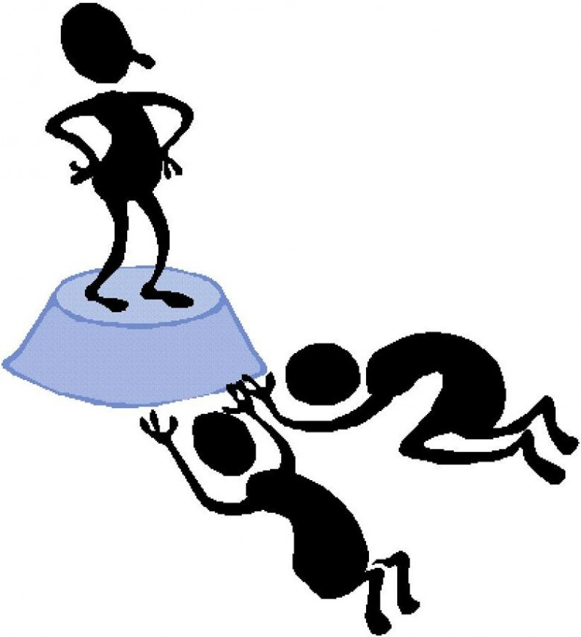
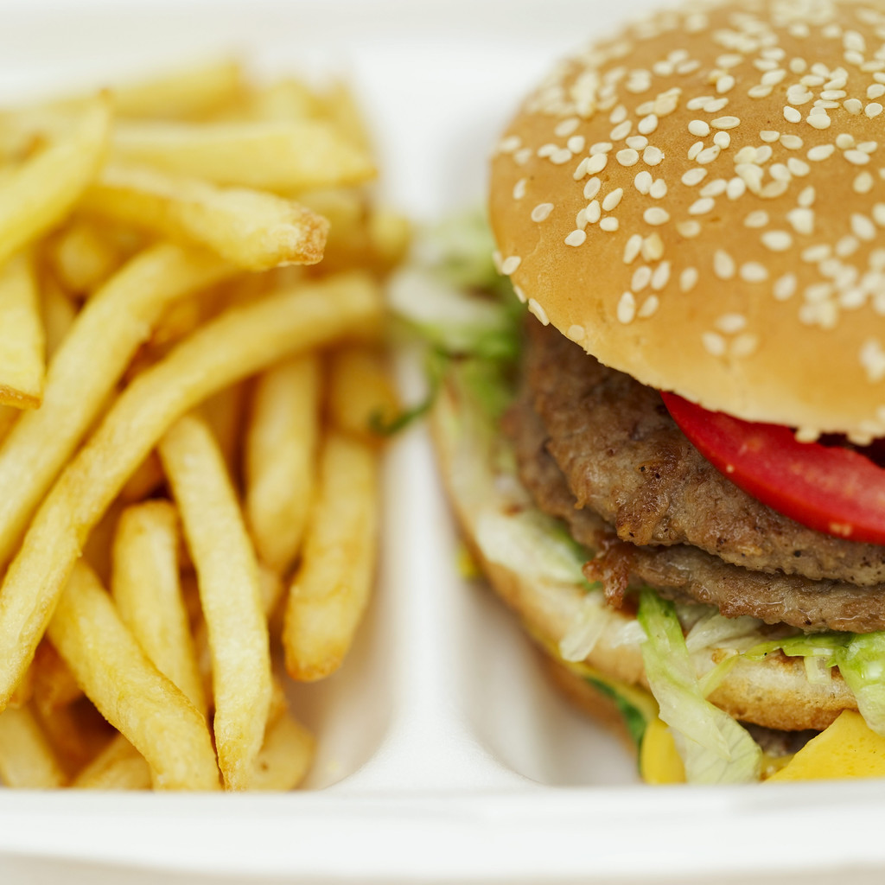
People have appetites for:
Power Money
Love Food
Acceptance Fame
Material things Sex

Slide 5
3 Points about Appetites

Slide 6
3 Points about Appetites
God made them.

Slide 7
3 Points about Appetites
God made them.
2) Sin distorted them.

Slide 8
3 Points about Appetites
God made them.
2) Sin distorted them.
3) They are never fully or finally satisfied.

Slide 9
Question:
What are the 2 things
appetites always say?

Slide 10
Answer:

Slide 11
Answer:
“Now, not later!”

Slide 12
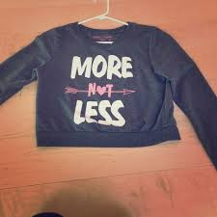
Answer:
“Now, not later!”
“More, not less!”

Slide 13
You are where you are today because of:

Slide 14
You are where you are today because of:
How your parents controlled their appetites.

Slide 15
You are where you are today because of:
How your parents controlled their appetites.
2) How you control your appetites.

Slide 16
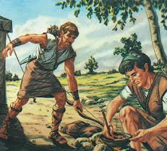
Our story from the Old Testament:
Jacob and Esau
in Genesis 25

Slide 17
Genesis 25:19-21
This is the genealogy of Isaac, Abraham's son. Abraham begot Isaac. Isaac was forty years old when he took Rebekah as wife, the daughter of Bethuel the Syrian of Padan Aram, the sister of Laban the Syrian. Now Isaac pleaded with the LORD for his wife, because she was barren; and the LORD granted his plea, and Rebekah his wife conceived.

Slide 18
Genesis 25:22-23
But the children struggled together within her; and she said, “If all is well, why am I like this?” So she went to inquire of the LORD. And the LORD said to her: “Two nations are in your womb, two peoples shall be separated from your body; one people shall be stronger than the other, and the older shall serve the younger.”

Slide 19
Genesis 25:24-26
So when her days were fulfilled for her to give birth, indeed there were twins in her womb. And the first came out red. He was like a hairy garment all over; so they called his name Esau. Afterward his brother came out, and his hand took hold of Esau's heel; so his name was called Jacob. Isaac was sixty years old when she bore them.

Slide 20
Genesis 25:27-28
So the boys grew. And Esau was a skillful
hunter, a man of the field; but Jacob was a
mild man, dwelling in tents. And Isaac
loved Esau because he ate of his game,
but Rebekah loved Jacob.

Slide 21
Genesis 25:29-31
Now Jacob cooked a stew; and Esau came
in from the field, and he was weary. And
Esau said to Jacob, “Please feed me with
that same red stew, for I am weary.”
Therefore his name was called Edom.
But Jacob said, “Sell me your birthright
as of this day.”

Slide 22
Birthrights are Shaped by Culture
American Values | Non-Western Values
Individualism | Group Orientation
Equality / Fairness | Rank, Status & Hierarchy
Direct and Open | Indirect, “saving face”
Future Orientation | Past Orientation
Control over the environment | Acceptance of fate
Change as natural & positive | Stability, Continuity, Tradition
Control over time | Human relationships, harmony
Informality | Formality, protocol and ritual
Self help, personal improvement | Birthright inheritance*
Competition | Cooperation
From A Look Inside America, pp. 10-11

Slide 23
Birthright in Jewish Culture
Privileges that went to the firstborn son:

Slide 24
Birthright in Jewish Culture
Privileges that went to the firstborn son:
1) Double portion of the estate.

Slide 25
Birthright in Jewish Culture
Privileges that went to the firstborn son:
1) Double portion of the estate.
2) Family leader with authority to settle disputes.

Slide 26
Birthright in Jewish Culture
Privileges that went to the firstborn son:
1) Double portion of the estate.
2) Family leader with authority to settle disputes.
3) Spiritual leader.

Slide 27
Genesis 25:31-32
But Jacob said, “Sell me your birthright as of this day.” And Esau said, “Look, I am about to die; so what is this birthright to me?”

Slide 28
What is Esau doing?
“I am about to die!”

Slide 29
What is Esau doing?
“I am about to die!”
Exaggerating!

Slide 30
Exaggerated appetites cause 2 things:

Slide 31
Exaggerated appetites cause 2 things:
1) Impact Bias: “This thing will be incredibly satisfying!”

Slide 32
Exaggerated appetites cause 2 things:
1) Impact Bias: “This thing will be incredibly satisfying!”
2) Focalism: You only see what you want; everything else blurs out, becomes unclear.

Slide 33
Who sells their birthright?

Slide 34
Who sells their birthright?
We do!!

Slide 35
A visit from
the future

Slide 36
Which do you prefer, Esau?
“The God of
Abraham,
Isaac and
Esau?”
“The God of
Abraham,
Isaac and
Jacob?”

Slide 37
Genesis 25:33-34
Then Jacob said to Esau, "Swear to me as of
this day.” So he swore to him, and sold his
birthright to Jacob. And Jacob gave Esau bread
and stew of lentils; then he ate and drank,
arose, and went his way. Thus Esau
despised his birthright.

Slide 38
Hebrews 12:16 calls Esau “profane,”
meaning common, ungodly, or
lawful to be stepped on.

Slide 39
How can we control our appetites?

Slide 40
How can we control our appetites?
Reframe appetite temptations in light of your future.

Slide 41
How can we control our appetites?
Reframe appetite temptations in light of your future.
“We do not look at the things which are seen, but at the things which are not seen. For the things which are seen are temporary, but the things which are not seen are eternal.”
-- 2 Corinthians 4:18

Slide 42
40 Consequences of Adultery
1. My relationship with God would suffer from a break in fellowship.
2. I would need to seek forgiveness from my Lord.
3. I would suffer from the emotional consequences of guilt.
4. I would spend countless hours replaying the failure.
5. My wife would suffer the scars of this abuse more deeply than I could begin to describe.
6. My wife would spend countless hours in counseling.
7. My wife's recovery would be long and painful.
8. Her pain would grieve me deeply and compound my own suffering and shame.
9. Our relationship would suffer a break in trust, fellowship, and intimacy.
10. We would be together, yet feel great loneliness.

Slide 43
40 Consequences of Adultery
11. The reputation of my family would suffer loss.
12. My sons would be deeply disappointed and bewildered.
13. My grandchildren would not understand.
14. My friends would be disappointed and would question my integrity.
15. I would lose my job at church.
16. My witness among neighbors would become worthless.
17. My witness to my brother would be worthless.
18. My testimony among my wife's family would be damaged.
19. I might never be employed by a church again.
20. I might never be in men's ministry leadership.

Slide 44
40 Consequences of Adultery
21. I would suffer God's discipline.
22. Satan would be thrilled at my failure.
23. Satan would work overtime to be sure my shame never departed.
24. My wife might divorce me.
25. My children might never speak to me.
26. Our mutual friends would shy away from us and break fellowship.
27. I would bring emotional pain to the woman.
28. I would bring reproach upon the woman.
29. If the woman is married, her husband might attempt to bring harm.
30. He might divorce her.

Slide 45
40 Consequences of Adultery
31. An unwanted child could be produced.
32. My part in conception might trigger an abortion, the killing of an innocent child.
33. Disease might result.
34. Some might conclude that all Christians are hypocrites.
35. My business could fail because I couldn't be trusted.
36. My leadership among those I have led in the past might also be diminished in impact.
37. My zeal for ministry would suffer and possibly result in others not continuing in ministry.
38. My health would suffer.
39. I might have to start life over again.
40. This same sin might be visited upon my family for four generations.
Family Life Marriage Memo, 7/20/25

Slide 46
How can we control our appetites?
Reframe appetite temptations in light of your future.
Refrain from appetite temptations you know are wrong.

Slide 47
How can we control our appetites?
Reframe appetite temptations in light of your future.
Refrain from appetite temptations you know are wrong.
“But you, O man of God, flee these evil things and pursue righteousness, godliness, faith, love, patience, gentleness.”
-- 1 Timothy 6:11

Slide 48
How can we control our appetites?
Reframe appetite temptations in light of your future.
Refrain from appetite temptations you know are wrong.
Remember that self-control occurs with God’s help.

Slide 49
How can we control our appetites?
Galatians 5:23 – “The fruit of the Spirit…is self-control.”

Slide 50
How can we control our appetites?
Galatians 5:23 – “The fruit of the Spirit…is self-control.”
2 Peter 1:3, 5-6 – “[God’s] divine power has given us all things that pertain to life and godliness…Giving all diligence, add to your faith knowledge, and to knowledge self-control…”

Slide 51
Conclusion
“He who is slow to anger is better
than the mighty and he who rules
his spirit than he who takes a city.”
-- Proverbs 16:32

